Slide 2
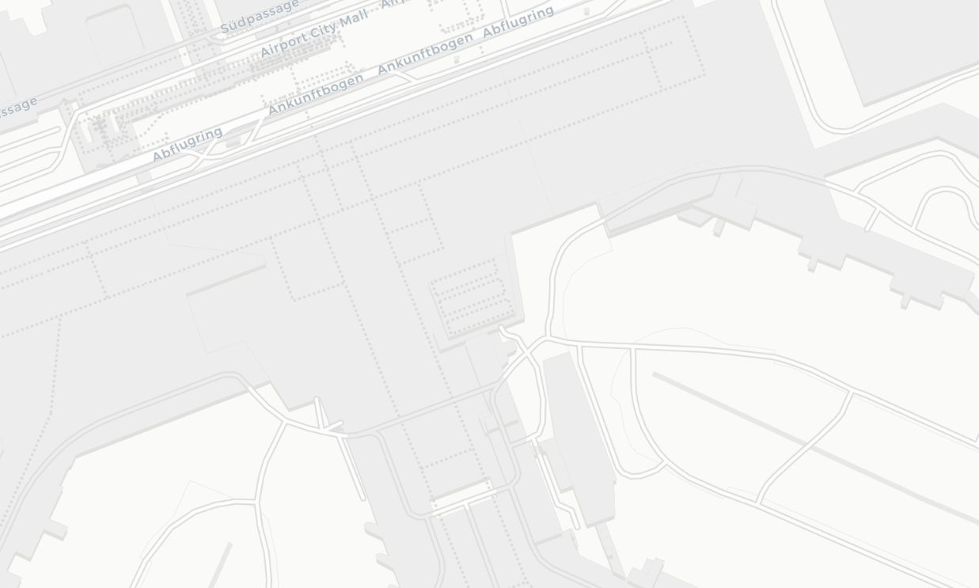



Slide 3

AdSight

Slide 4


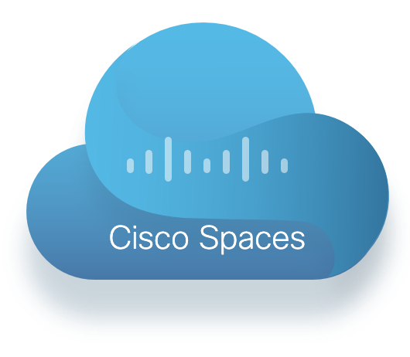




Notes:
Zoomen für Animation danach mit Werbung

Slide 5
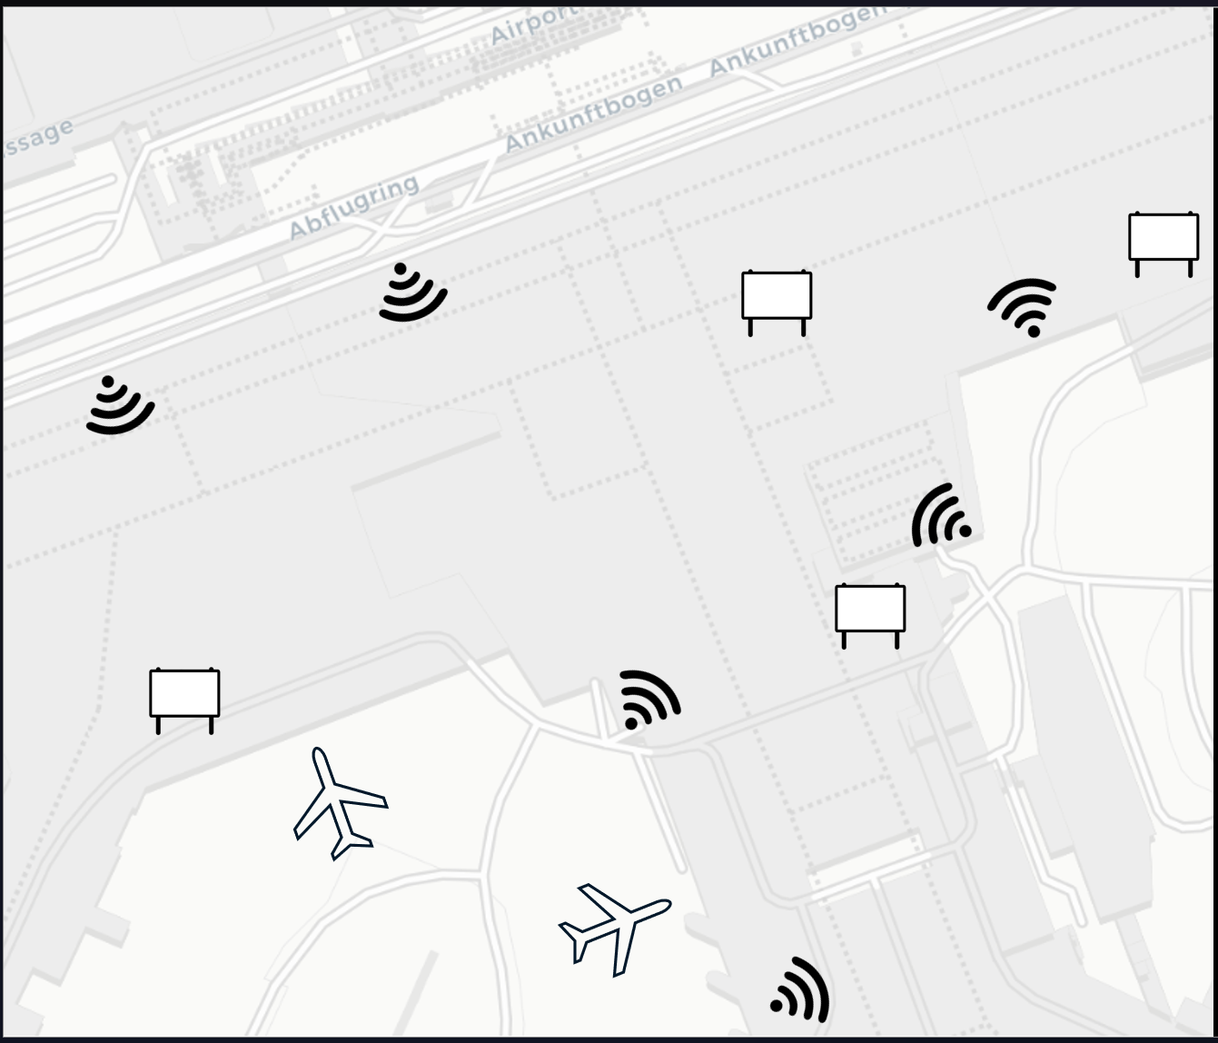



Notes:
Zoomen für Animation danach mit Werbung

Slide 6
Dashboard Stuff

Slide 8

TEAM obeilerding

Slide 9
Additional Information

Slide 10
AdSight
With AdSight, you‘re able to analyze the performance and profitability of your billboards or other marketing announcements
To that end, we propose to combined DNS-Data provided by Cisco Umbrella, with location data from Cisco Spaces and Business Data from the use case customer
We leverage this data to analyze how strongly people have been engaged with advertisement

Slide 11
Complexity & Technical Solution Usage of Cisco SPACES API‘s, SDK and Cisco Technologies
Analysis and visualization of Cisco Spaces data stream
Consideration of Cisco Umbrella Data
Usage of localization data as provided by Cisco Spaces for advertisement impact analysis

Slide 12
Design Usability of the solution
Modern, responsive and consistent design using Streamlit
User-centric interface
Minimalist and tidy structure

Slide 13
Viability Possibility of realizing the solution and integrate into Cisco SPACES or have it available in the Cisco Marketplace
Real world implementation feasibility – positively discussed with Cisco experts
High business value due to the large flexibility and scalability
Diverse use cases such as Airports, Train Stations, Shopping Mall, …
Utilization of highly scalable back-end framework (kafka)
Hardware and software components already exist today

Slide 14
Feasibility Maturity level of developed solution, does the prototype work?
The prototype features one use case with artificial data
Showcases the technical feasibilities and possibilities
For production, a tighter coupling between back-end and front-end and more detailed data analysis on real world data would be necessary

Slide 15
Creativity & Innovation Suprise and innovative ideas that has affected to the jury
We included a completely new data source (DNS-Data) to support the use case of advertisement impact analysis
In addition, we included business data (location of the billboards)
With this, we bring up new ideas in integrating new data sources from Cisco

