Slide 1




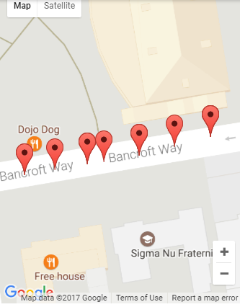
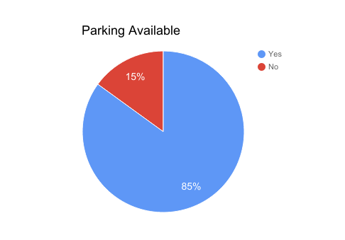
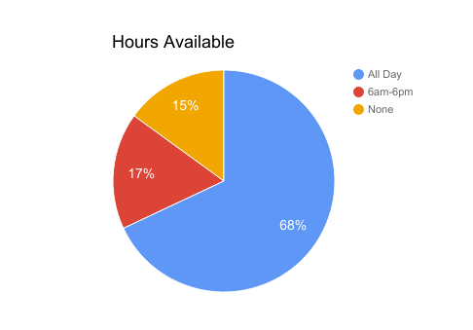
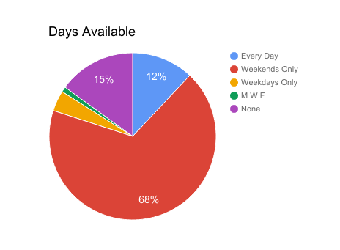
CheckPark: Crowdsourcing Parking Data
Anne Chen, Jonathan Joo, Suna Kim - California Institute of Technology
Introduction and Motivation
As shown in the picture, markers are placed on Google Maps to indicate information about parking availability.
A grid search was used in conjunction with Google’s nearest road API to determine where to place markers
Since our app is based on crowdsourcing, there might be some contradictory information; thus the information is presented in a pie graph form, which allows the user to see all the responses that has been recorded for a given marker.
Users can access this information by either searching for a specific location (which will return the closest available street parking), or by looking at a certain marker on the map.
We allow users to share their knowledge about a marker (or multiple markers, if relevant for an entire street, etc.)
Whether parking is available
If so, the hours and days available
Example Usage
Aim to improve some aspect of transportation.
It is often difficult to know in advance whether street parking is available.
Even if there is street parking, it can be difficult to determine what dates/times street parking is allowed.
Goal is to create a mobile app that helps users find a parking spot near their destination, based on data gathered by other users
Example Usage
Backend
Backend data will be stored in a dictionary format.
Key is a unique latitude/longitude
Value is an array of user responses
Thus, for each marker point, we will store all of the responses given by users.
These data will then get identified with a section of street.
The street sectors are coordinates on roads, and they are determined by finding the closest point on the street of each point in a grid.
* Share your knowledge about this point!! *
[ ] Parking is available:
all time
Weekdays ____ to ____
Weekends ____ to ____
[ ] Parking is not available

