Slide 1
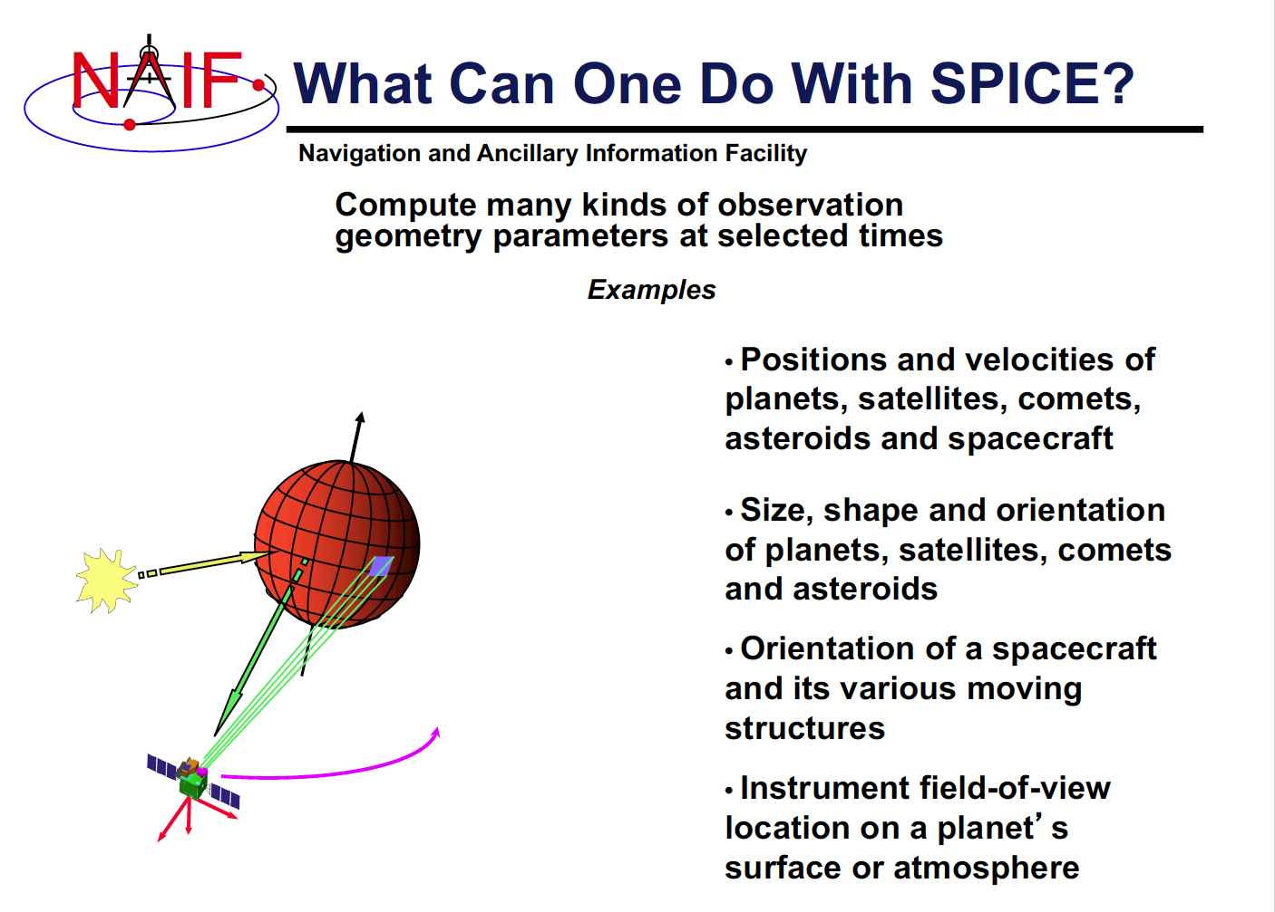
The SPICE Toolkit
How was Pluto orientated at your day of birth?
How to convert between SolO’s SC clock and UT?
How to rotate between different coordinate systems?

Slide 2
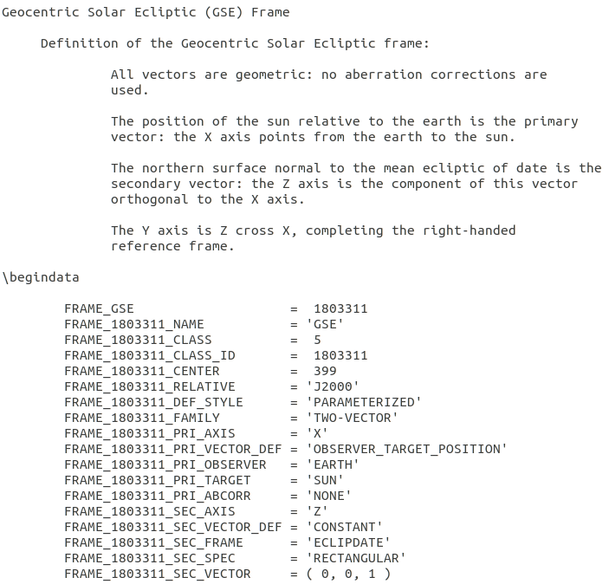
SPICE data
Data sets are stored in kernels:
SPK: SC and planet ephemeris
FK: Reference frame specification
SCLK: SC clock correlation data
LSK: Leapseconds
...

Slide 3

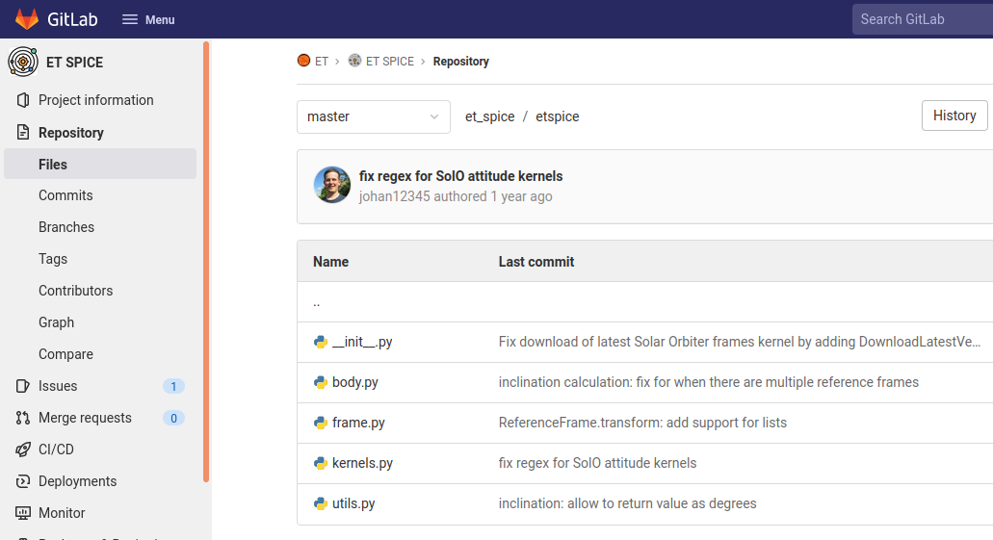
How to use SPICE
SPICE
SpiceyPy
ET SPICE
NASA NAIF
C, FORTRAN, MATLAB, ...
Andrew Annex
Python
Johan v. Forstner
Python
ET SPICE available in the ET GitLab:
https://gitlab.physik.uni-kiel.de/ET/et_spice
Installation via pip:
pip3 install git+https://gitlab.physik.uni-kiel.de/ET/et_spice.git

Slide 4
ET SPICE
- leapseconds
- reference frames
- Sun, planets, Pluto, moons
- Lagrange points
- MSL
- STEREO
- PSP
- SolO*
- SOHO
- Ulysses
- Helios
- MAVEN
- BepiColombo
- LRO
automatically loads kernels
downloads latest kernels
works with datetime.datetime
less cryptic syntax
extensible with SpiceyPy functions
Functions
position( )
sclk_to_datetime( )
datetime_to_sclk( )
inclination( )

Slide 5
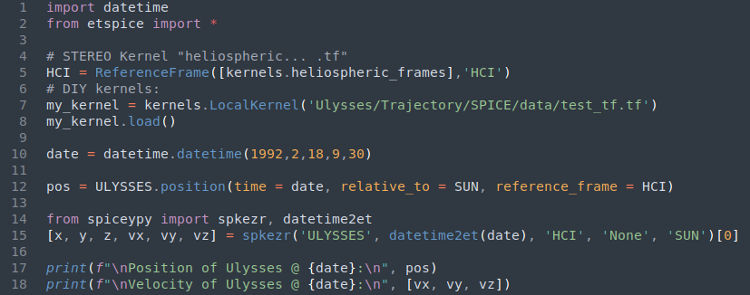
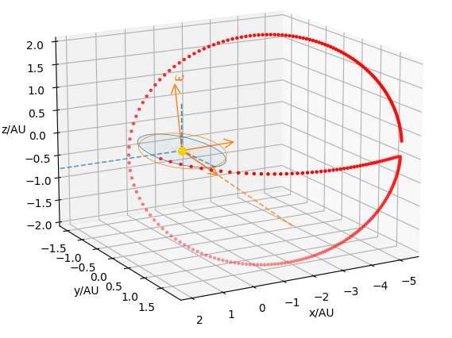
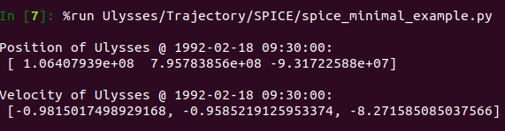
Code example

Slide 6
