Slide 1
3D Velocity Distribution Functions of Pickup Ions with Ulysses/SWICS
A. Fischer, L. Berger, V. Heidrich-Meisner, D. Keilbach, M. Kruse, R. F. Wimmer-Schweingruber
Extraterrestrial Physics,
Institute for Experimental and Applied Physics,
University of Kiel, Germany
14 Dec 2021
AGU Fall Meeting 2021
Session SH22A:
From the Sun to the Local Interstellar Medium II 09:45 - 11:00 CST

Slide 2
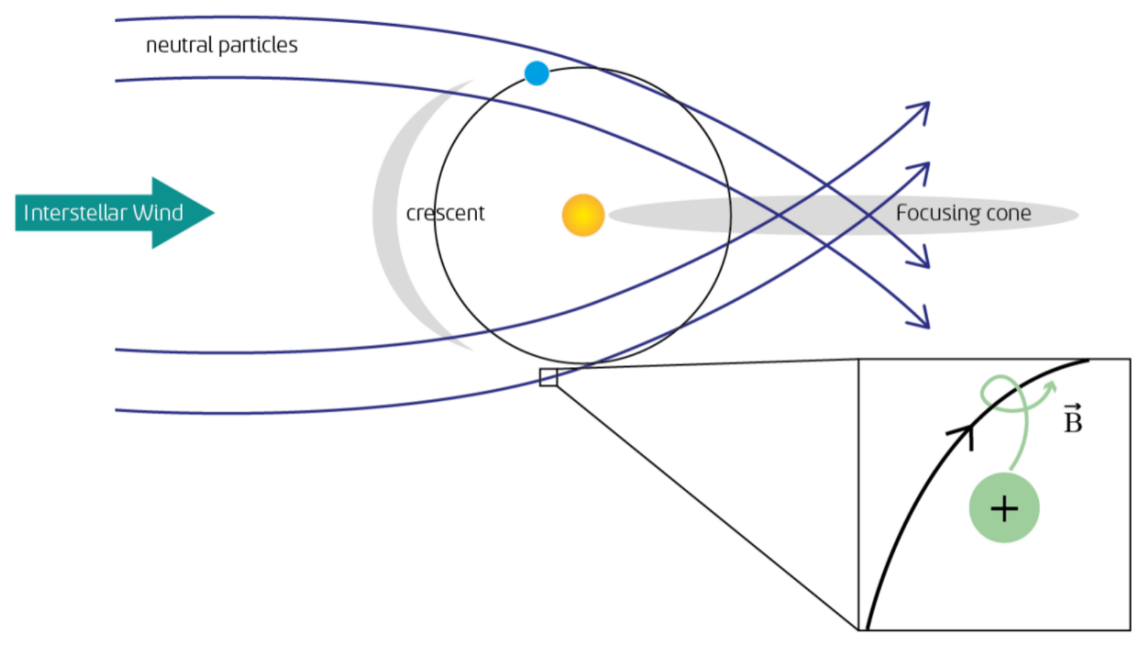
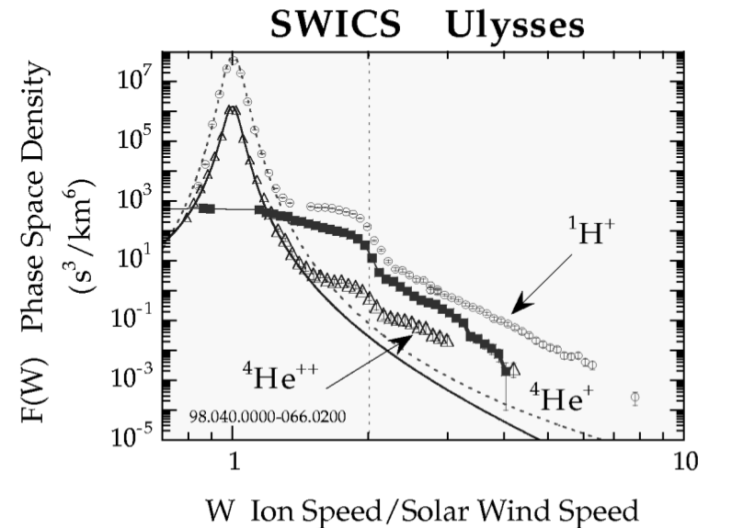
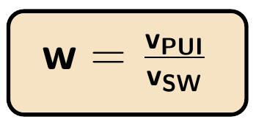
Pickup Ions (PUIs)
Taut, Drews et al., AGU Fall Meeting 2014
Gloeckler et al., 1999

Slide 3
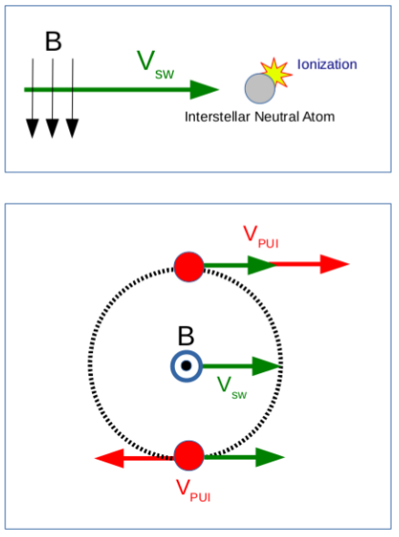
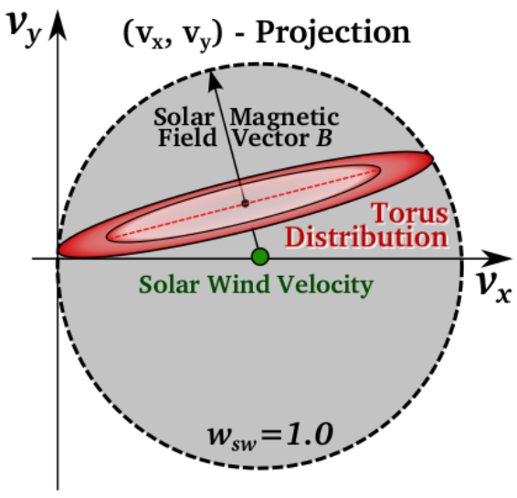
PUI Velocity Distribution Function (VDF)
Taut, Drews et al., AGU Fall Meeting 2014
Drews et al., 2016

Slide 4
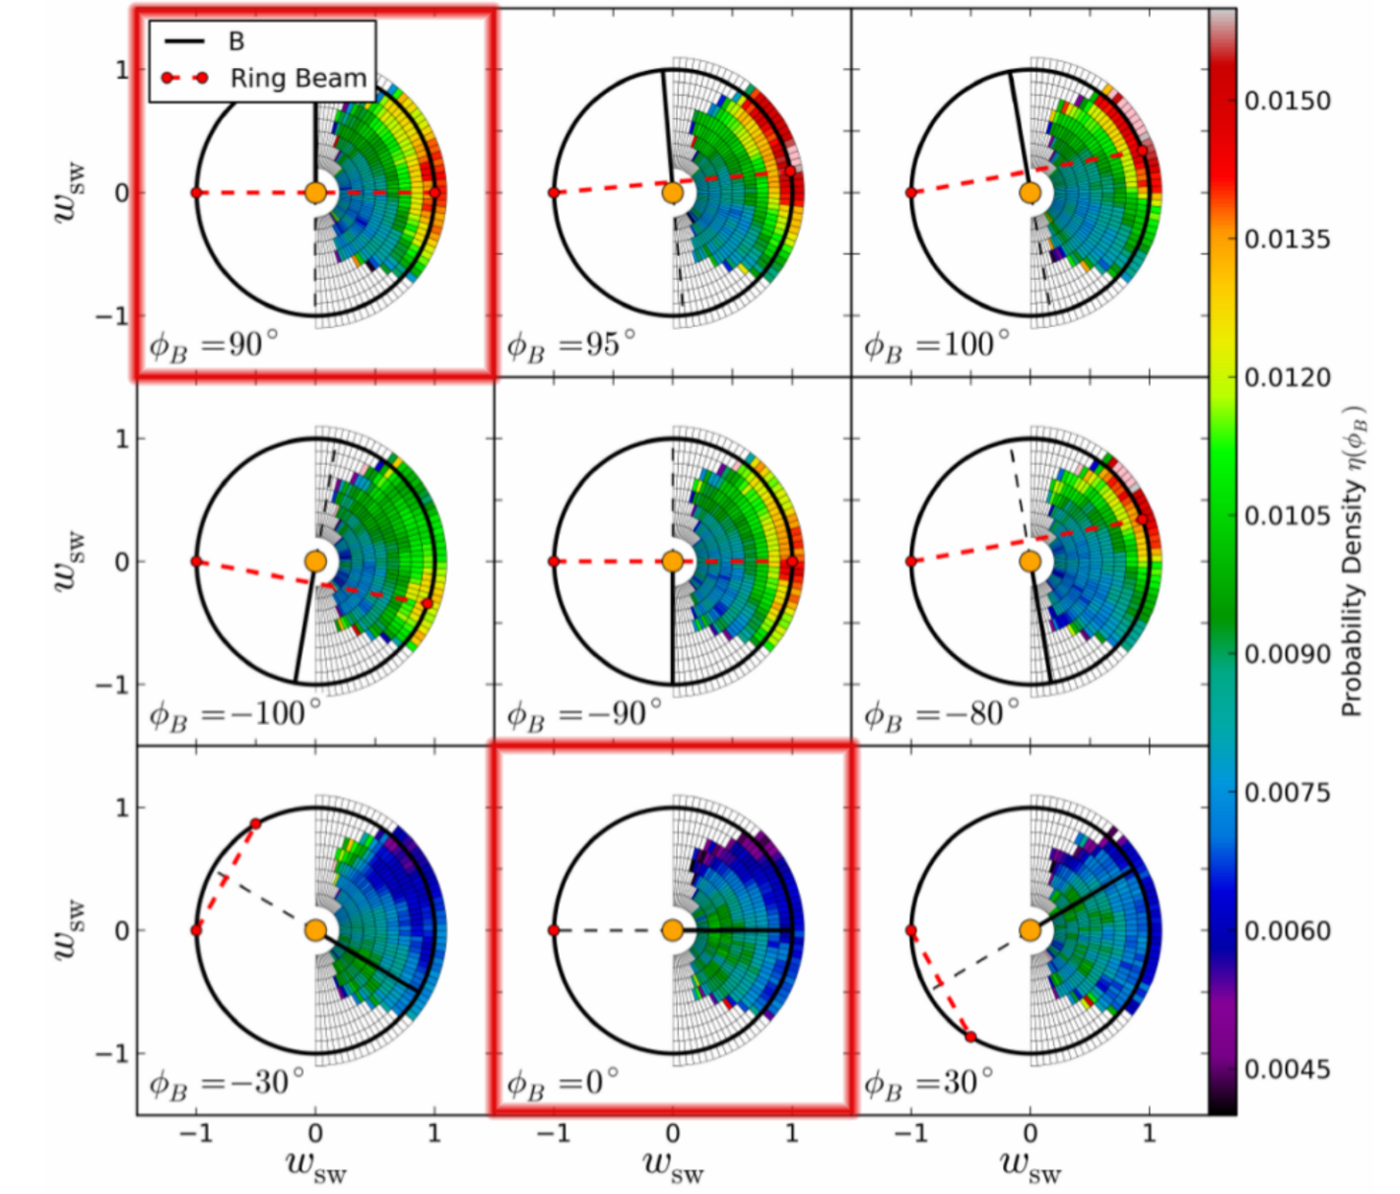
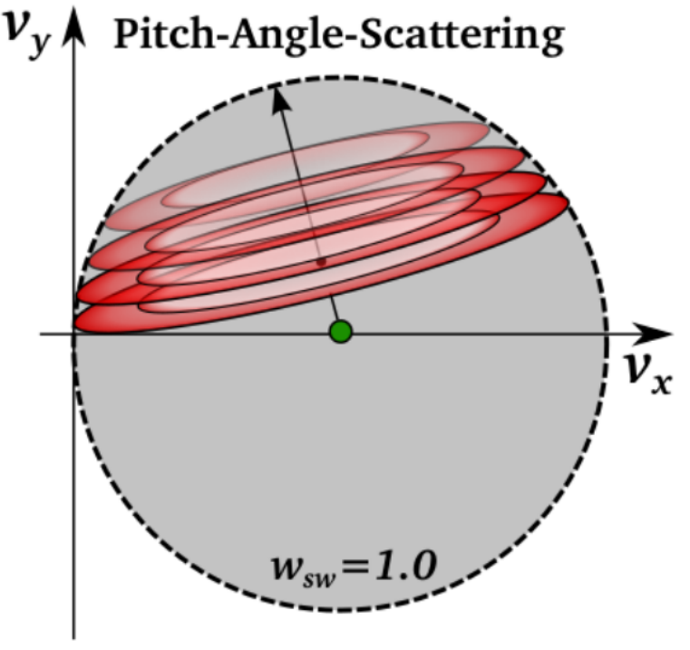
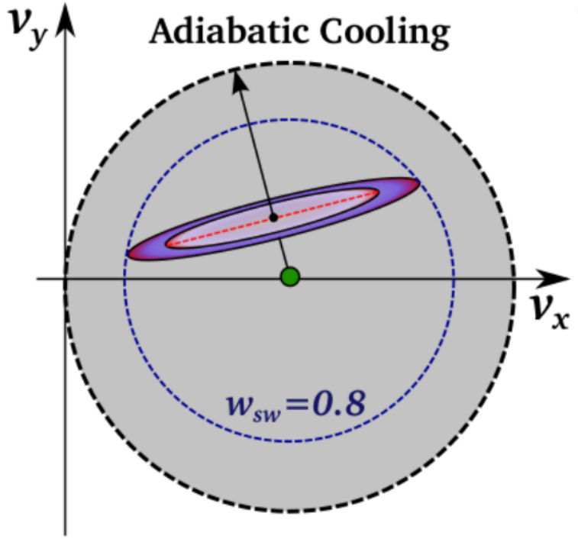
Development of the VDF
Theory - isotropization
Measurements:
STEREO/Plastic
Drews et al., 2016
Drews et al., 2015

Slide 5
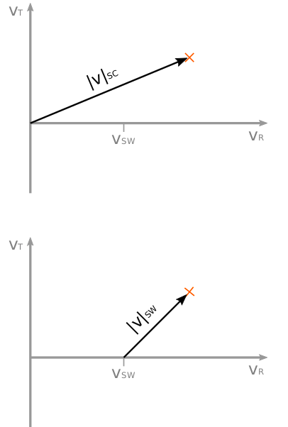
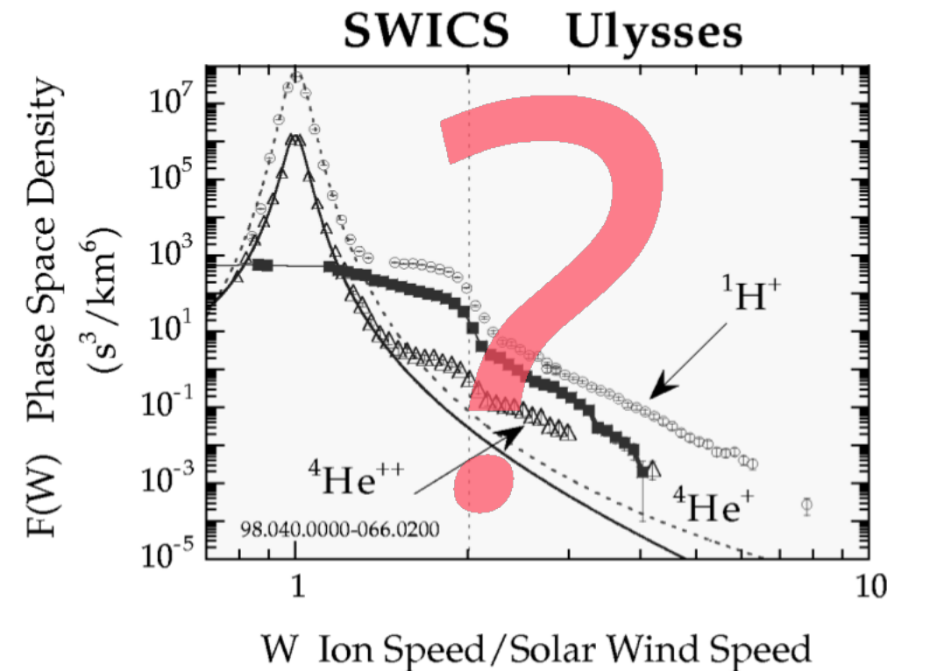
3D observations
Gloeckler et al., 1999

Slide 6
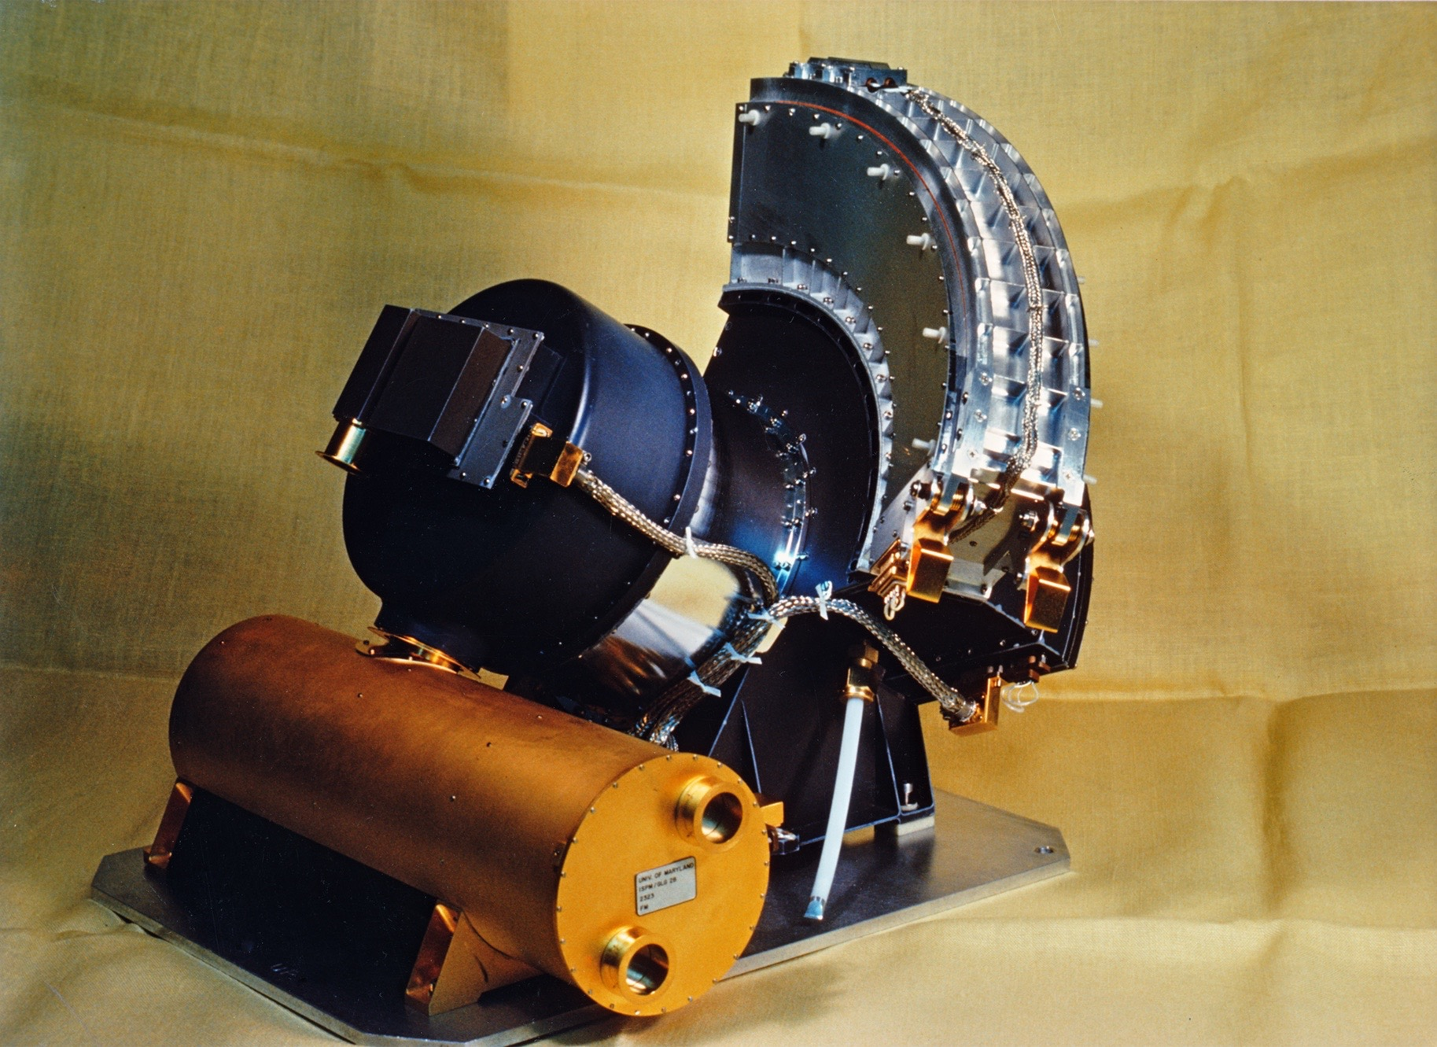
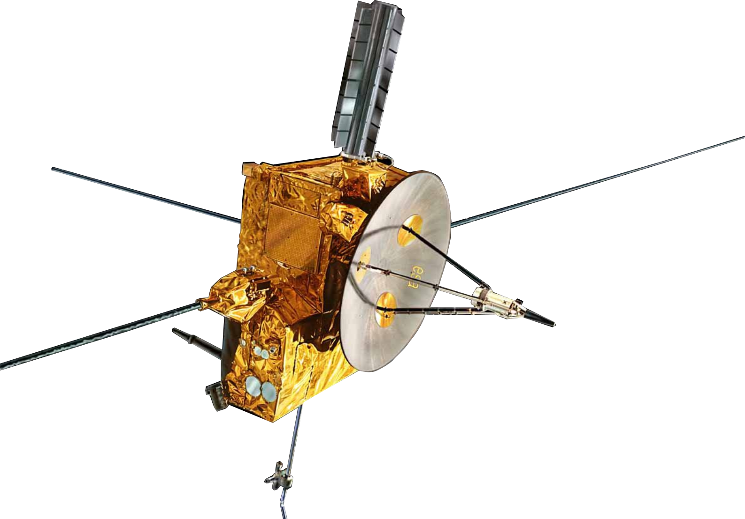
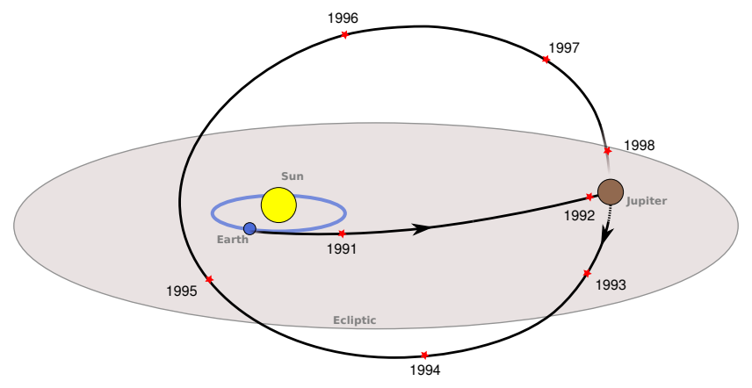
Ulysses / SWICS
The Solar Wind Ion Composition Spectrometer
Gloeckler, Geiss et al., 1992
Time-Of-Flight Mass Spectrometer:
m, m/q, E
► Identification of He+
► |v| of the ion
adapted from www.cosmos.esa.int, 2019

Slide 7
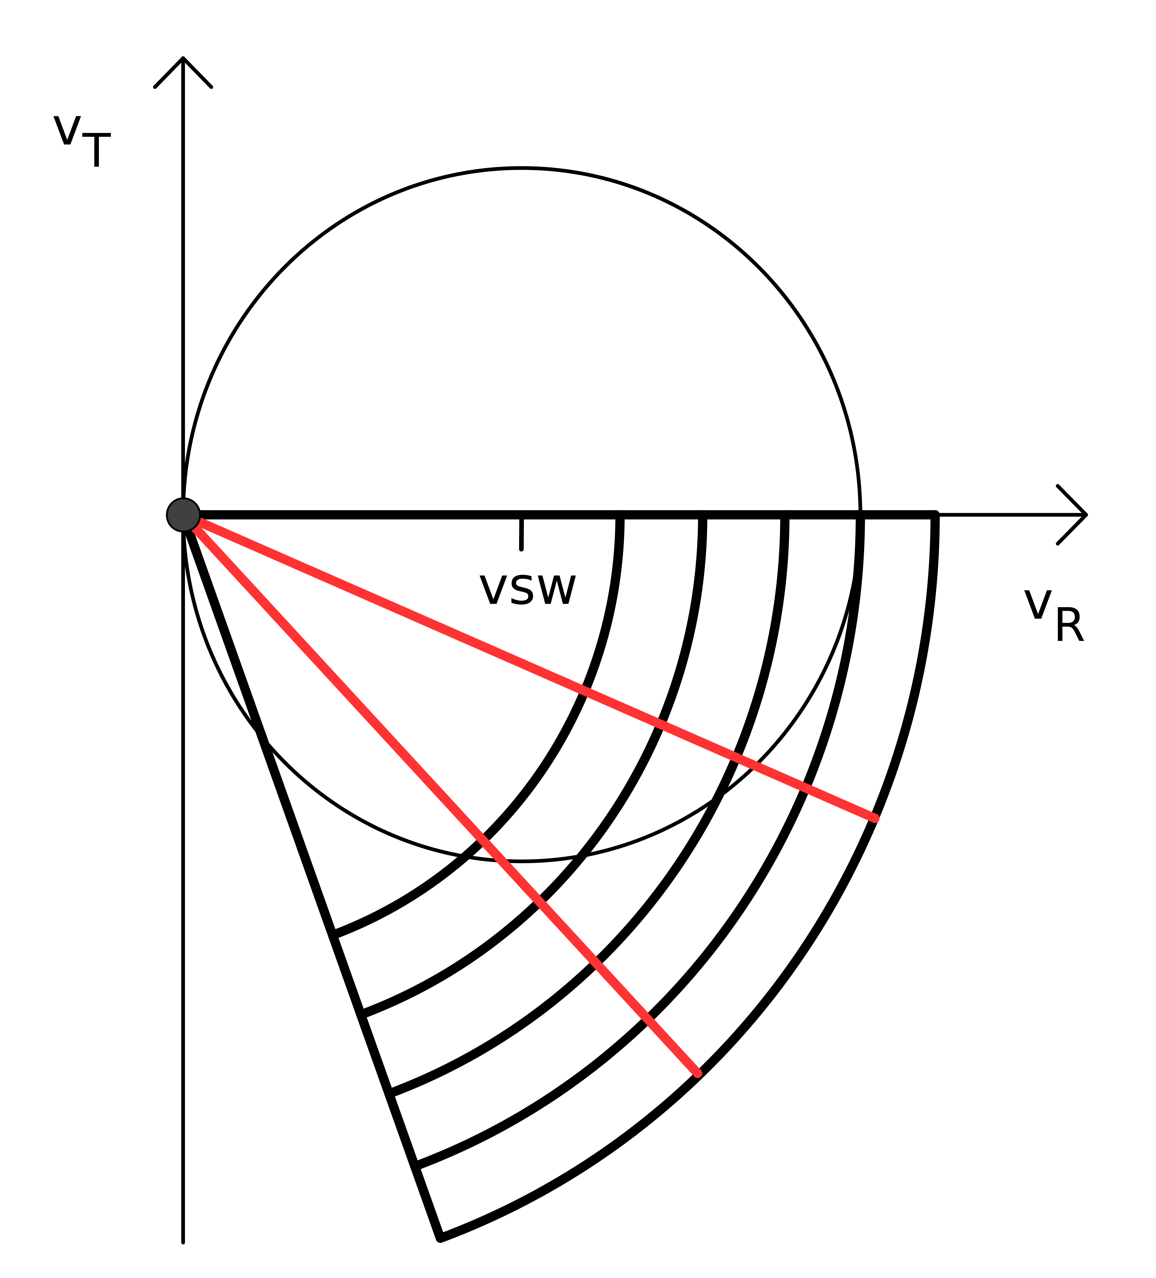
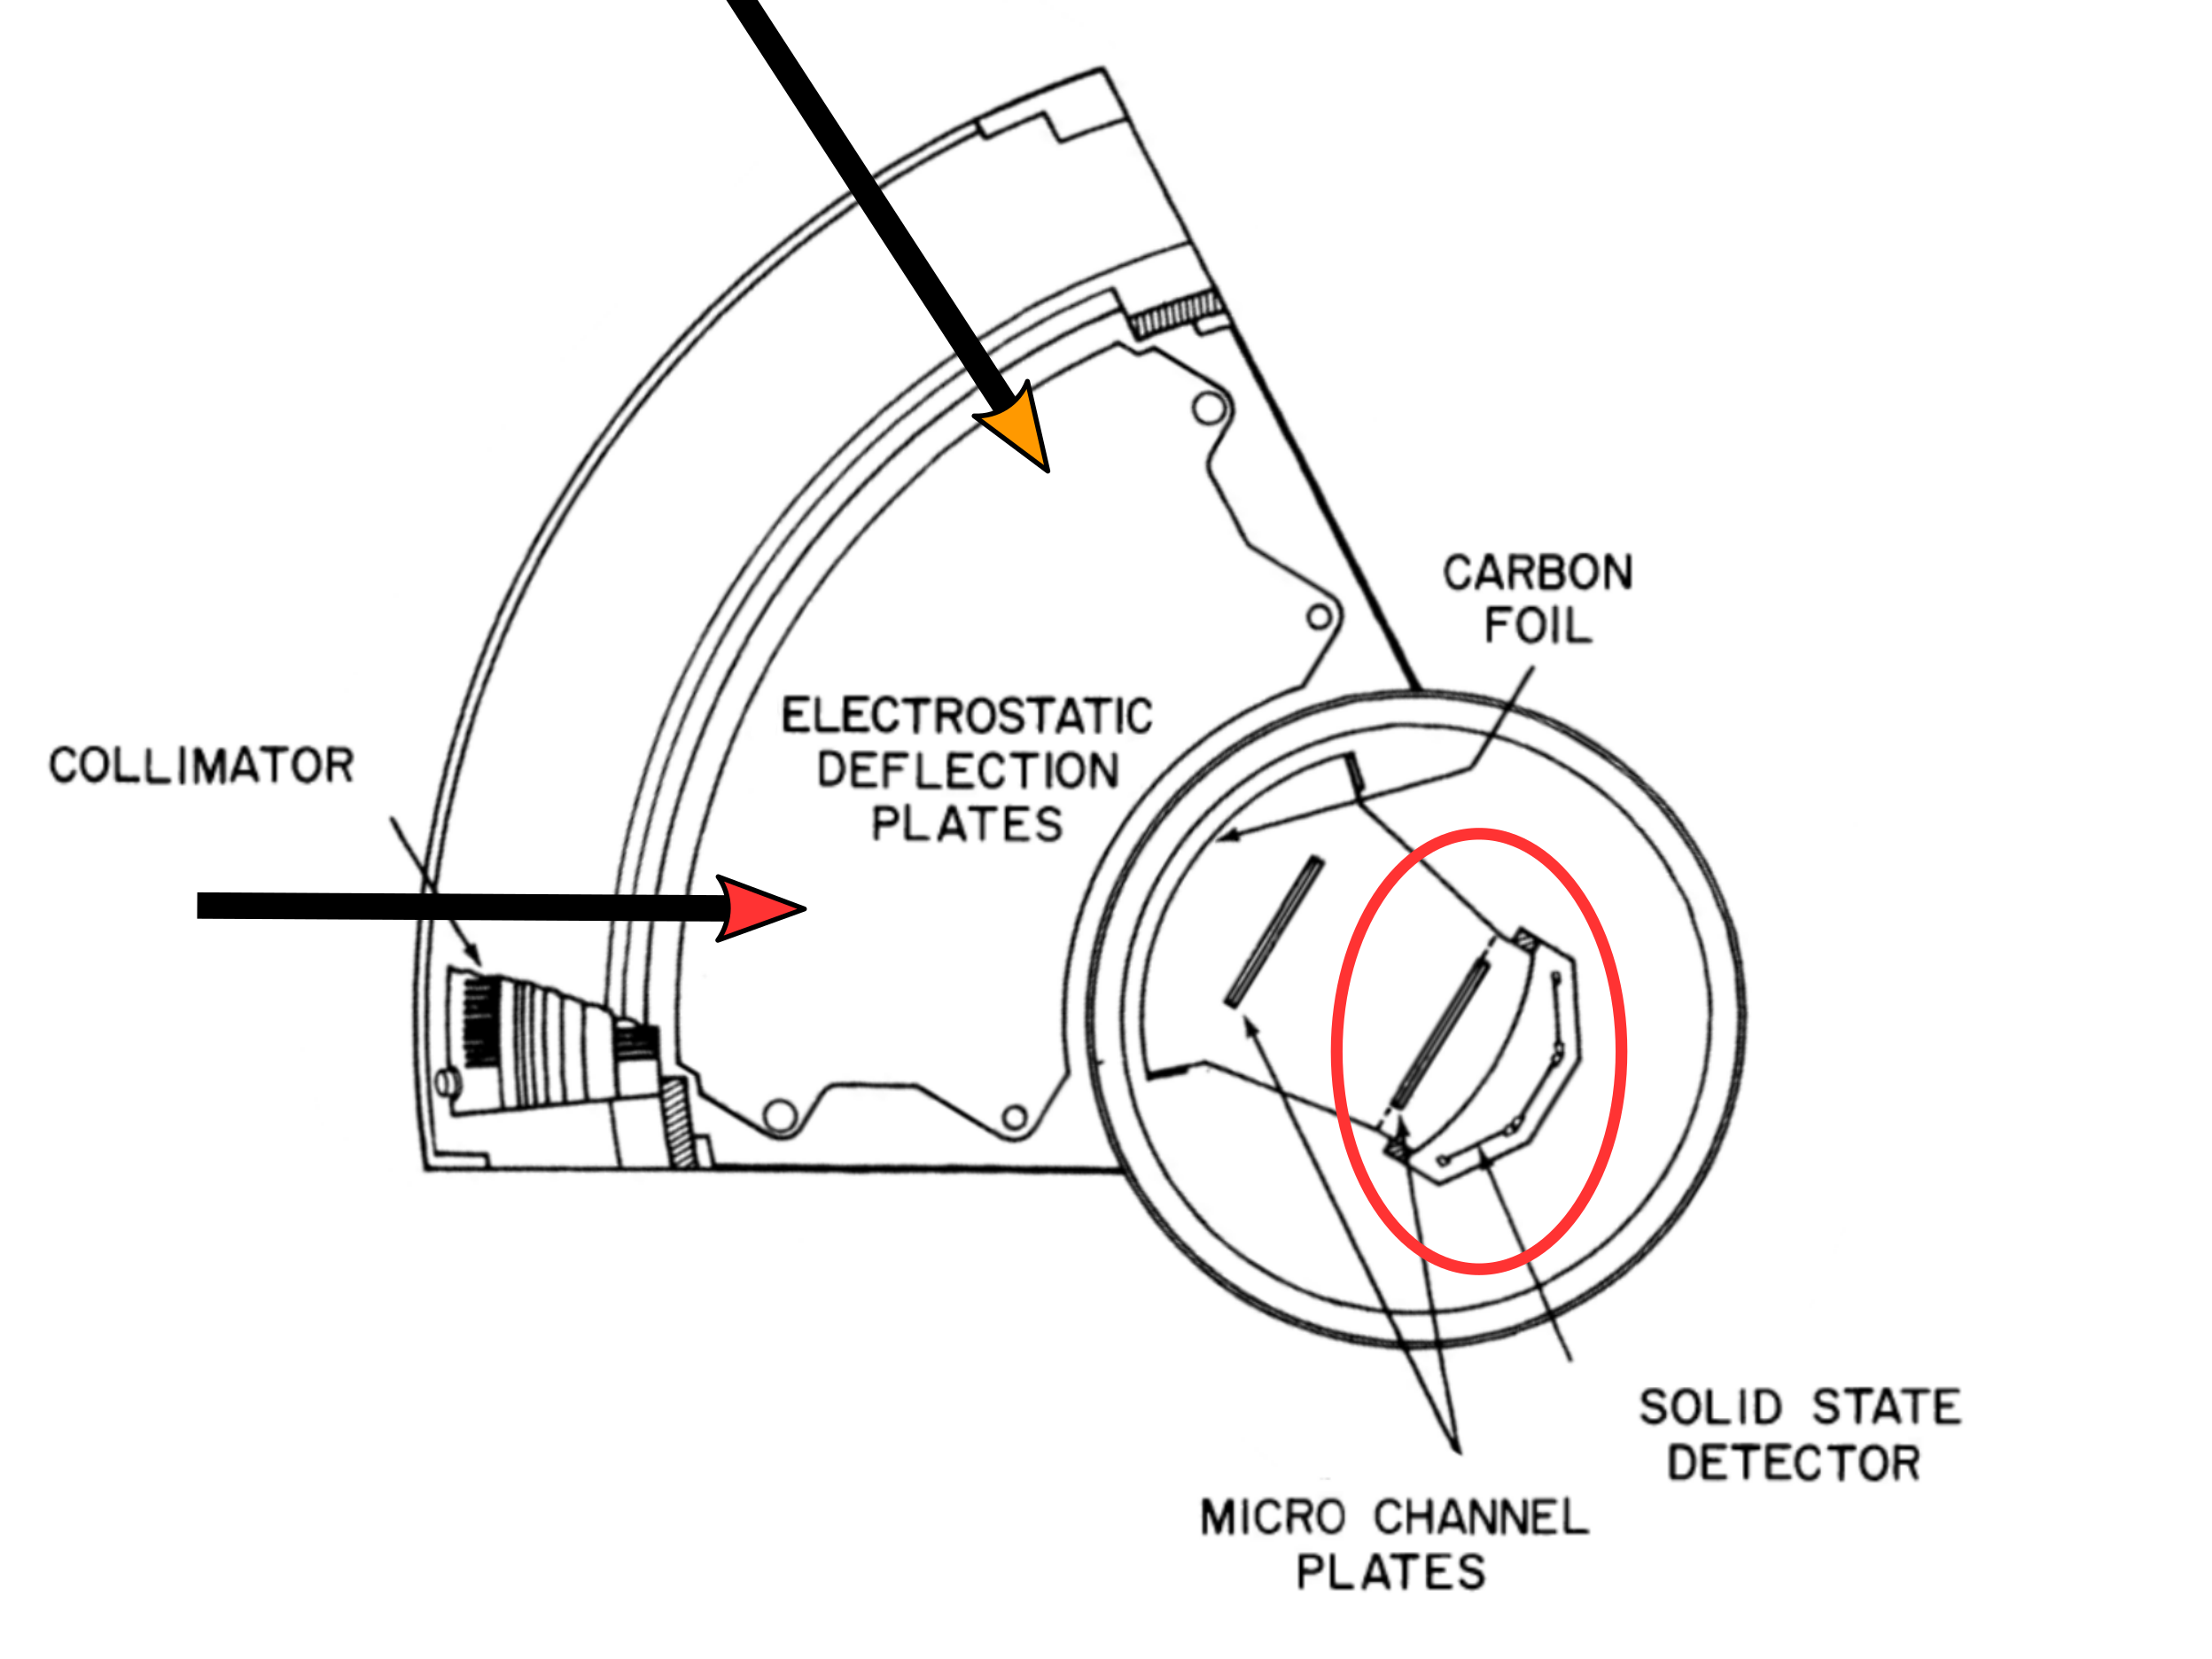
Angular resolution of velocity
|v| measurement:
locate ion on circular segment centered around
vSC = 0
velocity space
SC-frame
SWICS: 3 detectors
Rough distinction between angles of incidence
3rd dimension: spin of the SC
Divided into 8 sectors

Slide 8
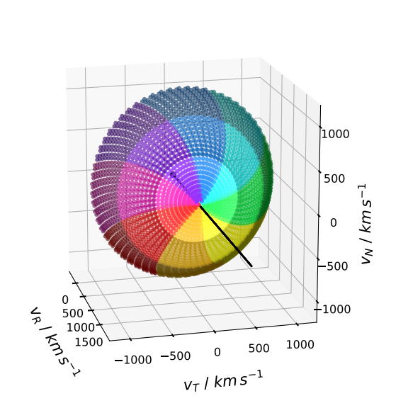
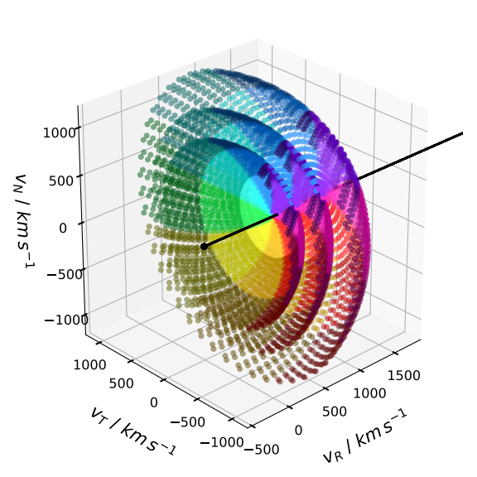
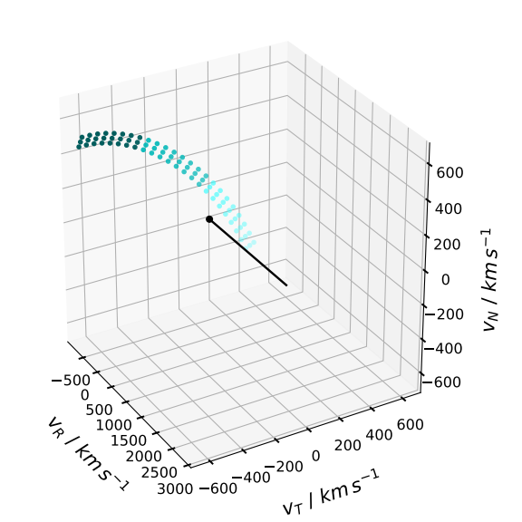
The Virtual Detector
Unrotated collimator acceptance
for one |v|
Collimator acceptance for
one spacecraft spin for one |v|
Collimator acceptance
for different |v|

Slide 9
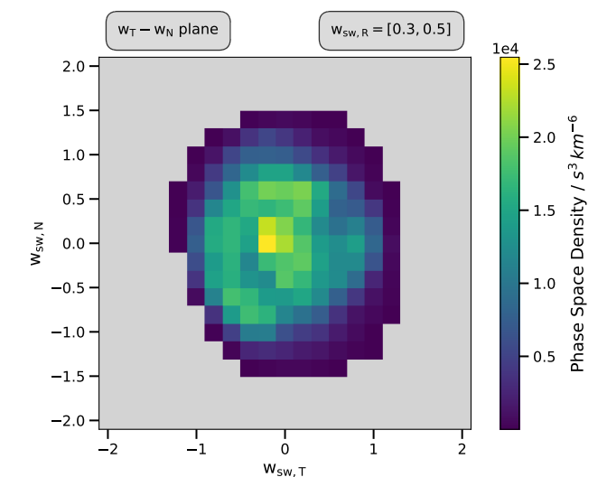
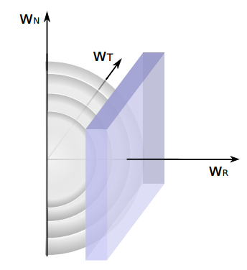
Cut through 3D Spectrum
50 days in 1993
vSW: 760 – 780 km/s

Slide 10
Conclusion & Outlook
Full information on velocity distributions only in 3D
Construction of a Virtual detector for directional resolution of He+ PUIs with Ulysses/SWICS
PUI distribution with the IMF

Slide 11


