Slide 1
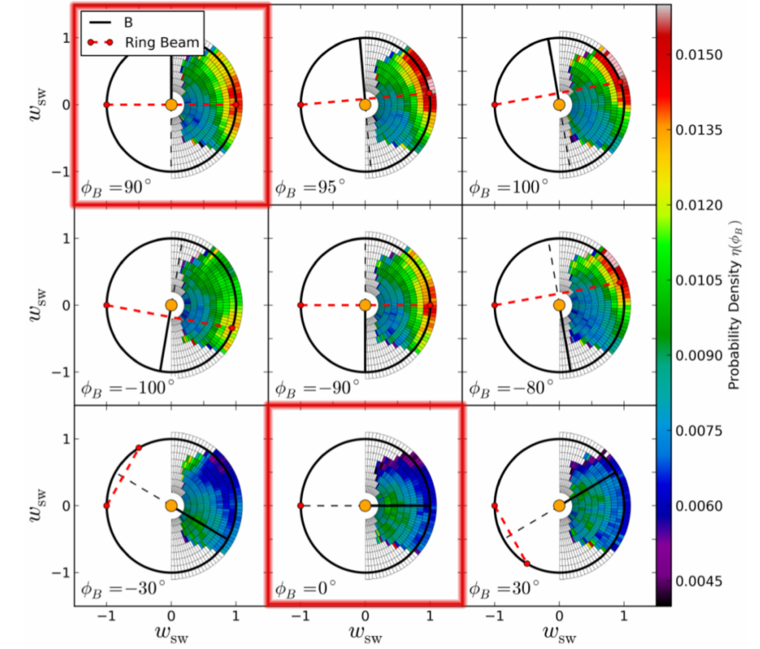
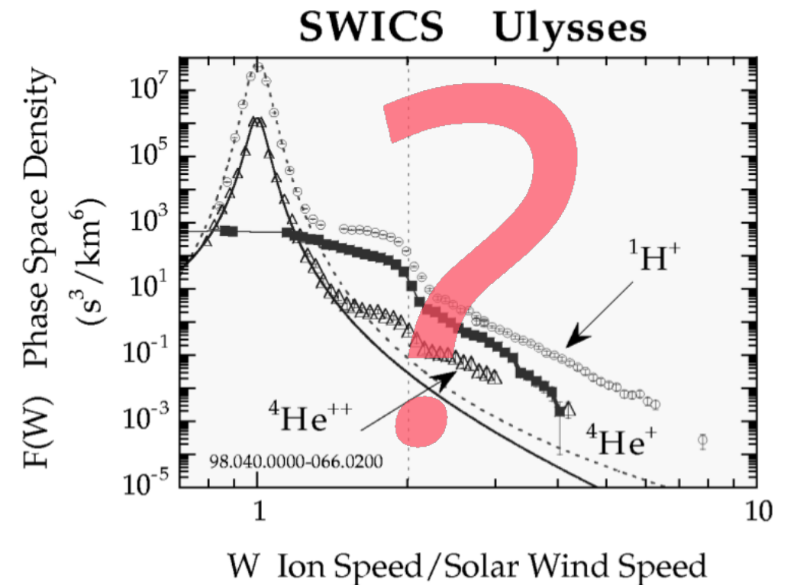
3D Velocity Distribution Functions of Pickup Ions with Ulysses/SWICS
Drews et al., 2015
Gloeckler et al., 1999

Slide 2
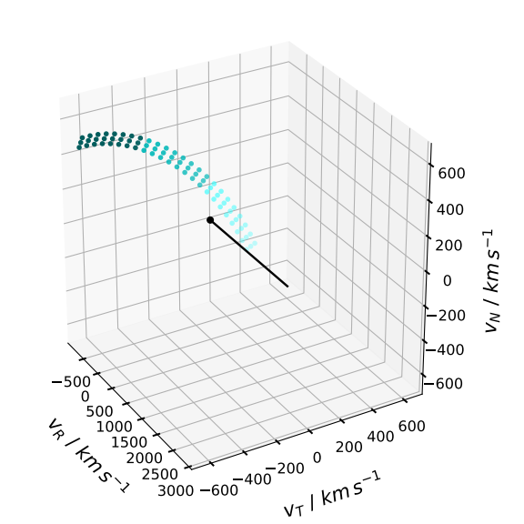
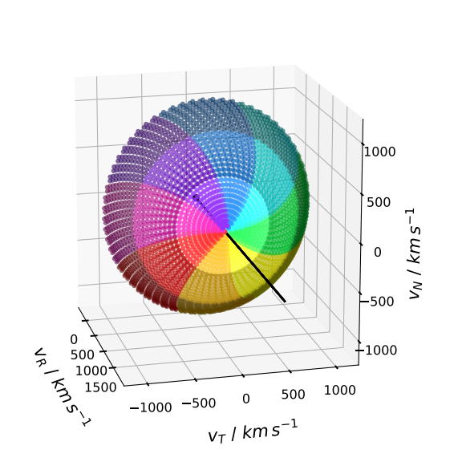
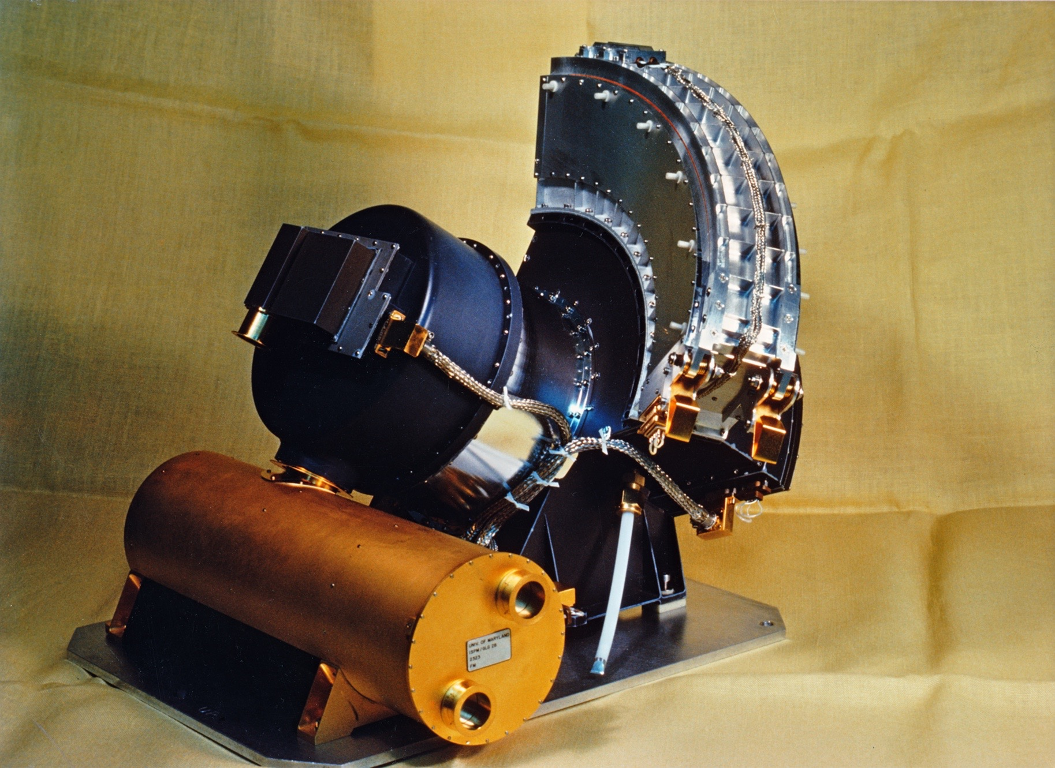
3D Velocity Distribution Functions of Pickup Ions with Ulysses/SWICS

Slide 3
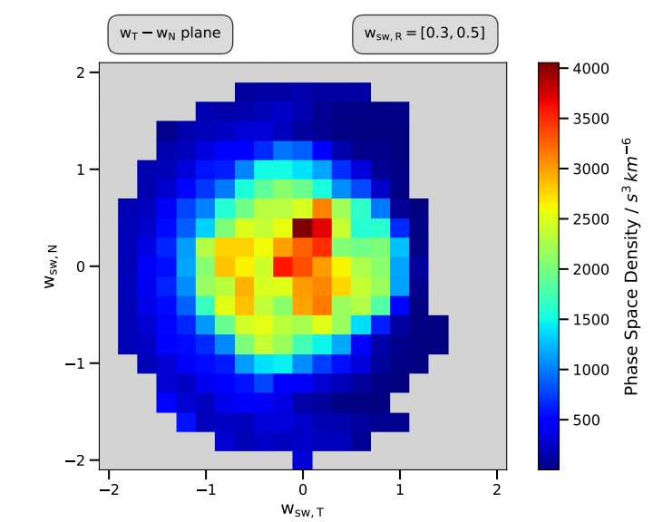
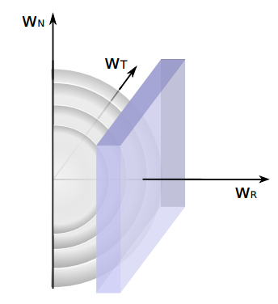
3D Velocity Distribution Functions of Pickup Ions with Ulysses/SWICS
Anne Fischer  afischer@physik.uni-kiel.de

