Slide 1

Foundations of natural language processing
"This movie was lame, lame, lame. […] Would not recommend it to my husband's dog, who will watch anything."
Well, then I
won‘t watch
this movie.

Slide 2

Foundations of natural language processing
SENTENCE & DOCUMENT EMBEDDINGS
Presenter: Anne Gritto
Supervisor: Matthias Aßenmacher
Date: 08.07.2021

Slide 3
Data
Bag-of-words approach
Neural network-based approaches
i. Paragraph Vector
ii. Skip-thought
4. Evaluation and Outlook

Slide 4
Data
Bag-of-words approach
Neural network-based approaches
i. Paragraph Vector
ii. Skip-thought
4. Evaluation and Outlook

Slide 5
Foundations of natural language processing
IMDB Data
Proposed by Maas et al. in 2011
50,000 movie reviews which consist of several sentences which I divided in 2 datasets:
- 40,000 labeled training instances
- 10,000 labeled test instances
2 types of labels: positive and negative
can be used for sentiment analysis
Data: Andrew L. Maas et al. (2011): Learning Word Vectors for Sentiment Analysis
https://github.com/assenmacher-mat/nlp_notebooks

Slide 6
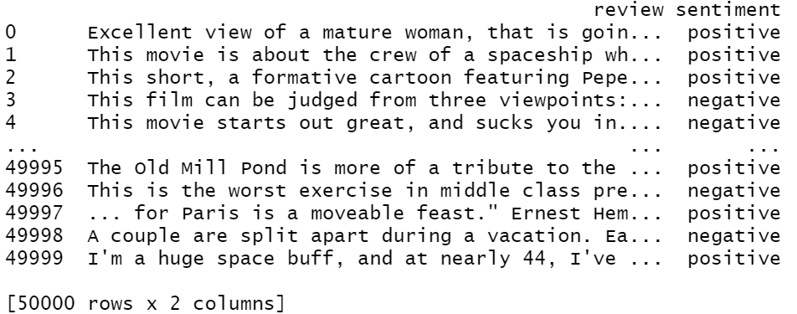
Foundations of natural language processing
IMDB Data

Slide 7
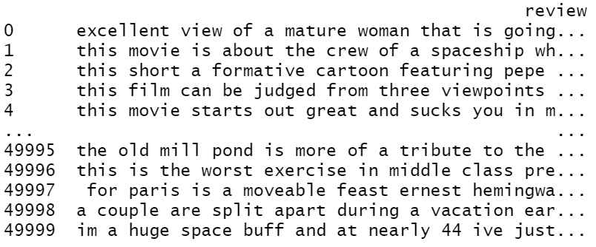
Foundations of natural language processing
Preprocessing

Slide 8
Foundations of natural language processing
Why do I need data in my presentation?
Reviews, e.g.
„This movie was lame.“
Some document embedding
Vector representation
Logistic Regression
With function LogisticRegression() from module sklearn.linear_model
Negative
Positive

Slide 9
Data
Bag-of-words approach
Neural network-based approaches
i. Paragraph Vector
ii. Skip-thought
4. Evaluation and Outlook

Slide 10
Foundations of natural language processing
Bag-of-words model
Representation of text that describes the occurence of words within a document
Contains a vocabulary of known words
Measure of the presence of known words has to be defined
binary (Is a word present or absent)
number of times a word occurs in a text

Slide 11
Foundations of natural language processing
Text 1: “This movie was lame, lame, lame.“
Text 2: “What a build up!“
Text 3: “What a let down.“
Tokenization
Text 1 Text 2 Text 3
this what what movie a a was build let lame up down lame lame

Slide 12
Foundations of natural language processing
Text 1 Text 2 Text 3
this what what movie a a was build let lame up down lame lame
 | this | movie | was | lame | what | a | build | up | let | down
Text 1 | 1 | 1 | 1 | 3 | 0 | 0 | 0 | 0 | 0 | 0
Text 2 | 0 | 0 | 0 | 0 | 1 | 1 | 1 | 1 | 0 | 0
Text 3 | 0 | 0 | 0 | 0 | 1 | 1 | 0 | 0 | 1 | 1

Slide 13
Foundations of natural language processing
Bag-of-words: N-grams
N-grams: composition of n words
Example with n = 2: Text 3: “What a let down.“
Text 3
what a a let let down
Captures more meaning from a document

Slide 14
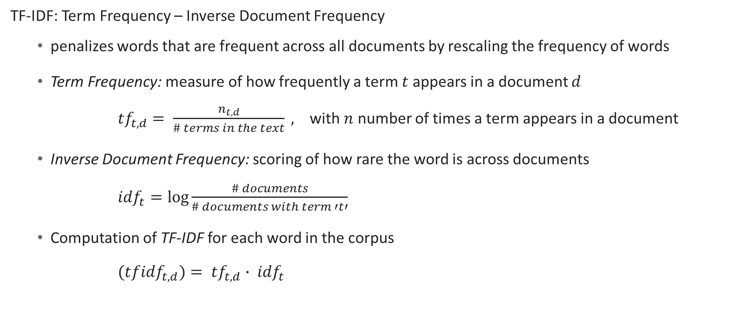
Foundations of natural language processing
Bag-of-words: TF-IDF
TF-IDF: Term Frequency – Inverse Document Frequency
penalizes words that are frequent across all documents by rescaling the frequency of words
Term Frequency: measure of how frequently a term $t$ appears in a document $d$
${tf}_{t,d}= \frac{n_{t, d}}{\# terms in the text} ,$ with $n$ number of times a term appears in a document
Inverse Document Frequency: scoring of how rare the word is across documents
${idf}_{t}=log⁡\frac{\# documents}{\# documents with term ′t′}$
Computation of TF-IDF for each word in the corpus
${(tfidf}_{t, d})= {tf}_{t, d}∙ {idf}_{t}$

Slide 15
Foundations of natural language processing
Bag-of-words: Application in Python
TfidfVectorizer() in module sklearn.feature_extraction.text
TfidfVectorizer(input, ngram_range = (1, 1), binary = False, use_idf = False,
… )
Accuracy with function accuracy_score() in module sklearn.metrics._classification
accuracy_score(ytrue, ypred)
ngram_range | use_idf | accuracy_score
(1, 1) | False | 0.8617
(1, 1) | True | 0.8907
(2, 2) | False | 0.8617
(2, 2) | True | 0.8756
(3, 3) | False | 0.8134
(3, 3) | True | 0.8376
(1, 3) | False | 0.8674
(1, 3) | True | 0.8844

Slide 16
Foundations of natural language processing
Bag-of-words: Advantages and Disadvantages
+ Simple and flexible - Sparsity: Dimension of resulting vector will be very
+ easy to use large and will contain many 0 values
function in Python: TfidfVectorizer() in module - Meaning: Discarding word order ignores
sklearn.feature_extraction.text the context and in turn meaning of words in the
TfidfVectorizer(input, document (semantics)
ngram_range = (1, 1),
binary = False,
use_idf = False)

Slide 17
Data
Bag-of-words approach
Neural network-based approaches
i. Paragraph Vector
ii. Skip-thought
4. Evaluation and Outlook

Slide 18
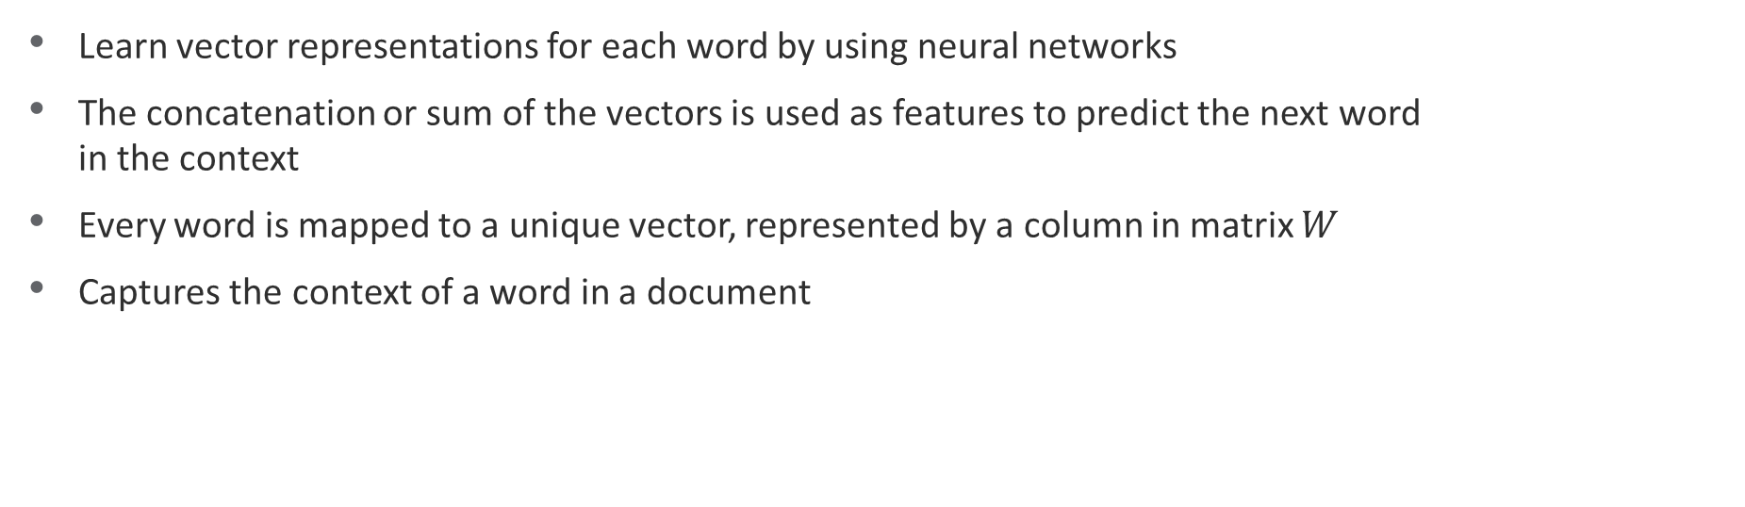
Foundations of natural language processing
Reminder: Vector Representation of Words
Learn vector representations for each word by using neural networks
The concatenation or sum of the vectors is used as features to predict the next word in the context
Every word is mapped to a unique vector, represented by a column in matrix $W$
Captures the context of a word in a document

Slide 19
Foundations of natural language processing
Paragraph Vector (Doc2Vec)
Inspired by the method for learning word vectors, but adds for each paragraph a unique paragraph vector
Unsupervised algorithm that learns continuous distributed vector representations for pieces of texts which may differ in length
Vector representation is trained to predict words in a given context
Two different approaches of Paragraph Vector
Distributed Memory (PV-DM)
Distributed Bag-of-words (PV-DBoW)

Slide 20
Foundations of natural language processing
Doc2Vec: Distributed Memory
Classifier
Average/Concatenate
Paragraph Matrix
down
D
W
W
W
Paragraph ID what a let
Figure 2: T. Mikolov, Q. Le (2014): Distributed Representations of Sentences and Documents

Slide 21
Foundations of natural language processing
Doc2Vec: Distributed Memory
Based on the idea of Word2Vec, in particular CBoW
trained by using stochastic gradient descent and backpropagation
At every step of gradient descent:
Fixed-length context is sampled from a random paragraph
An error gradient is computed
Gradient is used to update the parameters in the model
Inference step to compute the paragraph vector for a new paragraph

Slide 22
Foundations of natural language processing
Doc2Vec: Distributed Bag-of-words
what
a
let
down
Classifier
Paragraph Matrix
D
Paragraph ID
Figure 3: T. Mikolov, Q. Le (2014): Distributed Representations of Sentences and Documents

Slide 23
Foundations of natural language processing
Doc2Vec: Distributed Bag-of-words
Based on the idea of Word2Vec, in particular Skip-Gram
Word vectors are not used for predicting, only the paragraph vectors
At each iteration of stochastic gradient descent:
A text window is sampled
A word from that text window is randomly sampled
Classification task given the paragraph vector is formed

Slide 24
Foundations of natural language processing
Doc2Vec: Application in Python
Doc2Vec model with Doc2Vec() in module gensim.models.doc2vec
Doc2Vec(dm = 1, dm_concat = 0, dm_mean = 1, vector_size = 200, … )
Accuracy with function accuracy_score() in module sklearn.metrics._classification
accuracy_score(ytrue, ypred)
Method | accuracy_score
Distributed Memory | 0.8172
Distributed Bag-of-words | 0.8689
both | 0.8694

Slide 25
Foundations of natural language processing
Doc2Vec: Advantages and Disadvantages
+ can be learned from unlabelled data
+ input texts can be variable-length
+ capture the semantics and context of the texts
and words
- Computationally intensive
- Inference step to compute the paragraph vector
for a new paragraph
My example sentence: “This movie was lame, lame, lame. What a build up! What a let down[..] Would not recommend it to my husband's dog, who will watch anything.“
Most similar sentence (0.84): “no comment - stupid movie, acting average or worse... screenplay - no sense at all... SKIP IT!”

Slide 26
Data
Bag-of-words approach
Neural network-based approaches
i. Paragraph Vector
ii. Skip-thought
4. Evaluation and Outlook

Slide 27
Foundations of natural language processing
Skip-Thought Vectors
Neural Network for learning fixed length representations of sentences with unlabelled data
Unsupervised sentence encoder-decoder framework
Tries to reconstruct the surrounding sentences of an encoded passage
Model depends on having a training corpus of contiguous text: Book Corpus dataset contains 11,038 books

Slide 28
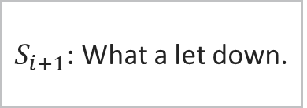
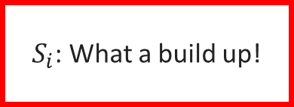
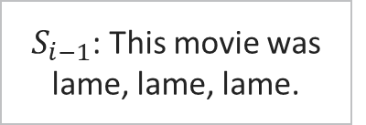

Foundations of natural language processing
Skip-Thought Vectors
$S_{i−1}$: This movie was lame, lame, lame.
Previous
Decoder
This movie was lame, lame, lame.
E
N
C
O
D
E
R
$S_{i}$: What a build up!
$$h_{i}$$
Next
Decoder
What a let down.
$S_{i+1}$: What a let down.

Slide 29
Foundations of natural language processing
Skip-Thought Vectors: Advantages and Disadvantages
+ robustness of representations - corpus must consist of sentences
+ capture semantics and syntax of the sentences
+ can be learned from unlabelled data

Slide 30
Data
Bag-of-words approach
Neural network-based approaches
i. Paragraph Vector
ii. Skip-thought
4. Evaluation and Outlook

Slide 31
Foundations of natural language processing
Evaluation
Bag-of-words | Paragraph Vector | Skip-Thought-Vectors
+ simple and flexible | + can be learned from unlabelled data | + can be learned from unlabelled data
+ easy to implement and use | + input texts can be of variable-length | + robustness of representations
 | + captures semantics and meaning | + captures semantics and meaning
- Loses order of words | - Inference step to compute new PV | - Corpus must consist of sentences
- Sparse vector representations | - Computationally intensive

Slide 32
Foundations of natural language processing
Evaluation
Method | accuracy_score
Uni BoW | 0.8617
Uni Bow – tfidf | 0.8907
Bi BoW | 0.8617
Bi BoW - tfidf | 0.8756
Tri Bow | 0.8134
Tri BoW - tfidf | 0.8376
Uni-, bi-, tri BoW | 0.8674
Uni-, bi-, tri BoW - tfidf | 0.8844
Distributed Memory | 0.8172
Distributed Bag-of-words | 0.8689
DM and DBoW | 0.8694

Slide 33
Foundations of natural language processing
Outlook: Sentence-BERT
State-of-the-art neural language model
Modification of the retrained BERT network
Uses Siamese and triplet network structures to derive semantically meaningful sentence embeddings that can be computed using cosine-similarity
More efficient than BERT

Slide 34
Foundations of natural language processing
Sources
https://towardsdatascience.com/document-embedding-techniques-fed3e7a6a25d
http://sanyam5.github.io/my-thoughts-on-skip-thoughts/
N. Reimer, I. Gurevych (2019): Sentence-BERT: Sentence Embeddings using Siamese BERT-Networks
Q. Le, T. Mikolov (2014): Distributed Representations of Sentences and Documents
R. Kiros et al. (2015): Skip-Thought Vectors
M.T. Pilehvar, J. Camacho-Collados (2021): Embeddings in Natural Language Processing – Theory and Advances in Vector Representation of Meaning
Maas et al. (2011): Learning Word Vectors for Sentiment Analysis
https://www.analyticsvidhya.com/blog/2020/02/quick-introduction-bag-of-words-bow-tf-idf/
https://machinelearningmastery.com/gentle-introduction-bag-words-model/
https://towardsdatascience.com/transforming-text-to-sentence-embeddings-layer-via-some-thoughts-b77bed60822c
https://github.com/assenmacher-mat/nlp_notebooks
https://medium.com/swlh/sentiment-classification-for-reviews-using-doc2vec-660ba594c336

Slide 35
Foundations of natural language processing
Evaluation
Bag-of-words | Paragraph Vector | Skip-Thought-Vectors
+ simple and flexible | + can be learned from unlabelled data | + can be learned from unlabelled data
+ easy to implement and use | + input texts can be of variable-length | + robustness of representations
 | + captures semantics and meaning | + captures semantics and meaning
- Loses order of words | - Inference step to compute new PV | - Corpus must consist of sentences
- Sparse vector representations | - Computationally intensive

Slide 36
Foundations of natural language processing
Appendix

Slide 37
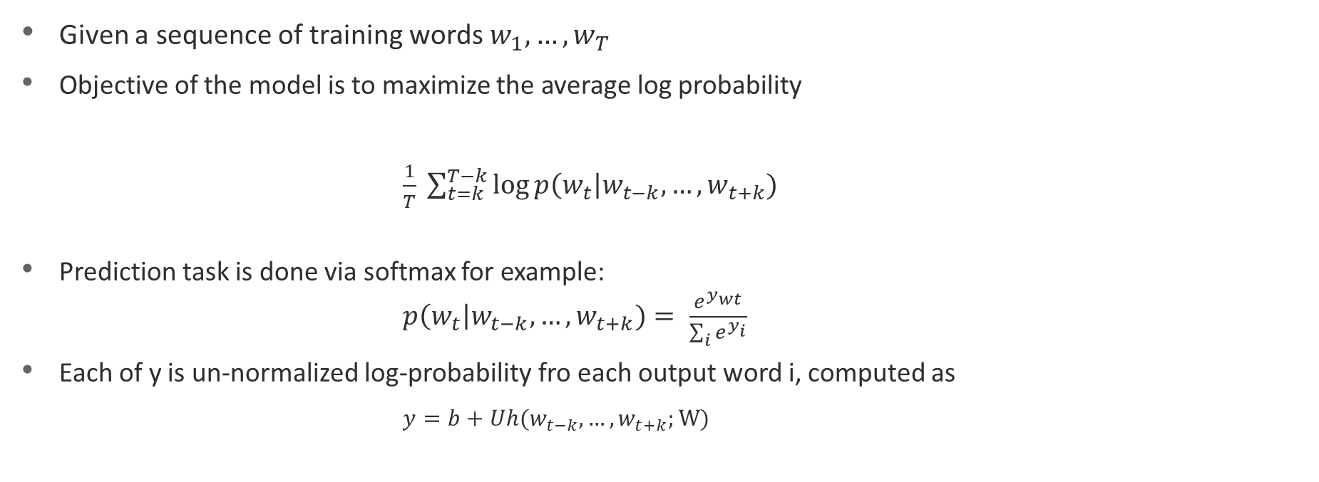
Foundations of natural language processing
Word2Vec
Given a sequence of training words $w_{1}, …, w_{T}$
Objective of the model is to maximize the average log probability $\frac{1}{T} \sum_{t=k}^{T−k}{\log{p\left(w_{t}\right|w_{t−k}, …, w_{t+k})}}$
Prediction task is done via softmax for example:
$p\left(w_{t}\right|w_{t−k}, …, w_{t+k})= \frac{e^{y_{wt}}}{\sum_{i}{e^{y_{i}}}}$
Each of y is un-normalized log-probability fro each output word i, computed as
$$y=b+Uh(w_{t−k}, …, w_{t+k};W)$$

Slide 38
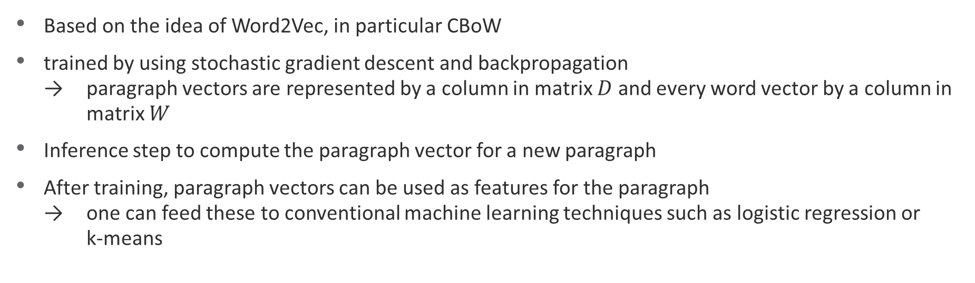
Foundations of natural language processing
Doc2Vec: Distributed Memory
Based on the idea of Word2Vec, in particular CBoW
trained by using stochastic gradient descent and backpropagation → paragraph vectors are represented by a column in matrix $D$ and every word vector by a column in matrix $W$
Inference step to compute the paragraph vector for a new paragraph
After training, paragraph vectors can be used as features for the paragraph → one can feed these to conventional machine learning techniques such as logistic regression or k-means

Slide 39
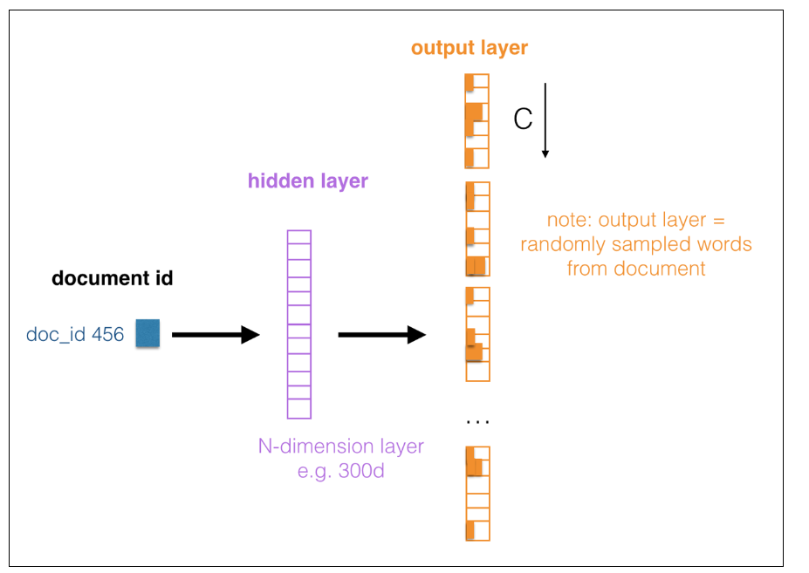
Foundations of natural language processing
Doc2Vec: Distributed Bag-of-words
takes the document ID as the input and tries
to predict randomly sampled words from the document
completely ignores the context words in our output altogether
Training: sample a list of words and then classify whether a word belongs to the document such that word vectors can be learnt
https://www.oreilly.com/library/view/mastering-machine-learning/9781785283451/e8de8ffa-a86b-4613-a246-04f90e6d456c.xhtml

Slide 40
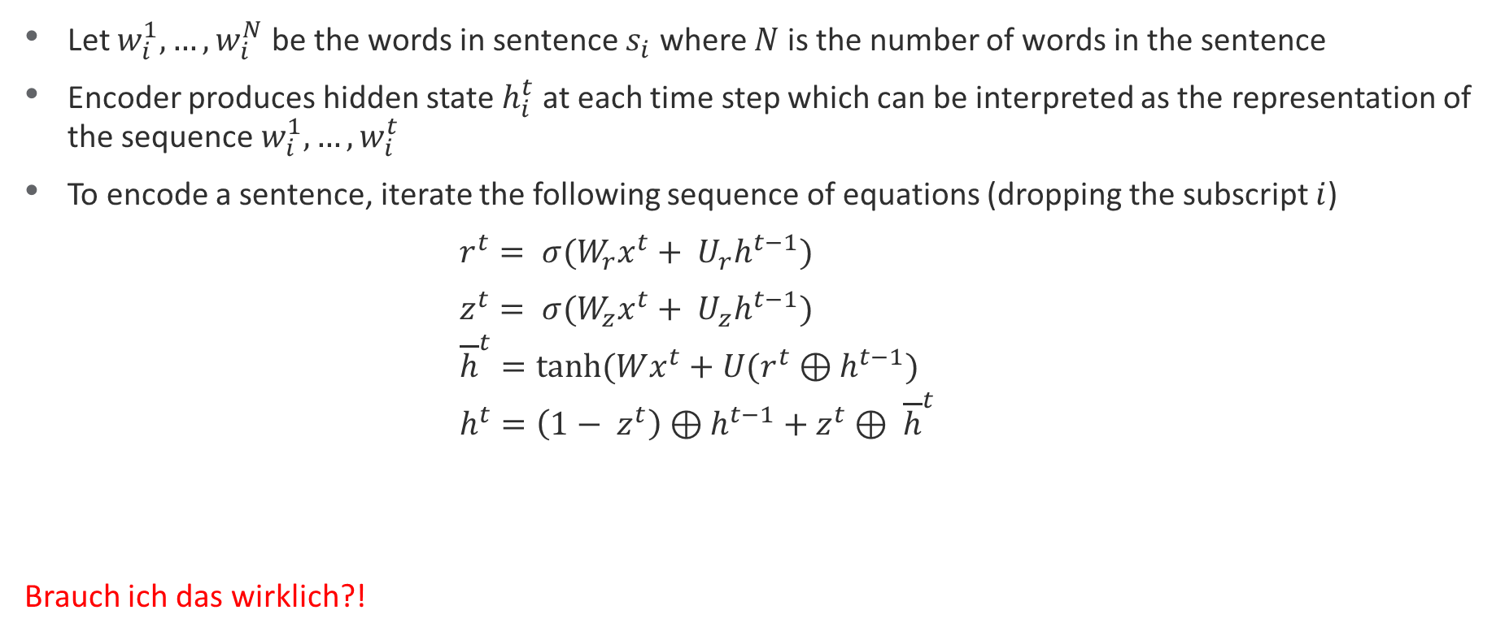
Foundations of natural language processing
Skip-Thought: Encoder
Let $w_{i}^{1}, …, w_{i}^{N}$ be the words in sentence $s_{i}$ where $N$ is the number of words in the sentence
Encoder produces hidden state $h_{i}^{t}$ at each time step which can be interpreted as the representation of the sequence $w_{i}^{1}, …, w_{i}^{t}$
To encode a sentence, iterate the following sequence of equations (dropping the subscript $i$)
$r^{t}= σ(W_{r}x^{t}+ U_{r}h^{t−1})$
$z^{t}= σ(W_{z}x^{t}+ U_{z}h^{t−1})$
${\overline{h}}^{t}=tanh⁡(Wx^{t}+U(r^{t}⊕h^{t−1})$
$h^{t}=\left(1− z^{t}\right)⊕$ $h^{t−1}$ $+ z^{t}$ $⊕ {\overline{h}}^{t}$
Brauch ich das wirklich?!

Slide 41
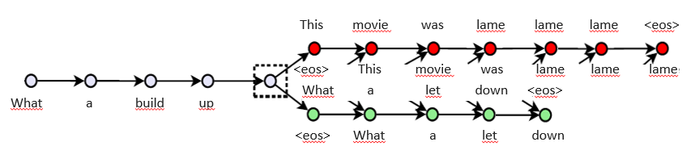

Foundations of natural language processing
Skip-Thought: Decoder
Teacher forcing: Decoders generate the sentence word-by-word while being fed the words of the true target sentence from the corpus with a delay of one time-step.
The teacher forcing is done for 100% of the words being predicted.
The prediction is a probability distribution over words that could occur at that position given the context $h_{i}$of a neighbouring sentence and the sequence of words that occurred before the current position

Slide 42
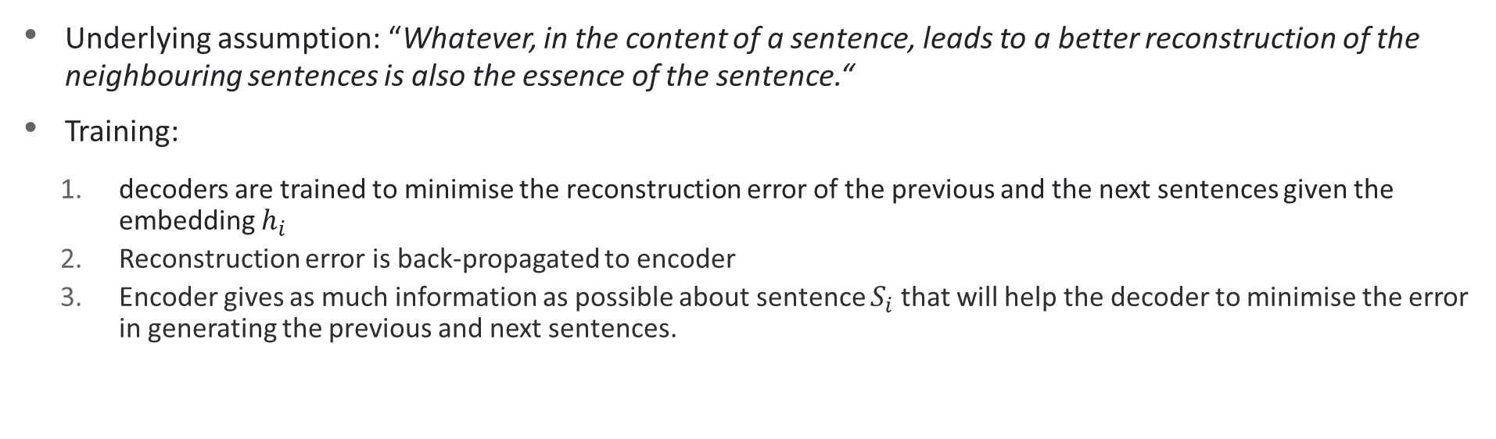
Foundations of natural language processing
Skip-Thought Vectors
Underlying assumption: “Whatever, in the content of a sentence, leads to a better reconstruction of the neighbouring sentences is also the essence of the sentence.“
Training:
decoders are trained to minimise the reconstruction error of the previous and the next sentences given the embedding $h_{i}$
Reconstruction error is back-propagated to encoder
Encoder gives as much information as possible about sentence $S_{i}$that will help the decoder to minimise the error in generating the previous and next sentences.

Slide 43
Foundations of natural language processing
Skip-Thought Vectors: Advantages and Disadvantages
+ robustness of representations - fixed sentence representation
→ consumes large amount of memory if sentence
+ capture semantics and syntax of the sentences is very long
+ can be learned from unlabeled data

Slide 44
Anne Gritto
anne.gritto@campus.lmu.de

