Slide 1
Bread Walk
Bread walk inventory system

Slide 2

Project Title
Bread Walk Inventory System,
October 10, 2017

Slide 3
Project Description
The Bread Walk bakeshop has issues in keeping track of their daily transactions since they had just recently opened for business for the last few months and has fewer staff. That is where our team of three come in. We have proposed a system for the bakeshop that will help them keep track of their business transactions with ease and without the use of a pen and paper.

Slide 4
Team Roles
Fullname | Role
Villapaz, Emil Andre | System Designer/Documentation
Escol, Anne Guinivere | System Analyst/Documentation
Daquipa, Brylle Justin | System Programmer

Slide 5
Project Development Platform
The tools that we have utilized on each end of the system are as follows:
A) Front end: Jframe(NetBeans), Jcalendar, JasperSoft
B) Back end: SQLite
C) Development Environment: Java(NetBeans)

Slide 6
Project Scope
Our system’s features can perform the following functionalities:
Adding data into the database.
Updating each data that is present unto the database.
Removing each data that is present unto the database.
Viewing the list of all data available inside the database.
Recording each transaction that has been made on a daily-basis.

Slide 7
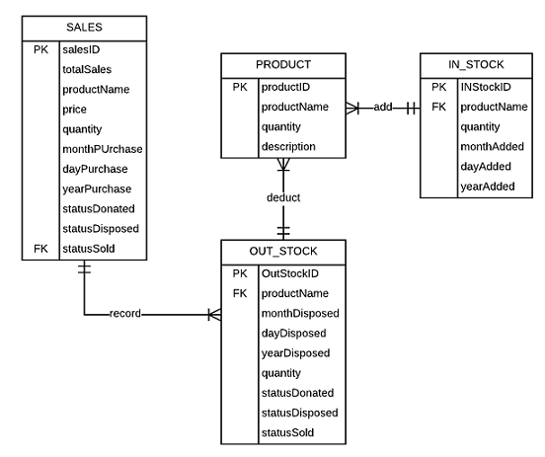
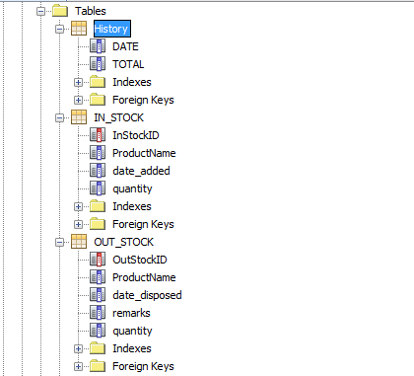
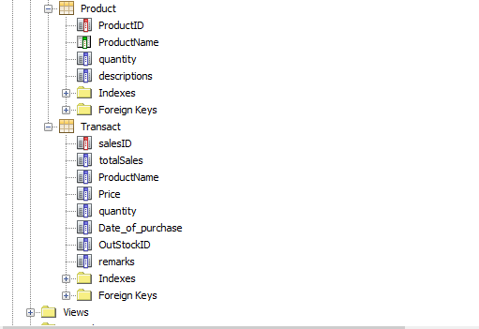
Database Schema

Slide 8
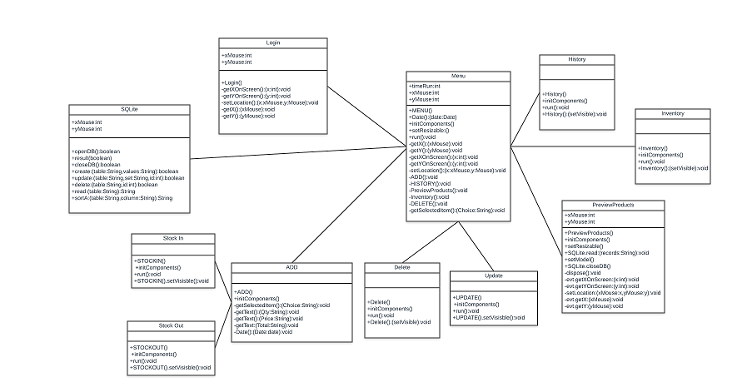
Class Diagram

Slide 9
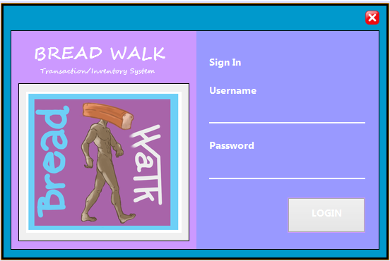
Wireframe
The login interface will allow the admin to access the database system and grant all privileges.

Slide 10
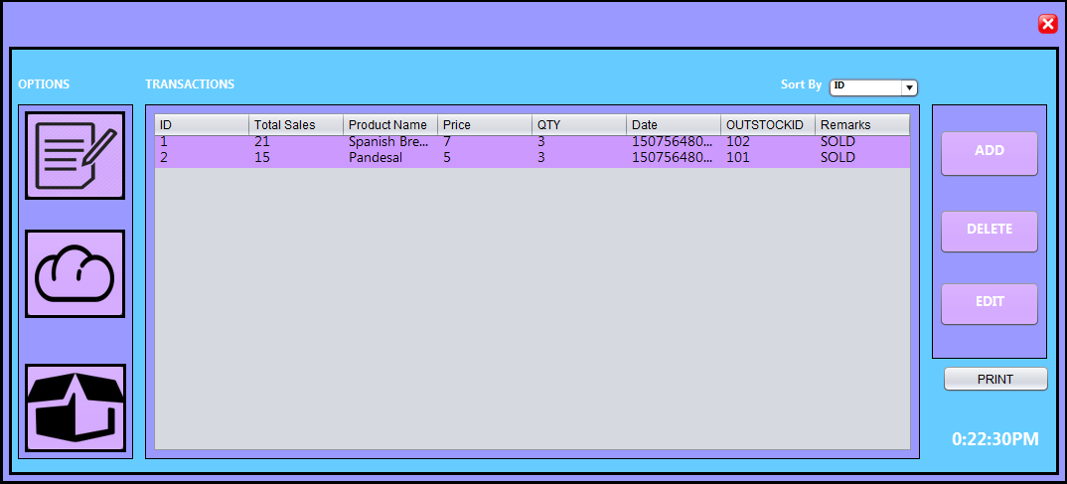
This is the transactions menu that will show up right after the admin logs in, in this window, the user can select the options; add, edit, delete, history, products, and the stocks.

Slide 11
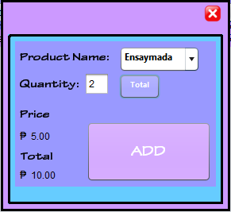
This window pops up when the admin decides to add a transaction that is made into the database, the system will ask for the product’s name, quantity, and price. The price of the product will then be added in total depending on the quantity inputed.

Slide 12
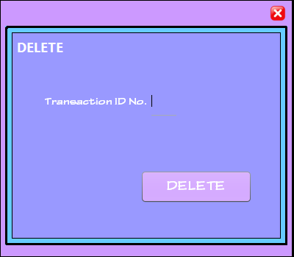
This windows will show up when the admin deletes a transaction when needed, the admin firsts types in the transaction ID and then deletes that particular transaction

Slide 13
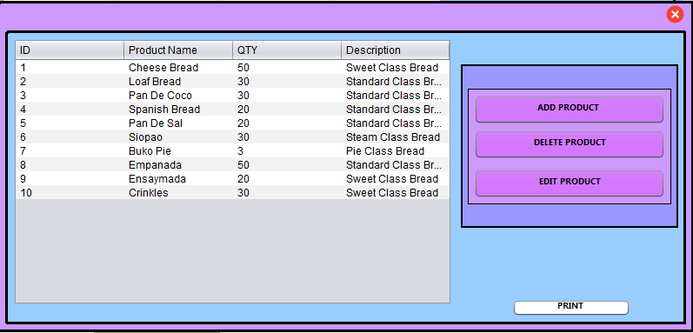
This window displays all the products that are present inside the database, the same window also has option for adding, deleting, and editing products.

Slide 14
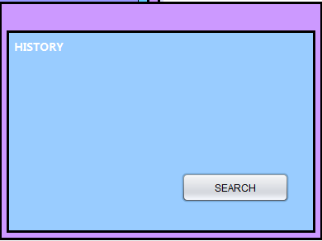
This windows shows up when the admin decides to search for a particular transaction that took place in the past and only that transaction will be displayed in the history.

Slide 15
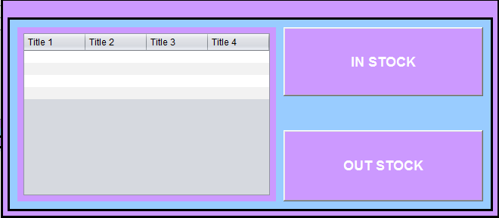
This window will display all the products that are in stock as well as the products that are out of stock, and products of the sort are displayed on the left.

Slide 16
PROJECT DEMO

