Slide 1
Introduction to Database Systems
Notes:
Today we will open the main topic of this class, which is databases. Before we start talking about databases do you have any questions about what we have done so far? Do you have any questions about the homework?
In todays world, databases are used practically in every system. Pretty much any website is built up on top of a database. All organizations (banks, hospitals, universities etc) have their own databases. So we will start with the definition. Anyone want to try? What is the first thing that comes in mind when you hear the word “database”?

Slide 2
Entity Relationship Diagrams (ERD)
Notes:
Now we will move forward and discuss the entity relationship diagram, which is a methodology that help us understand what data we have, and what is the best way to structure our database.

Slide 3
Basic Concepts
Entities
Attributes
Primary keys
Relationships
Cardinalities
Key constraints
Participation constraints
Crow’s foot notation

Slide 4
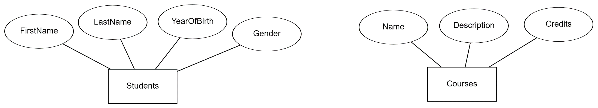

Entities, Attributes, Domain of Attribute Values
An entity is an abstract object
Each entity is described by a set of attributes
Each attribute has a domain of possible values. Common generic domains (ie data types) are “text”, “number”, “date”; often though domains have restricted values, and sometimes the domain may have a lightweight structure as well (e.g., “address” being “street-city-state-zip”).
Domain: 1940…2010
Attributes
Domain: M, F, X
Entities
The entity describes the structure of the instances:
Instance of “Students” might be: (“Peter“, “Pan”, 2001, “M”)
Instance of “Courses” might be: (“Data analysis”,“Learning to analyze data” , 4)
Notes:
Stop at 4 minutes.

Slide 5
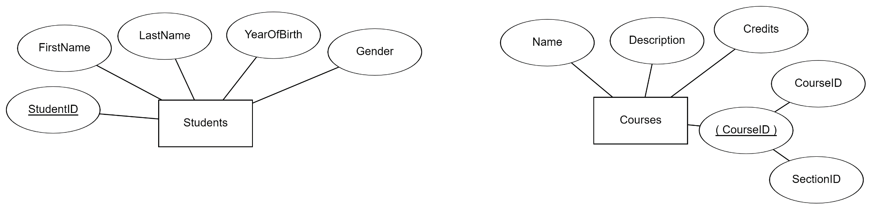
Primary Key (PK)
An attribute whose value is unique for each separate instance:
Student id in the students entity
Composite primary key: A primary key that consists of two or more attributes, whose values together (but not separately) are unique for each instance in an entity:
Course id and section id in the courses entity
Composite
Primary Key
Other Examples?

Slide 6
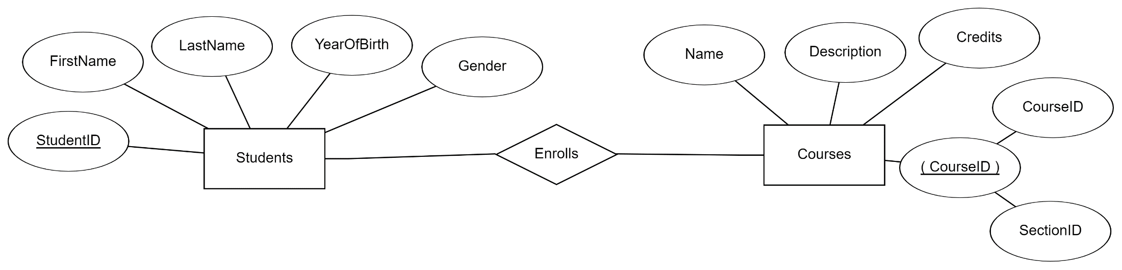
Relationship
A relationship is an association among entities:
Students enrolls in courses (enrolls is a relationship)
A relationship is shown as a line connecting the associated entities, with a diamond in the middle, labeled with the name of the relationship
A relationship name is usually a verb (e.g., takes)

Slide 7
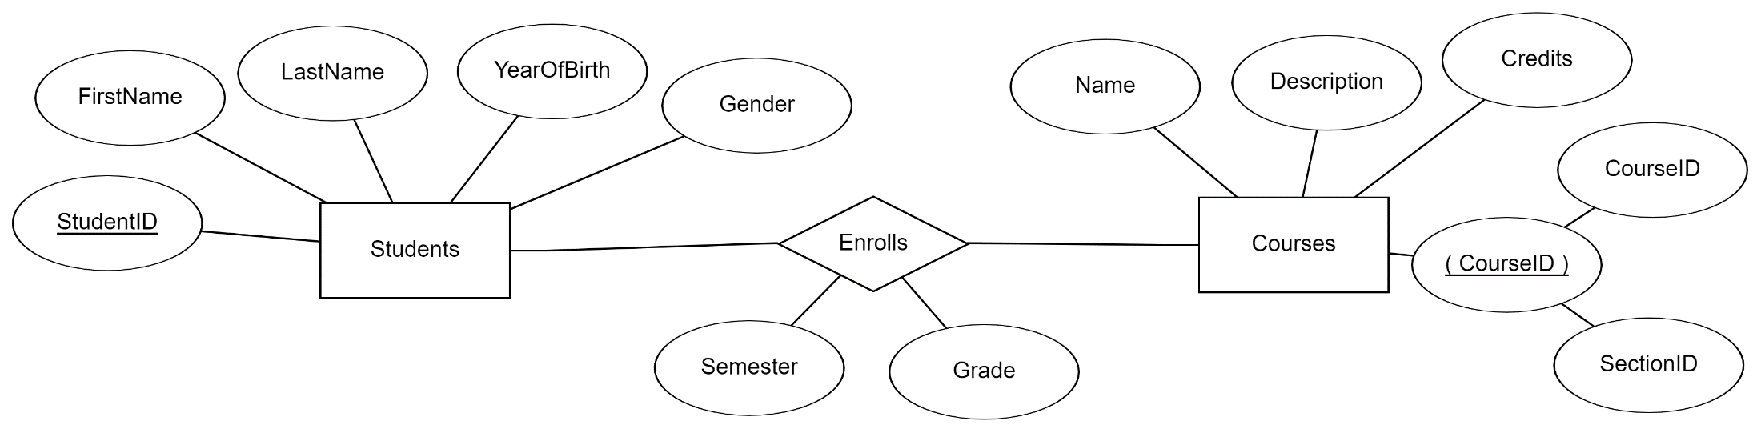
Relationships can have attributes
A relationship may have attributes:
Students enrolls in courses (enrolls is a relationship)
Each enrollment has a registration semester and a grade that the student received for the course

Slide 8
Relationship Cardinalities
Cardinalities describe the number of instances that participate in a relationship
Office
Office 1
Office 2
Advisors
Advisor 1
Advisor 2
Students
Student 1
Student 2
Student 3
Courses
Course 1
Course 2
Course 3
Course 4
Each office can have one advisor, at most. An office can also be empty
Each advisor should have an office. Each advisor has one office at most.
An advisor should advise one or more students; advisor with no advisees not allowed.
A student should have an advisor, and can have at most one advisor.
A student can may take from zero to 5 courses.
A course may have from zero to 70 students.

Slide 9
Relationship Cardinality: Key constraints
Cardinalities describe the number of instances that participate in a relationship
Key constraint: Maximum number of relationships for each instance
Office
Office 1
Office 2
Advisors
Advisor 1
Advisor 2
Students
Student 1
Student 2
Student 3
Courses
Course 1
Course 2
Course 3
Course 4
One to one: Each office has one advisor at most. Each advisor has one office at most.
One to many: An advisor can advise many students. A student has at most one advisor
Many to many: A student can take many courses. A course can have many students

Slide 10
Relationship Cardinality: Participation constraints
Cardinalities describe the number of instances that participate in a relationship
Participation constraint: Minimum number of relationships for each instance
Office
Office 1
Office 2
Advisors
Advisor 1
Advisor 2
Students
Student 1
Student 2
Student 3
Courses
Course 1
Course 2
Course 3
Course 4
Optional participation:
Each office has one advisor at most but it can also be empty
A course may have no students
A student may take no courses
Mandatory participation
Each advisor should have an office and should advise students
Each student needs an advisor assigned

Slide 11
Cardinality Notation: Crow’s Foot Notation
Symbol | Meaning
 | One - mandatory
 | Many - mandatory
 | One - optional
 | Many - optional
Notation schemes:
Chen notation: Solid lines for mandatory, dashed lines for optional; write 1 or N on the line for one or many, respectively
UML notation: Write minimum and maximum numbers on the line
Arrow notation: Single arrow for one, two arrows for many
(many others)

Slide 12
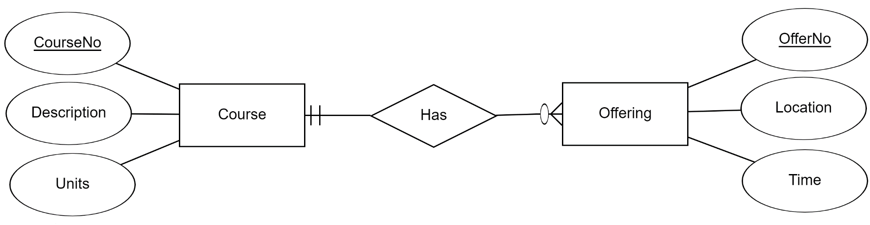
Cardinality Notation Example
Inside symbol Minimum cardinality
“Crow’s foot” Cardinality: Many
Circle Cardinality: Zero
Outside symbol Maximum cardinality
Perpendicular line Cardinality: One
Notice that the notation goes to the “other side” of the relationship.
The “1-1” cardinality next to the Course means that “Each Offering has at least one and at most one Course”
The “0-many” cardinality next to the Offering means that “Each Course may have zero Offerings and may have many Offerings”
Notes:
Here is another example, where we have two entities, the course enticing with attributes…and the offering entity with ….and the relationship that shows that a course has an offering (or is offered) we can see the cardinality represntation,

Slide 13
Examples of Cardinality Signs
Minimum-one, Maximum-one ( || ): there must be exactly 1 relationship. e.g., a professor must have an office (minimum one) and exactly one office (maximum one).
Minimum-one, Maximum-many (| ). e.g., each department must have at least one instructor (minimum-one) but may also have many instructors (but at least one!)
Minimum-zero, Maximum-many( ). e.g., each person can have a maximum of many phones (maximum-many) but may also have no phone number (minimum-zero)
Minimum-zero, Maximum-one (0 ): e.g., a student may have 0 or 1 university email accounts

Slide 14
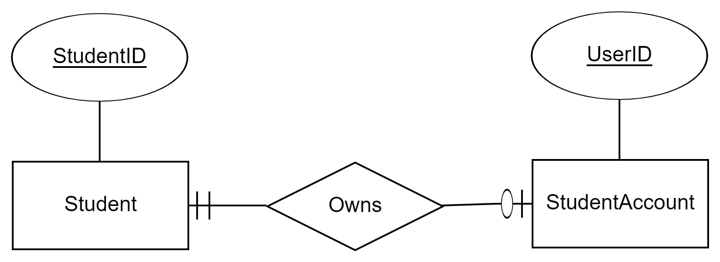
One-to-one Relationships
Cardinalities
One-to-one: The maximum number involved in a 1 to 1 relationship is one
Each student can own zero or one (expressed as “o|”) account
Each account is owned by exactly one (expressed as “||”) student

Slide 15
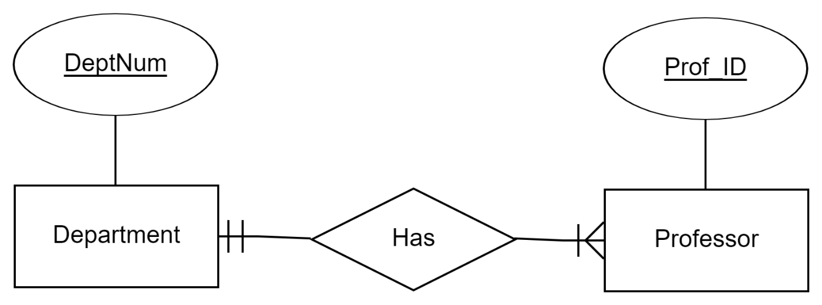
One-to-many Relationships
Cardinalities
One-to-many , e.g., each department has many professors:
Each department can have one or more (expressed as “ | ”) professors
Each professor is affiliated with one and only one (expressed as “| |”) department

Slide 16
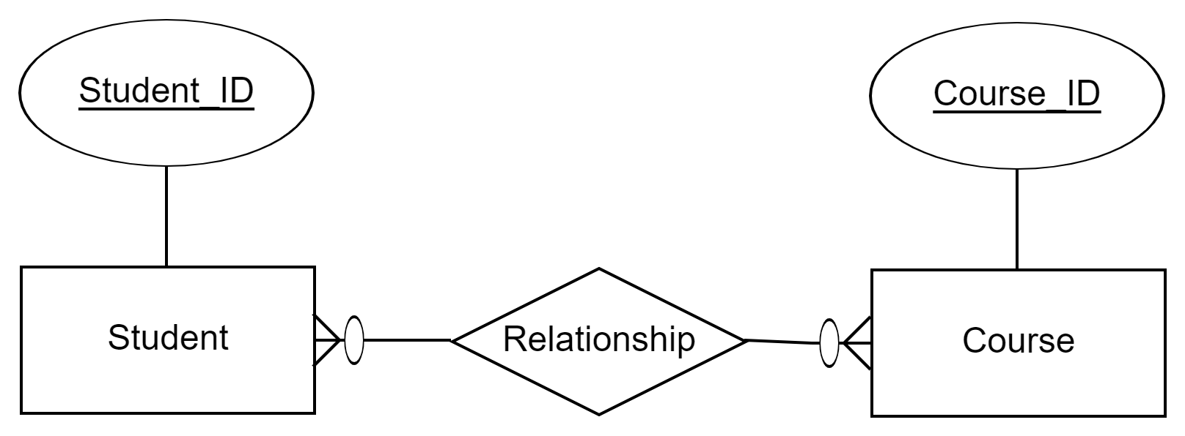
Many-to-Many Relationships
Cardinalities
Many-to-many, e.g., many students enroll in many courses:
Each student can take 0 or more courses
Each course can enroll 0 to many students
This is the most flexible relationship, but too much flexibility may result in various data quality problems

Slide 17
Review
An entity is a collection of objects with the same properties (attributes). Each attribute has a domain of values.
Students (student name, student id, dob, sex, etc. )
Courses (course id, section id, course description, location, etc..)
A primary key is an attribute whose value is unique in each instance:
Student id in the students entity
A relationship is an association among entities:
Students enrolls in courses (enrolls is a relationship)
Cardinalities describe the number of instances that participate in a relationship. Cardinality constraints specify the maximum (key constraint) and minimum (participation constraint) number of relationship for each entity.
Notes:
Last time we discussed ER diagrams.

Slide 18
In-class example: Create the following ER Diagram
A painter can paint many paintings; each painting is painted by one painter. A gallery can have many paintings. A painting can be exhibited by a gallery.
The description above is only a partial specification and requires clarifications to be translated into a proper ER diagram.
Try variations in the cardinalities among the entities and see the resulting differences in semantics.

