Slide 1
From ER diagrams to Tables

Slide 2

ER Diagram → Relational Model
Step 0: Identify:
Entities
Relationships (many-to-many, one-to-many, one-to-one)
Special attributes (primary key)
Step 1: Entities
Step 2: Many-to-many relationships
Step 3: One-to-many relationships
Step 4: One-to-one relationships

Slide 3
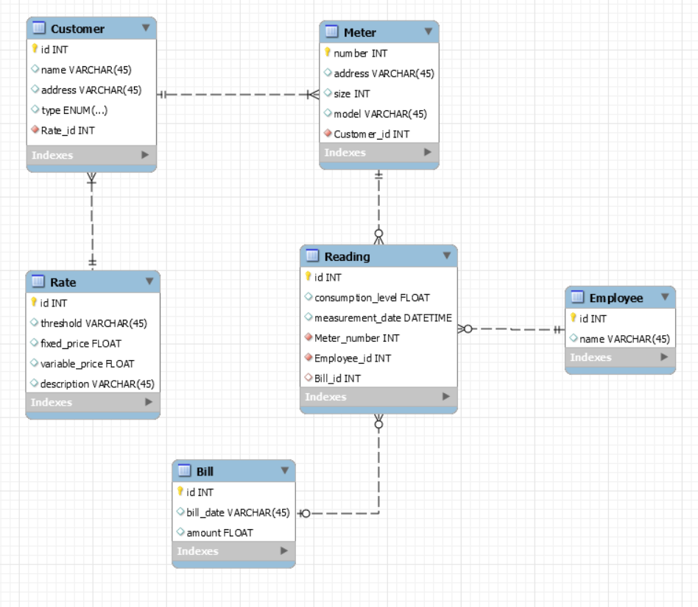
Example - Water Utility

Slide 4
Step 0: Entities map to Tables
Each entity maps to a table
Each attribute maps to a column in the table
The primary key of the entity maps to the primary key of the table
Primary keys are underlined

Slide 5
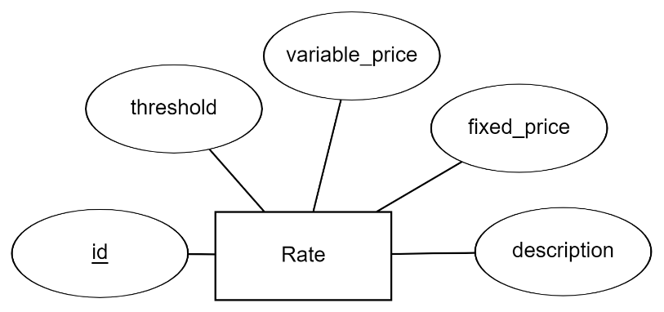
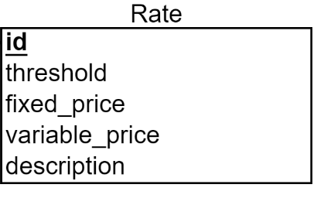
Step 1: Water Utility Entities
ER Diagram
Relational Schema
Rate
Actual data
id | description | Fixed_price | Variable_price | Threshold
R1278 | Consumer Basic | 40 | 10 | 2
R982 | Consumer Savings | 70 | 5 | 5
R1908 | Restaurant Rate | 120 | 2 | 20
We do this mapping for all our entities in the ER Diagram, creating one table per entity

Slide 6
Step 2: Converting relationships into a relational schema: One to many relationships
For each One-to-Many relationship
Add a foreign key (FK) to the table corresponding to the “many” entity
A foreign key is an attribute that can only take values that appear as primary keys in the referenced table

Slide 7
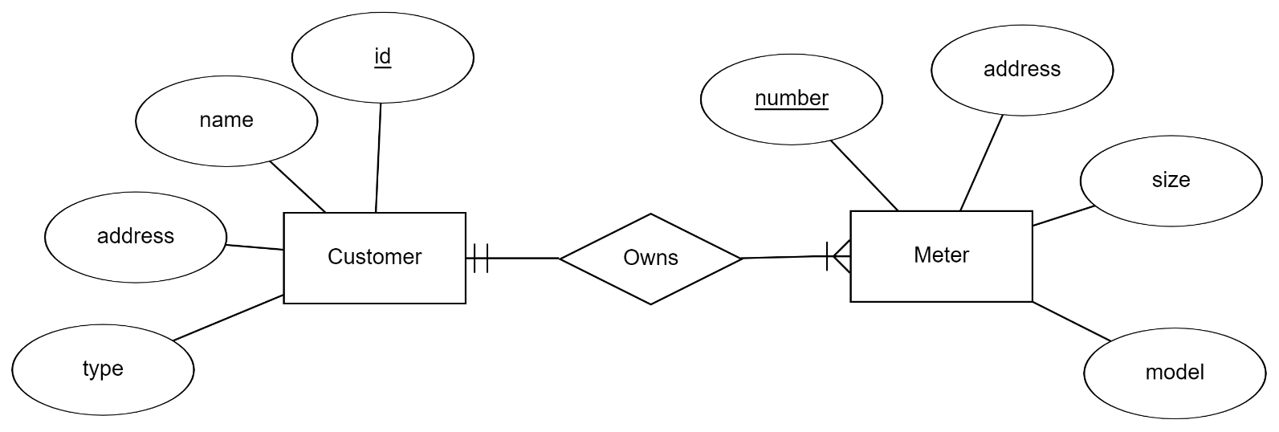
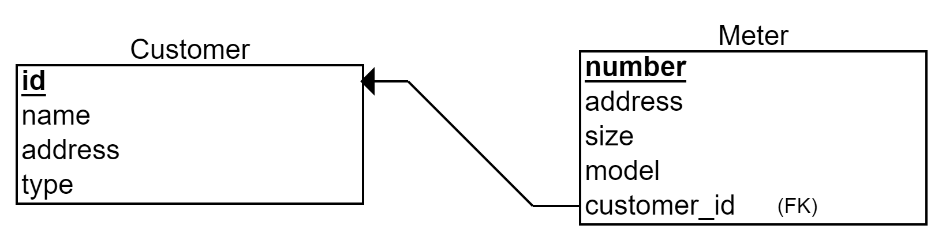
Step 2: Example
ER Diagram
Relational Schema
Foreign Key

Slide 8
Step 3: One to one Relationships
We treat One-to-One relationship similarly as we treat One-to-Many relationship
Option 1: Add a Foreign Key to either of the two tables
Option 2: Merge the two tables (sometimes ok, sometimes bad style)

Slide 9
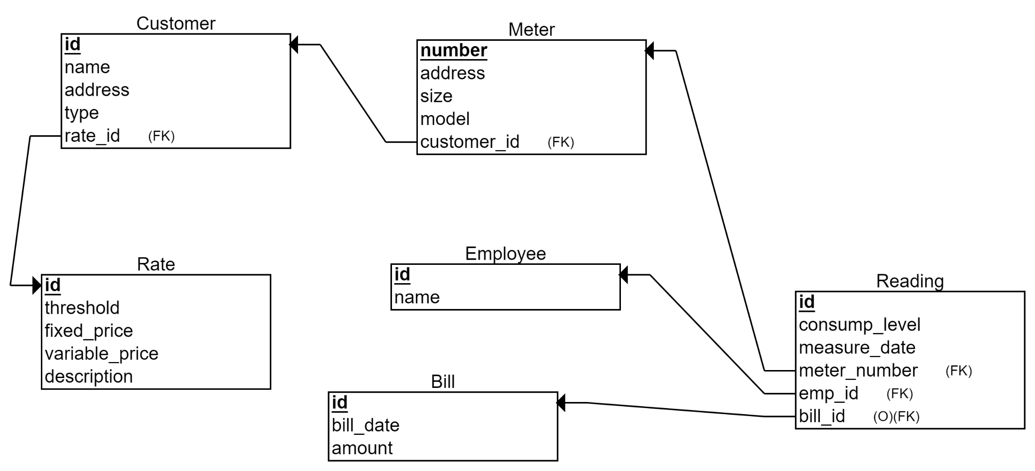
Relational Schema

Slide 10
Step 4: Many to many relationships
Need to introduce bridge table (Each Many-to-Many relationship becomes a separate table)
The primary key of the bridge table is the combination of the primary keys of the entity types participating in the relationship
Each of the primary keys stored in the bridge table is a foreign key, pointing to the original entity table

Slide 11
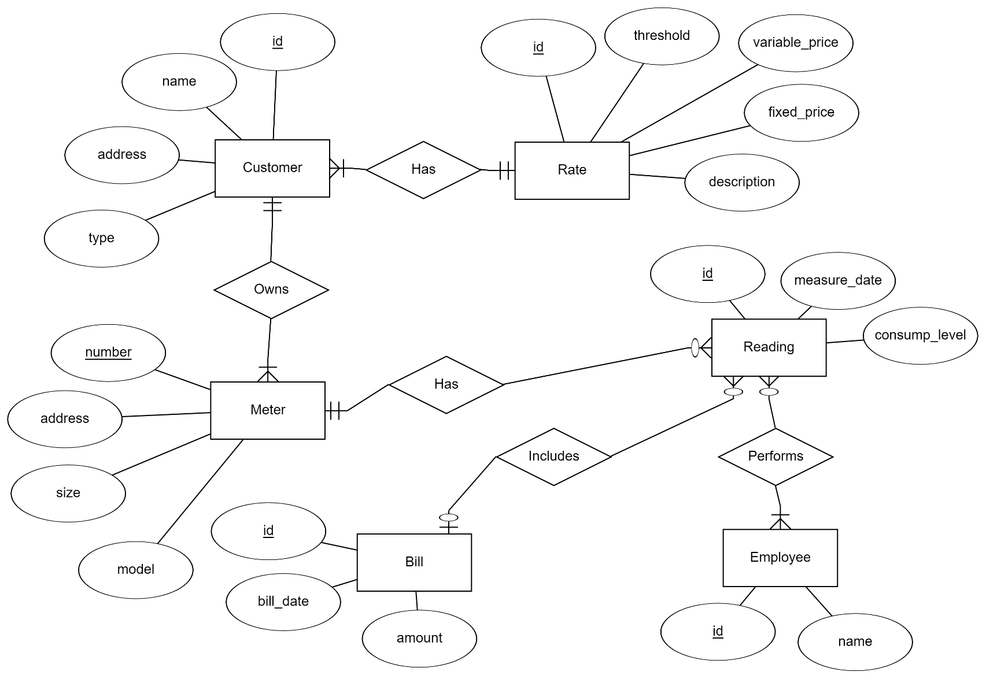
Step 4: Example
Lets assume that a reading can be done by many employees

Slide 12
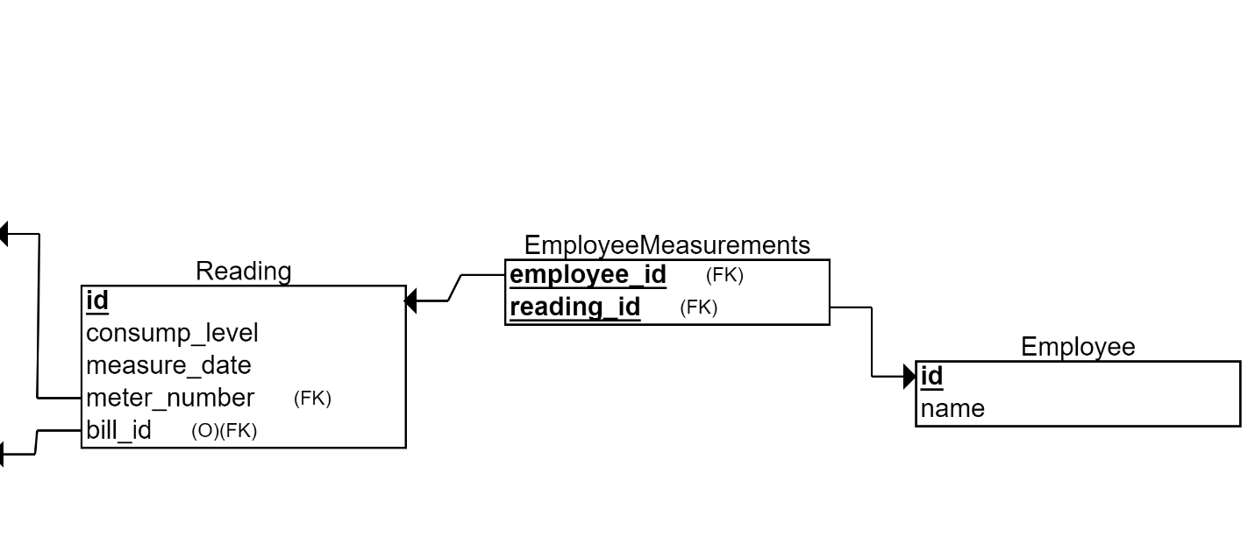
Step 4: Example
Lets assume that a reading can be done by many employees
The many-to-many relationship becomes a bridge table
Reading Id | Employee Id
Reading Id | Measure_Date | …
Bridge Table
Employee Id | Name | …

Slide 13
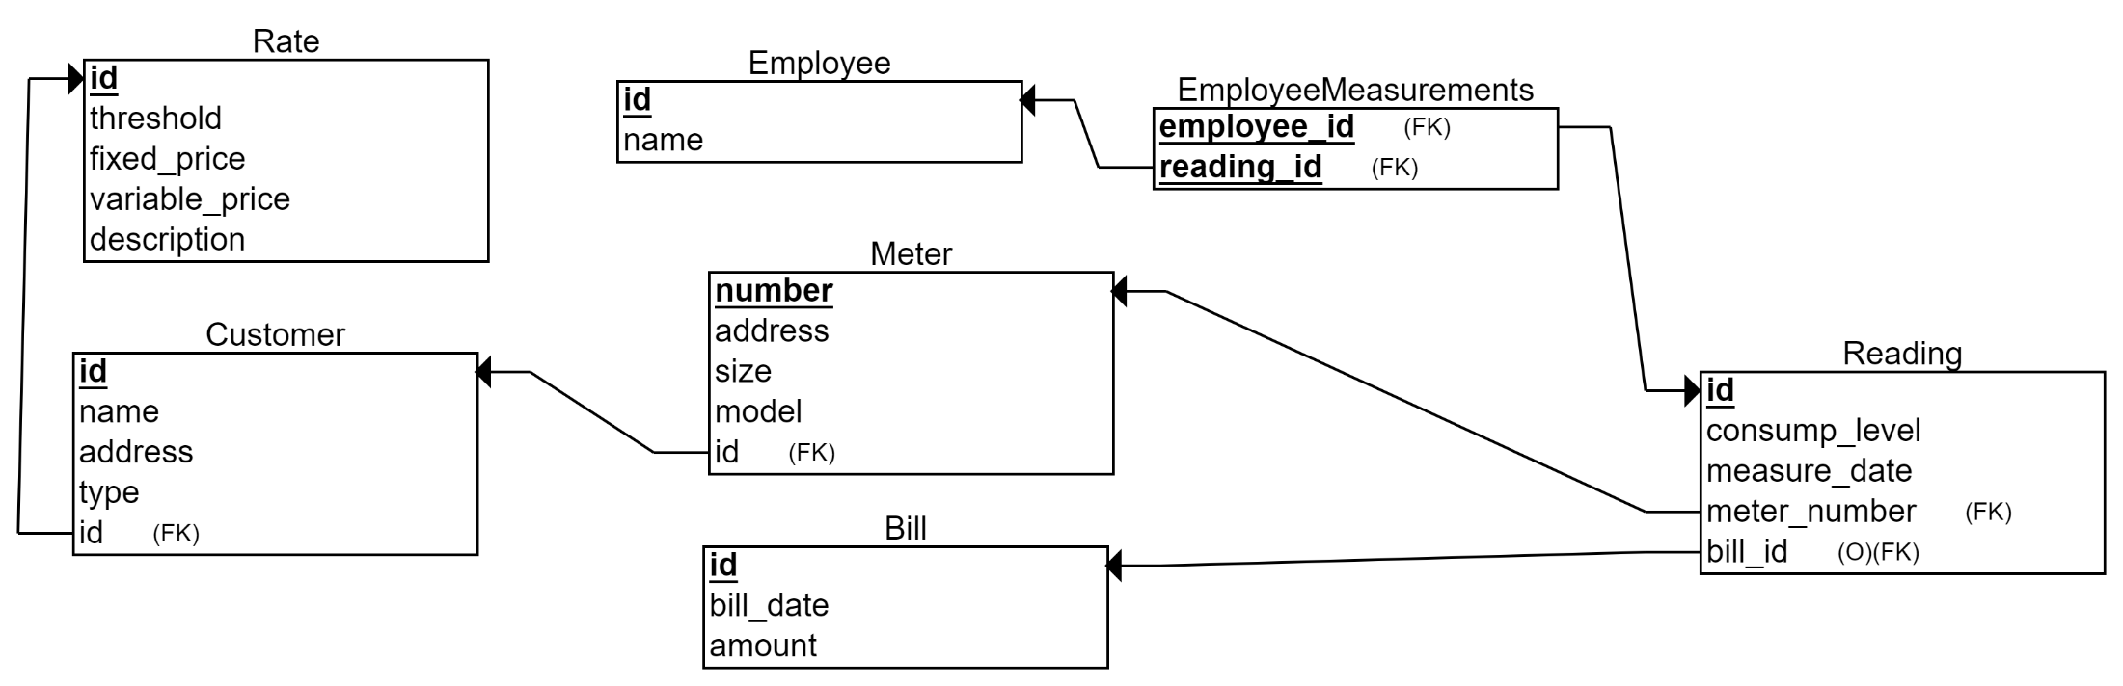
Relational Schema

Slide 14
Final Results
Meter (meter_id, address, size, model, cust_id)
Customer (cust_id, name, address, type, rate_id)
Rate (rate_id, description, fixed_amount, variable_amount, consumption_threshold)
Reading (reading_id, timestamp,consumption, meter_id, bill_id)
Employee_Measurements (reading_id, employee_id)
Employee (employee_id, name)
Bills (bill_id, cust_id, bill_date, amount)

Slide 15
Summary of ER modeling
ER model is popular for conceptual design
Constructs are expressive, intuitive and graphical.
Basic constructs: entity types, relationships (cardinalities), and attributes
ER modeling is subjective!
There are often many ways to model a given scenario!
Analyzing alternatives is key
ER modeling is iterative!
Resulting diagram should be analyzed and refined further.

Slide 16
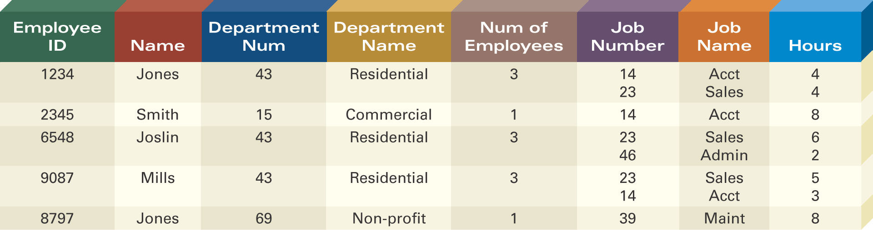
Defining Entity Classes and Primary Keys
What are the entity classes and primary keys for the report below?
What entities/tables should we create?
Are there fields that are redundant once you create the tables?

Slide 17
In-class exercise: (if we have time) Create the following ERDs and tables
NoFuture Records has decided to store information about musicians who perform on its albums (as well as other company data) in a database.
Each musician that records at NoFuture has an SSN, a name, an address, and a phone number. Poorly paid musicians often share the same address, and no address has more than one phone.
Each instrument used in songs recorded at NoFuture has a unique identification number, a name (e.g., guitar, synthesizer, ﬂute) and a musical key (e.g., C, B-ﬂat, E-ﬂat).
Each album recorded on the NoFuture label has a unique identification number, a title, a copyright date, a format, and an album identifier.
Each song recorded at NoFuture has a title and an author.
Each musician may play several instruments, and a given instrument may be played by several musicians.
Each album has a number of songs on it, but no song may appear on more than one album.
Each song is performed by one or more musicians, and a musician may perform a number of songs.
Each album has exactly one musician who acts as its producer. A musician may produce several albums.

