Slide 1
From a business narrative to an
Entity - Relationship Model to a
Relational Database

Slide 2

Questions
How can we create an ER diagram from scratch?
How can we go from an ER diagram to a design for a database?
How can we use SQL to create the database in a relational database?
Notes:
Last time we discussed ER diagrams.

Slide 3
Outline
Step-by-step procedure for converting narrative data into Entity-Relationship Diagram
Application of the procedure for designing a DB for water-utility company
Common problems during ER Design

Slide 4
From Narrative to ER diagram
The procedure for analysis:
Identify entities and attributes
Determine primary keys
Identify relationships
Determine relationship cardinalities
Refine the ERD

Slide 5
Example: Water-Utility Database
Customer database for a municipal water utility
Business Narrative:
A customer has a name and a billing address. Each customer has a type (residential or commercial), an applicable rate, and a collection of meters for which the customer is billed.
The rate has a consumption threshold. Below the threshold the customer pays a fixed price. Above the threshold the customer pays based on a variable rate per cubic foot of consumption above the threshold.
Each meter corresponds to a customer who is the owner of the meter. The same customer can have multiple meters. Each meter has a number, an address, size, and model.
Each meter is measured periodically by an employee, who marks the consumption level and the date of the reading.
Periodically, the customer gets a bill based on the most recent meter reading. Sometimes the bill includes multiple readings (only the most recent counts), and sometimes is based on estimates (i.e., not based on a reading)

Slide 6
Step 1: Identify Entities and Attributes
For entities, find nouns that describe people, places, things, and events
For attributes, look for details about the entities
Common decision: Attributes vs. Entities
Simplicity principal: consider as an attribute unless other details are presented.
Example : Should an address be an attribute or a separate entity? Advantages and disadvantages?
Notes:
For example, which one of the two should we choose?

Slide 7
Step 2: Determine primary keys
Stable: never change after assigned
Each entity should have one and only one (good choice: automatically generated values, eg StudentId, CourseId)
What about the following PKs for a person?
Credit card
Phone number
PassportID
SSN
Notes:
SSN: immigrants (outside US) don’t have one. PPl lose it . PPl don’t want to share their SSN.

Slide 8
Water utility DB: Entities & attributes
A customer has a name and a billing address. Each customer has a type (residential or commercial), an applicable rate, and a collection of meters for which the customer is billed.
The rate has a consumption threshold. Below the threshold the customer pays a fixed price. Above the threshold the customer pays based on a variable rate per cubic foot of consumption above the threshold.
Each meter corresponds to a customer who is the owner of the meter. The same customer can have multiple meters. Each meter has a number, an address, size, and model.
Each meter is measured periodically by an employee, who marks the consumption level and the date of the reading.
Periodically, the customer gets a bill based on the most recent meter reading. Sometimes the bill includes multiple readings (only the most recent counts), and sometimes is based on estimates (i.e., not based on a reading)

Slide 9
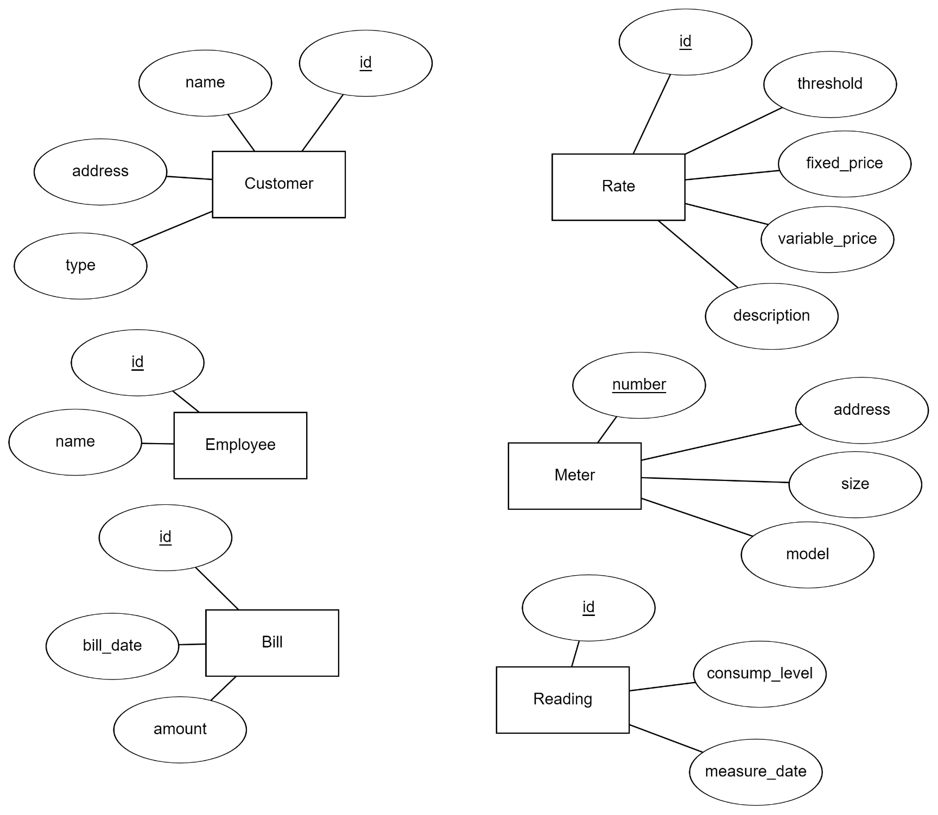
Entities & Attributes

Slide 10
Step 3: Identify Relationships and determine cardinalities
Identify relationships connecting previously identified entity types
Relationships = associations among nouns representing entity types
Identify maximum cardinalities and minimum cardinalities

Slide 11
Identify Relationships
Customer has id, name, billing address, type, applicable rate, collection of meters.
Available meter data is number, address, size, model.
Employee periodically reads each meter. Reading has meter reading number, timestamp, consumption level, and employee number.
Bills are based on most recent meter readings and applicable rates.
Rate has rate number, description, fixed and variable dollar amounts, consumption threshold.

Slide 12
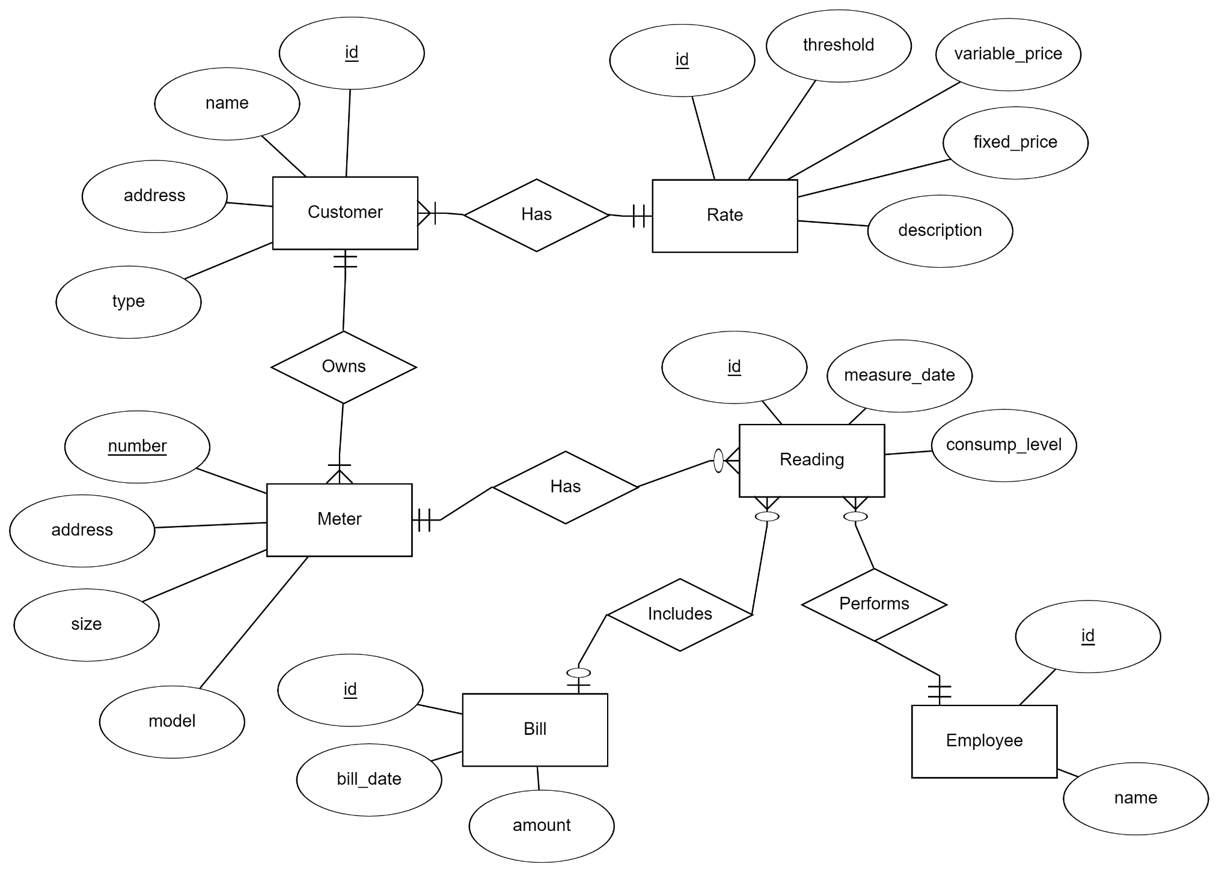
Water Utility: Relationships & Cardinalities

Slide 13
ERD refinements
We constructed initial ERD
Refinements are common
Example of refinements:
Attributes -> Entities
Splitting compound attributes
Data types becoming ENUM entries

Slide 14
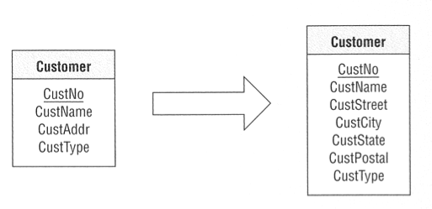
Splitting attributes
Customer Address is a compound attribute. Maybe we need to search by city?

Slide 15
Attribute or Entity?
We often need to decide whether something is an entity or an attribute (e.g., an address)
A free-form attribute allows the introduction of data quality issues (e.g., “California” vs “CA”).
When we have a limit number of values, that are unlikely to change in the future, then we make the data type of the attribute an “ENUM” where we list all the possible values, eg ENUM(“Alabama”, “Alaska”,… “Wyoming”) which limits and standardizes the values for the attribute.
We make the attribute a separate entity when we want to add new values over time, or want to keep more information about the attribute value (e.g. “keep extra information about the address, such as owned/rented, estimated home value, commercial/residential, etc”)
The common decision is “keep things as attributes” unless you are ready to handle the extra complexity

Slide 16
From ER diagrams to Tables

Slide 17
ER Diagram → Relational Model
Step 0: Identify:
Entities
Relationships (many-to-many, one-to-many, one-to-one)
Special attributes (primary key)
Step 1: Entities
Step 2: Many-to-many relationships
Step 3: One-to-many relationships
Step 4: One-to-one relationships

Slide 18
Example - Water Utility

Slide 19
Step 0: Entities map to Tables
Each entity maps to a table
Each attribute maps to a column in the table
The primary key of the entity maps to the primary key of the table
Primary keys are underlined

Slide 20
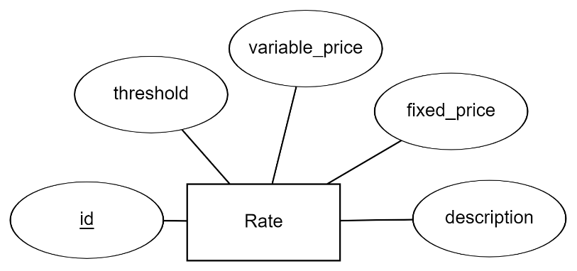
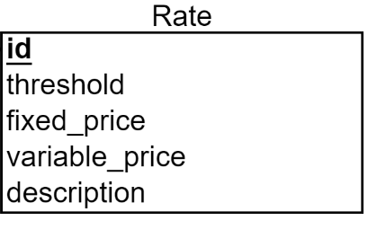
Step 1: Water Utility Entities
ER Diagram
Relational Schema
Rate
Actual data
id | description | Fixed_price | Variable_price | Threshold
R1278 | Consumer Basic | 40 | 10 | 2
R982 | Consumer Savings | 70 | 5 | 5
R1908 | Restaurant Rate | 120 | 2 | 20
We do this mapping for all our entities in the ER Diagram, creating one table per entity

Slide 21
Step 2: Converting relationships into a relational schema: One to many relationships
For each One-to-Many relationship
Add a foreign key (FK) to the table corresponding to the “many” entity
A foreign key is an attribute that can only take values that appear as primary keys in the referenced table

Slide 22
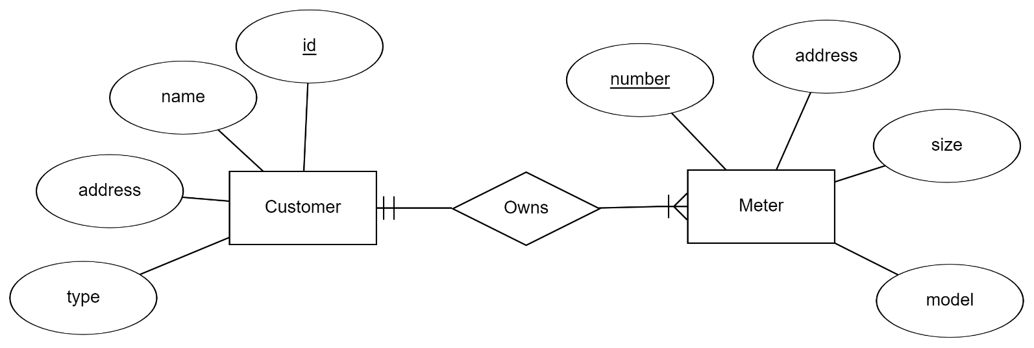
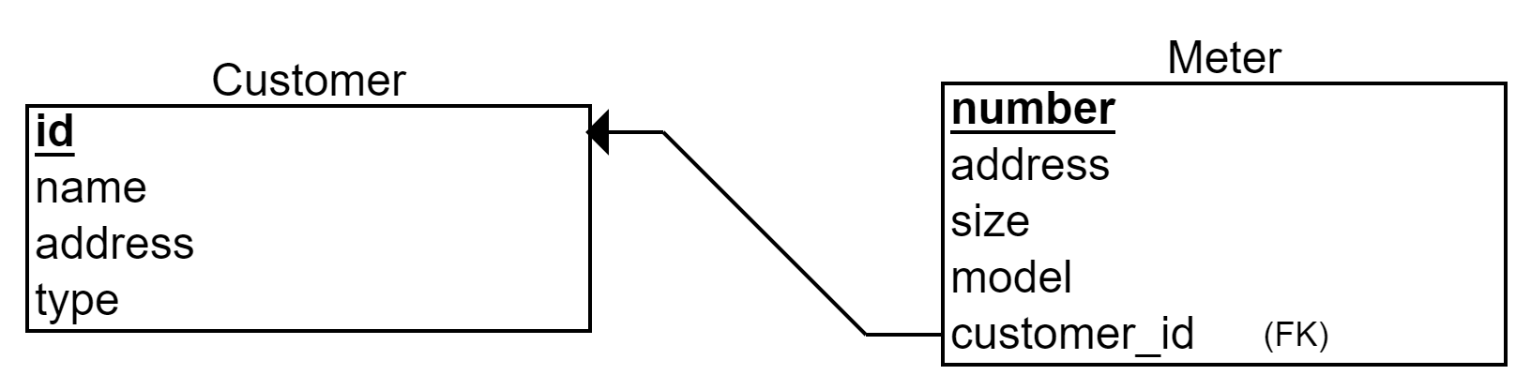
Step 2: Example
ER Diagram
Relational Schema
Foreign Key

Slide 23
Step 3: One to one Relationships
We treat One-to-One relationship similarly as we treat One-to-Many relationship
Option 1: Add a Foreign Key to either of the two tables
Option 2: Merge the two tables (sometimes ok, sometimes bad style)

Slide 24
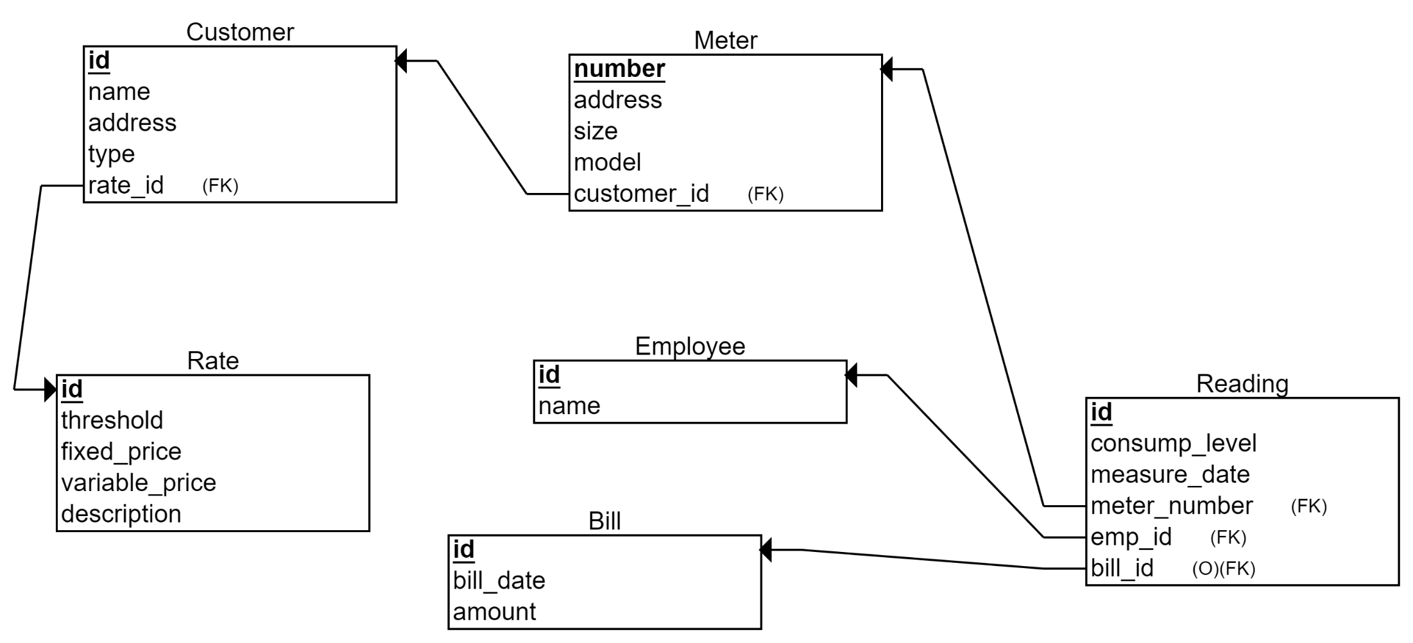
Relational Schema

Slide 25
Step 4: Many to many relationships
Need to introduce bridge table (Each Many-to-Many relationship becomes a separate table)
The primary key of the bridge table is the combination of the primary keys of the entity types participating in the relationship
Each of the primary keys stored in the bridge table is a foreign key, pointing to the original entity table

Slide 26
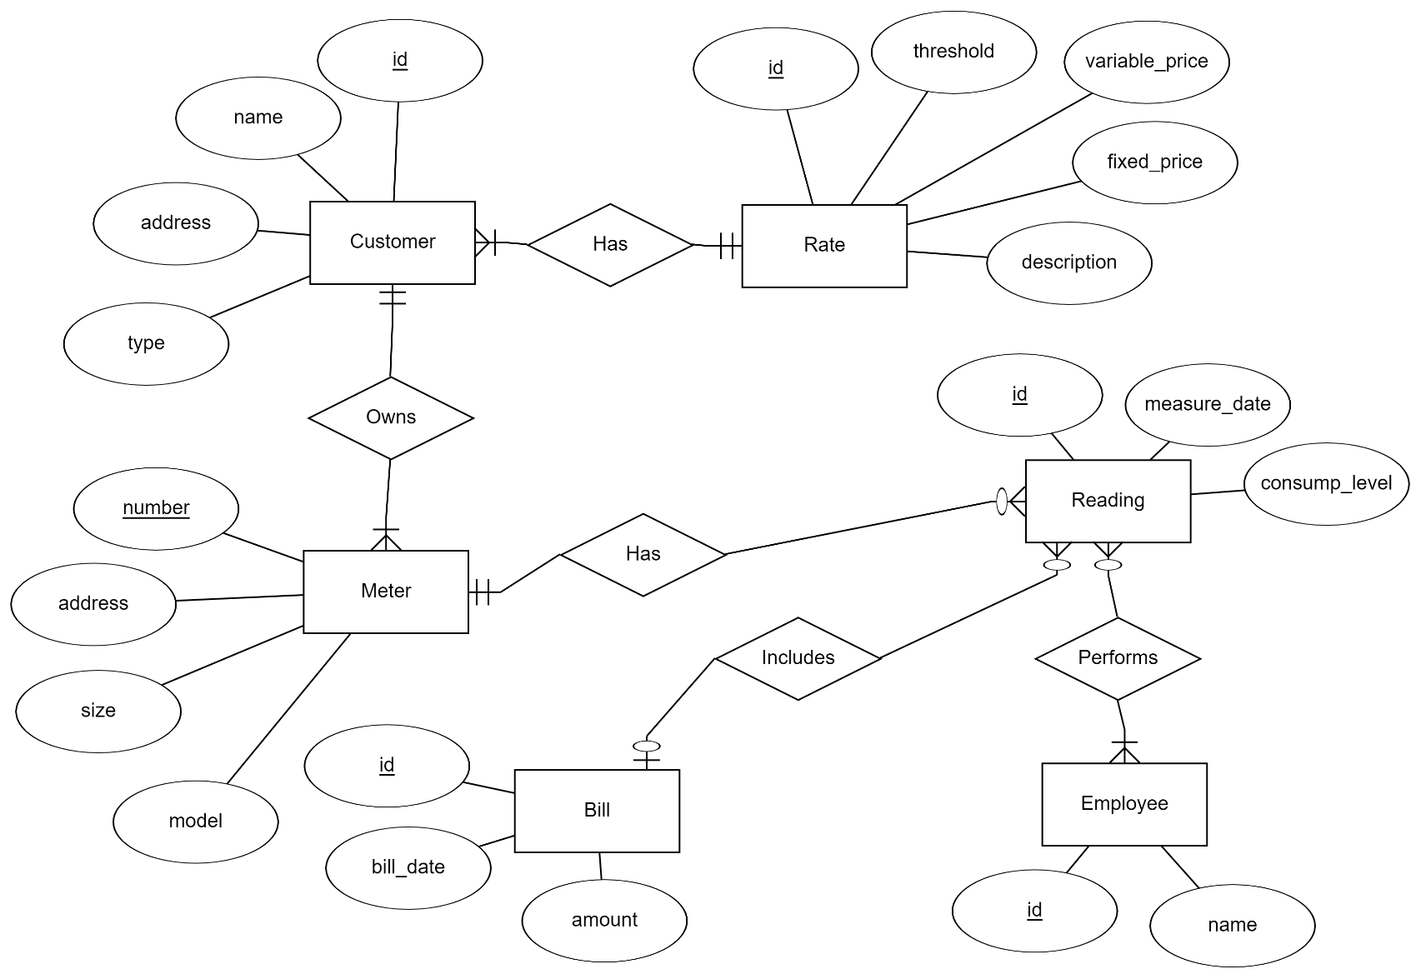
Step 4: Example
Lets assume that a reading can be done by many employees

Slide 27
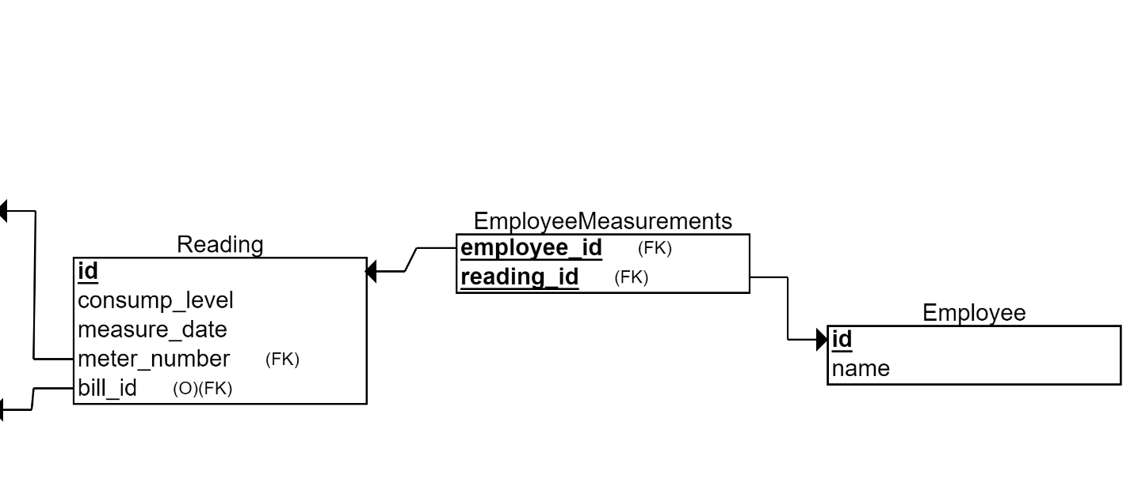
Step 4: Example
Lets assume that a reading can be done by many employees
The many-to-many relationship becomes a bridge table
Reading Id | Employee Id
Reading Id | Measure_Date | …
Bridge Table
Employee Id | Name | …

Slide 28
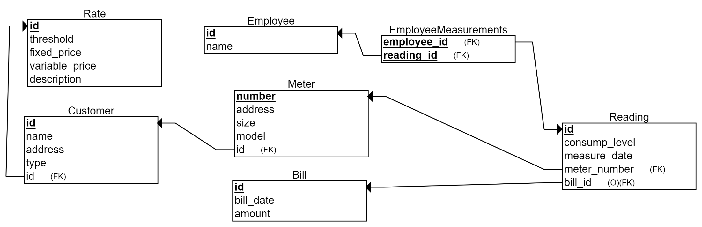
Relational Schema

Slide 29
Final Results
Meter (meter_id, address, size, model, cust_id)
Customer (cust_id, name, address, type, rate_id)
Rate (rate_id, description, fixed_amount, variable_amount, consumption_threshold)
Reading (reading_id, timestamp,consumption, meter_id, bill_id)
Employee_Measurements (reading_id, employee_id)
Employee (employee_id, name)
Bills (bill_id, cust_id, bill_date, amount)

Slide 30
Summary of ER modeling
ER model is popular for conceptual design
Constructs are expressive, intuitive and graphical.
Basic constructs: entity types, relationships (cardinalities), and attributes
ER modeling is subjective!
There are often many ways to model a given scenario!
Analyzing alternatives is key
ER modeling is iterative!
Resulting diagram should be analyzed and refined further.

Slide 31
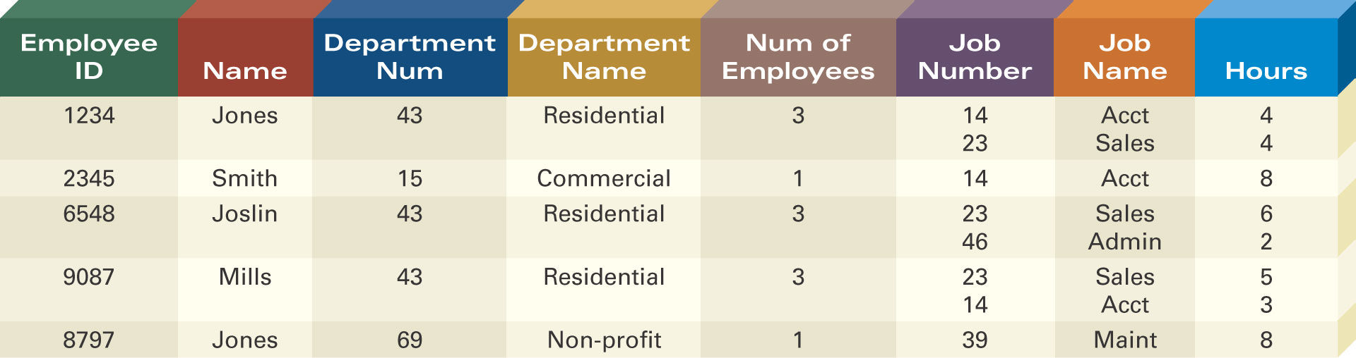
Defining Entity Classes and Primary Keys
What are the entity classes and primary keys for the report below?
What entities/tables should we create?
Are there fields that are redundant once you create the tables?

Slide 32
In-class exercise: (if we have time) Create the following ERDs and tables
NoFuture Records has decided to store information about musicians who perform on its albums (as well as other company data) in a database.
Each musician that records at NoFuture has an SSN, a name, an address, and a phone number. Poorly paid musicians often share the same address, and no address has more than one phone.
Each instrument used in songs recorded at NoFuture has a unique identification number, a name (e.g., guitar, synthesizer, ﬂute) and a musical key (e.g., C, B-ﬂat, E-ﬂat).
Each album recorded on the NoFuture label has a unique identification number, a title, a copyright date, a format, and an album identifier.
Each song recorded at NoFuture has a title and an author.
Each musician may play several instruments, and a given instrument may be played by several musicians.
Each album has a number of songs on it, but no song may appear on more than one album.
Each song is performed by one or more musicians, and a musician may perform a number of songs.
Each album has exactly one musician who acts as its producer. A musician may produce several albums.

