Slide 1
Window Queries

Slide 2
Aggregation vs window functions
In aggregation functions, have as input a group of rows, and we get back one value per group (e.g., count rows in group, avg value of an attribute, etc)
With window functions, we calculate functions over a group of rows (we call this a “window”), but we return a value for each row that belongs to the window.

Slide 3
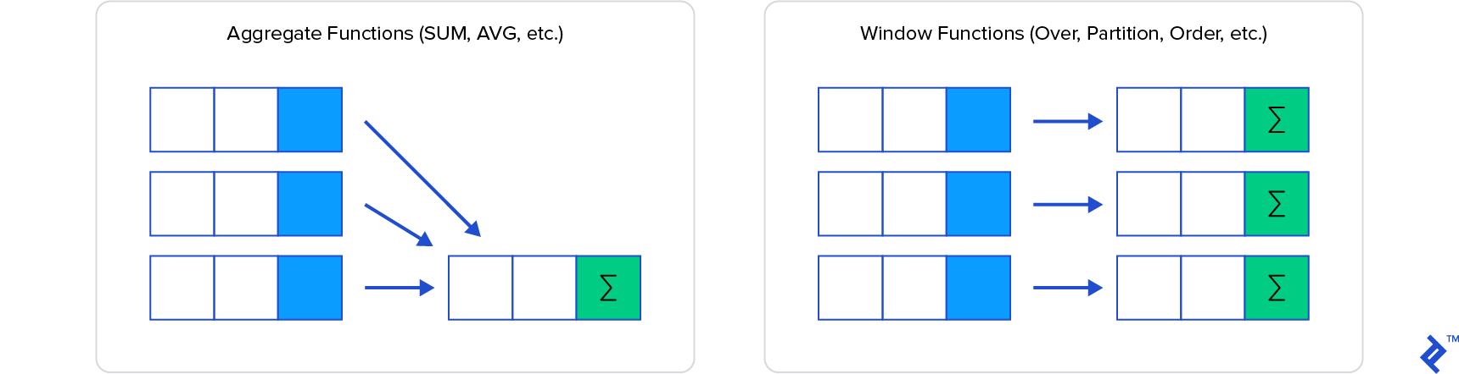
Aggregation vs window functions
In groupby-aggregation functions, have as input a group of rows, and we get back one value per group (e.g., count rows in group, avg value of an attribute, etc)
With window functions, we calculate functions over a group of rows (we call this a “window”), but we return a value for each row that belongs to the window.

Slide 4
Window Functions
Ranking
RANK()
ROW_NUMBER()
DENSE_RANK()
PERCENT_RANK()
NTILE(n)
Value
LAG()
LEAD()
FIRST_VALUE()
LAST_VALUE()
NTH_VALUE()
Aggregate
AVG()
SUM()
COUNT()
MIN()
MAX()
STDDEV()

Slide 5
Simple Example: RANK()
Setup: Create a (temporary) table with the most popular music on Facebook:
CREATE TEMPORARY TABLE popular_music AS
SELECT Music AS music, COUNT(ProfileID) AS cnt
FROM FavoriteMusic
GROUP BY Music
ORDER BY cnt DESC;

Slide 6
Simple Example: RANK()
Using the popular_music table, we want to calculate the rank of each music:
The rank of each music: 1 to the most popular, 2 to next most popular, etc.
SELECT music, cnt,
RANK() OVER (ORDER BY cnt DESC) AS music_rank FROM popular_music;
RANK(): the function applied to each row in the window
OVER (ORDER BY cnt DESC): the window (in this case, the whole table, ordered by descending counts)

Slide 7
The various ranking functions
The difference between RANK(), ROW_NUMBER(), and DENSE_RANK() is mainly how they handle ties:
ROW_NUMBER(): No ties
RANK(): Ties get the same rank, gaps in numbers after a tie
DENSE_RANK(): Ties get the same rank, no gap in rank after a tie
NTILE(n): Create n ranked buckets and assign each value to a bucket
PERCENT_RANK(): Percentile score, a normalized value from 0 to 1, with 0 to the highest ranked element, 1 to the lowest rank.
Run the following query and scroll down to see the differences
SELECT music, cnt
, RANK() OVER (ORDER BY cnt DESC) AS music_rank
, DENSE_RANK() OVER (ORDER BY cnt DESC) AS music_dense_rank
, ROW_NUMBER() OVER (ORDER BY cnt DESC) AS music_row_number
, NTILE(20) OVER (ORDER BY cnt DESC) AS music_row_20_buckets
, NTILE(100) OVER (ORDER BY cnt DESC) AS music_row_100_buckets
, PERCENT_RANK() OVER (ORDER BY cnt DESC) AS music_row_percentile
FROM popular_music;

Slide 8
WINDOW clause: Named Windows
Sometimes, we may want to define a window once and use it multiple tines.
To do this, we use a WINDOW clause.
The WINDOW clause falls between the positions of the HAVING and ORDER BY clauses.
Consider this query, which defines the same window multiple times:
SELECT music, cnt
, RANK() OVER w AS music_rank
, DENSE_RANK() OVER w AS music_dense_rank
, ROW_NUMBER() OVER w AS music_row_number
, NTILE(20) OVER w AS music_row_20_buckets
, NTILE(100) OVER w AS music_row_100_buckets
, PERCENT_RANK() OVER w2 AS music_row_percentile
FROM popular_music
WINDOW w AS (ORDER BY cnt DESC)
, w2 AS (ORDER BY cnt)

Slide 9
Partitioning Example: RANK()
Create a (temporary) table with the most popular music on Facebook:
CREATE TEMPORARY TABLE popular_music_and_gender AS
SELECT M.Music, P.Sex, COUNT(P.ProfileID) AS cnt
FROM FavoriteMusic M JOIN Profiles P ON P.ProfileID = M.ProfileID
WHERE P.Sex IS NOT NULL
GROUP BY M.Music, P.Sex
ORDER BY cnt DESC;
SELECT Music, Sex,
RANK()
OVER (PARTITION BY Sex ORDER BY cnt DESC) AS music_rank
FROM popular_music_and_gender;
RANK(): the function applied to each row in the window
OVER (PARTITION BY Sex ORDER BY cnt DESC): the window (in this case, music counts grouped by “Sex”, ordered by descending counts)

Slide 10
Defining windows for aggregate
SELECT *,
AVG(fare_per_mile) OVER () AS overall_avg,
AVG(fare_per_mile) OVER (PARTITION BY origin) AS origin_avg,
AVG(fare_per_mile) OVER (PARTITION BY dest) AS dest_avg,
AVG(fare_per_mile) OVER (PARTITION BY carrier) AS carrier_avg
FROM flights.m_ticket_prices;
AVG(fare_per_mile): the function calculated OVER (): the window (in this case, the avg fare over all entries)
OVER (PARTITION BY origin): calculate average fare across all flights leaving from the origin airport
OVER (PARTITION BY dest): calculate average fare across all flights arriving to the dest airport
OVER (PARTITION BY carrier): calculate average fare across all flights of the carrier in general
Question: How can we add the average for the origin-dest pair?

Slide 11
Frame Specification
The frame clause, if given, has this syntax:
frame_clause:
{ROWS | RANGE} [BETWEEN] frame_start [AND frame_end]
ROWS: The frame is defined by beginning and ending row positions. Offsets are differences in row numbers from the current row number.
RANGE: The frame is defined by rows within a value range. Offsets are differences in row values from the current row value.
frame_start, frame_end: { CURRENT ROW | UNBOUNDED PRECEDING | UNBOUNDED FOLLOWING | expr PRECEDING | expr FOLLOWING }
Default:
With ORDER BY: RANGE BETWEEN UNBOUNDED PRECEDING AND CURRENT ROW
Without ORDER BY: RANGE BETWEEN UNBOUNDED PRECEDING AND UNBOUNDED FOLLOWING
https://dev.mysql.com/doc/refman/8.0/en/window-functions-frames.html

Slide 12
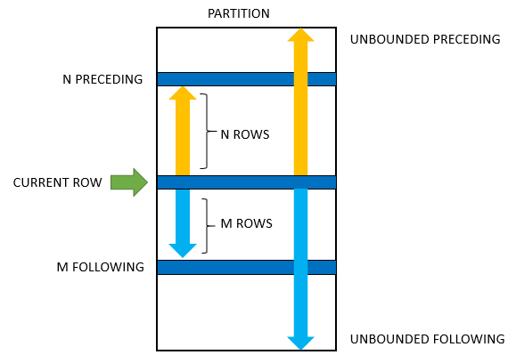
Frame Specification
Window
https://www.sqltutorial.org/sql-window-functions/

