Slide 1
Introduction to SQL

Slide 2

Intro
“S.Q.L.” or “sequel”
Supported by all major commercial DBMS
Standardized
Interactive via GUI or command line, or embedded in programs (e.g., in Python programs)
Declarative
Notes:
When sequel is used, you can use it through GUIs in databases or through programs, for example python programs that directly interact with the database.
SQL is declerative, in the sense that you just declare what you need , and no how to get it.

Slide 3
Terminology
Data Definition Language (DDL)
Create Table
Drop Table
Indexes
Data Manipulation language (DML)
Select
Insert
Delete
Update
Other Commands
constraints, views, triggers etc.

Slide 4
Navigating a DB

Slide 5
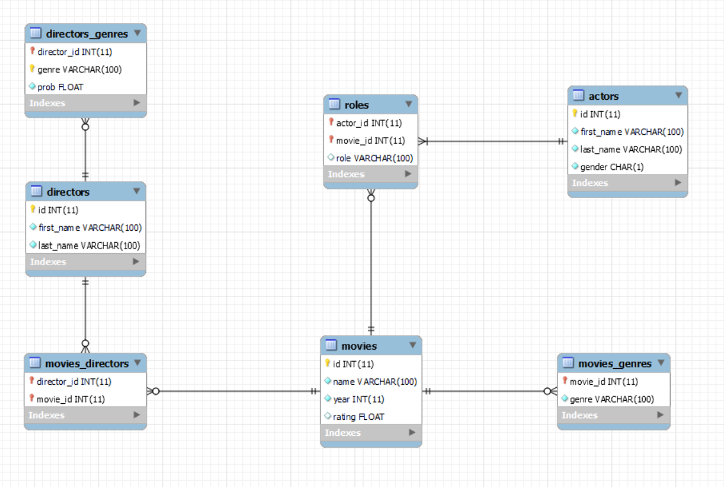
Example 1: IMDB

Slide 6
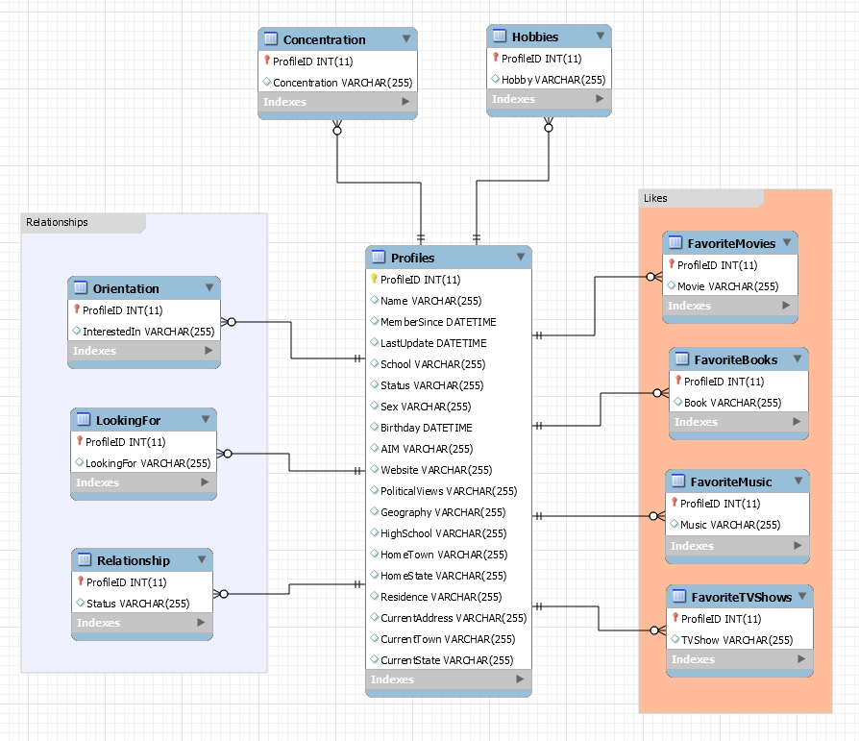
Example 2: Facebook

Slide 7
Navigating a database in MySQL
SHOW DATABASES;
Lists the available databases in MySQL
USE <database>;
Chooses which database to work with
Example: USE imdb;
SHOW TABLES;
Lists the tables in the database
DESCRIBE <table>;
Lists the attributes and data types for a table

