Slide 1
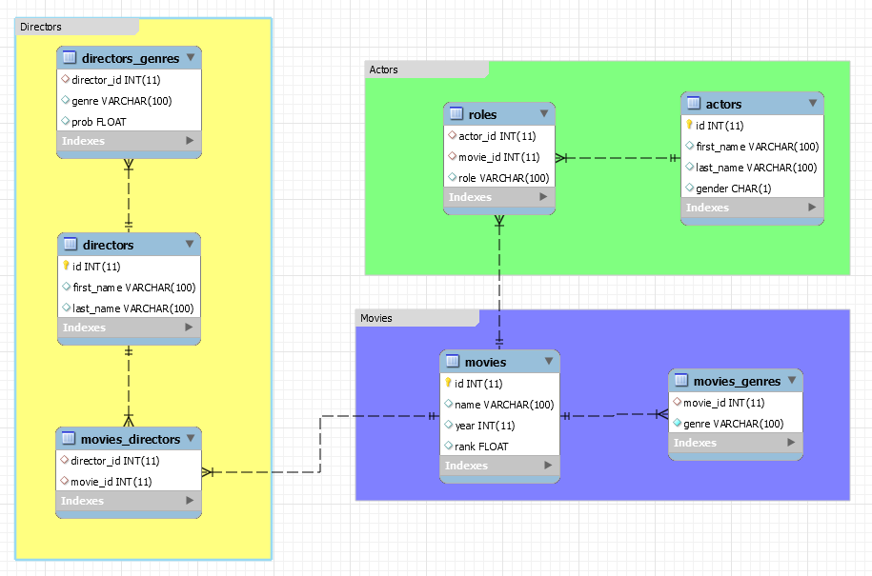
Schema for IMDB database

Slide 2
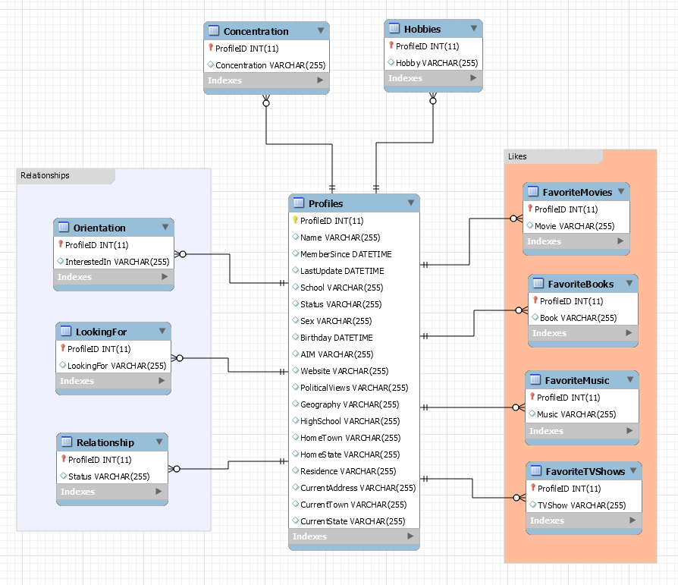
Schema for Facebook database

Slide 3
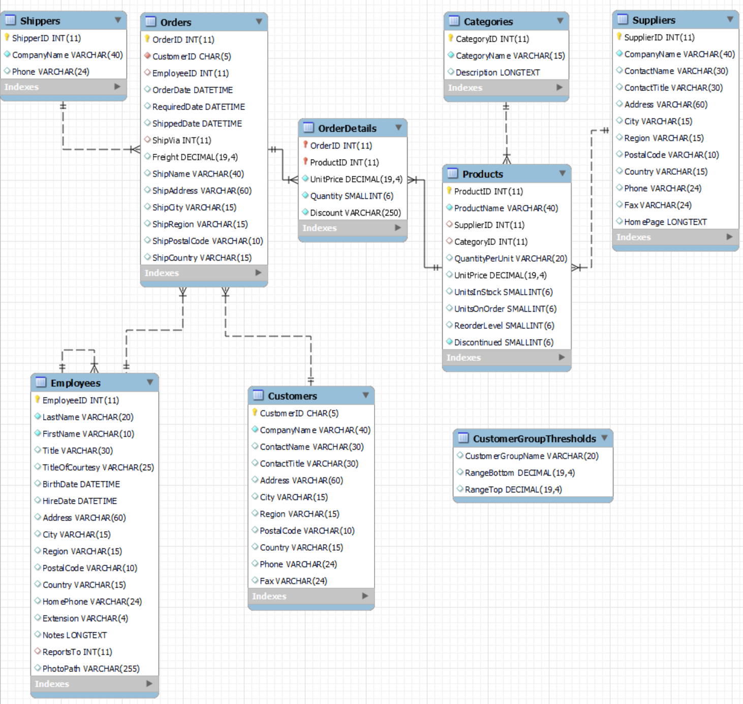
Schema for Northwind database

