Slide 1
Creating Tables in SQL

Slide 2
SQL Statements to create tables
CREATE TABLE table_name
(
column_name1 data_type(size),
column_name2 data_type(size),
column_name3 data_type(size),
....
);

Slide 3
SQL Statements to create tables
CREATE TABLE Rate ( id INT, name VARCHAR(20), price FLOAT, startdate DATE );

Slide 4
Define primary key
CREATE TABLE Rate ( id INT, name VARCHAR(20), price FLOAT, startdate DATE,
PRIMARY KEY(id)
);

Slide 5
Define FOREIGN KEY
CREATE TABLE Rate ( id INT,
customerid INT, price FLOAT, startdate DATE,
PRIMARY KEY(id)
FOREIGN KEY (customerid) REFERENCES Customer(id) );

Slide 6
“Enforcing participation” in a relationship
To specify that a relationship has a minimum cardinality of one, we specify that the attribute cannot be NULL (ie empty)
In this case, the rate needs to be associated with a customer
CREATE TABLE Rate ( id INT,
customerid INT NOT NULL, price FLOAT, startdate DATE,
PRIMARY KEY(id),
FOREIGN KEY (customerid) REFERENCES Customer(id) );

Slide 7
“Enforcing 1-1” in a relationship
To specify that a relationship has a maximum cardinality of one, we specify that the foreign key is UNIQUE
In this case, the rate needs to be associated with a customer, and a customer can be assigned with only one rate (due to the UNIQUE)
CREATE TABLE Rate ( id INT,
customerid INT NOT NULL, price FLOAT, startdate DATE,
PRIMARY KEY(id),
UNIQUE (customerid),
FOREIGN KEY (customerid) REFERENCES Customer(id) );

Slide 8

Facilitating the process in practice
ERD Plus (and other modeling tools) automate many of these steps for you:
Create the ER diagram
From the main menu, select the diagram, and “Convert to Relational Schema”
If you have problems, check that all relationships are fully specified in cardinalities, that all entities have attributes and primary keys
Check the relational schema and ensure that everything looks good. Pay special attention to the foreign keys and their names.
From the main menu select the schema and “Convert to SQL”
Often, you need to fine-tune the output based on what we learned

Slide 9
Importing Data into Tables
Option 1: INSERT statements
INSERT INTO Rate VALUES (1023, ‘Winter Promotion’, 2.25, 2020-01-15), (1054, ‘Regular Rate’, 3.25, 2015-01-15), (1076, ‘Senior Discount’, 1.95, 2015-01-15)

Slide 10
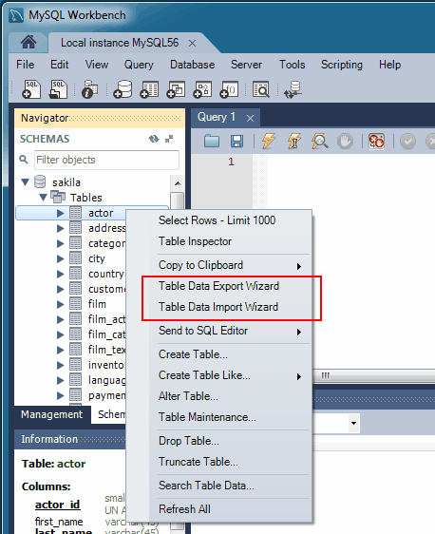
Importing Data into Tables
Option 1: INSERT statements
INSERT INTO Rate VALUES (1023, ‘Winter Promotion’, 2.25, ‘2020-01-15’), (1054, ‘Regular Rate’, 3.25, ‘2015-01-15’), (1076, ‘Senior Discount’, 1.95, ‘2015-01-15’)
Option 2: MySQL Workbench Data Import Wizard
https://dev.mysql.com/doc/workbench/en/wb-admin-export-import-table.html

