Slide 1
Predict Reservations Resulting from Amount Spent on Paid Search
Anneil Basnandan

Slide 2
Background
“Paid Search” is the advertising fee that a website owner pays to have their listing on top of the search results
Question: How many conversions (i.e., reservations) can be expected in a given month based on the amount spent on paid search?
Factors such as paid search cost, number of clicks, occupancy and average web price were investigated to see which one influenced the number of reservations
Amount Spent on Paid Search (“Cost”) correlated the most with the Number of Reservations (“Reservations”)

Slide 3
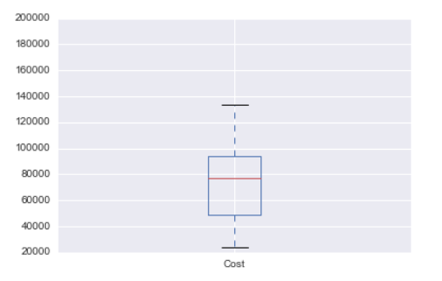
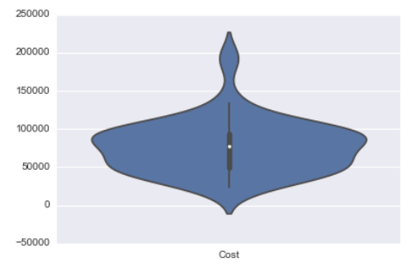
“Cost” Variable

Slide 4
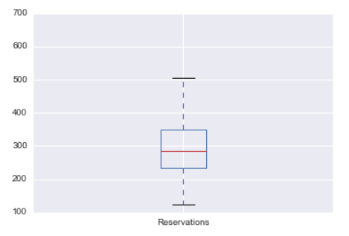
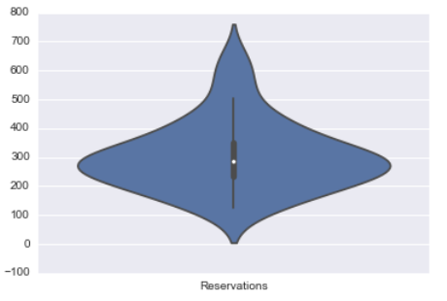
“Reservations” Variable

Slide 5
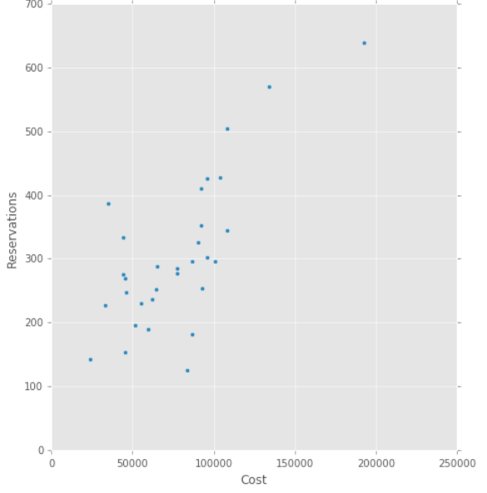
Number of Reservations vs Cost

Slide 6
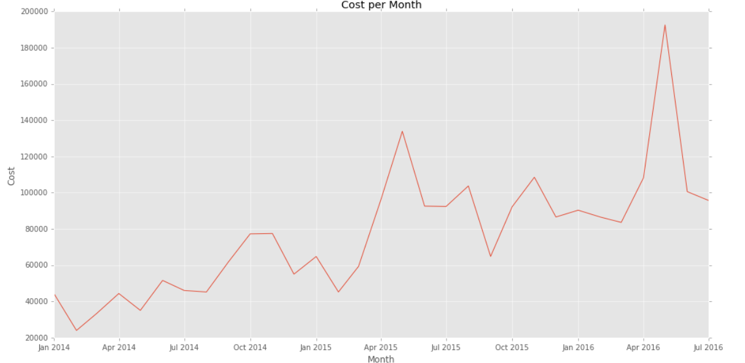
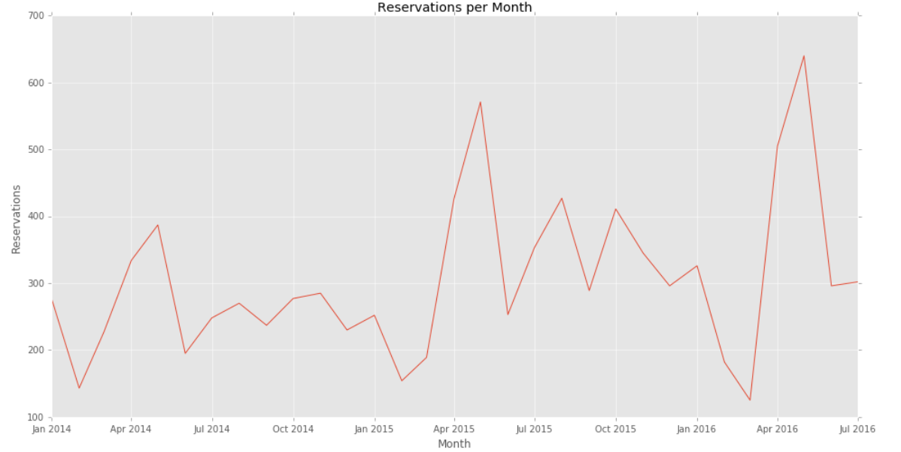
Amount Spent on Paid Search over Time
Number of Reservations over Time

Slide 7
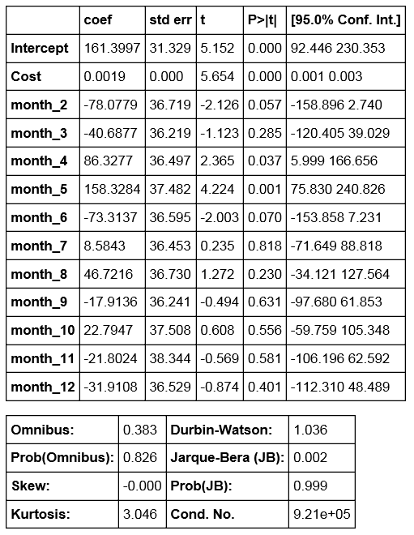
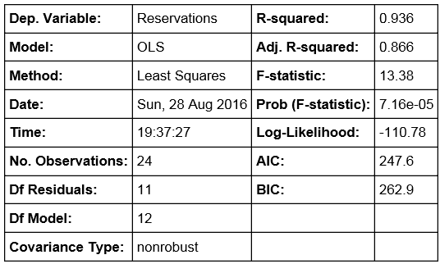
Linear Regression Results

Slide 8
Predictions
Month | Amount | Month Influence Factor | Reservation Estimate
1 | $90,313.80 | 0 | 333
2 | $86,506.91 | -78.0779 | 248
3 | $83,566.48 | -40.6877 | 279
4 | $108,179.62 | 86.3277 | 453
5 | $192,555.50 | 158.3284 | 686
6 | $100,552.75 | -73.3137 | 279
7 | $95,634.96 | 8.5843 | 352
8 | $83,370.86 | 46.7216 | 367
9 | $73,181.09 | -17.9136 | 283
10 | $85,532.33 | 22.7947 | 347
11 | $88,002.57 | -21.8024 | 307
12 | $71,019.62 | -31.9108 | 264
High positive month influence factors mean that the more money invested in paid search, the more reservations are made (i.e., April and May)
Large negative month influence factors mean that investing in paid search during these month will not give the return that we would expect (i.e., February and June)
Month 1’s Month Influence Factor is 0 because all of the month influence factors are relative to it

Slide 9
Comparing Model to Actuals

