Slide 1
Building a Mortality Predictor
AJ Strauman-Scott
Data 606 Final Project
May 9th, 2024

Slide 2

ABSTRACT
The paper investigates the impact of demographic and socioeconomic factors on mortality outcomes in the United States, utilizing the Public Use Microdata Sample of the National Longitudinal Mortality Study (NLMS) spanning from 1973 to 2011. By examining variables such as occupation, industry, income, education, race, and ethnicity, the research seeks to uncover the underlying relationships between socioeconomic status and identity demographics and mortality risk.

Slide 3

Overview
DATA
Single data set from Public Use Microdata Sample (PUMS) of National Longitudinal Mortality Study (NLMS) that tracks the 6 year mortality rates of 745162 individuals
DEPENDENT VARIABLES
Two outcome variables, for two models: death indicator binary variable, and numeric count of days survived after initial interview
INDEPENDENT VARIABLES
Seventeen possible independent variables, all relating to the demographics and circumstances of the individual
What demographic variables are significant predictors of an individual's death within the next six years?
If that individual does pass away, what variables are significant predictors of the length of days that person survives from the initial interview?

Slide 4
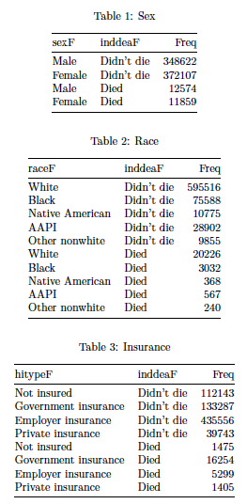
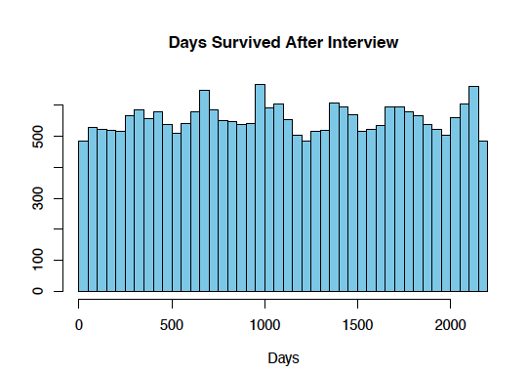
Summary Statistics

Slide 5
Methodology
Discover the independent demographic variables' relationship to each of the dependent variables, this analysis will construct two models:
a logistic regression model of the independent variables' relationship to the death indicator variable, using the full dataset, titled CHANCE OF DEATH model
a regression model of the independent variables' relationship to the count of days survived variable, using a subset of the data including only those who did die during the study period, titled DAYS LEFT model
Regression model dictated by variable’s residual distribution – uniform dependent variable presents challenges!

Slide 6
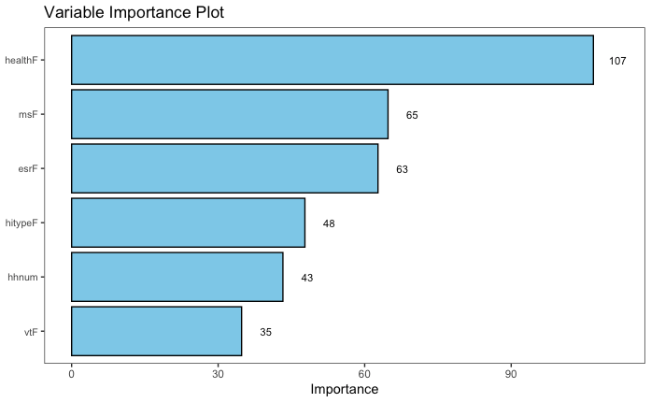
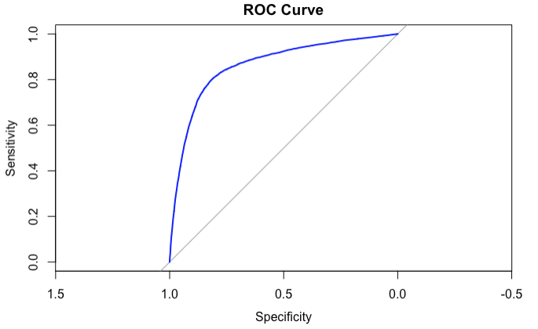
ChanCe of Death Model
With six independent variables, it's unsurprising the most influential variable is the only variable related to health in the dataset. Marital status and employment type (white collar or blue collar) are nearly identically influential. Health insurance type, number of people in your household and veteran status are the least influential.
A best-case ROC would look like a 90 degree angle. The ROC curve for the logistic model shows that the model balances specificity and sensitivity well

Slide 7

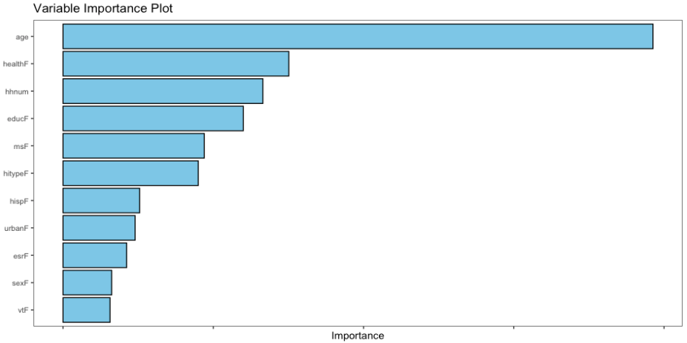
Days LEFT MODEL
Age is the most important variable in predicting how many days the individual will survive after the interview.
Quality of health, number of individuals in the household, and level of education are the next most influential.

Slide 8
Conclusion
Encountered challenges such as non-normal residuals distributions and a dependent variable with a uniform distribution
Fit both a logistic regression Chance of Death model and a randomForest regression Days Left model with moderate-high success
The non-normal residuals distributions and the uniform distribution of the dependent variable necessitate cautious interpretation of the results.
Further analysis can include training machine learning models on two unused datsets in the NLMS PUMS six year dataset that begins in 1990, and test them on a subset of the eleven year dataset (also begins in 1990), filtered to only include the deaths in the first six years of the eleven year study.

