Slide 1
Django Book
Chapter 10
Advanced Model
Anne Lai
Django Girls meetup
2015/10/8

Slide 2
Outline
Related Objects
Making Changes to a Database Schema
Manager
Model Methods
Executing Raw SQL Queries

Slide 3
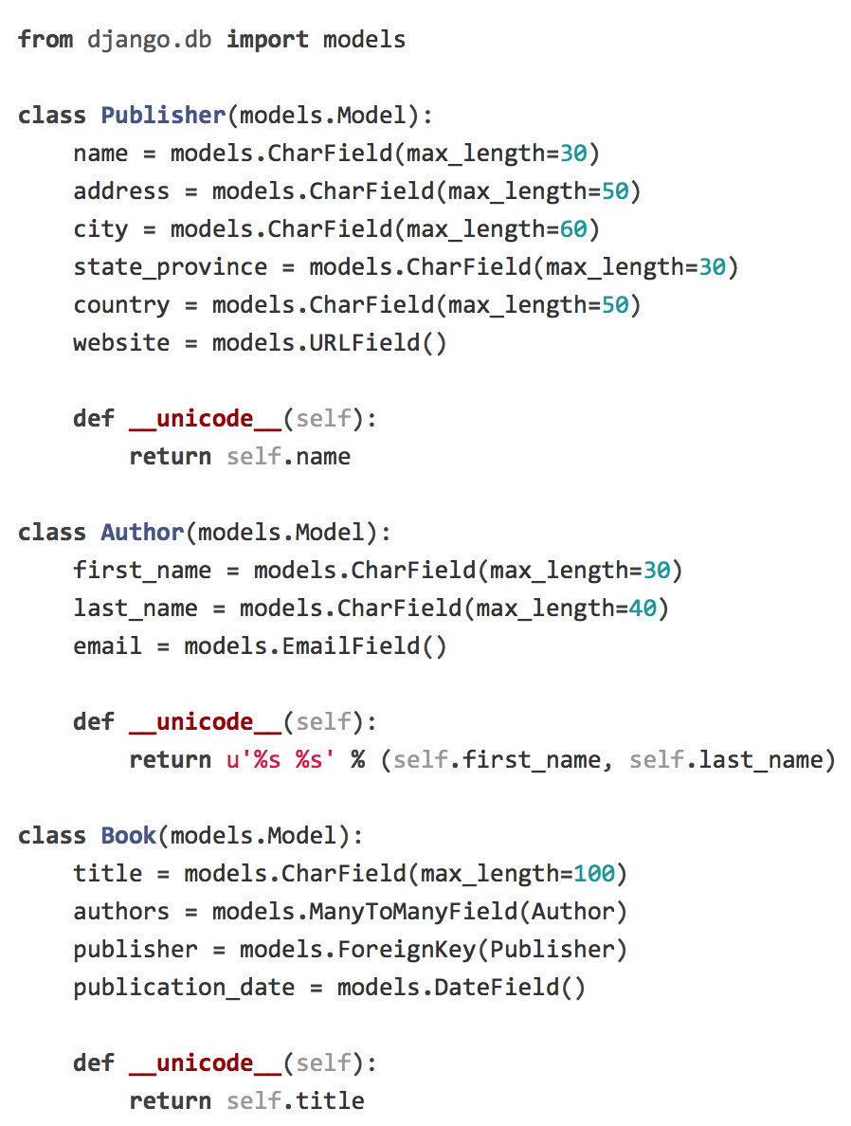
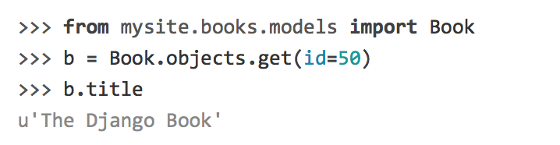
Recall of Chapter 5
Define models
Use the database API to create, retrieve, update and delete records

Slide 4
Related Objects

Slide 5
Related Objects
ForeignKey
ManyToManyField

Slide 6
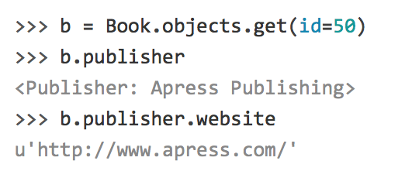
Related Objects

Slide 7
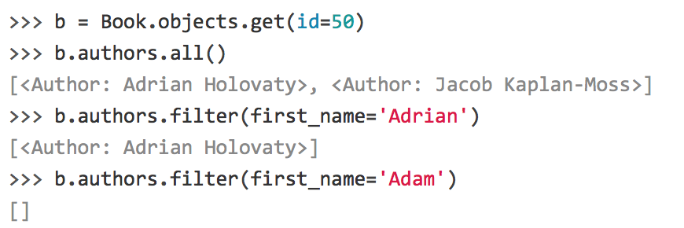
Related Objects
✐return QuerySet values instead of model instances

Slide 8

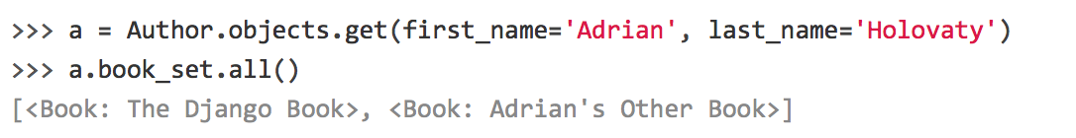
Related Objects
✐ book_set = lowercase(Book) + “_set”
QuerySet

Slide 9
Making Changes to a Database Schema

Slide 10
Making Changes to a Database Schema
syncdb
sync model to the database
merely creates tables that don’t yet exist in database
does not sync changes in models or perform deletions of models

Slide 11
Making Changes to a Database Schema
Adding Fields
Removing (normal/ Many-to-Many) Fields
Removing Models

Slide 12
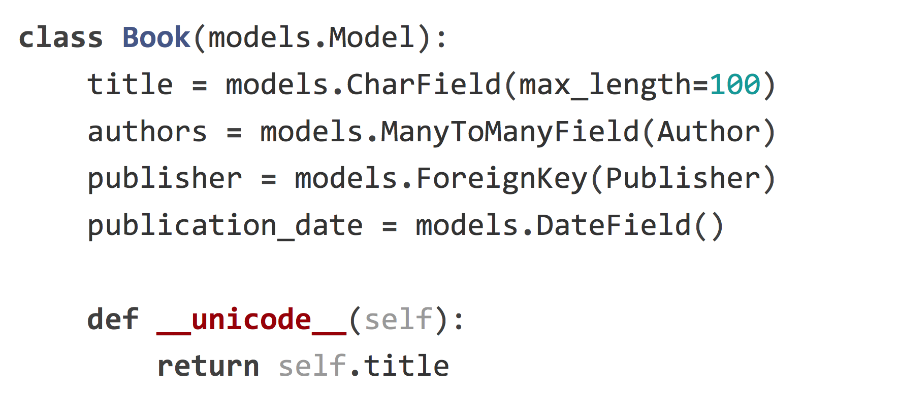
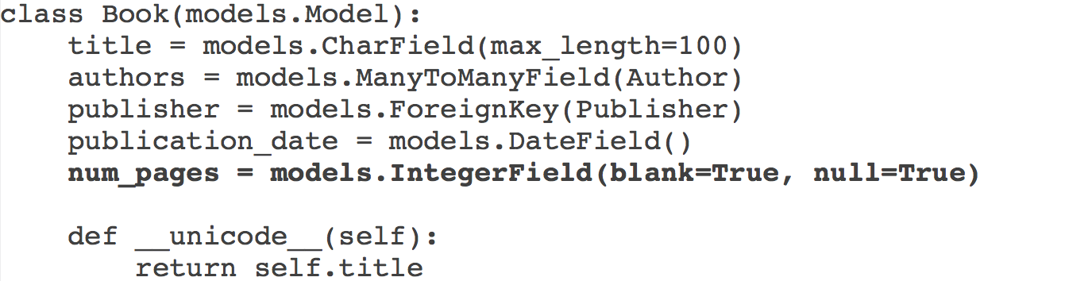
Adding Fields
Development Environment
Add the field to your model
✐a database column will contain NULL values when first created.

Slide 13
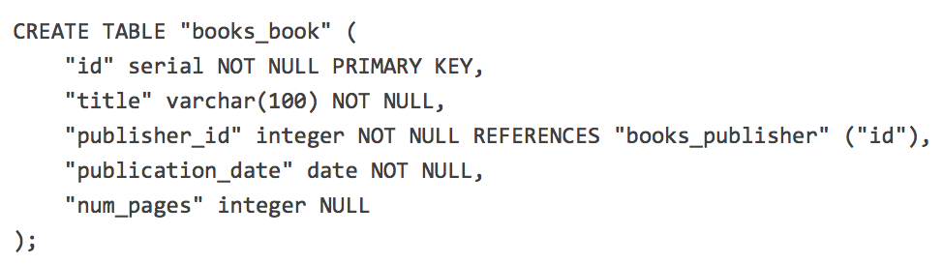
Adding Fields
Development Environment
Run manage.py sqlall [app] to see the new CREATE TABLE statement for the model
✐column definition for the new field

Slide 14
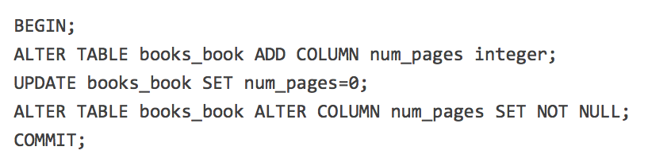
Adding Fields
Development Environment
Start database’s interactive shell
(e.g., psql or mysql, or you can use manage.py dbshell)
Execute an ALTER TABLE statement that adds your new column
NULL column
NOT NULL column

Slide 15

Adding Fields
Development Environment
Verify with Python interactive shell manage.py shell
✐ If a model contains a field that has not yet
been created in the database table, it will cause
an error happens at code execution time.

Slide 16
Adding Fields
Development Environment
Add the field to your model.
Run manage.py sqlall [app] to see the new CREATE TABLE statement for the model. Note the column definition for the new field.
Start database’s interactive shell (e.g., psql or mysql, or you can use manage.py dbshell). Execute an ALTER TABLE statement that adds your new column.
Verify with Python interactive shell manage.py shell by importing the model and selecting from the table (e.g., MyModel.objects.all()[:5]).

Slide 17
Adding Fields
Production Server
Start database’s interactive shell (e.g., psql or mysql, or you can use manage.py dbshell)
Execute the ALTER TABLE statement
Add the field to your model. If you’re using source-code revision control and you checked in your change in development environment step 1, now is the time to update the code (e.g., svn update, with Subversion) on the production server
Restart the Web server

Slide 18

Removing Fields
✐ Order sensitive
Normal Field
Remove the field from model and restart the Web server.
Remove the column from your database, using a command like this:
Many-to-Many Field
Remove the ManyToManyField from model and restart the Web server.
Remove the many-to-many table from your database,
using a command like this:

Slide 19

Removing Models
✐ Order sensitive
Remove the model from your models.py file and restart the Web server.
Remove the table from your database, using a command like this:

Slide 20
Manager

Slide 21
Manager
✐ Managers = database queries
Adding Extra Manager Methods
Modifying Initial Manager QuerySets
Multiple Managers

Slide 22
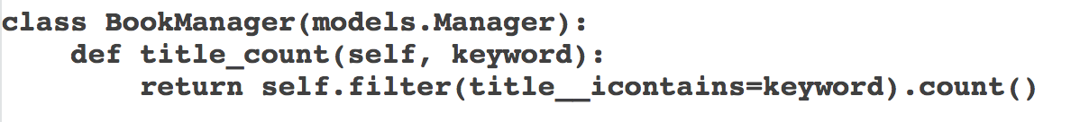
Adding Extra Manager Methods

Slide 23
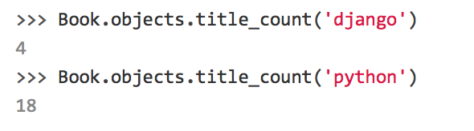
Adding Extra Manager Methods
✐ extends django.db.models.Manager
✐ manager itself (objects)
✐ replacing the “default” manager

Slide 24
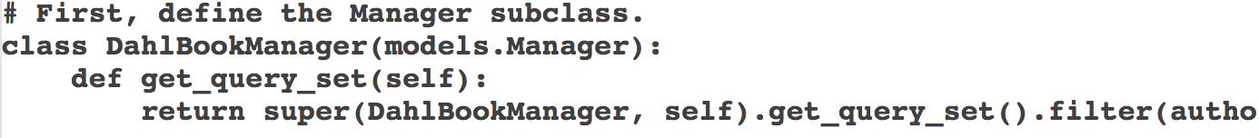

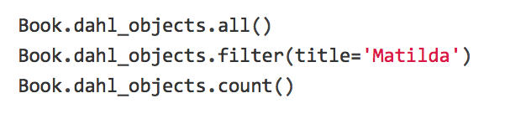
Modifying Initial Manager QuerySets
QuerySet

Slide 25
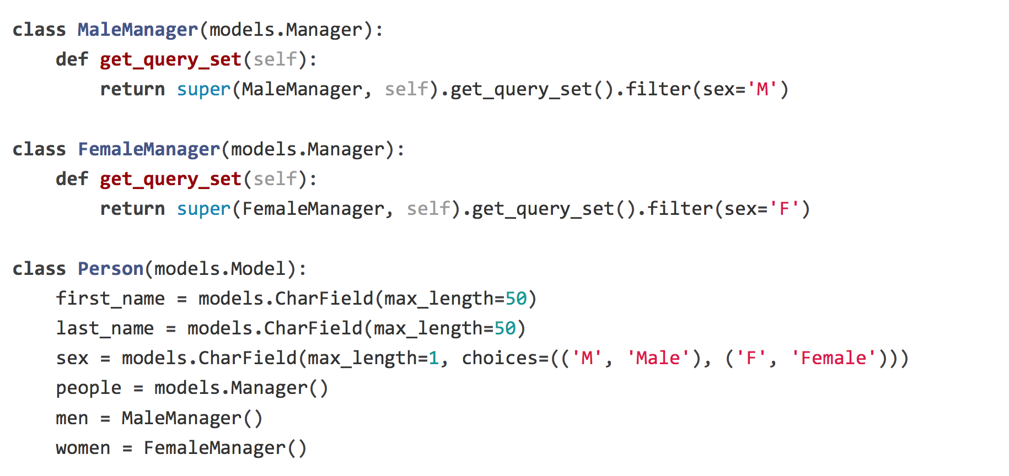
Multiple Managers
✐ Django interprets the first Manager
defined in a class as the “default” Manager

Slide 26
Model Methods

Slide 27
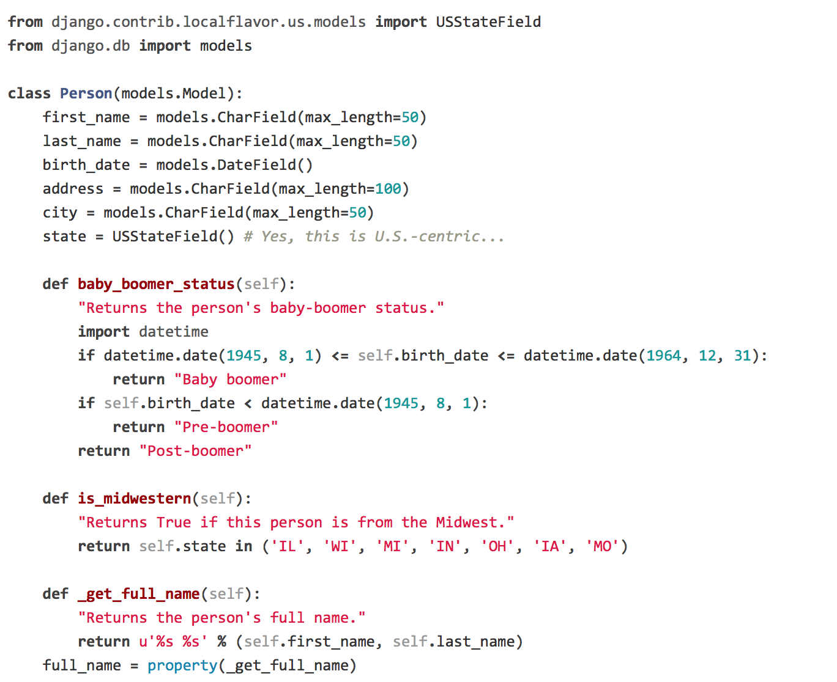
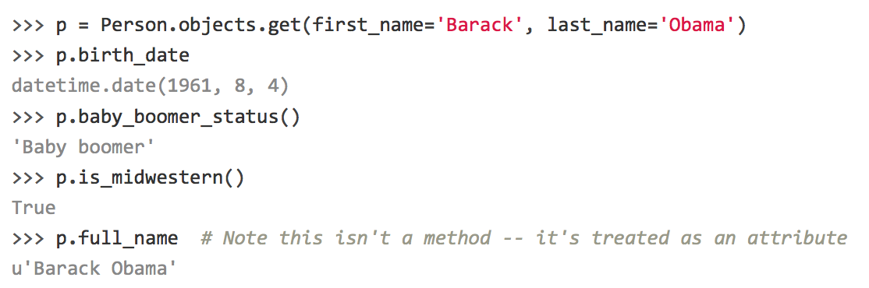
Model Methods
✐property(fget=None, fset=None, fdel=None, doc=None)
http://www.python.org/download/releases/2.2/descrintro/#property

Slide 28
Comparison
Model Method:
“row-level” functionality to objects
Act on a particular model instance
Managers:
“table-wide” or “table-level”

Slide 29
Executing Raw SQL Queries

Slide 30
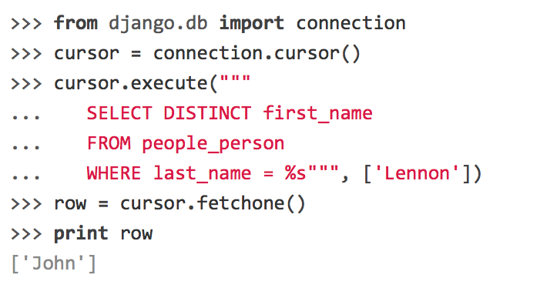
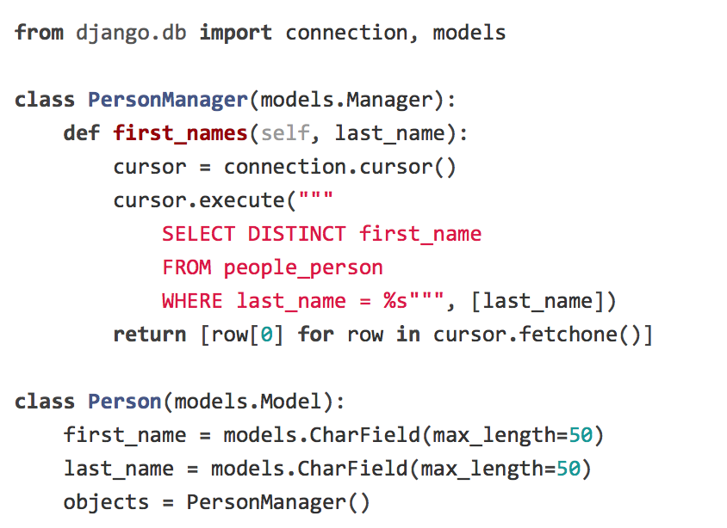
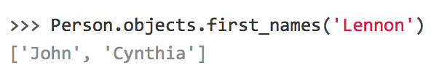
Executing Raw SQL Queries
✐ current db connection
✐use placeholders rather than adding parameters directly within the SQL
standard Python “DB-API”: https://www.python.org/dev/peps/pep-0249/

Slide 31
Thank you

