Slide 1







ArcGIS API for JavaScript: Clustering
Kristian Ekenes, Anne Fitz
https://arcg.is/mvPX8
2021 ESRI DEVELOPER SUMMIT

Slide 2
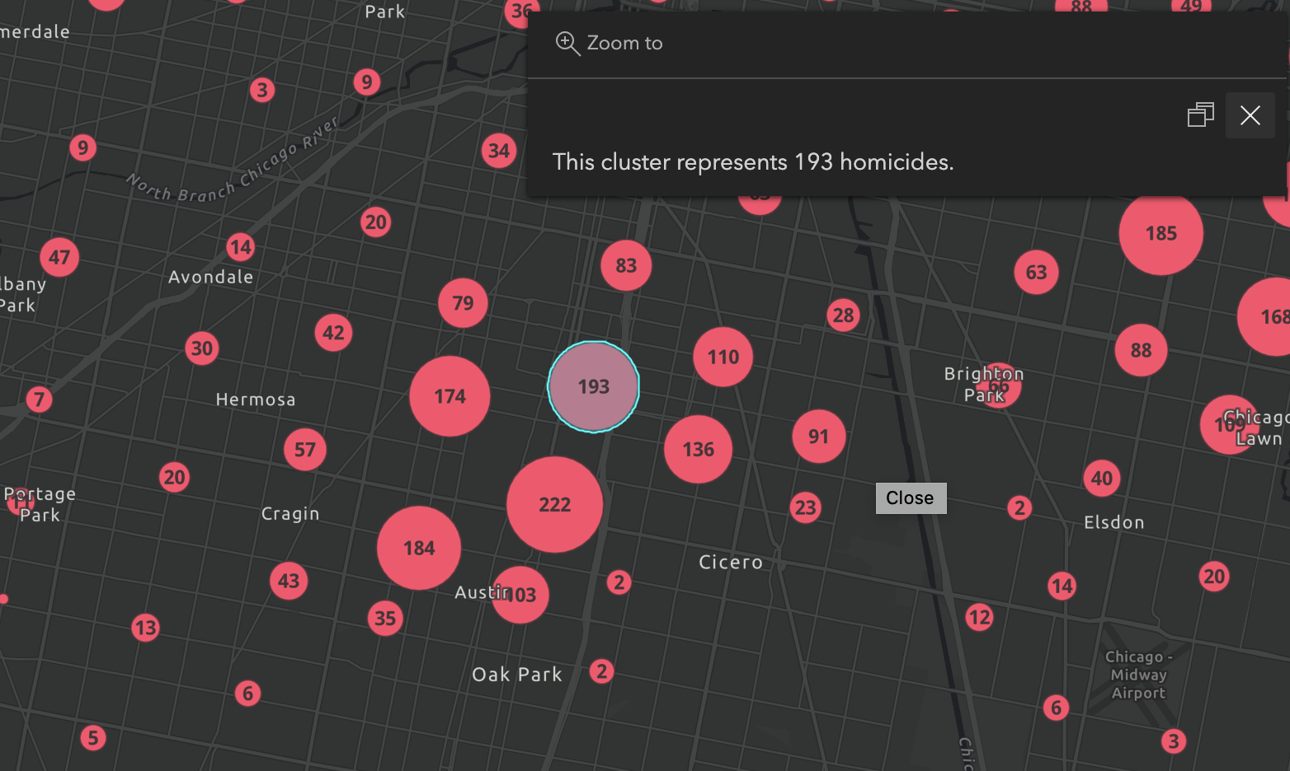
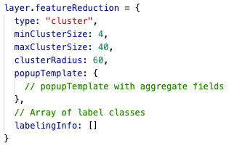


Basic configuration

Slide 3
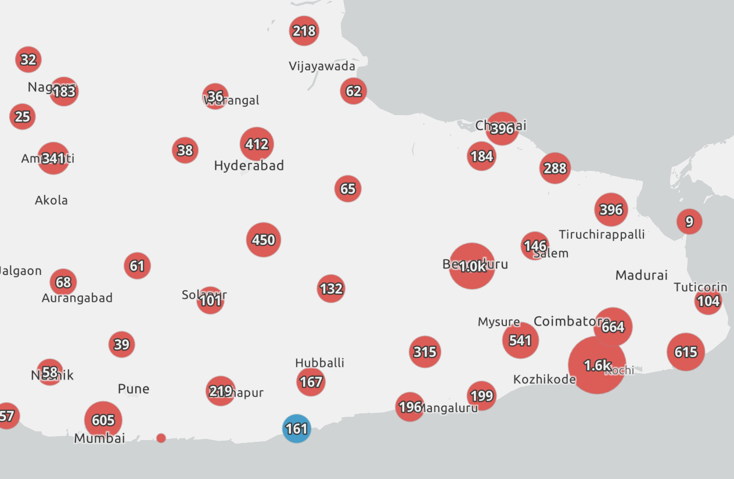
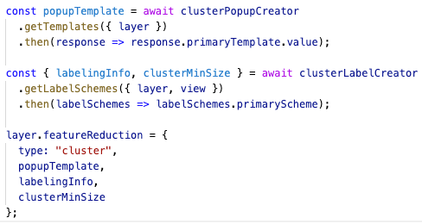
Generate suggested configuration

Slide 4
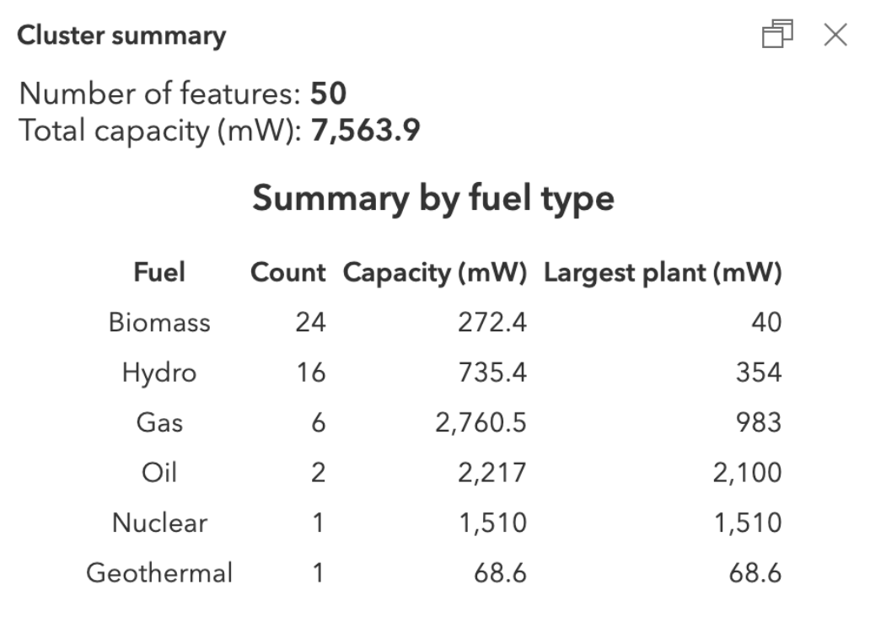
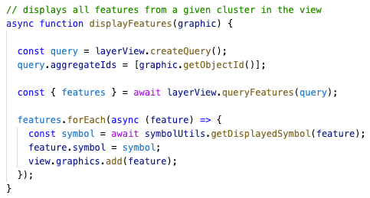
Query clusters

Slide 5








Please provide your feedback for this session by clicking on the session survey link directly below the video.

Slide 6

Copyright © 2021 Esri. All rights reserved.

