Slide 1

checkout
merge

Slide 2
git checkout branch1
master
branch1

Slide 3
git checkout –b branch1
master
branch1

Slide 4
git checkout ea6d5fd…
HEAD
HEAD
master
C1
C2
C3
C4
C5
ea6d5fd…
h5g8kk…
f4gtyg…
rfg6ht…
e5fdgtt…

Slide 5
master
branch1
git checkout –q branch1
message
git checkout --help
information about git checkout

Slide 6
merge

Slide 7
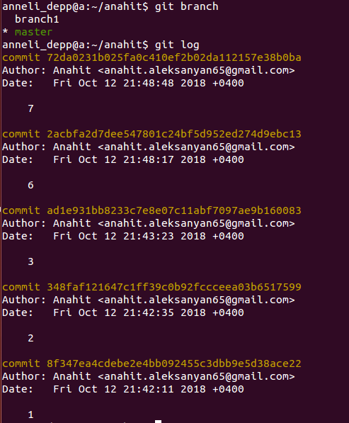
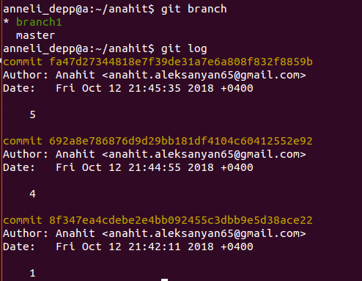
1
2
3
6
7
master
branch1
1
4
5

Slide 8
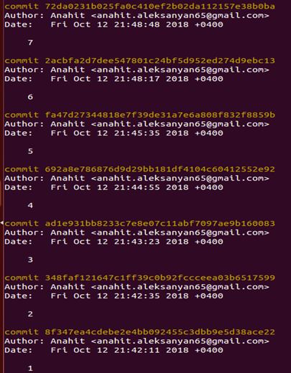
1
2
3
4
master
branch1
1
4
5
git merge branch1
5
6
7

Slide 9


file1
master
file1
branch1
file1
Hello
master
Hello world
file1
branch1

Slide 10
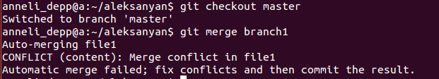
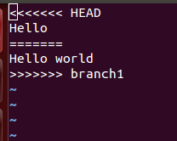

Slide 11





git merge --abort
master
branch1
master
branch1
CONFLICT
git merge
master
branch1
--abort
master
branch1

Slide 12
master
C1
C3
C3
C4
branch2
branch1
C1
C2
git merge branch1 branch2
master
C1
C2
C3
C4
C3
C4
branch2
branch1
C1
C2

Slide 13



