Slide 1
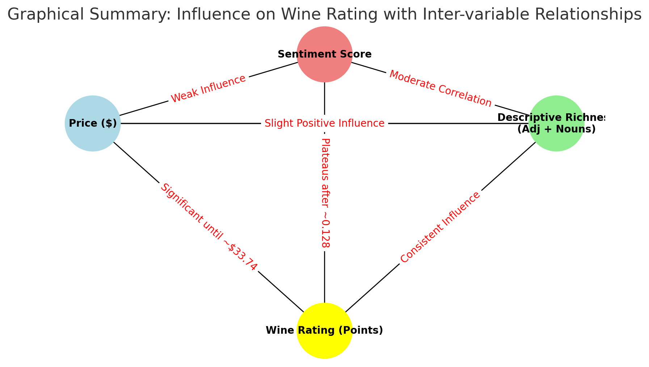

Slide 2





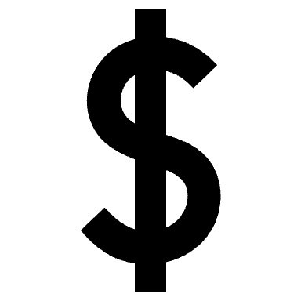
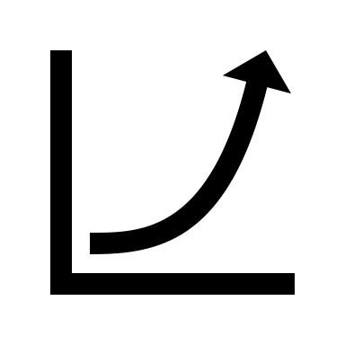


Price
Description richness
Description sentiment
>
>
Up to 33$
Up to +0.13
Wine Rating
Notes:
Plateau symbol

