Slide 1
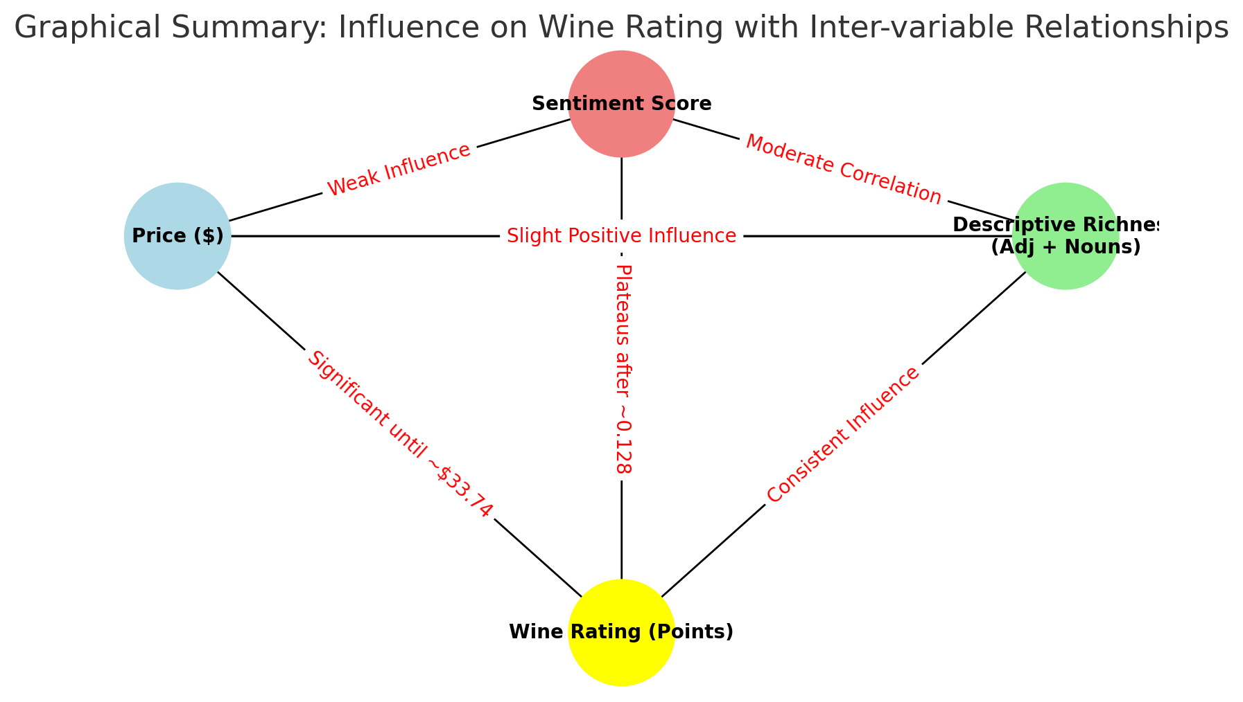

Slide 2









Price
Description richness
Description sentiment
>
>
Up to 33$
Up to +0.13
Wine Rating
Notes:
Plateau symbol

Slide 3
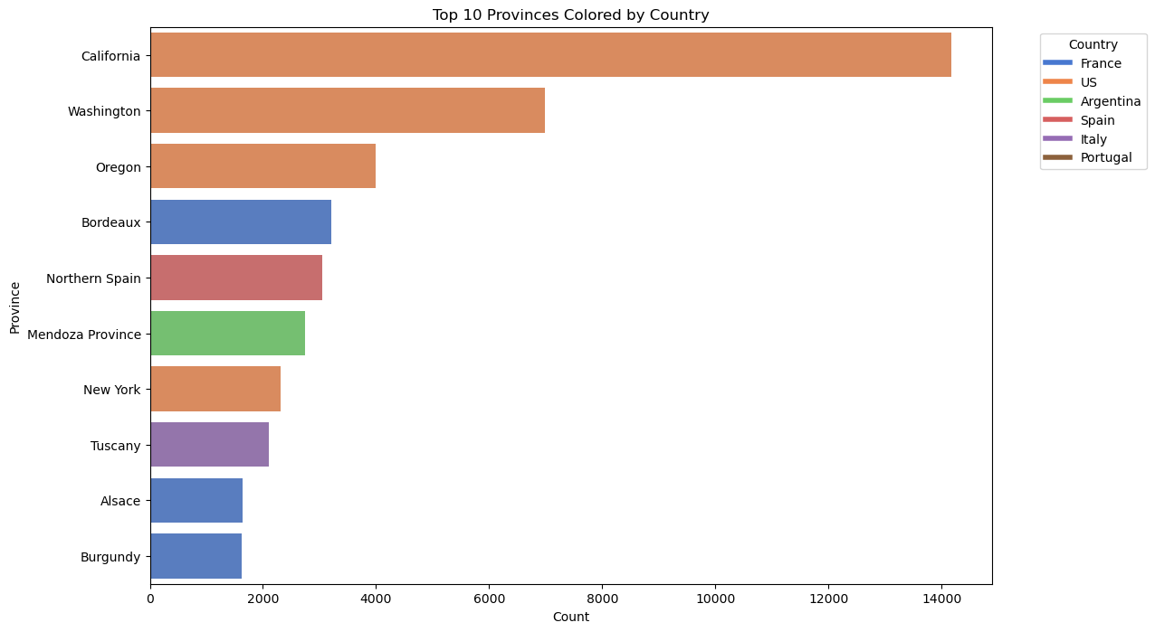
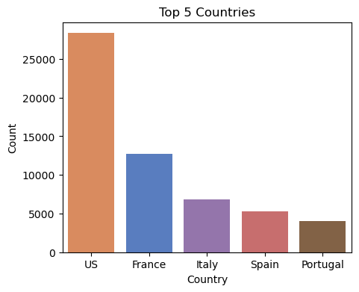

Slide 4
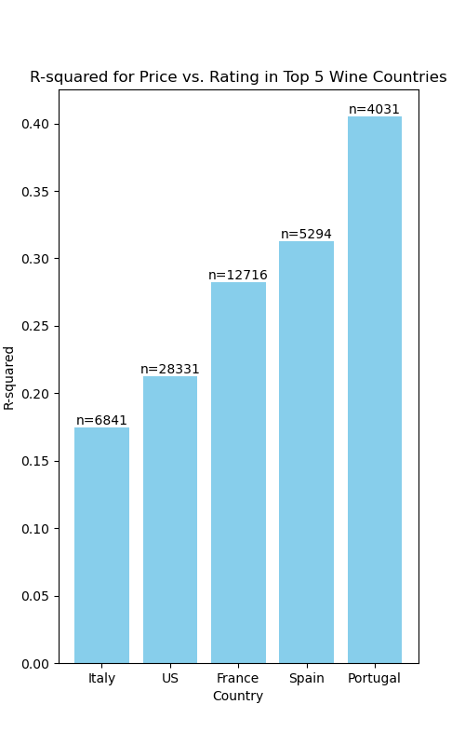
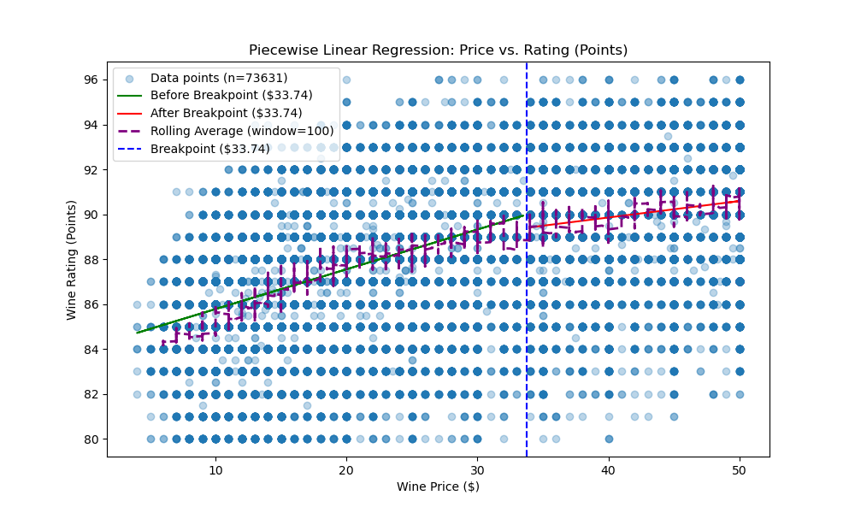
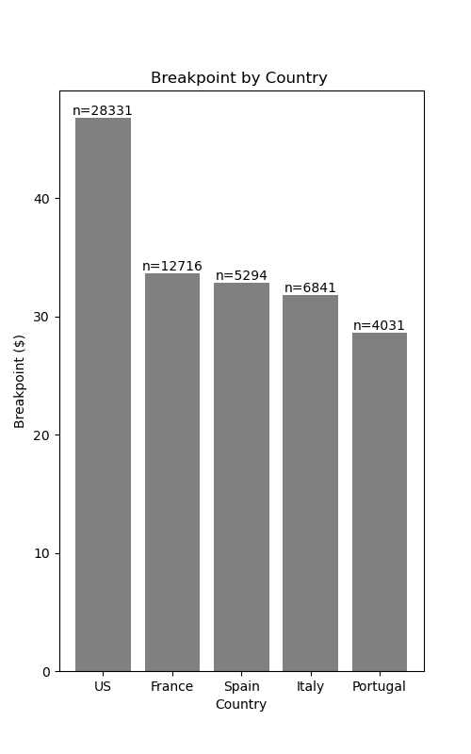
A
Wine Price-Rating link [R²]
B
Linear Regression: Wine Price vs. Rating
C
Wine Price-Rating breaking-point
🇵🇹
🇺🇸
v
v
🇪🇸
🇫🇷
🇫🇷
🇪🇸
🇮🇹
🇵🇹
🇺🇸
🇮🇹

