Slide 1


SDL
SMART DIGITAL LIBRARY
COMPETITION PITCH DECK
Accessible, Searchable, and Listenable Digital Learning Platform
Turning books into smart learning experiences for students, workers, institutions, and people with reading barriers.
Presented by Anne Louange Nishimwe
Project: SMART DIGITAL LIBRARY
Rwanda EdTech Innovation ? July 2026

Slide 2
OVERVIEW
Pitch Deck Agenda
01
Problem Statement
06
System Architecture
Why learners need smarter book access
How the platform works end-to-end
02
Current Gap
07
Core Features
Limits of traditional digital libraries
Search, upload, translate, listen, recommend
03
Proposed Solution
08
Technology
SMART DIGITAL LIBRARY and its value
AI, web, database, and speech services
04
Objectives
09
Impact & Next Steps
What the project aims to achieve
Funding use, growth, and future features
05
Methodology
How the platform is built and improved
SMART DIGITAL LIBRARY
Agenda
02

Slide 3
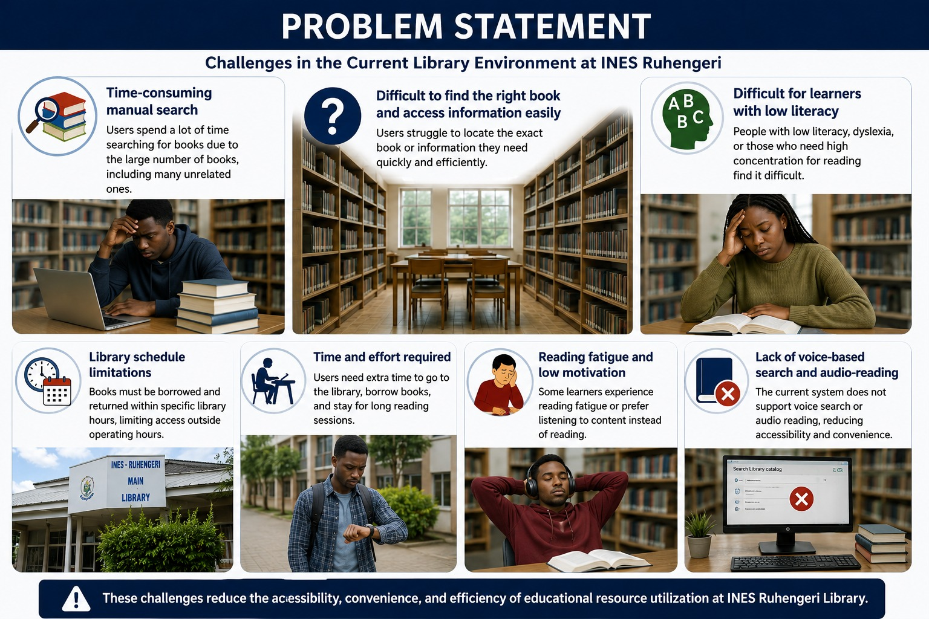
Search. Read. Listen. Learn.
A smart digital library for inclusive education in Rwanda and beyond.
SMART DIGITAL LIBRARY
03

Slide 4
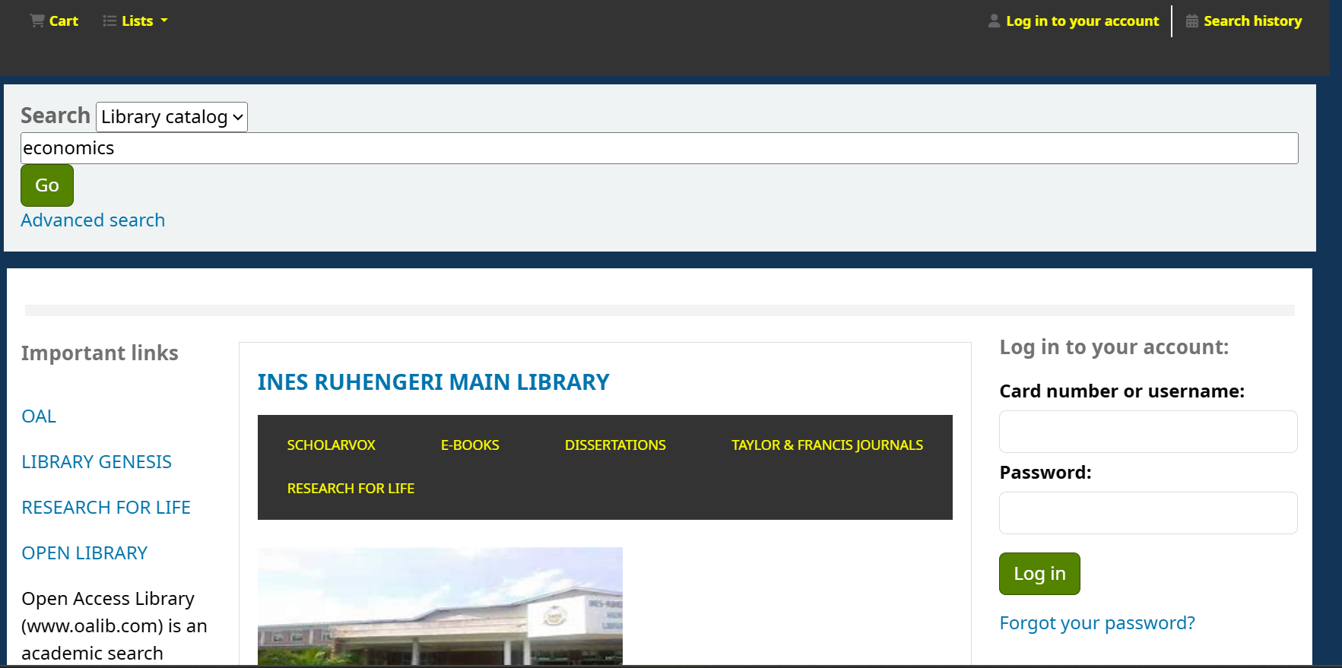
CURRENT GAP
What Learners and Libraries Face Today
Search friction
Learners waste time finding the right book or page.
Reading barriers
Long text is difficult for some users to read manually.
Key Limitations
Slow book and information retrieval
Limited support for voice search
No built-in audio-reading for long books
Language limits
English/French support is needed for better understanding.
Accessibility gap
Low literacy, dyslexia, and visual impairment need audio support.
Barriers for dyslexia, visual impairment, and low literacy
Busy learners lack time to read manually
Traditional digital libraries and book systems often store books, but do not make them easy enough to retrieve, understand, or listen to.
SMART DIGITAL LIBRARY
Current Gap
04

Slide 5











PROPOSED SOLUTION
How SMART DIGITAL LIBRARY Answers Each Problem
THE PROBLEM
OUR SOLUTION
Difficult book retrieval
Easy search and discovery
Users quickly find academic books and relevant content.
Limited time to read
Text-to-speech narration
Books and uploaded documents can be read aloud while users work, commute, or rest.
Language barriers
English/French translation
Key content can be translated for better understanding.
Accessibility barriers
Inclusive audio learning
Supports people with visual impairments, dyslexia, low literacy, or reading fatigue.
Generic recommendations
Smart book suggestions
Users choose books/interests and receive more relevant recommendations.
SMART DIGITAL LIBRARY
Proposed Solution
05

Slide 6




PROJECT OBJECTIVES
What SMART DIGITAL LIBRARY Aims to Achieve
General Objective
To build a smart Rwandan digital library platform that makes books searchable, readable, translatable, and listenable for inclusive education.
Specific Objectives
01
02
03
04
Improve Access
Support Audio Learning
Enable Smart Retrieval
Scale for Institutions
Provide existing academic books and allow users to upload personal books/documents.
Read books aloud using narration for busy learners and people with reading barriers.
Use search, voice search, recommendations, bookmarks, and progress tracking.
Support schools, universities, libraries, lecturers, and learning programs.
SMART DIGITAL LIBRARY
Objectives
06

Slide 7






METHODOLOGY
A Practical Five-Stage Development Approach
1
2
3
4
5
Identify Problem
Collect Needs
Design Platform
Build Features
Test & Improve
User & Market Needs
Testing
The platform is shaped around real learner challenges: time limits, language barriers, accessibility needs, and library management gaps.
Live testing verifies login, book upload, search, reader, translation, recommendations, STT, TTS, borrowing, and system health.
SMART DIGITAL LIBRARY
Methodology
07

Slide 8



SYSTEM ARCHITECTURE
How the Smart Library Platform Is Structured
Frontend :React
User interface for students, lecturers, and admins
Users
students, workers, lecturers
Web App
search, upload, reader
Backend API
security, roles, data
AI Services
STT, TTS, translation
Database
books, progress, reports
Backend : PHP API
Controls business logic and request validation
Database : MySQL
AI Services : FastAPI
Stores users, books, activity records
PyTorch speech models (STT/TTS)
SMART DIGITAL LIBRARY
System Architecture
08

Slide 9



CORE FEATURE
Book-to-Audio and Search Pipeline
User Action
Web Platform
AI Services
Database & Library
Learning Result
Upload, search, read, translate, or press play
Validates the request and connects to the right service
Processes speech, translation, or narration
Stores books, users, progress, bookmarks, and recommendations
User reads, listens, retrieves, or continues learning faster
SMART DIGITAL LIBRARY
Smart Pipeline
09

Slide 10




TECHNOLOGY DEEP-DIVE
AI and Accessibility Tools Behind the Platform
Speech-to-Text
Voice search helps users find books without typing.
Text-to-Speech
Narration reads books aloud for busy learners and accessibility support.
Translation Models
English/French support reduces language barriers.
Recommendation Logic
Suggests books using user choices, interests, and activity.
Document Processing
Uploaded books and documents become readable, searchable learning materials.
SMART DIGITAL LIBRARY
AI & Accessibility
10

Slide 11


TECHNOLOGY STACK
Tools Across the Full System
Frontend
Backend
Database
AI Services
Speech & Translation
Local/Cloud Ready
React, Vite, CSS
PHP API, role permissions, secure endpoints
MySQL for books, users, progress, and activity
Python, FastAPI, PyTorch, Transformers
STT, TTS, OPUS/NLLB translation support
XAMPP locally, scalable cloud deployment later
Together, these tools turn a normal digital library into a smart learning platform that retrieves books, reads them aloud, translates key text, and supports inclusive education.
SMART DIGITAL LIBRARY
Technology Stack
11

Slide 12
LIVE DEMONSTRATION
1
Login
Student opens the platform
2
Find Books
Search existing books or upload own file
3
Read/Translate
Open page and switch English/French
4
Listen
Narration reads the text aloud
5
Save & Learn
Bookmark, track progress, get recommendations
SMART DIGITAL LIBRARY
Demo Flow
12

Slide 13

IMPACT
What This Project Can Deliver
Students can access academic books already on the website and upload their own learning materials.
Busy workers can listen to books while commuting, working, or managing limited time.
People with visual impairments, dyslexia, low literacy, or reading fatigue gain a more accessible way to learn.
Schools, universities, lecturers, and libraries gain a scalable platform for inclusive digital education.
SMART DIGITAL LIBRARY
Impact
13

Slide 14

FUNDING USE & FUTURE WORK
How Support Will Help Us Scale
Strengthen Product
Grow Content & Partnerships
Improve upload, reader, narration, translation, recommendations, accessibility, and mobile experience.
Add more academic books and work with schools, universities, libraries, and lecturers.
Add AI Learning Tools
Summaries, chapter quizzes, offline audio, and lecturer-curated paths.
Scale Operations
Hosting, security, outreach, pilots, and institutional onboarding.
Grow the Platform
Add mobile support and multilingual speech for a wider range of learners.
SMART DIGITAL LIBRARY
Funding & Future Work
14

Slide 15

SDL
THANK YOU
Questions & Answers
Anne Louange Nishimwe
SMART DIGITAL LIBRARY ? Rwanda EdTech Innovation ? July 2026

