Slide 1


AICHAT PR
AI COPILOT APPLICATION PROJECT
SOFTWARE ENGINEERING
INSTRUCTOR: PHAM HOANG HAI

Slide 2




TEAM MEMBER
1
NGUYỄN THỊ NGỌC TRANG
22127421
2
NGUYỄN CÁT HUY
21127300
3
TRẦN LÊ BẢO DUY
22127089
4
PHÙNG TỐ UYÊN
22127447
VŨ THANH VIỆT
5
22127455

Slide 3

CONTENT
1
About the project
2
Project management
3
Software requirements
4
Analysis and design
5
Software testing
6
Demo

Slide 4
I. ABOUT THE PROJECT

Slide 5

PROBLEM STATEMENT
The problem of
Affects
The impact is
Inefficient AI-driven assistance, limited adaptability to user needs, and lack of seamless integration
B2B, B2C businesses and individual users
Resulting in decreased productivity, frustrated user experiences, and missed opportunities for personalized solutions
A successful solution would be
· AI-powered personalized recommendations
· Intelligent data analysis capabilities that provide insights, predictive trends, and actionable recommendations for better decisions.
· Smart task prioritization and data analysis features
· High-performance algorithms with faster response times
· Intuitive and easy-to-use interface
· Automated processes for efficiency and time-saving

Slide 6
PRODUCT POSITION STATEMENT
For
Who
That
Businesses (B2B), individual customers (B2C) and individual users
Who want efficient, personalized, and seamless assistance
Provides tailored insights, recommendations, and automated support for better decision-making
AICHAT PR
Unlike
Our product
Gemini, ChatGPT,BingAI, Claude …
Offers adaptable, intelligent analysis, and saves time through automation

Slide 7
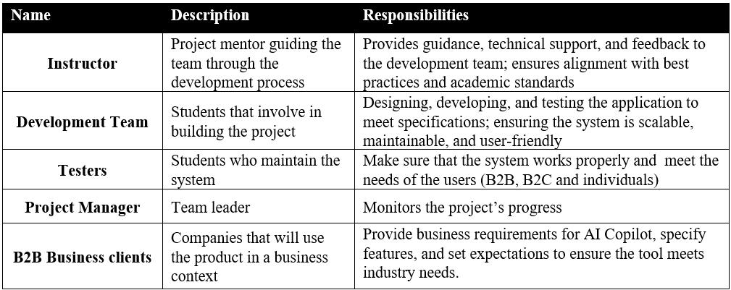
STAKEHOLDER SUMMARY

Slide 8
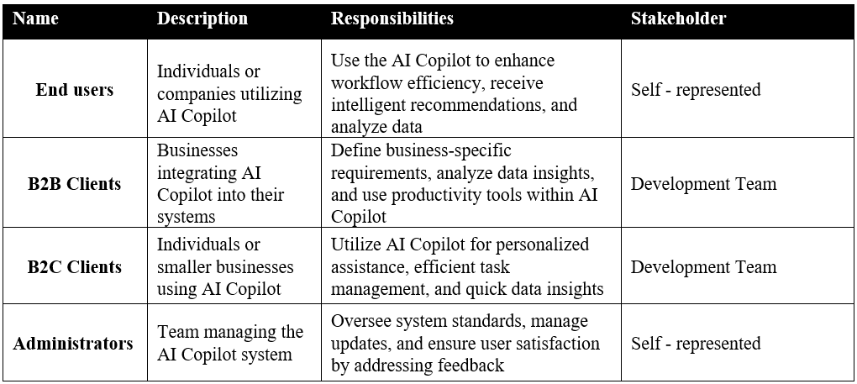
USER SUMMARY

Slide 9
II. PROJECT MANAGEMENT

Slide 10
TEAM STRUCTURE
Nguyễn Thị Ngọc Trang
Project manager (Team leader)
BA,
Tester
Phùng Tố Uyên
Tester,
BA
Trần Lê Bảo Duy
Back-end developer
Vũ Thanh Việt
Front-end developer,
UI/UX designer
Nguyễn Cát Huy
Front-end developer

Slide 11
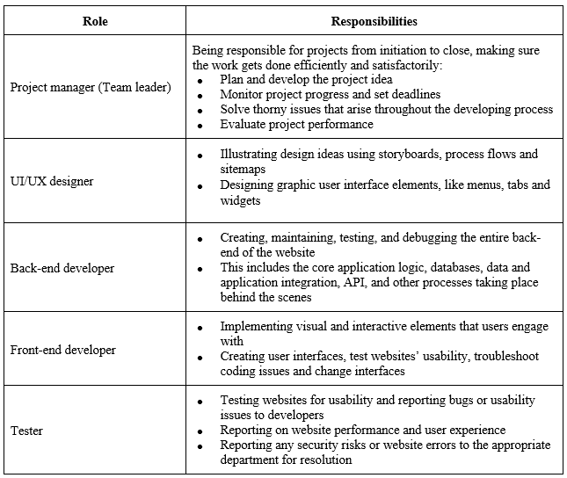
RESPONSIBILITY OF TEAM MEMBERS

Slide 12
III. SOFTWARE REQUIREMENTS

Slide 13

USE-CASE MODEL
Disable existance AI Bot
Add advertisement
View crash/error report
Enable existance AI Bot
ADMIN
Edit Q&A

Slide 14
USE-CASE MODEL
Update AI Bot
Update Token Count to unlimited
Take photo
Sign in
Communicate with created AI Bot via Chat widget
Sign out
Search AI Bot
Capture image
<<include>>
Delete AI Bot
Change personal info
B2C CLIENTS
Preview AI Bot
Create AI Bot
Upgrade plan
Chat with image
Sign up
Upload image for chat

Slide 15
USE-CASE MODEL
<<extend>>
Delete knowledge
Search knowledge
<<extend>>
<<extend>>
Load data from URL
Add knowledge data
<<extend>>
Load data from Google Drive
<<extend>>
Load data from Slack
<<extend>>
Load data from File
<<extend>>
Create new private prompt
Update prompt for AI Bot
<<extend>>
<<extend>>
Update new private prompt
B2C CLIENTS
<<extend>>
<<extend>>
Search puplic prompt
Use prompt from library
<<extend>>
<<extend>>
Delete private prompt
Filter prompt by category
<<extend>>
<<extend>>
<<extend>>
View favorite list
Add prompt to favorite
Search private prompt
<<extend>>

Slide 16
USE-CASE MODEL
Update AI Bot
Update Token Count to unlimited
Take photo
<<include>>
Remove employee
Search employee
Communicate with created AI Bot via Chat widget
Sign out
Search AI Bot
Capture image
Delete AI Bot
<<include>>
Change personal info
B2B CLIENTS
Preview AI Bot
Create AI Bot
Upgrade plan
Chat with image
Usage staticstic
Upload image for chat
Sign up
Add employee
Sign in

Slide 17
USE-CASE MODEL
<<extend>>
Delete knowledge
Search knowledge
<<extend>>
<<extend>>
Load data from URL
<<extend>>
Load data from Google Drive
Add knowledge data
<<extend>>
Load data from Slack
<<extend>>
Load data from File
<<extend>>
Create new private prompt
Update prompt for AI Bot
<<extend>>
<<extend>>
Update new private prompt
B2B CLIENTS
<<extend>>
<<extend>>
Search puplic prompt
Use prompt from library
<<extend>>
<<extend>>
Delete private prompt
Filter prompt by category
<<extend>>
<<extend>>
<<extend>>
View favorite list
Add prompt to favorite
Search private prompt
<<extend>>

Slide 18
NON-FUNCTIONAL REQUIREMENTS
Standards and Platform Requirements
Performance Requirements
Robustness and Fault Tolerance
Browsers: Latest stable versions of web browsers.
Mobile Platforms: iOS, Android.
Load operations within 2 seconds for most users.
Support at least 100 concurrent users during peak hours.
Execute queries within 500 milliseconds.
Fault Tolerance: Implement automatic failover and backup.
Error Recovery: Recover from errors and provide clear instructions.
Data Backup: Regular user data backups to prevent loss.
Usability
Scalability
Navigation: Ensure that all features are intuitive and easy to use.
Responsiveness: Test the layout and interface responsiveness across different devices (laptops, tablets, and mobile screens).
User Experience: Verify a seamless and user-friendly experience while interacting with the AI for various tasks.
Ensure the system can scale with user base and data load.

Slide 19
IV. ANALYSIS AND DESIGN

Slide 20
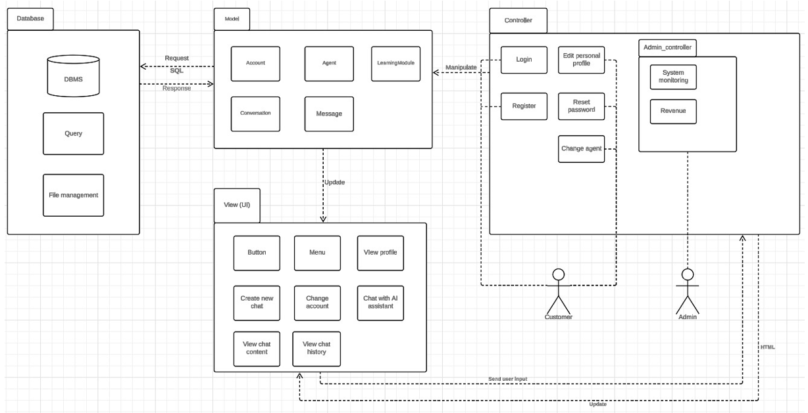
ARCHITECTURE

Slide 21
TECHNOLOGIES USED
Runtime environment
Design tool
Figma
NodeJS
Programming Languages:
Frameworks and Libraries:
JavaScript
Express.js
Database
MongoDB

Slide 22
V. SOFTWARE TESTING

Slide 23
HARDWARE REQUIREMENTS
SOFTWARE IN THE TEST ENVIRONMENT
PRODUCTIVITY AND SUPPORT TOOLS
Operating System
Google Chrome
Github
Windows 10 or 11 (64 bit).
To deploy the system of the website (Browser)
Version control
Internet Browser
Excel
Google Chrome or Microsoft Edge with latest version.
Defect Tracking
Microsoft Edge
To deploy the system of the website (Browser)
JIRA
Bug tracking, sprint planning, and issue management
RAM
At least 8GB RAM (enough to run the Internet Browser).
Windows 10, 64 bit
Windows 11, 64 bit
The operating system for running the website
Display
The screen aspect ratio is 16:9 with a minimum resolution of 1280x720.
Lists software items for testing
· Register and Login
· Chat with AI Bot

Slide 24
TEST PLAN (NON-FUNCTIONAL)
Standards and Platform Requirements
Performance Requirements
Robustness and Fault Tolerance
Browsers: Latest stable versions of web browsers.
Mobile Platforms: iOS, Android.
Load testing: Load operations within 2 seconds for most users.
Stress testing: Support at least 100 concurrent users during peak hours.
Response Time: Evaluate the response time of AI interactions and ensure timely results are delivered under varying conditions.
Fault Tolerance: Implement automatic failover and backup.
Error Recovery: Recover from errors and provide clear instructions.
Data Backup: Regular user data backups to prevent loss.
Usability
Navigation: Ensure that all features are intuitive and easy to use.
Responsiveness: Test the layout and interface responsiveness across different devices (laptops, tablets, and mobile screens).
User Experience: Verify a seamless and user-friendly experience while interacting with the AI for various tasks.

Slide 25

TEST PLAN (FUNCTIONAL FEATURES)
UC01: Register and Login
UC02: Chat with AI Bot
UI01: Provide a helpful response for common user queries
UI02: Initiate a conversation with AI Copilot
UI03: Handle unrecognized or ambiguous queries
UI04: AI Copilot responds to a detailed inquiry
UI05: AI Copilot suggests related topics after a question
UI01: Register with valid information
UI02: Register with invalid email
UI03: Register with mismatched password
UI04: Register with too short password
UI05: Register with existing username

Slide 26
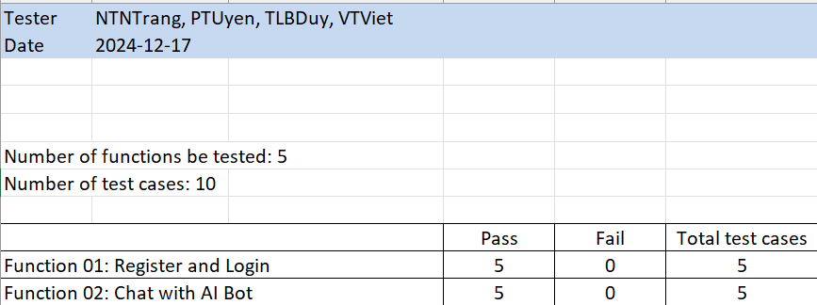
TEST RESULTS

Slide 27
VI. DEMO

Slide 28



THANK YOU FOR LISTENING

