Slide 1
AWT

Slide 2
The Java Foundation Classes(JFC) provide two frameworks for building GUI-based applications.
1)The Abstract Windowing Toolkit(AWT) relies on the underlying windowing system on a specific platform to present its GUI components.
2) The other GUI toolkit in the JFC, called Swing, implements a new set of lightweight GUI components that are written in Java and have a pluggable look and feel.
They are lightweight because they are not dependent on the underlying windowing system.

Slide 3
AWT Components
TextField
Buttons
Checkbox
CheckboxGroup
Choice
Label
List
TextArea

Slide 4


TextField
TextField is a box into which the user can type text
Text can be edited (backspace, delete, etc.)
Text can be set using setText()

Slide 5
Text Field
Declaring a Text Field
Classname objectname;
Example:
TextField text1;
Initializing with the init() Method
public void init(){}
Allocating Memory for Objects
Objectname=new classname();
Example:
text1=new TextField();

Slide 6
Text Field cond…
import java.applet.*;
import java.awt.*;;
/*<applet code=text.class width=300 height=300>
</applet>*/
public class text extends Applet
{//Declare a textfield
TextField text1;
public void init()
{
Text1=new TextField(20);
add(text1);
text1.setText(“Welcome to java”);
}
}

Slide 7
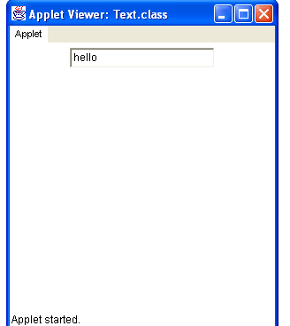
Output

Slide 8
BUTTONS
A Button has a single line label and may be "pushed" with a mouse click.

Slide 9
BUTTONS (Cond..)
Declaring a Text Field
Classname objectname;
Example:
Button button1;
Initializing with the init() Method
public void init(){}
Allocating Memory for Objects
Objectname=new classname();
Example:
button1=new Button();

Slide 10
BUTTONS (cond..)
import java.awt.*;
import java.applet.*;
/*<applet code=Button1.class height=500 width=500></applet>*/
public class Button1 extends Applet
{
public void init()
{
Button b1=new Button("ONE");
add(b1);
Button b2=new Button("TWO");
add(b2);
}
}

Slide 11
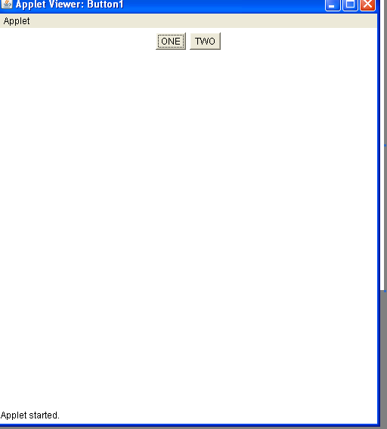
BUTTON

Slide 12
CHECK BOX
Used to allow user to select one or more items
Always has a label
Program often needs to react to the user selection(s)

Slide 13
CHECK BOX (Cond..)
Declaring a Check box
Classname objectname;
Example:
Checkbox check1;
Initializing with the init() Method
public void init(){}
Allocating Memory for Objects
Objectname=new classname();
Example:
check1=new Checkbox();

Slide 14
CHECKBOX (Cond..)
import java.awt.*;
import java.applet.*;
/*<applet code=checkbox.class height=500 width=500></applet>*/
public class checkbox extends Applet
{
String s;
public void init()
{
Checkbox ch=new Checkbox("ONE");
add(ch);
Checkbox ch1=new Checkbox("TWO");
add(ch1);
}
}

Slide 15
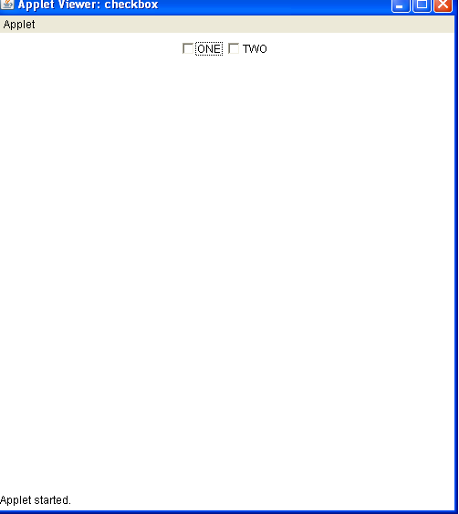
CHECK BOX (CONT..)

Slide 16
CHECK BOX (CONT..)
The state of a Checkbox is either true (button is checked) or false (button not checked).
The default initial state is false.
Clicking a Checkbox toggles its state.
//Coding
import java.awt.*;
import java.applet.Applet;
/*<applet code=Cbox.class height=500 width=500></applet>*/
public class Cbox extends Applet {
public void init() {
Checkbox m = new Checkbox("Label", true);
add(m);
}
}

Slide 17
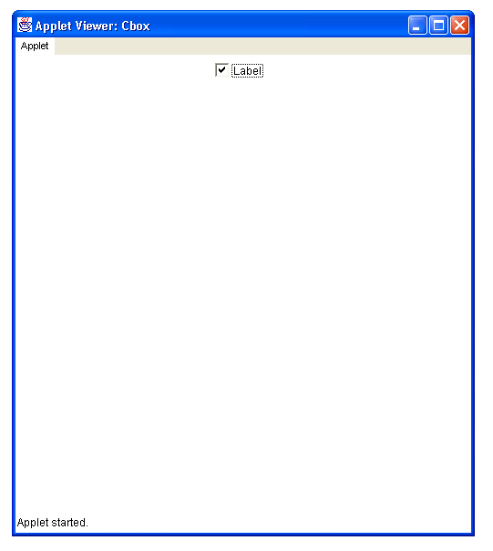
CHECK BOX (CONT..)

Slide 18
CheckboxGroup
A CheckboxGroup is used to control the behavior of a group of Checkbox objects (each of which has a true or false state).
Exactly one of the Checkbox objects is allowed to be true at one time.
Checkbox objects controlled with a CheckboxGroup are usually referred to as "radio buttons".

Slide 19
CheckboxGroup
(Cond..)
Declaring a CheckboxGroup Button
Classname objectname;
Example:
CheckboxGroup radio1;
Initializing with the init() Method
public void init(){}
Allocating Memory for Objects
Objectname=new classname();
Example:
radio1=new CheckboxGroup();

Slide 20
CheckboxGroup(cond..)
import java.awt.*;
import java.applet.*;
/*<applet code=radiobutton height=500 width=500></applet>*/
public class CheckboxGroupTest.class extends Applet
{
public void init()
{
CheckboxGroup cbg = new CheckboxGroup();
Checkbox cb1 = new Checkbox("Show lowercase only", cbg, true);
Checkbox cb2 = new Checkbox("Show uppercase only", cbg, false);
add(cb1);
add(cb2);
}
}

Slide 21
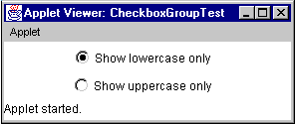
CheckboxGroup
(Cond..)

Slide 22
CHOICE
select a single item from this component which shows one item but will display all of them in a "dropdown" menu when clicked on
Choice objects are drop-down lists.
The visible label of the Choice object is the currently selected entry of the Choice.

Slide 23
CHOICE(COND..)
Declaring a Choice
Classname objectname;
Example:
Choice choice1;
Initializing with the init() Method
public void init(){}
Allocating Memory for Objects
Objectname=new classname();
Example:
choice1=new Choice();

Slide 24
CHOICE(COND..)
import java.awt.*;
import java.applet.Applet;
/*<applet code= ChoiceSimpleTest.class height=500 width=500></applet>*/
public class ChoiceSimpleTest extends Applet
{
public void init()
{
Choice rgb = new Choice();
rgb.add("Red");
rgb.add("Green");
rgb.add("Blue");
add(rgb);
}
}

Slide 25
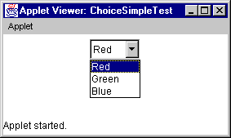
CHOICE(COND..)

Slide 26
LABEL
A Label is a displayed Label object.
It is usually used to help indicate what other parts of the GUI do
(ie)The purpose of a neighboring text field.

Slide 27
LABEL(Cond..)
Declaring a Label
Classname objectname;
Example:
Label label1;
Initializing with the init() Method
public void init(){}
Allocating Memory for Objects
Objectname=new classname();
Example:
label1=new Label();

Slide 28
LABEL(Cond..)
import java.awt.*;
import java.applet.* ;
/*<applet code= LabelTest.class height=500 width=500></applet>*/
public class LabelTest extends Applet
{ public void init()
{ add(new Label("A label"));
// right justify next label
add(new Label("Another label", Label.RIGHT));
}
}

Slide 29
LIST
A List is a scrolling list box that allows you to select one or more items.
Multiple selections may be used by passing true as the second argument to the constructor.

Slide 30
LIST(Cond..)
Declaring a List
Classname objectname;
Example:
List list1;
Initializing with the init() Method
public void init(){}
Allocating Memory for Objects
Objectname=new classname();
Example:
list1=new List();

Slide 31
LIST(Cond..)
import java.awt.*;
import java.applet.Applet;
public class ListSimpleTest.class extends Applet
{ public void init()
{ List list = new List(5, false);
list.add("Seattle");
list.add("Washington");
list.add("New York");
list.add("Chicago");
list.add("Miami");
list.add("San Jose");
list.add("Denver");
add(list);
}
}

Slide 32
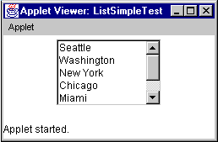
LIST(Cond..)

Slide 33
TEXT AREA
A Text Area is a multi-row text field that displays a single string of characters, where newline ('\n' or '\n\r' or '\r', depending on platform) ends each row.
The width and height of the field is set at construction, but the text can be scrolled up/down and left/right.

Slide 34
TEXT AREA(Cond…)
import java.awt.*;
import java.applet.Applet;
public class TextAreaSimpleTest.class extends Applet
{
public void init()
{
TextArea disp = new TextArea("Code goes here", 10, 30);
add(disp);
}
}

Slide 35
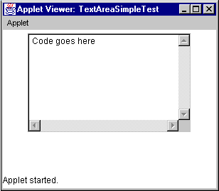
TEXT AREA(Cond…)

