Slide 1
Layout Managers

Slide 2
Layout
Layout for applet and panel
Default places components in left to right and top to bottom
Rows are centered by default

Slide 3
Flow Layout
The Flow Layout manager arranges the components left-to-right, top-to-bottom in the order they were inserted into the container.
When the container is not wide enough to display all the components, the remaining components are placed in the next row, etc.
Each row is centered.
default

Slide 4
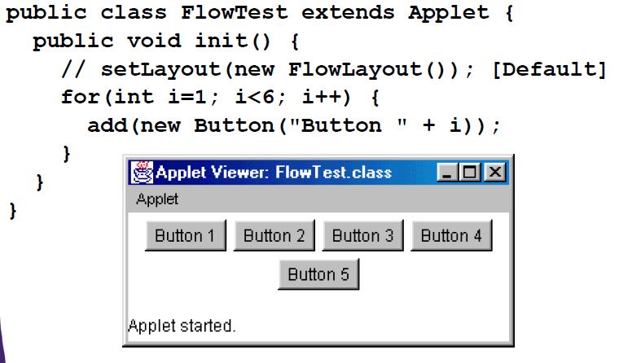
Flow layout

Slide 5
Border Layout
The Border Layout manager arranges components into five regions: North, South, East, West, and Center.
Components in the North and South are set to their natural heights and horizontally stretched to fill the entire width of the container.
Components in the East and West are set to their natural widths and stretched vertically to fill the entire width of the container.
The Center component fills the space left in the center of the container.

Slide 6
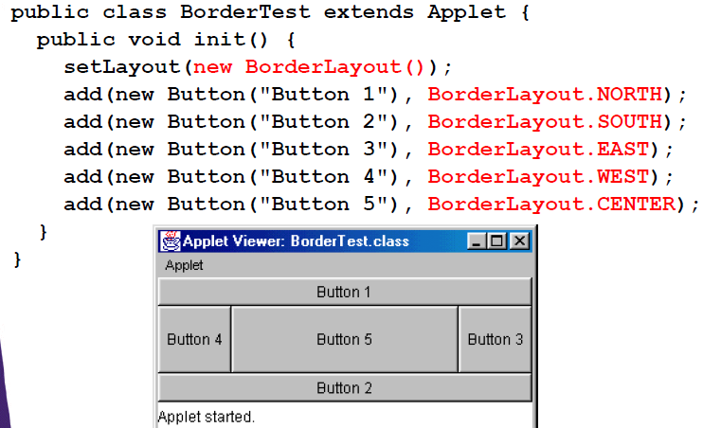

Slide 7
Grid Layout
The Grid Layout manager lays out all the components in a rectangular grid. All the components have identical sizes, since the manager automatically stretches or compresses the components as to fill the entire space of the container.

Slide 8
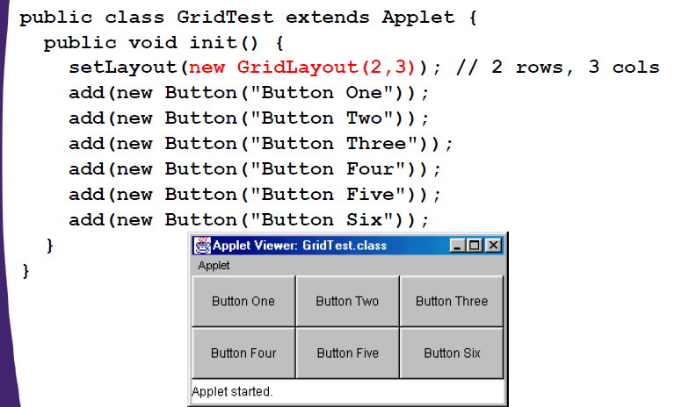
Grid Layout

