Slide 1
Process Synchronization
Tanenbaum Ch 2.3, 2.5
Silberschatz Ch 6

Slide 2
Interprocess Communications
Passing information between processes
Used to coordinate process activity
May result in data inconsistency if mechanisms are not in place to ensure orderly execution of the processes.
The problem can be identified as a race condition
cs431-cotter
Notes:
cs431-cotter

Slide 3
Producer / Consumer Problem
Producer
Buffer
Consumer
cs431-cotter
Notes:
cs431-cotter

Slide 4
Producer / Consumer Problem
Producer
Buffer
Consumer
cs431-cotter

Slide 5
Producer / Consumer Problem
Shared data:
int counter, in , out
item buffer[n];
cs431-cotter
Notes:
cs431-cotter

Slide 6
Producer / Consumer Problem
Shared data:
int counter, in , out
item buffer[n];
Producer:
repeat
...
produce an item in nextp
...
while counter = n do noop;
buffer[in] := nextp;
in := (in + 1) mod n;
counter := counter + 1;
until false;
cs431-cotter
Notes:
cs431-cotter

Slide 7
Producer / Consumer Problem
Shared data:
int counter, in , out
item buffer[n];
Producer:
repeat
...
produce an item in nextp
...
while counter = n do noop;
buffer[in] := nextp;
in := (in + 1) mod n;
counter := counter + 1;
until false;
Consumer:
repeat
...
while counter = 0 do noop;
nextc := buffer[out];
out := (out + 1) mod n;
counter := counter -1;
...
consume the item in nextc
...
until false;
cs431-cotter
Notes:
cs431-cotter

Slide 8
Producer / Consumer Problem
Shared data:
int counter, in , out
item buffer[n];
Producer:
repeat
...
produce an item in nextp
...
while counter = n do noop;
buffer[in] := nextp;
in := (in + 1) mod n;
counter := counter + 1;
until false;
Consumer:
repeat
...
while counter = 0 do noop;
nextc := buffer[out];
out := (out + 1) mod n;
counter := counter -1;
...
consume the item in nextc
...
until false;
The Problem:
  atomic execution of counter changes
cs431-cotter
Notes:
cs431-cotter

Slide 9

Race Conditions
Figure 2-21. Two processes want to access
shared memory at the same time.
cs431-cotter
Tanenbaum, Modern Operating Systems 3 e, (c) 2008 Prentice-Hall, Inc. All rights reserved. 0-13-6006639
Notes:
cs431-cotter

Slide 10
The Critical Section / Region Problem
Occurs in systems where multiple processes all compete for the use of shared data.
Each process includes a section of code (the critical section) where it accesses this shared data.
The problem is to ensure that only one process at a time is allowed to be operating in its critical section.
cs431-cotter
Notes:
cs431-cotter

Slide 11
The Critical Section / Region Problem
Occurs in systems where multiple processes all compete for the use of shared data.
Each process includes a section of code (critical section) where it accesses this shared data.
The problem is to ensure that only one process at a time is allowed to be operating in its critical section.
      repeat
      entry_to_section
      critical section
      exit_section
      remainder of program
      until false;
cs431-cotter
Notes:
cs431-cotter

Slide 12
Criteria for Critical Region
1. Mutual Exclusion
  If one process is in its critical section, no other process may be in its respective section
2. Progress
  If no process is executing in its critical section and there exists some process that needs to enter its critical section, then the selection of that process cannot be delayed indefinitely
3. Bounded Waiting
  There is a bound on the number of times that a waiting process can be superceded
cs431-cotter
Notes:
cs431-cotter

Slide 13
Critical Regions (1)
Conditions required to avoid race condition:
No two processes may be simultaneously inside their critical regions.
No assumptions may be made about speeds or the number of CPUs.
No process running outside its critical region may block other processes.
No process should have to wait forever to enter its critical region.
cs431-cotter
Tanenbaum, Modern Operating Systems 3 e, (c) 2008 Prentice-Hall, Inc. All rights reserved. 0-13-6006639
Notes:
cs431-cotter

Slide 14

Critical Regions (2)
Figure 2-22. Mutual exclusion using critical regions.
cs431-cotter
Tanenbaum, Modern Operating Systems 3 e, (c) 2008 Prentice-Hall, Inc. All rights reserved. 0-13-6006639
Notes:
cs431-cotter

Slide 15
Mutual Exclusion with Busy Waiting
Proposals for achieving mutual exclusion:
Disabling interrupts
Lock variables
Strict alternation
Peterson's solution
The TSL instruction
cs431-cotter
Tanenbaum, Modern Operating Systems 3 e, (c) 2008 Prentice-Hall, Inc. All rights reserved. 0-13-6006639
Notes:
cs431-cotter

Slide 16
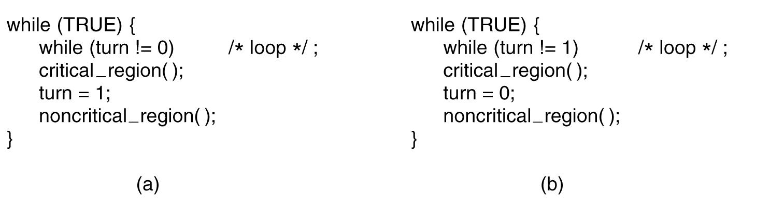
Strict Alternation
Figure 2-23. A proposed solution to the critical region problem.
(a) Process 0. (b) Process 1. In both cases, be sure to note the semicolons terminating the while statements.
cs431-cotter
Tanenbaum, Modern Operating Systems 3 e, (c) 2008 Prentice-Hall, Inc. All rights reserved. 0-13-6006639
Notes:
cs431-cotter

Slide 17
Second Approach
Shared variables:
  int flag[2]; // if (flag[i]==true), P_{i} ready to enter its CS
  initially flag[0] := flag[1] := false;
Process P_{i}
      repeat
      flag[i] := true;
      while (flag[j] = true), do noop;
      critical section
      flag[i] := false;
      remainder of program
      until false;
cs431-cotter
Notes:
cs431-cotter

Slide 18
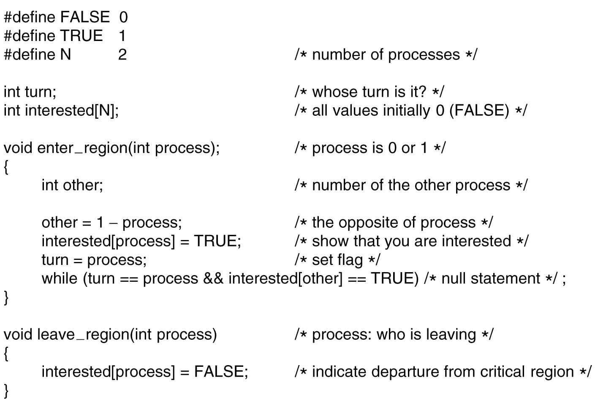
Peterson's Solution
Figure 2-24. Peterson’s solution for achieving mutual exclusion.
cs431-cotter
Tanenbaum, Modern Operating Systems 3 e, (c) 2008 Prentice-Hall, Inc. All rights reserved. 0-13-6006639
Notes:
cs431-cotter

Slide 19
Multiple Process Solution
The Bakery Algorithm
Shared variables:
  int choosing[n], number [n];
Process P_{i}
  repeat
  choosing[i] := true;
  number[i] := max (number[...]) +1;
  choosing[i] := false;
  for (j := 0..n-1)
  while (choosing[j]:=true:) noop;
  while (number[j] &&
  number[j],j < number[i],i) noop;
  critical section
  number[i] := 0;
  remainder of program
  until false;
cs431-cotter
Notes:
cs431-cotter

Slide 20
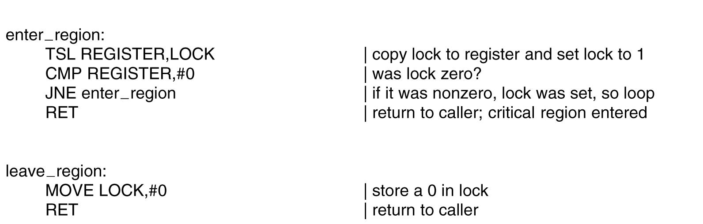
The TSL Instruction (1)
Figure 2-25. Entering and leaving a critical region
using the TSL instruction.
cs431-cotter
Tanenbaum, Modern Operating Systems 3 e, (c) 2008 Prentice-Hall, Inc. All rights reserved. 0-13-6006639
Notes:
cs431-cotter

Slide 21
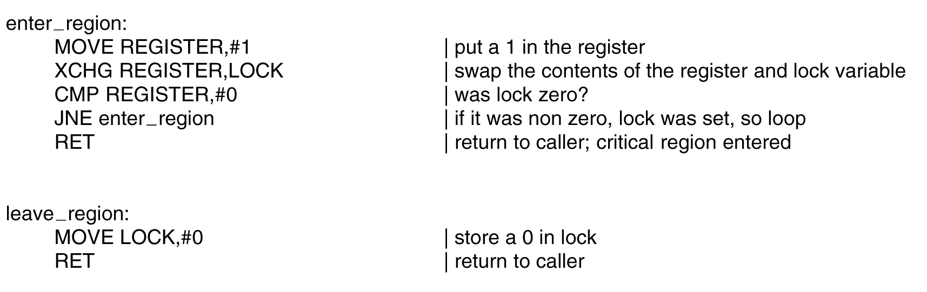
The TSL Instruction (2)
Figure 2-26. Entering and leaving a critical region
using the XCHG instruction.
cs431-cotter
Tanenbaum, Modern Operating Systems 3 e, (c) 2008 Prentice-Hall, Inc. All rights reserved. 0-13-6006639
Notes:
cs431-cotter

Slide 22
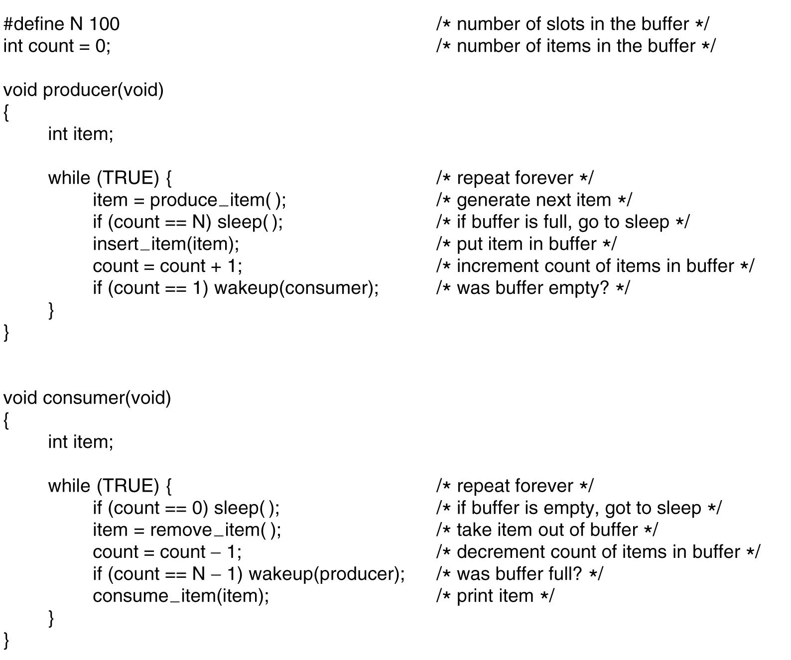
The Producer-Consumer Problem
. . .
Figure 2-27. The producer-consumer problem
with a fatal race condition.
cs431-cotter
Tanenbaum, Modern Operating Systems 3 e, (c) 2008 Prentice-Hall, Inc. All rights reserved. 0-13-6006639
Notes:
cs431-cotter

Slide 23
Semaphores
Need to generalize critical section problems
Need to ensure ATOMIC access to shared variables.
Semaphore provides an integer variable that is only accessible through semaphore operations:
cs431-cotter
Notes:
cs431-cotter

Slide 24
Semaphores
Need to generalize critical section problems
Need to ensure ATOMIC access to shared variables.
Semaphore provides an integer variable that is only accessable through semaphore operations:
  Wait P
  while (s < 0) ; // empty while loop
  s--;
  Signal V
  s++;
cs431-cotter
Notes:
cs431-cotter

Slide 25
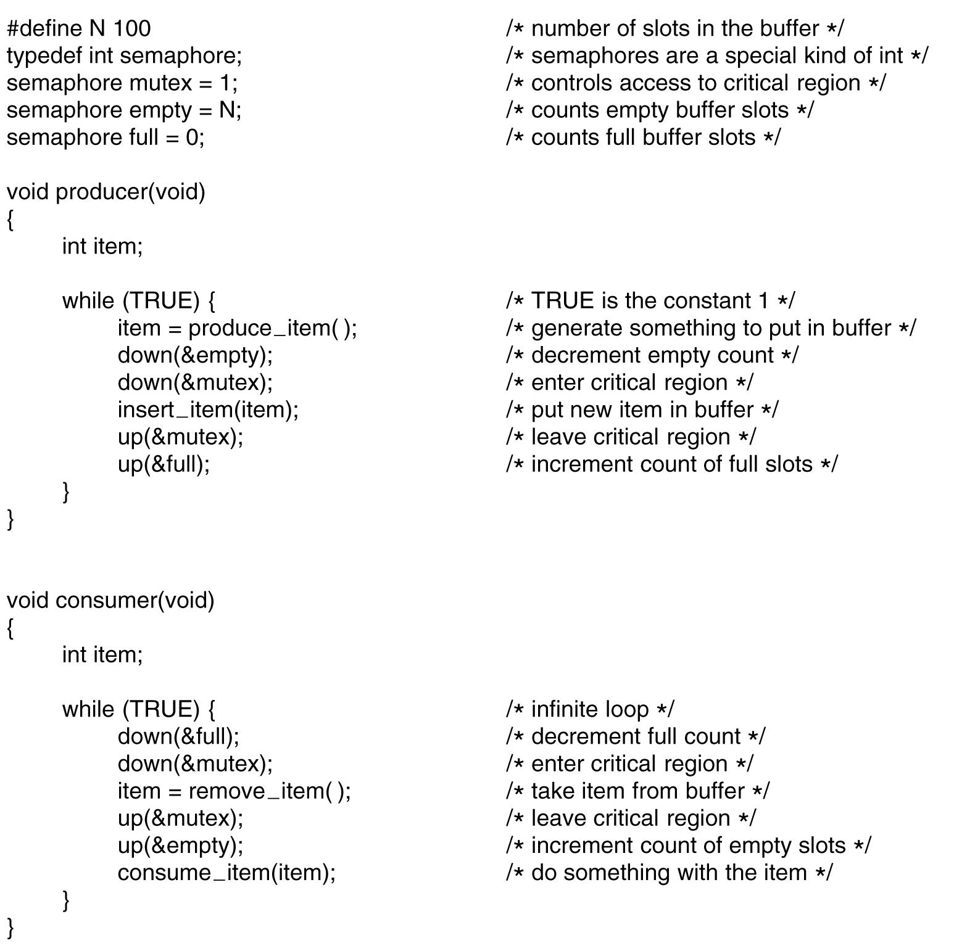
Semaphores
. . .
Figure 2-28. The producer-consumer problem using semaphores.
cs431-cotter
Tanenbaum, Modern Operating Systems 3 e, (c) 2008 Prentice-Hall, Inc. All rights reserved. 0-13-6006639
Notes:
cs431-cotter

Slide 26
Sync with Semaphore
Process 1
:
:
:
A
signal (sync);
:
Process 2
wait (sync);
B
:
:
:
cs431-cotter
Notes:
cs431-cotter

Slide 27
Counting Semaphore
Implementation
struct semaphore
{
int value;
int L[size];
} s ;
Assumes 2 internal operations:
  block;
  wakeup(p);
cs431-cotter
Notes:
cs431-cotter

Slide 28
Counting Semaphore
Implementation
wait(s)
s.value--;
if (s.value <0)
add to s.L
block;
signal(s)
s.value++;
if (s.value <= 0)
remove P from s.L;
wakeup(P)
cs431-cotter
Notes:
cs431-cotter

Slide 29
Semaphore Deadlock
P
wait(B);
wait(A);
:
:
:
signal(B);
signal(A);
Q
wait(A);
wait(B);
:
:
:
signal(A);
signal(B);
cs431-cotter
Notes:
cs431-cotter

Slide 30
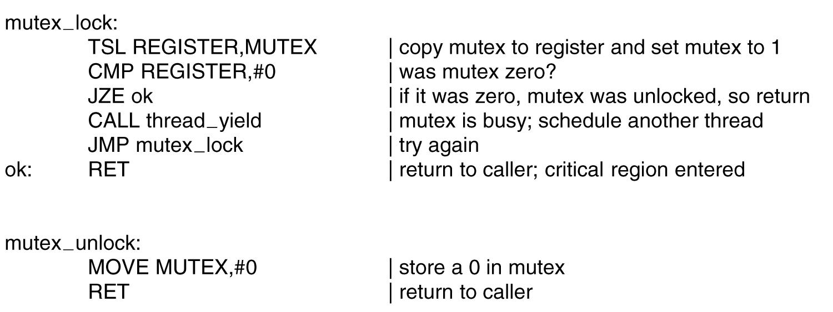
Mutexes
Figure 2-29. Implementation of mutex lock and mutex unlock.
cs431-cotter
Tanenbaum, Modern Operating Systems 3 e, (c) 2008 Prentice-Hall, Inc. All rights reserved. 0-13-6006639
Notes:
cs431-cotter

Slide 31
“Critical Regions”
Objective of semaphores (etc.) is to ensure that a critical region of code is used exclusively.
Misuse can defeat the objective.
One solution is to define a higher level object that specifically creates the critical region
cs431-cotter
Notes:
cs431-cotter

Slide 32
“Critical Regions”
Objective of semaphores (etc.) is to ensure that a critical region of code is used exclusively.
Misuse can defeat the objective.
One solution is to define a higher level object that specifically creates the critical region
region V when B do S;
  The region V is a critical region. When a given boolean expression B is true, allow an operation S that operates on the region to take place. However, ensure that only one process is in V at a time.
cs431-cotter
Notes:
cs431-cotter

Slide 33
“Critical Region”
var buffer: shared record
pool: array [0..n-1] of item;
count, in, out: integer;
end;
cs431-cotter
Notes:
cs431-cotter

Slide 34
“Critical Region”
var buffer: shared record
pool: array [0..n-1]of item;
count, in, out: integer;
end;
Producer:
region buffer when count < n
do begin
pool[in]:= nextp;
in :=( in + 1) mod n;
count := count + 1;
end;
Consumer:
region buffer when count > 0
do begin
pool[out]:= nextp;
out :=( out + 1) mod n;
count := count - 1;
end;
cs431-cotter
Notes:
cs431-cotter

Slide 35
Monitors
Another high level sync construct
Programmer defined operators.
Local data accessible only through monitor procedures.
Only 1 process can be executing in the monitor at a time. (Many may be queued up at procedures)
cs431-cotter
Notes:
cs431-cotter

Slide 36
Monitors
Input ...
Another high level sync construct
Programmer defined operators.
Local data accessible only through monitor procedures.
Only 1 process can be executing in the monitor at a time.
C1 ...
local
data
C2 ...
Procedure 1
:
:
C3 ...
C4 ...
Procedure n
cs431-cotter
Notes:
cs431-cotter

Slide 37
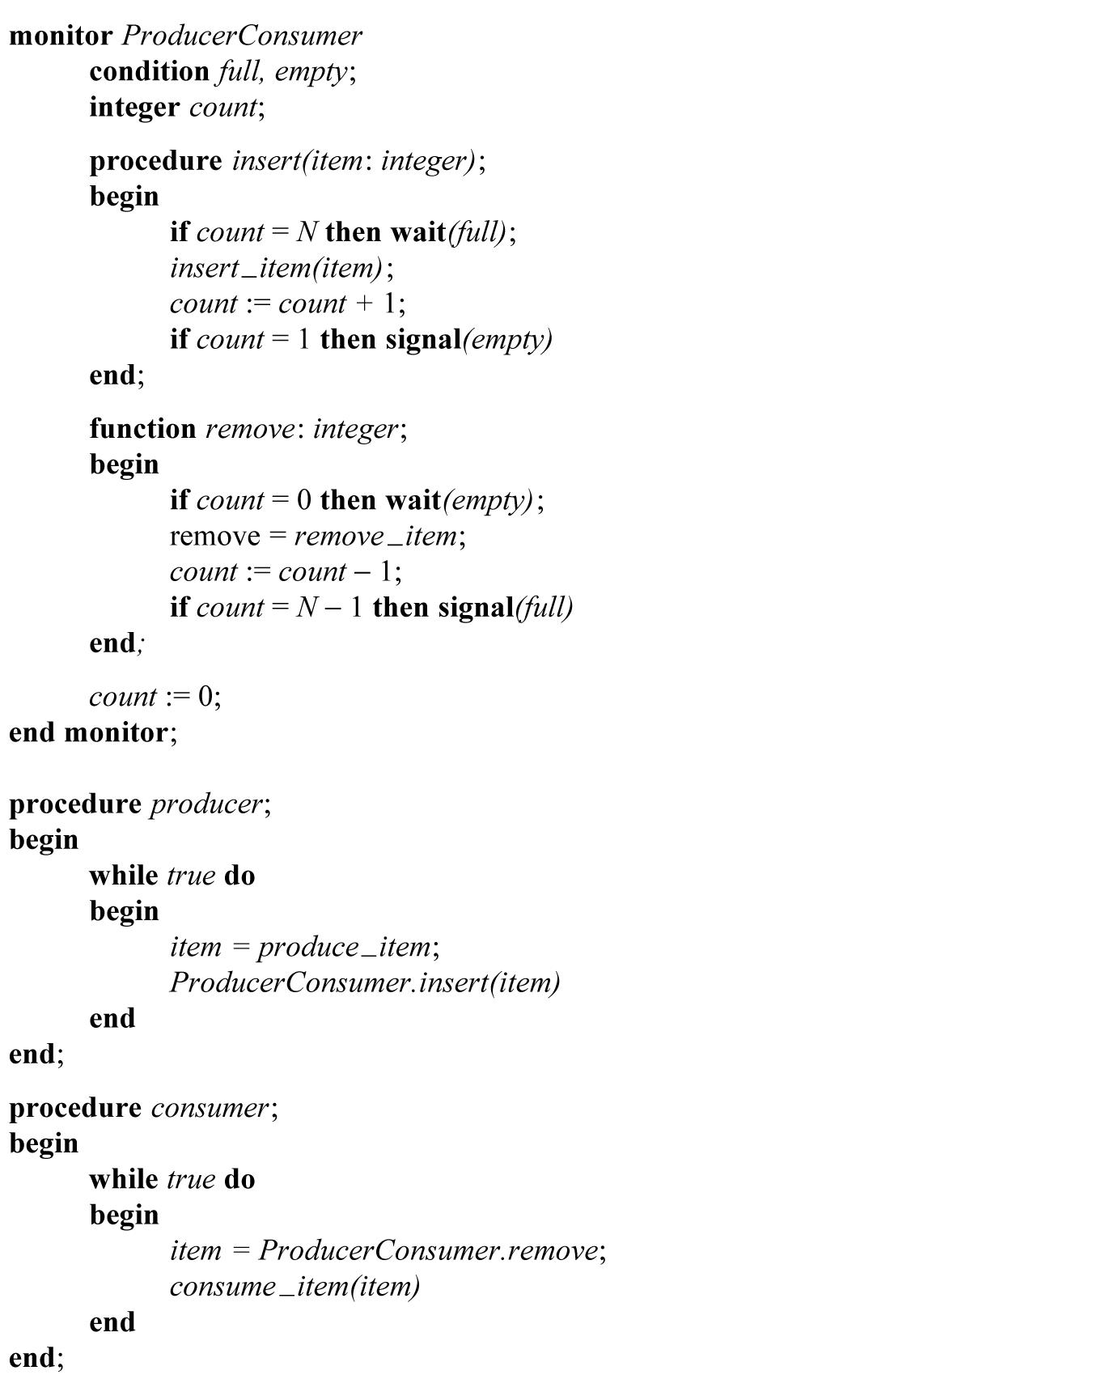
Monitors
Figure 2-34. An outline of the producer-consumer problem with monitors.
cs431-cotter
Tanenbaum, Modern Operating Systems 3 e, (c) 2008 Prentice-Hall, Inc. All rights reserved. 0-13-6006639
Notes:
cs431-cotter

Slide 38
Classical IPC Problems
Dining Philosophers
Readers and Writers
Bakery Problem
cs431-cotter

Slide 39

Dining Philosophers Problem (1)
Figure 2-44. Lunch time in the Philosophy Department.
cs431-cotter
Tanenbaum, Modern Operating Systems 3 e, (c) 2008 Prentice-Hall, Inc. All rights reserved. 0-13-6006639
Notes:
cs431-cotter

Slide 40
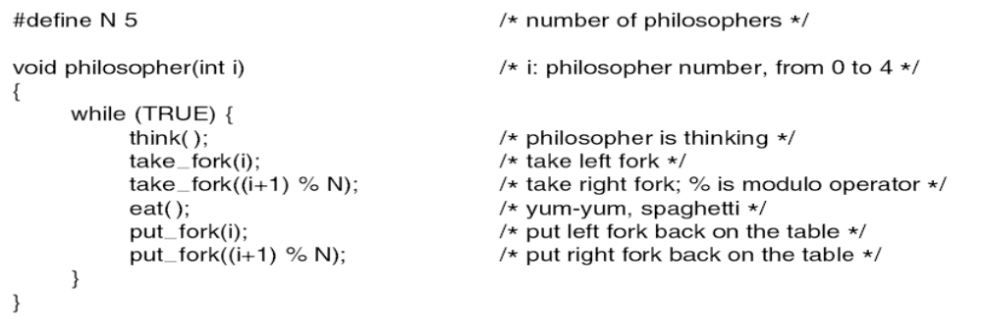
Dining Philosophers Problem (2)
Figure 2-45. A nonsolution to the dining philosophers problem.
cs431-cotter
Tanenbaum, Modern Operating Systems 3 e, (c) 2008 Prentice-Hall, Inc. All rights reserved. 0-13-6006639
Notes:
cs431-cotter

Slide 41
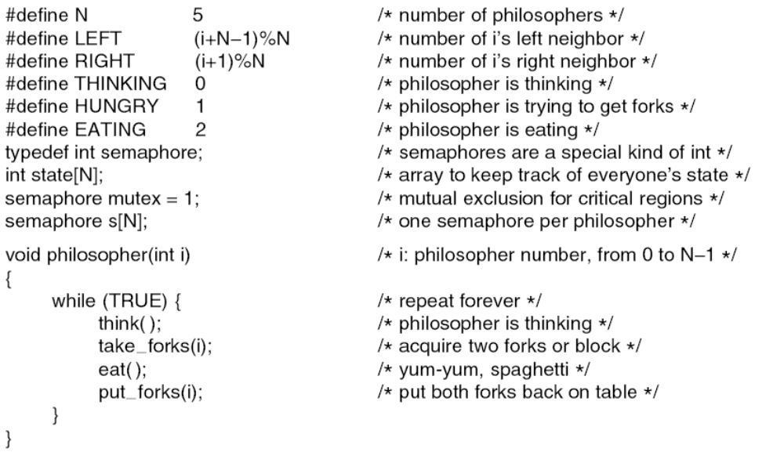
Dining Philosophers Problem (3)
. . .
Figure 2-46. A solution to the dining philosophers problem.
cs431-cotter
Tanenbaum, Modern Operating Systems 3 e, (c) 2008 Prentice-Hall, Inc. All rights reserved. 0-13-6006639
Notes:
cs431-cotter

Slide 42
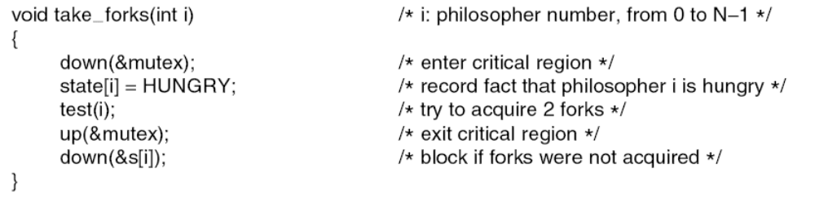
Dining Philosophers Problem (4)
. . .
. . .
Figure 2-46. A solution to the dining philosophers problem.
cs431-cotter
Tanenbaum, Modern Operating Systems 3 e, (c) 2008 Prentice-Hall, Inc. All rights reserved. 0-13-6006639
Notes:
cs431-cotter

Slide 43
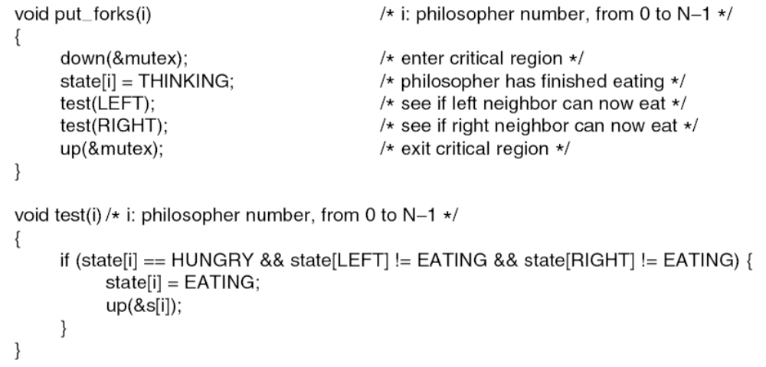
Dining Philosophers Problem (5)
. . .
Figure 2-46. A solution to the dining philosophers problem.
cs431-cotter
Tanenbaum, Modern Operating Systems 3 e, (c) 2008 Prentice-Hall, Inc. All rights reserved. 0-13-6006639
Notes:
cs431-cotter

Slide 44
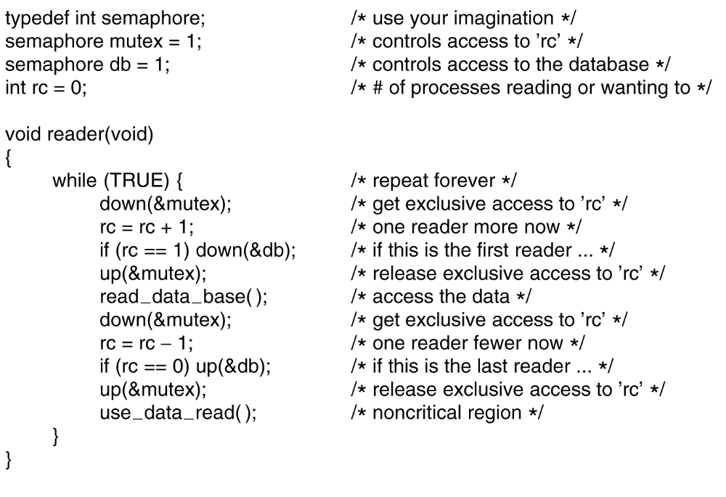
The Readers and Writers Problem (1)
. . .
Figure 2-47. A solution to the readers and writers problem.
cs431-cotter
Tanenbaum, Modern Operating Systems 3 e, (c) 2008 Prentice-Hall, Inc. All rights reserved. 0-13-6006639
Notes:
cs431-cotter

Slide 45
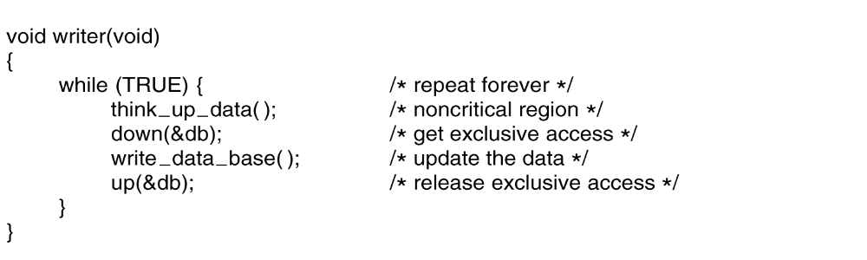
The Readers and Writers Problem (2)
. . .
Figure 2-47. A solution to the readers and writers problem.
cs431-cotter
Tanenbaum, Modern Operating Systems 3 e, (c) 2008 Prentice-Hall, Inc. All rights reserved. 0-13-6006639
Notes:
cs431-cotter

Slide 46
Atomic Transactions
Database origins
Transaction: A collection of instructions that performs a single logical function.
Many operations need to be atomic. Either fully committed, or fully removed.
Examples:
  Bank account transactions
  database updates.
cs431-cotter
Notes:
cs431-cotter

Slide 47
Transactions
Begin transaction
do reads and writes
if (transaction successful)
commit transaction;
else
abort transaction;
How do we determine when we need to commit or abort transaction??
cs431-cotter
Notes:
cs431-cotter

Slide 48
Computer Storage Media
Volatile Storage
  Subject to data loss in the event of power failure.
  (main memory)
Non-volatile Storage
  Resistant to power failure, system failures.
  (hard disk, tape)
Stable Storage -
  Data "never" lost
  (combination of non-volatile elements)
cs431-cotter
Notes:
cs431-cotter

Slide 49
Transaction Log based recovery
Log entry to record each event
  transaction name (number?)
  data item name
  old value
  new value
< T_{i} start>
< T_{i} entry> (when write)
< T_{i} commit>
cs431-cotter
Notes:
cs431-cotter

Slide 50
Transaction Log based recovery
Log entry to record each event
  transaction name (number?)
  data item name
  old value
  new value
< T_{i} start>
< T_{i} entry> (when write)
< T_{i} commit>
Entries are idempotent
cs431-cotter
Notes:
cs431-cotter

Slide 51
Transaction Log based recovery
undo command
  start, but no commit
redo command
  start and commit
Checkpoints
  save log records
  save data items
  <checkpoint>
cs431-cotter
Notes:
cs431-cotter

Slide 52
Concurrent Atomic Transactions
Need to ensure that any interactions between transaction elements do not affect end results.
Serializability
cs431-cotter
Notes:
cs431-cotter

Slide 53
Concurrent Atomic Transactions
Need to ensure that any interactions between transaction elements do not affect end results.
Serializability
T₀ T₁
R(A)
W(A)
R(B)
W(B)
R(A)
W(A)
R(B)
W(B)
cs431-cotter
Notes:
cs431-cotter

Slide 54
Concurrent Atomic Transactions
Need to ensure that any interactions between transaction elements do not affect end results.
Serializability
T₀ T₁
R(A)
W(A)
R(B)
W(B)
R(A)
W(A)
R(B)
W(B)
T₀ T₁
R(A)
W(A)
R(A)
W(A)
R(B)
W(B)
R(B)
W(B)
cs431-cotter
Notes:
cs431-cotter

Slide 55
Concurrent Atomic Transactions
Serializability
Step 1
T₀ T₁
R(A)
W(A)
R(A)
R(B)
W(A)
W(B)
R(B)
W(B)
cs431-cotter
Notes:
cs431-cotter

Slide 56
Concurrent Atomic Transactions
Serializability
Step 1
Step 2
T₀ T₁
R(A)
W(A)
R(A)
R(B)
W(A)
W(B)
R(B)
W(B)
T₀ T₁
R(A)
W(A)
R(B)
R(A)
W(A)
W(B)
R(B)
W(B)
cs431-cotter
Notes:
cs431-cotter

Slide 57
Concurrent Atomic Transactions
Serializability
Step 1
Step 2
Step 3
T₀ T₁
R(A)
W(A)
R(A)
R(B)
W(A)
W(B)
R(B)
W(B)
T₀ T₁
R(A)
W(A)
R(B)
R(A)
W(A)
W(B)
R(B)
W(B)
T₀ T₁
R(A)
W(A)
R(B)
R(A)
W(B)
W(A)
R(B)
W(B)
cs431-cotter
Notes:
cs431-cotter

Slide 58
Concurrent Atomic Transactions
Need to ensure that any interactions between transaction elements do not affect end results.
Not Serializable!
T₀ T₁
R(A)
W(A)
R(B)
W(B)
R(B)
W(B)
R(A)
W(A)
T₀ T₁
R(A)
W(A)
R(B)
W(B)
R(B)
W(B)
R(A)
W(A)
cs431-cotter
Notes:
cs431-cotter

Slide 59
Concurrent Transactions
Locking Protocol
Shared Locks (read but not write)
Exclusive Locks (read or write)
A transaction may require a number of locks that must be applied consistently (same sequence..)
cs431-cotter
Notes:
cs431-cotter

Slide 60
Concurrent Transactions
Locking Protocol
Shared Locks (read but not write)
Exclusive Locks (read or write)
A transaction may require a number of locks that must be applied consistently (same sequence..)
2 Phase locking protocol
  Growing Phase (obtain but not release locks)
  Shrinking Phase (release but not obtain locks)
cs431-cotter
Notes:
cs431-cotter

Slide 61
Summary
Main issue with interprocess communications is the need to synchronize access to shared data
Many techniques available:
  Critical Section, locking techniques, Bakery Algorithm
  Semaphore, Mutex, Monitor
  Message passing
Classical IPC Problems
Transactions
cs431-cotter

Slide 62
Questions
Why is it necessary to synchronize processes? Give an example that demonstrates the need for process synchronization.
What is a "critical section"? How is it used in synchronizing the operations of more than 1 process?
How does the Bakery Algorithm solve the problem of synchronizing multiple processes?
What is the difference between a semaphore and a mutex?
What is an atomic transaction?
What is a serial schedule? How does it differ from a serializable schedule?
cs431-cotter

Slide 63
Questions
Discuss how the Baker's algorithm ensures that each process that tries to get access to a critical section will eventually be guaranteed of getting in.

