Slide 1
MODERN OPERATING SYSTEMS
Third Edition
ANDREW S. TANENBAUM
Chapter 6
Deadlocks
Tanenbaum, Modern Operating Systems 3 e, (c) 2008 Prentice-Hall, Inc. All rights reserved. 0-13-6006639

Slide 2
Preemptable and Nonpreemptable Resources
Sequence of events required to use a resource:
Request the resource.
Use the resource.
Release the resource.
Tanenbaum, Modern Operating Systems 3 e, (c) 2008 Prentice-Hall, Inc. All rights reserved. 0-13-6006639

Slide 3
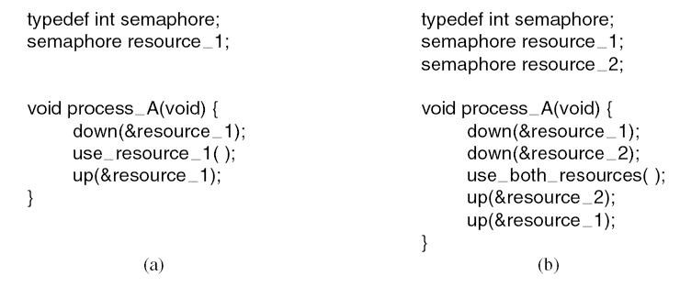
Resource Acquisition (1)
Figure 6-1. Using a semaphore to protect resources.
(a) One resource. (b) Two resources.
Tanenbaum, Modern Operating Systems 3 e, (c) 2008 Prentice-Hall, Inc. All rights reserved. 0-13-6006639

Slide 4
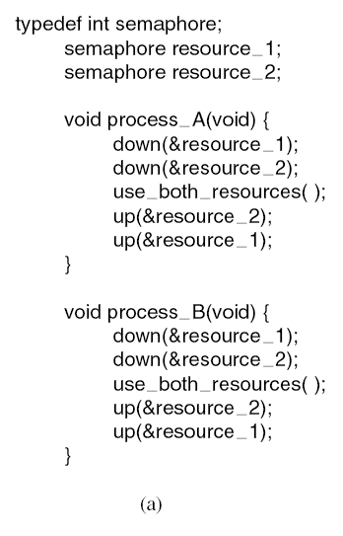
Resource Acquisition (2)
Figure 6-2. (a) Deadlock-free code.
Tanenbaum, Modern Operating Systems 3 e, (c) 2008 Prentice-Hall, Inc. All rights reserved. 0-13-6006639

Slide 5
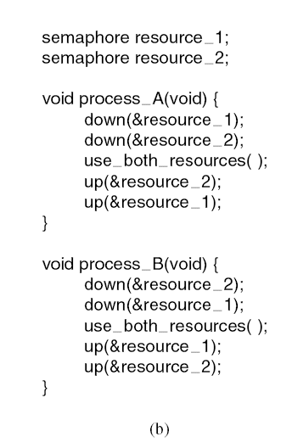
Resource Acquisition (3)
Figure 6-2. (b) Code with a potential deadlock.
Tanenbaum, Modern Operating Systems 3 e, (c) 2008 Prentice-Hall, Inc. All rights reserved. 0-13-6006639

Slide 6
Introduction To Deadlocks
Deadlock can be defined formally as follows:
A set of processes is deadlocked if each process in the set is waiting for an event that only another process in the set can cause.
Tanenbaum, Modern Operating Systems 3 e, (c) 2008 Prentice-Hall, Inc. All rights reserved. 0-13-6006639

Slide 7
Conditions for Resource Deadlocks
Mutual exclusion condition
Hold and wait condition.
No preemption condition.
Circular wait condition.
Tanenbaum, Modern Operating Systems 3 e, (c) 2008 Prentice-Hall, Inc. All rights reserved. 0-13-6006639

Slide 8
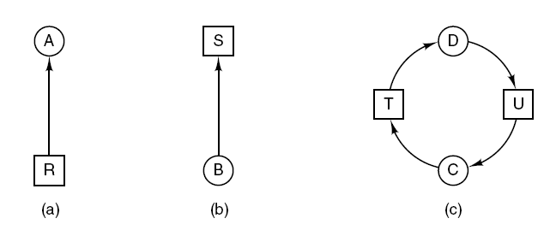
Deadlock Modeling (1)
Figure 6-3. Resource allocation graphs. (a) Holding a resource. (b) Requesting a resource. (c) Deadlock.
Tanenbaum, Modern Operating Systems 3 e, (c) 2008 Prentice-Hall, Inc. All rights reserved. 0-13-6006639

Slide 9
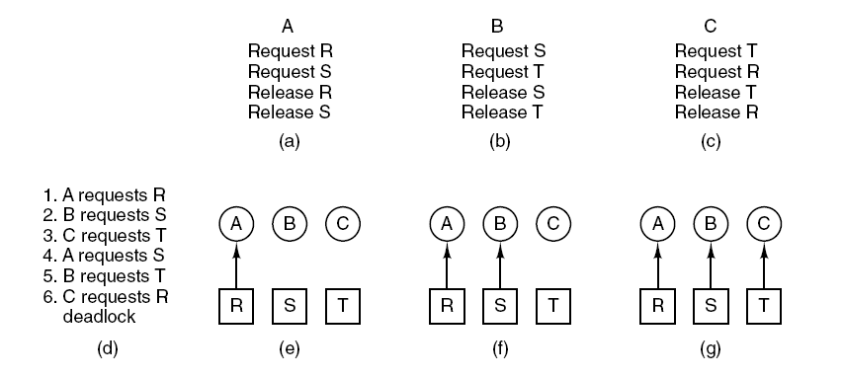
Deadlock Modeling (2)
Figure 6-4. An example of how deadlock occurs
and how it can be avoided.
Tanenbaum, Modern Operating Systems 3 e, (c) 2008 Prentice-Hall, Inc. All rights reserved. 0-13-6006639

Slide 10
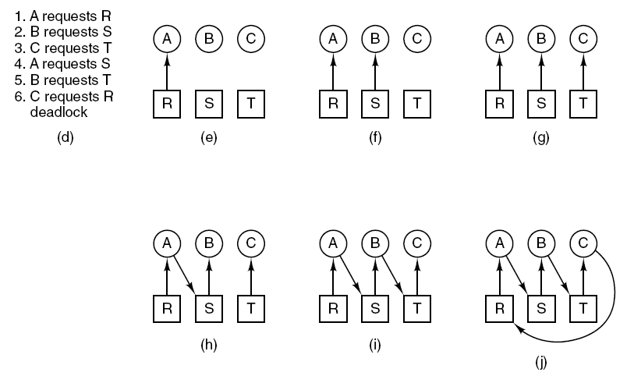
Deadlock Modeling (3)
Figure 6-4. An example of how deadlock occurs
and how it can be avoided.
Tanenbaum, Modern Operating Systems 3 e, (c) 2008 Prentice-Hall, Inc. All rights reserved. 0-13-6006639

Slide 11
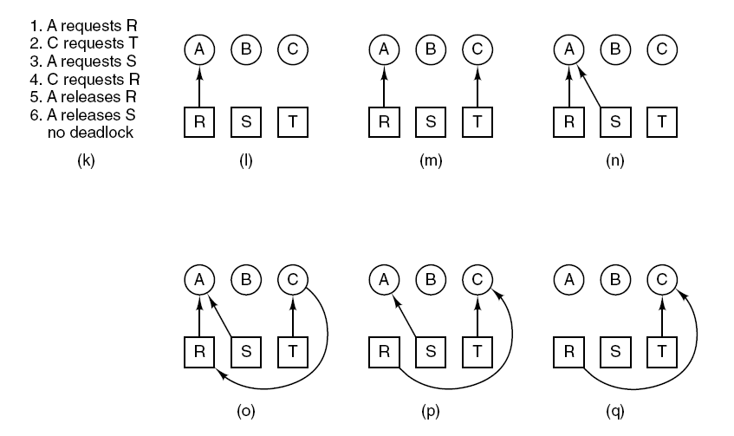
Deadlock Modeling (4)
Figure 6-4. An example of how deadlock occurs
and how it can be avoided.
Tanenbaum, Modern Operating Systems 3 e, (c) 2008 Prentice-Hall, Inc. All rights reserved. 0-13-6006639

Slide 12
Deadlock Modeling (5)
Strategies for dealing with deadlocks:
Just ignore the problem.
Detection and recovery. Let deadlocks occur, detect them, take action.
Dynamic avoidance by careful resource allocation.
Prevention, by structurally negating one of the four required conditions.
Tanenbaum, Modern Operating Systems 3 e, (c) 2008 Prentice-Hall, Inc. All rights reserved. 0-13-6006639

Slide 13
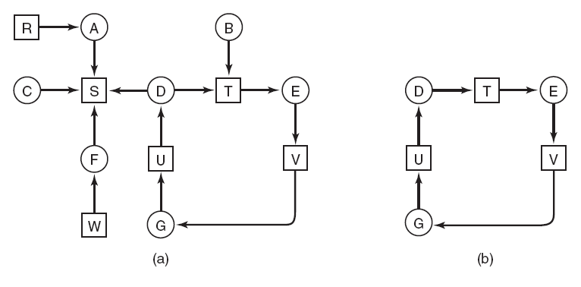
Deadlock Detection with
One Resource of Each Type (1)
Process A holds R and wants S.
Process B holds nothing but wants T.
Process C holds nothing but wants S.
Process D holds U and wants S and T.
Process E holds T and wants V.
Process F holds W and wants S.
Process G holds V and wants U.
Figure 6-5. (a) A resource graph. (b) A cycle extracted from (a).
Tanenbaum, Modern Operating Systems 3 e, (c) 2008 Prentice-Hall, Inc. All rights reserved. 0-13-6006639

Slide 14
Deadlock Detection with
One Resource of Each Type (2)
Algorithm for detecting deadlock:
For each node, N in the graph, perform the following five steps with N as the starting node.
Initialize L to the empty list, designate all arcs as unmarked.
Add current node to end of L, check to see if node now appears in L two times. If it does, graph contains a cycle (listed in L), algorithm terminates.
From given node, see if any unmarked outgoing arcs. If so, go to step 5; if not, go to step 6.
Pick an unmarked outgoing arc at random and mark it. Then follow it to the new current node and go to step 3.
If this is initial node, graph does not contain any cycles, algorithm terminates. Otherwise, dead end. Remove it, go back to previous node, make that one current node, go to step 3.
Tanenbaum, Modern Operating Systems 3 e, (c) 2008 Prentice-Hall, Inc. All rights reserved. 0-13-6006639

Slide 15
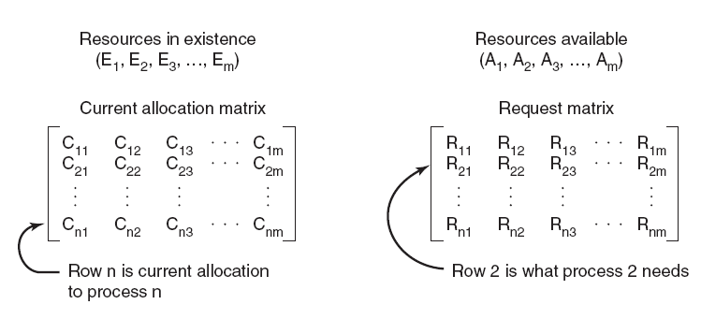
Deadlock Detection with Multiple Resources of Each Type (1)
i denote type of resources in Ei and Ai
Ei and Ai denote the number of resources of type i
Example, if class 1 is tape drives, then E1 = 2 means the system has two tape drives.
Figure 6-6. The four data structures needed
by the deadlock detection algorithm.
Tanenbaum, Modern Operating Systems 3 e, (c) 2008 Prentice-Hall, Inc. All rights reserved. 0-13-6006639

Slide 16
Deadlock Detection with Multiple Resources of Each Type (2)
Deadlock detection algorithm:
Look for an unmarked process, P_{i} , for which the i-th row of R is less than or equal to A.
If such a process is found, add the i-th row of C to A, mark the process, and go back to step 1.
If no such process exists, the algorithm terminates.
Tanenbaum, Modern Operating Systems 3 e, (c) 2008 Prentice-Hall, Inc. All rights reserved. 0-13-6006639

Slide 17
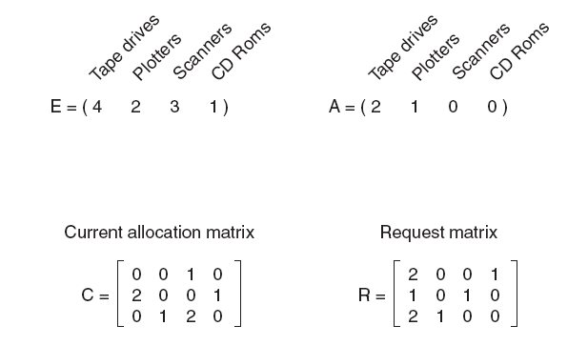
Deadlock Detection with Multiple Resources of Each Type (3)
Figure 6-7. An example for the deadlock detection algorithm.
Tanenbaum, Modern Operating Systems 3 e, (c) 2008 Prentice-Hall, Inc. All rights reserved. 0-13-6006639

Slide 18
Recovery from Deadlock
Recovery through preemption
  Example: snatch the printer from the process A, give it to process B. Process B completes. Return the printer to process A. Process A completes.
Recovery through rollback
  Create a checkpoint for the process A, stop process A, allocate the resource needed to process B. Process B completes. Restart process A from the checkpoint.
Recovery through killing processes
  Carefully choose a process to kill so that others can proceed.
Tanenbaum, Modern Operating Systems 3 e, (c) 2008 Prentice-Hall, Inc. All rights reserved. 0-13-6006639

Slide 19
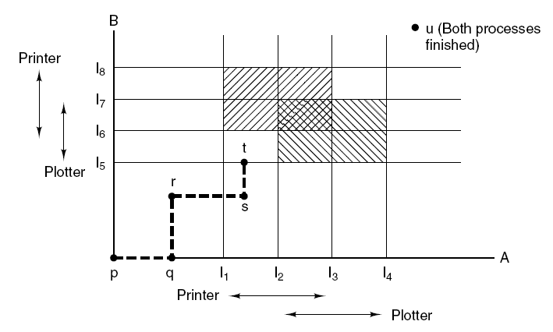
Deadlock Avoidance
Figure 6-8. Two process resource trajectories.
Tanenbaum, Modern Operating Systems 3 e, (c) 2008 Prentice-Hall, Inc. All rights reserved. 0-13-6006639

Slide 20
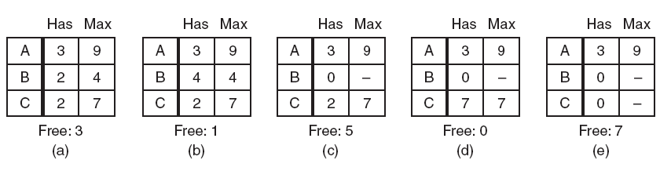
Safe and Unsafe States (1)
Total number of resources=10
Figure 6-9. Demonstration that the state in (a) is safe.
Tanenbaum, Modern Operating Systems 3 e, (c) 2008 Prentice-Hall, Inc. All rights reserved. 0-13-6006639

Slide 21
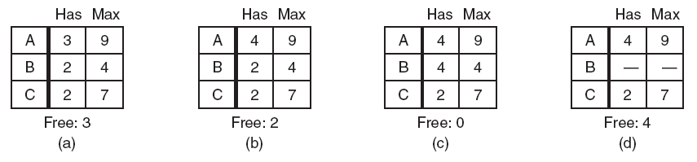
Safe and Unsafe States (2)
Note: An unsafe state is not a deadlocked state. Starting at Fig. 6-10(b), the system can run for a while. In fact, one process can even complete.
Figure 6-10. Demonstration that the state in (b) is not safe.
Tanenbaum, Modern Operating Systems 3 e, (c) 2008 Prentice-Hall, Inc. All rights reserved. 0-13-6006639

Slide 22
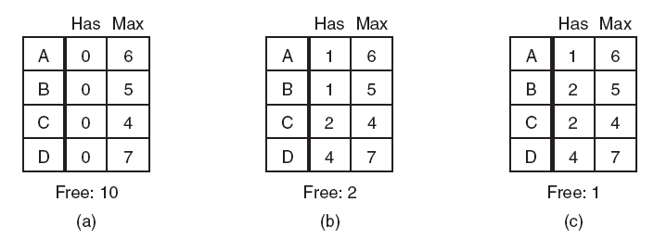
The Banker’s Algorithm for a Single Resource
If granting the request leads to an unsafe state, the request is denied, else accepted ☺.
Figure 6-11. Three resource allocation states:
(a) Safe. (b) Safe. (c) Unsafe.
Tanenbaum, Modern Operating Systems 3 e, (c) 2008 Prentice-Hall, Inc. All rights reserved. 0-13-6006639

Slide 23
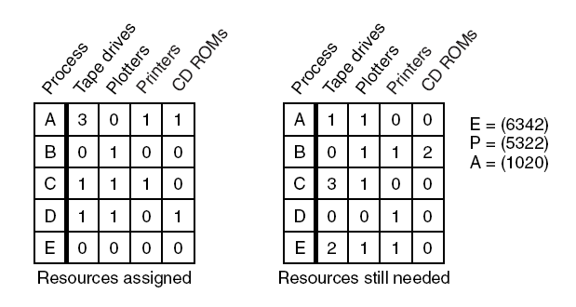
The Banker’s Algorithm for Multiple Resources (1)
Process B wants a printer, state=safe, granted
Process E want a printer, state=unsafe, denied
Q) Suppose that process A requests the last tape drive. Does this action lead to a deadlock?
Q) Can a system be in a state that is neither deadlocked nor safe?
Figure 6-12. The banker’s algorithm with multiple resources.
Tanenbaum, Modern Operating Systems 3 e, (c) 2008 Prentice-Hall, Inc. All rights reserved. 0-13-6006639

Slide 24
The Banker’s Algorithm for Multiple Resources (2)
Algorithm for checking to see if a state is safe:
Look for row, R, whose unmet resource needs all
≤ A. If no such row exists, system will eventually deadlock since no process can run to completion
Assume process of row chosen requests all resources it needs and finishes. Mark process as terminated, add all its resources to the A vector.
Repeat steps 1 and 2 until either all processes marked terminated (initial state was safe) or no process left whose resource needs can be met (there is a deadlock).
Tanenbaum, Modern Operating Systems 3 e, (c) 2008 Prentice-Hall, Inc. All rights reserved. 0-13-6006639

Slide 25
Deadlock Prevention
Attacking the mutual exclusion condition
  resource assigned exclusively to a single process, e.g. memory
  Not possible for all type of resources.
Attacking the hold and wait condition
  require all processes to request all their resources before starting execution
  processes do not know how many resources they will need until they have started running
Attacking the no preemption condition
  Forcibly take away the resource.
  Problem, e.g. forcibly taking away the printer while it is printing.
Attacking the circular wait condition
Tanenbaum, Modern Operating Systems 3 e, (c) 2008 Prentice-Hall, Inc. All rights reserved. 0-13-6006639

Slide 26
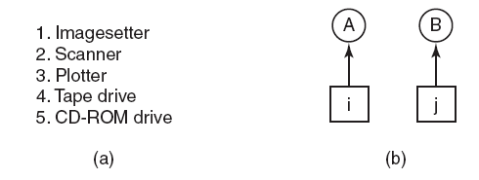
Attacking the
Circular Wait Condition
Processes can request resources whenever they want to, but all requests must be made in numerical order.
Example: A process may request first a printer and then a tape drive, but it may not request first a plotter and then a printer.
Figure 6-13. (a) Numerically ordered resources.
(b) A resource graph.
Tanenbaum, Modern Operating Systems 3 e, (c) 2008 Prentice-Hall, Inc. All rights reserved. 0-13-6006639

Slide 27
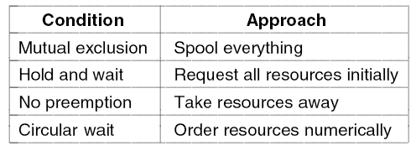
Approaches to Deadlock Prevention
Figure 6-14. Summary of approaches to deadlock prevention.
Tanenbaum, Modern Operating Systems 3 e, (c) 2008 Prentice-Hall, Inc. All rights reserved. 0-13-6006639

Slide 28
Questions?
A system has two processes and three identical resources. Each process needs a maximum of two resources. Is deadlock possible?
A computer has six tape drives, with n processes competing for them. Each process may need two drives. For which values of n is the system deadlock free?

Slide 29
Other Issues
Two-phase locking
  Commonly used in databases.
  First phase: lock all the needed resources. If locking succeeds, go to second phase, else release all the locks.
  Second phase: do the read or write operation.
Communication deadlocks
Livelock
Starvation
Tanenbaum, Modern Operating Systems 3 e, (c) 2008 Prentice-Hall, Inc. All rights reserved. 0-13-6006639

Slide 30
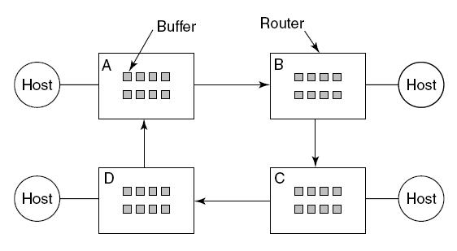
Communication Deadlocks
Figure 6-15. A resource deadlock in a network.
Tanenbaum, Modern Operating Systems 3 e, (c) 2008 Prentice-Hall, Inc. All rights reserved. 0-13-6006639

Slide 31
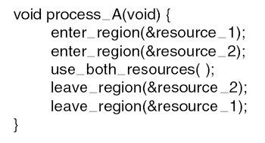
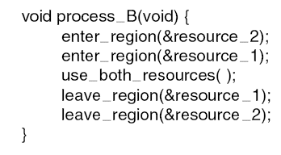
Livelock
Figure 6-16. Busy waiting that can lead to livelock.
Tanenbaum, Modern Operating Systems 3 e, (c) 2008 Prentice-Hall, Inc. All rights reserved. 0-13-6006639

