Slide 1

Lung Cancer Prediction STAT 362: Project
Anirudh Tiku - 19at77@queensu.ca
Anneth Sivakumar - 21as221@queensu.ca
Avi Mohan - 19am3@queensu.ca
Braedon Van Wiechen - 21bjvw@queensu.ca
Zain Zaidi - zain.zaidi@queensu.ca

Slide 2
Motivation Behind the Problem
Global Impact of Lung Cancer:
Lung cancer is a significant global health concern, with high prevalence and consequences.
It is the most diagnosed cancer in Canada and a leading cause of cancer-related deaths worldwide.
According to the International Agency for Research on Cancer (IARC), lung cancer is the leading cause of cancer-related deaths globally, resulting in over 1.8 million fatalities (18%) in 2020.
Urgency for Understanding Risk Factors:
Detection often occurs at advanced stages, limiting treatment options and prognosis.
Understanding risk factors is crucial for early detection, targeted screening, public health policies, and personalized treatments.

Slide 3
Introduction:
Study Objective:
Analyze risk factors associated with lung cancer using a dataset of diagnosed patients.
Focus on lifestyle, environmental, and genetic factors to understand mechanisms of lung cancer development.
Dataset
We obtained our dataset from Kaggle.
Previous studies on this dataset have focused on CT imaging interpretation; however, our study explores the various factors and their interactions contributing to lung cancer development, by leveraging statistical tools.

Slide 4
Description of The Dataset:
Variable Name | Mean | Maximum | Minimum | Variable Type
Age | 37.17 | 73 | 14 | numerical
Gender | 1.40 | 2 | 1 | binary
Air Pollution | 3.84 | 8 | 1 | categorical
Alcohol Use | 4.56 | 8 | 1 | categorical
Dust Allergy | 5.17 | 8 | 1 | categorical
OccuPational Hazards | 4.84 | 8 | 1 | categorical
Genetic Risk | 4.58 | 7 | 1 | categorical
chronic Lung Disease | 4.38 | 7 | 1 | categorical
Balanced Diet | 4.49 | 7 | 1 | categorical
Obesity | 4.47 | 7 | 1 | categorical
Smoking | 3.95 | 8 | 1 | categorical
Passive Smoker | 4.20 | 8 | 1 | categorical
Variable Name | Mean | Maximum | Minimum | Variable Type
Chest Pain | 4.44 | 9 | 1 | categorical
Coughing of Blood | 4.86 | 9 | 1 | categorical
Fatigue | 3.86 | 9 | 1 | categorical
Weight Loss | 3.86 | 8 | 1 | categorical
Shortness of Breath | 4.24 | 9 | 1 | categorical
Wheezing | 3.78 | 8 | 1 | categorical
Swallowing Difficulty | 3.75 | 8 | 1 | categorical
Clubbing of Finger Nails | 3.92 | 9 | 1 | categorical
Frequent Cold | 3.54 | 7 | 1 | categorical
Dry Cough | 3.85 | 7 | 1 | categorical
Snoring | 2.93 | 7 | 1 | categorical
Level | “Medium” | “High” | “Low” | categorical
The dataset initially contained 1000 records with 26 attributes. Although on further inspection, we realized that the 1st and 2nd attribute i.e. Index and Patient.Id were redundant for our analysis, so we dropped them from our dataset.
Next, we checked for missing values in the dataset, but there were none.
Upon examining the dataset, we realized that all the variables were factors, so we converted them from numeric to factors (except age).
We added a new variable, AgeGroup, which categorized the age groups into appropriate bins.
Figure 1: Dataset table
Figure 2: Dataset table

Slide 5
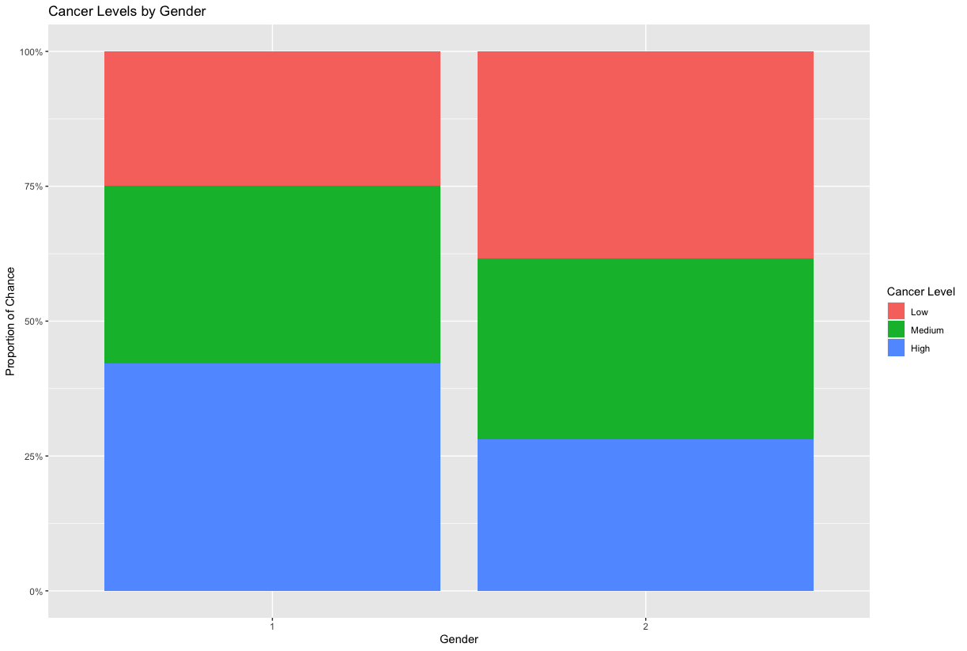
Lung Cancer Statistics by Gender:
Figure 3 displays the correlation between lung cancer levels and gender
Relatively similar in terms of medium-stage cancer for both genders
Males have a greater chance of developing higher-stage cancer, whereas females have a greater chance of low-stage cancer.
Figure 3: Stacked Bar Chart of Lung Cancer (by level) Gender Distribution

Slide 6
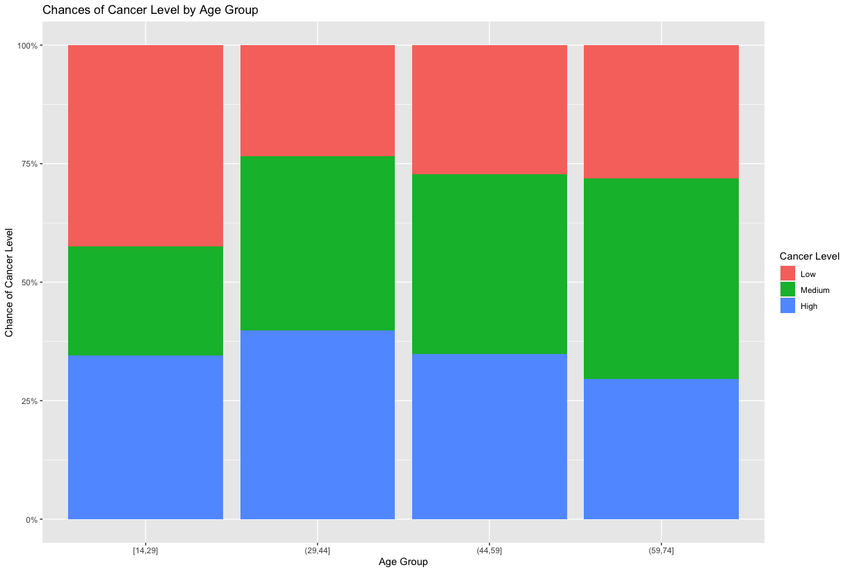
Lung Cancer Statistics by Age Group
Figure 4 displays the correlation between age groups and lung cancer level
Relatively similar across ages of 29-74
Ages 14-29 have a significantly greater proportion of low stage lung cancer
High stage cancer is relatively similar across all age groups
Figure 4: Lung Cancer (by level) Age Distribution plot

Slide 7
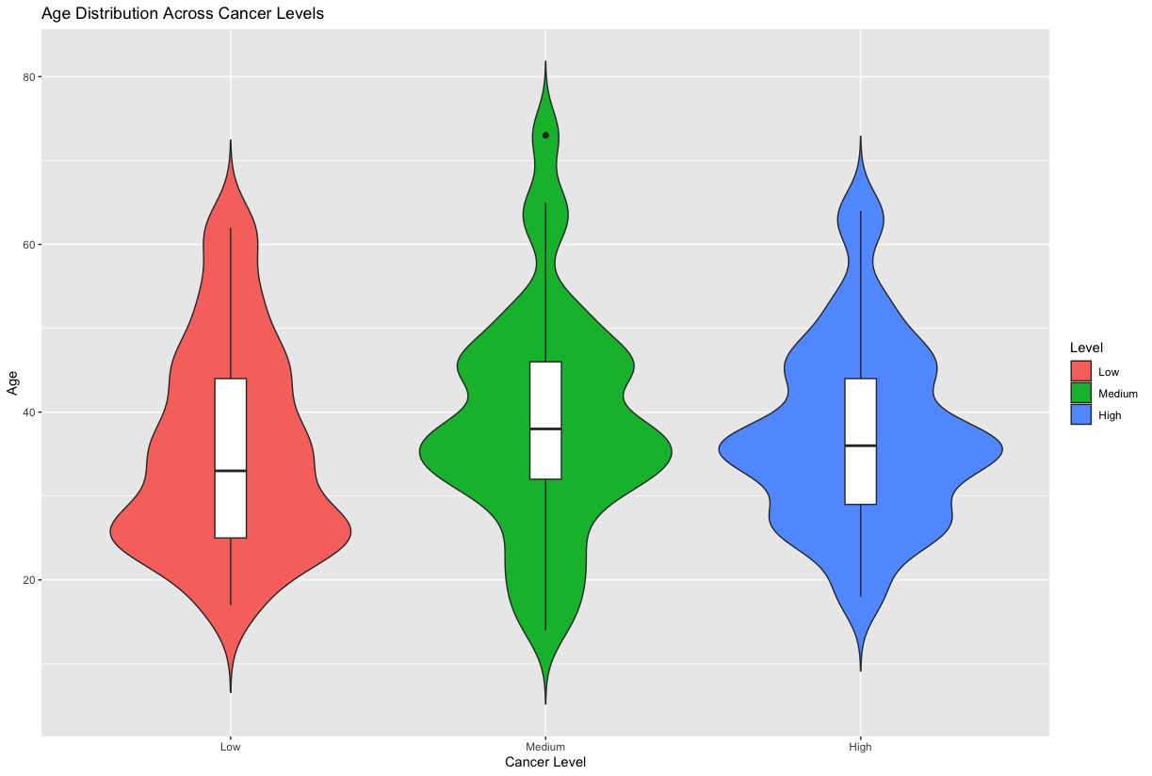
Lung Cancer Statistics by Age Group (contd.)
Figure 5 displays the age distribution across cancer levels
A large number of patients appear to get diagnosed with Medium or High level lung cancer at about the age of 35
The median age to get diagnosed with lung cancer at any level appears to be between 25-40 years of age
​
Figure 5: Violin Plot of Age Distribution and Lung Cancer (by level)

Slide 8
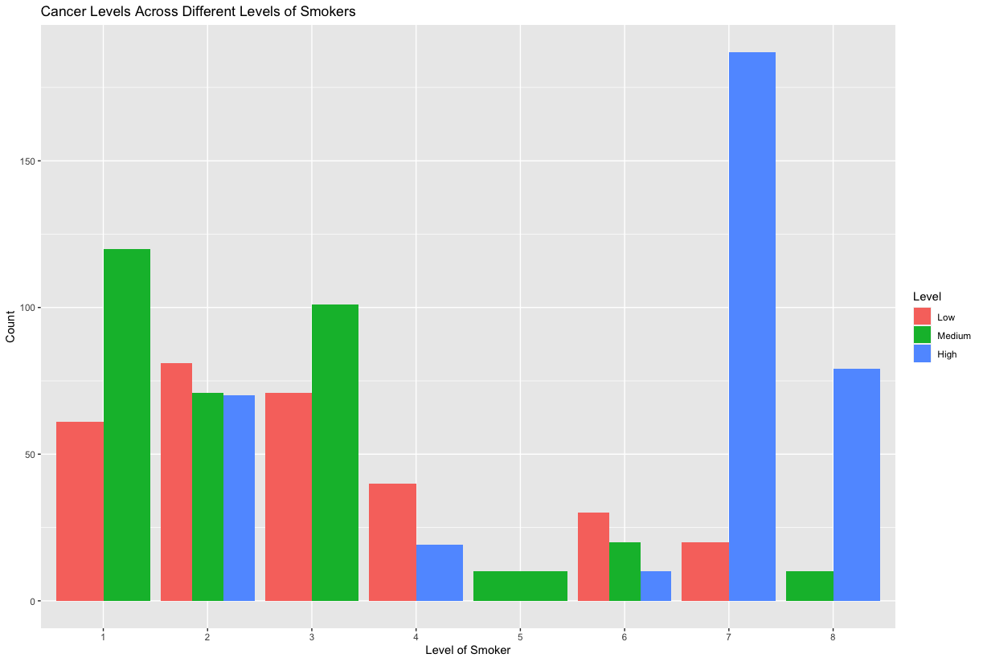
Lung Cancer and Smoking
Figure 6 displays Cancer Levels across different levels of smokers
​Low level cancer count peaks among level 2 smokers and steadily decreases across the higher levels
​Level 7 smokers have the greatest high level cancer count
Figure 6: Histogram of Lung Cancer (by level) across different levels of smokers

Slide 9
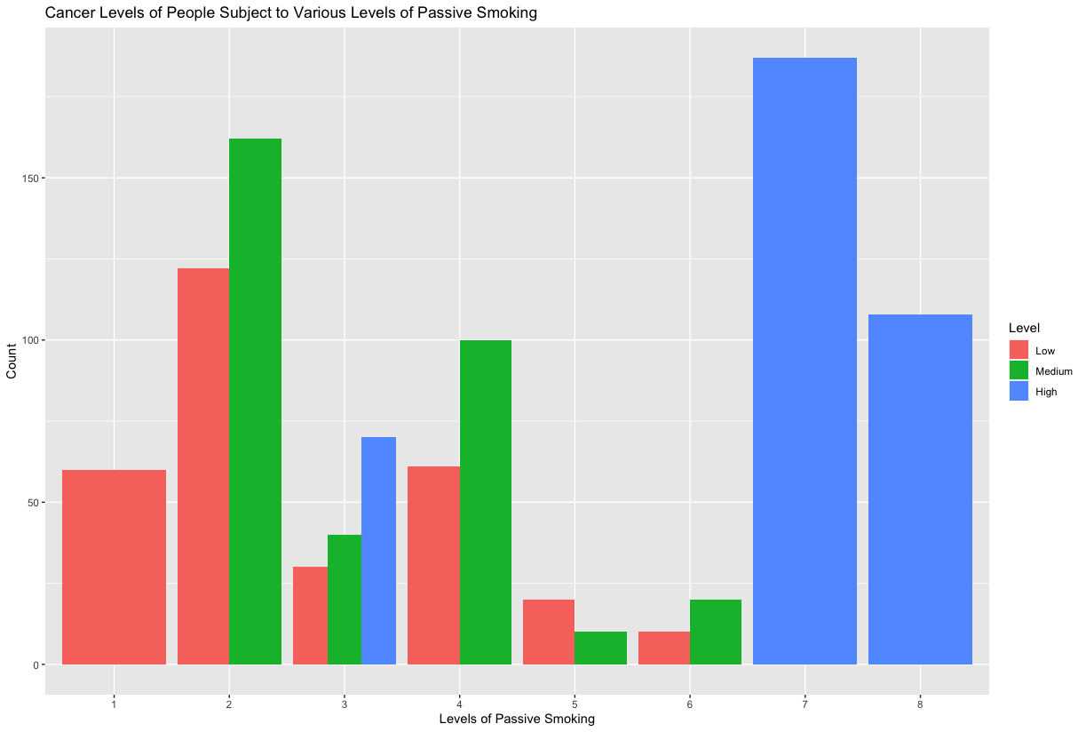
Lung Cancer and Smoking (contd.)
Figure 7 displays lung cancer levels across people exposed to different levels of passive smoking
​
​Higher cancer levels generally make up a greater proportion of cancer among higher levels of smokers
​
​People at level 7 exposure to passive smoking have a higher lung cancer count
Figure 7: Histogram of Lung Cancer (by level) across different levels of exposure to passive smoking

Slide 10
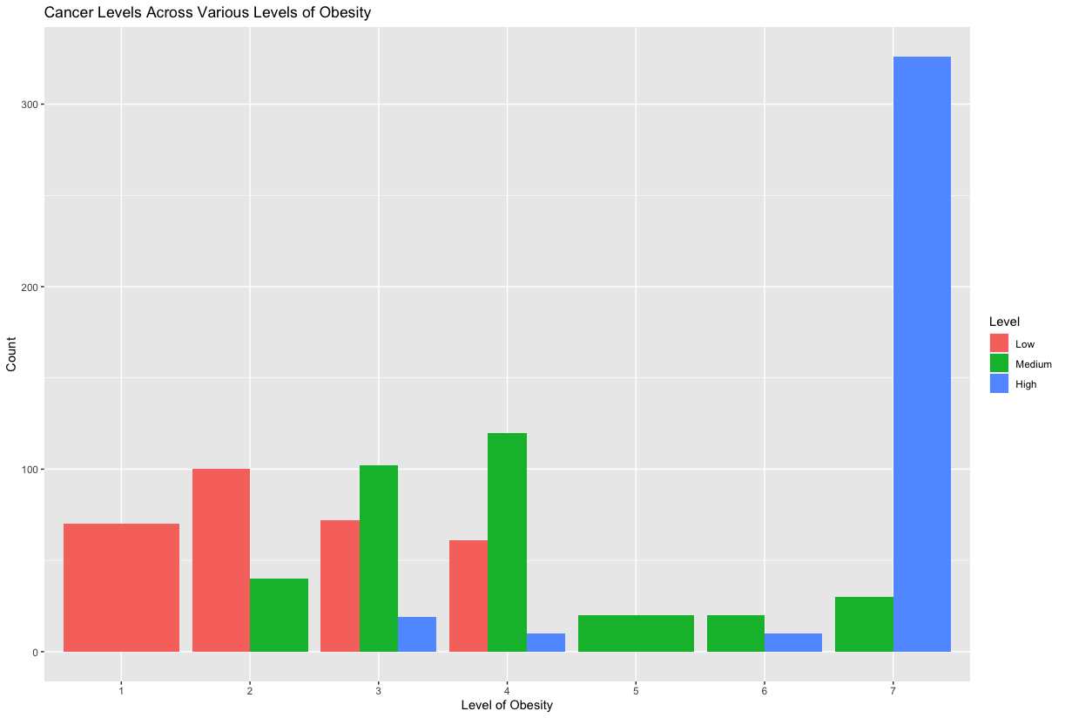
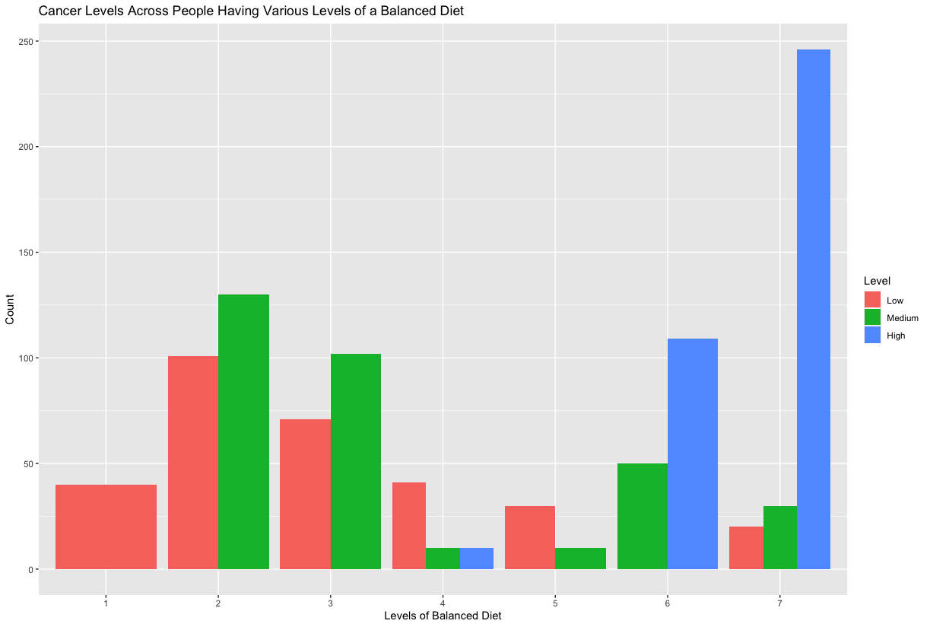
Lung Cancer and Health/Eating Habits
Add text:
Figure 8: Histogram of Lung Cancer across different levels of obesity
Figure 9: Histogram of Lung Cancer across different levels of balanced diets

Slide 11
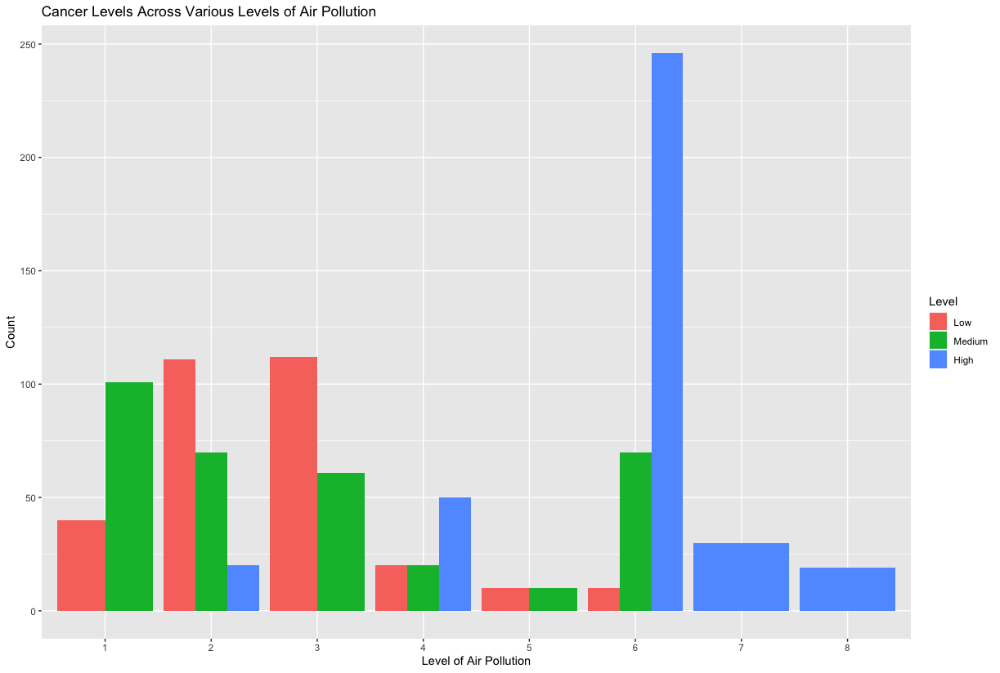
Lung Cancer Statistics by Levels of Air Pollution
Figure 11 displays correlation between lung cancer stage and level of air pollution
Higher count of end-stage lung cancer in areas of poor air quality
Add text:
Figure 10: Histogram of Lung Cancer across different levels of exposure to air pollution

Slide 12
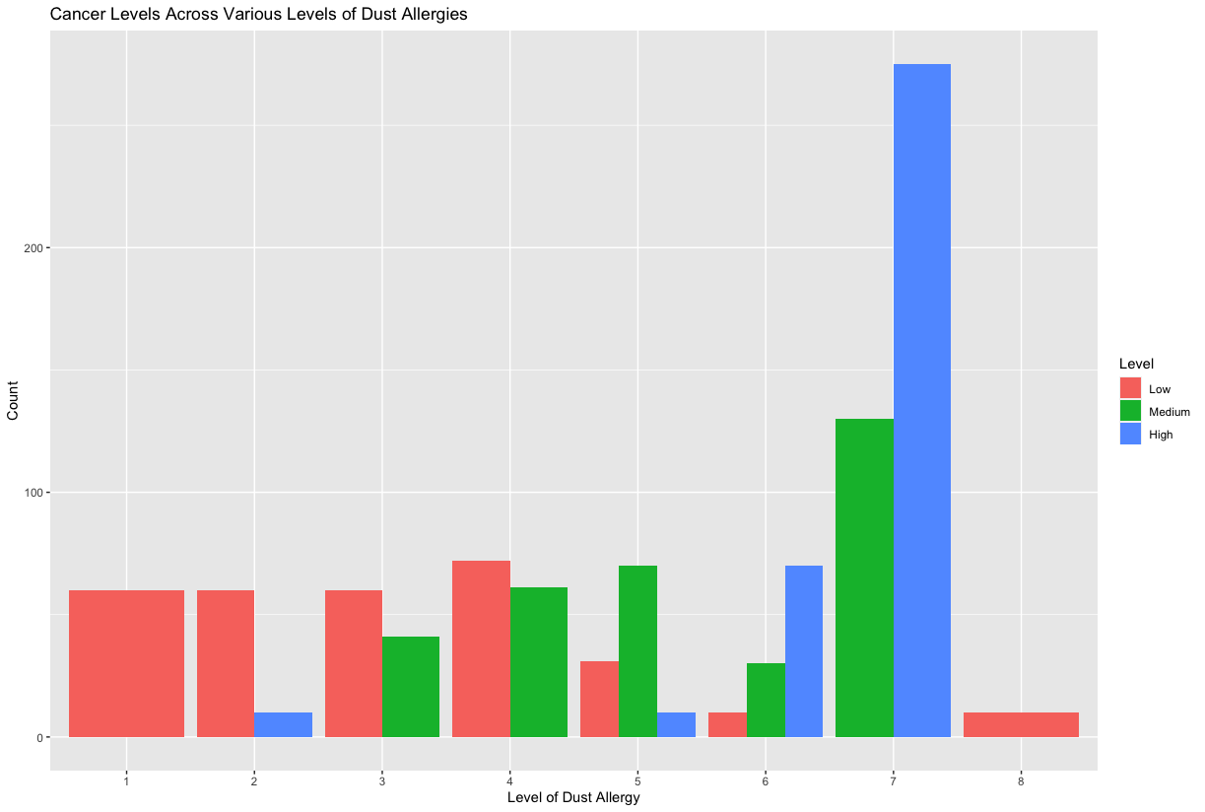
Dust Allergies and Lung Cancer Statistics
Figure 13 displays the correlation of lung cancer levels for patients with pre-existing dust allergies
Dust allergies damage upper respiratory tract, but could create conditions for cancer.
As the severity of dust allergies increases, the risk of developing medium to high stage lung cancer increases
Add text:
Figure 11: Histogram of Lung Cancer across different levels of dust allergies

Slide 13
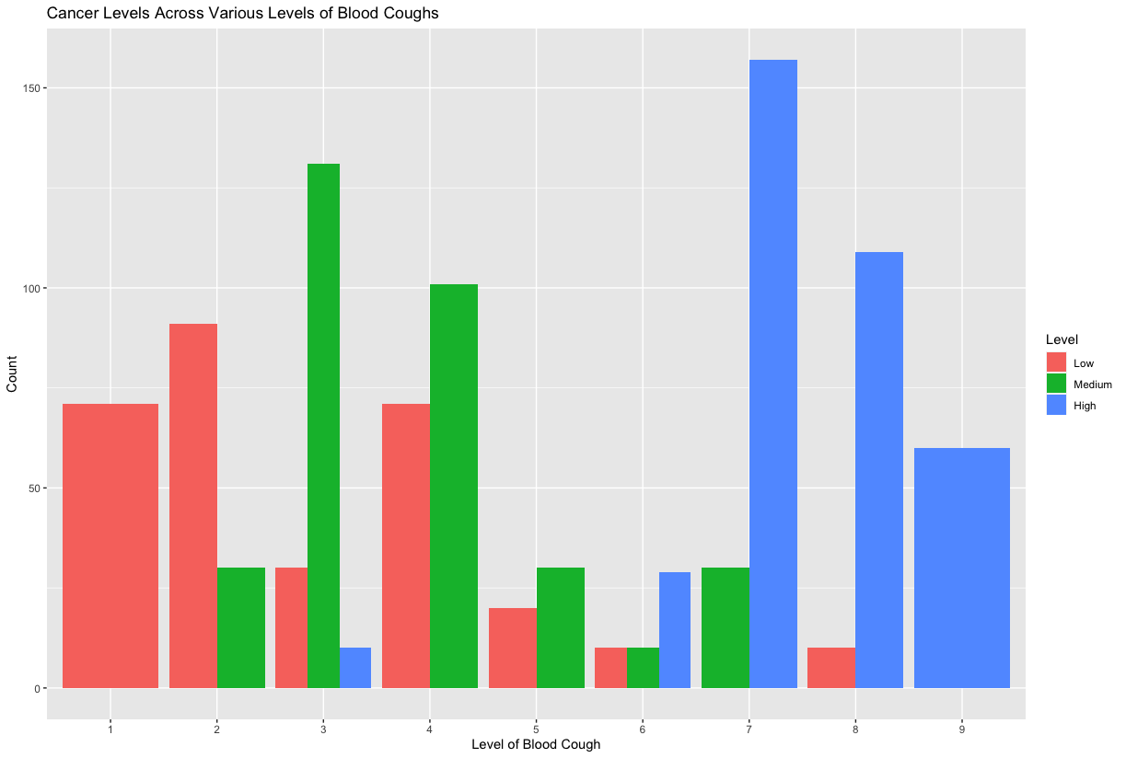
Blood Coughs and Lung Cancer
Figure 14 displays the correlation of lung cancer levels for patients who display the symptom of blood coughs
Tumor causes blood vessels around it to erode and bleed into airways.
Good indicator of lung cancer
As the blood coughs start to worsen, there is an increased likelihood of end-stage lung cancer
Add text:
Figure 12: Histogram of Lung Cancer across different levels of blood coughs

Slide 14
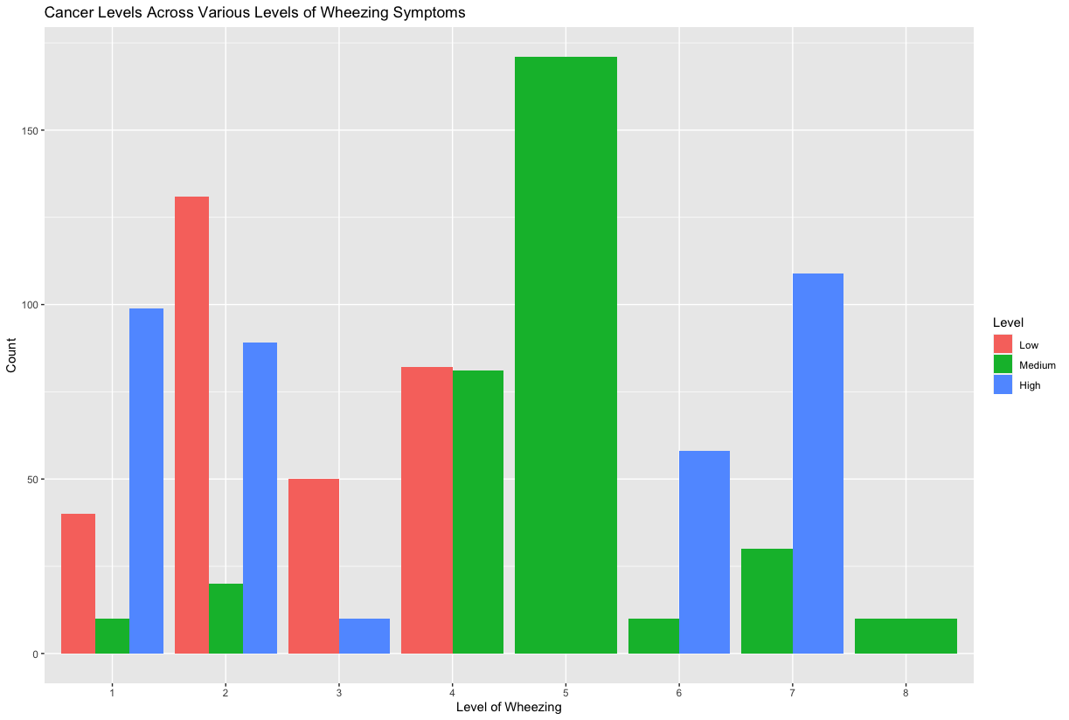
Wheezing and Lung Cancer
Figure 15 displays the correlation of lung cancer levels for patients who display the symptom of wheezing
Wheezing is a common symptom of respiratory illness usually associated with asthma and COPD
We can observe that there is a high level of variance in the dataset in terms of Wheezing, leading to inconsistent results throughout all three levels of lung cancer.
Add text:
Figure 13: Histogram of Lung Cancer across different levels of patients experiencing wheezing

Slide 15
Method 1: K-Nearest Neighbors
Hypothesis:
The hypothesis is that there is a significant relationship between the patient's attributes and the likelihood of having a certain level of lung cancer. KNN is suitable because it can capture complex correlations without assuming a specific data distribution. It works by comparing a patient's features to its nearest neighbors, which aligns with the idea that similar patients may have similar cancer risks.
Model Explanation:
KNN is a machine learning algorithm used for classification and regression. It identifies k nearest neighbors for each data point based on Euclidean distance, assigning responses by comparing predicted and actual data. KNN can handle various data types, making it suitable for our nearly categorical dataset. This method is ideal for classification tasks, predicting if a patient will develop lung cancer based on various factors such as age, gender, and pollution exposure.
Preprocessing:
The dataset is split into training and testing sets. 500 samples were used for training, with the rest for testing. Min-max normalization was applied to scale data between 0 and 1, ensuring all features contribute equally to distance calculations. Cross-validation was used to find the optimal k value, which was 3 for this dataset.

Slide 16
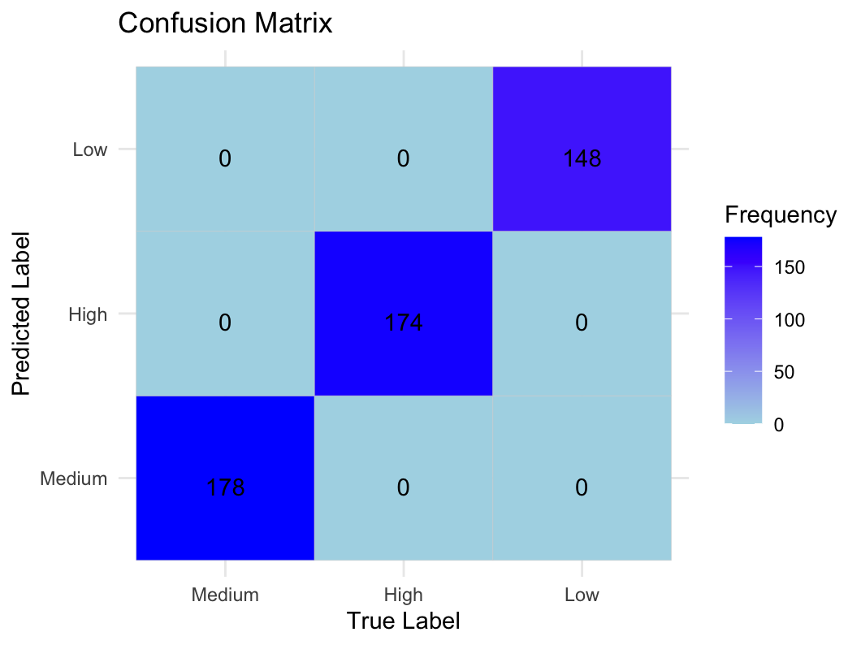
Method 1: K-Nearest Neighbors
 | Medium | High | Low
Sensitivity | 1.0 | 1.0 | 1.0
Specificity | 1.0 | 1.0 | 1.0
Figure 14: Sensitivity and Specificity Results from KNN Model in a Table
Figure 15: Classification Results from KNN Model in a Confusion Matrix

Slide 17
Method 2: Decision Tree
Hypothesis:
The decision tree model can accurately classify the levels of cancer (Low, Medium, High) by learning the nonlinear relationships and interactions among various risk factors and symptoms.
Model Explanation:
Decision trees are capable of modelling nonlinear relationships without requiring any assumptions about the distribution of variables, which makes them suitable for complex datasets where the relationships between features and the response is not straightforward. Decision trees can also inherently capture interactions between features which is crucial for medical datasets where the interaction between risk factors (e.g. air pollution, balanced diet) may significantly impact the outcome.
Preprocessing:
The data was split into training and testing sets using an 80-20 split, as this is usually an optimal split. We set a seed for the random index to ensure reproducibility.

Slide 18
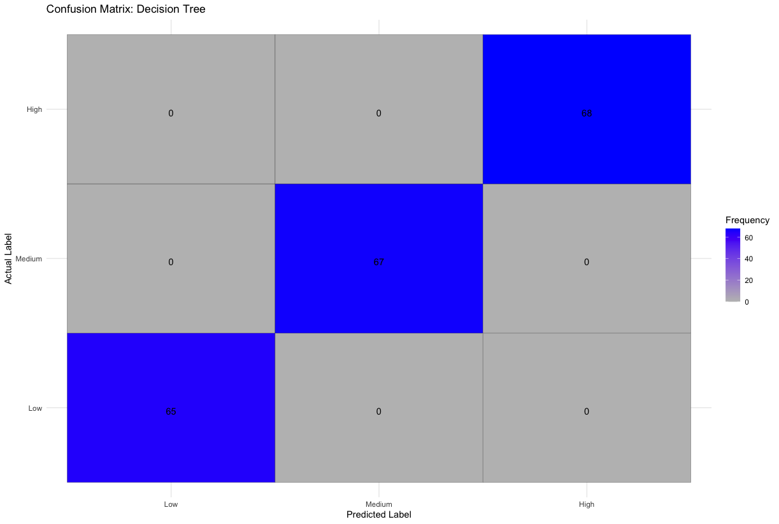
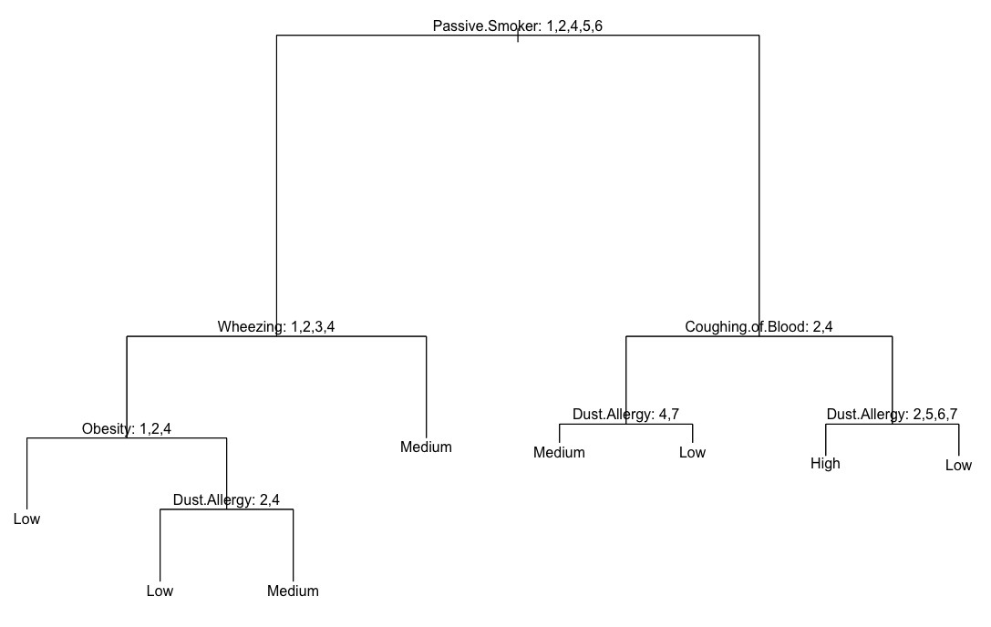
Method 2: Decision Tree
Figure 16: Decision Tree Results
Figure 17: Classification Results from Decision Tree Model

Slide 19
Method 3: Logistic Regression
Hypothesis: The hypothesis is that there is a statistically significant association between patient attributes and the probability of having lung cancer, quantified by odds ratios. Logistic regression is suitable because it can model this relationship, providing estimates of odds ratios for each attribute. This allows for quantifying the strength and direction of association between attributes and the likelihood of lung cancer, aiding in identifying potential risk factors.
Model Explanation: Logistic regression analyzes the relationship between a categorical dependent variable (lung cancer diagnosis) and independent variables (patient attributes). It estimates the probability of the dependent variable based on the independent variables. In our dataset, logistic regression can show how patient attributes are associated with the likelihood of lung cancer, providing insights into significant predictors and their impact, quantified as odds ratios.
Preprocessing: The dataset is split into training and testing sets using a 70-30 split. Min-max normalization is applied to scale data between 0 and 1. The 'Level' column is removed for normalization and added back afterward. Instances where the 'Level' variable is 'Medium' are filtered out. The 'Level' variable is converted to a binary outcome, with 'High' as 1 and other levels as 0, added to the training set as 'Level binary'.

Slide 20
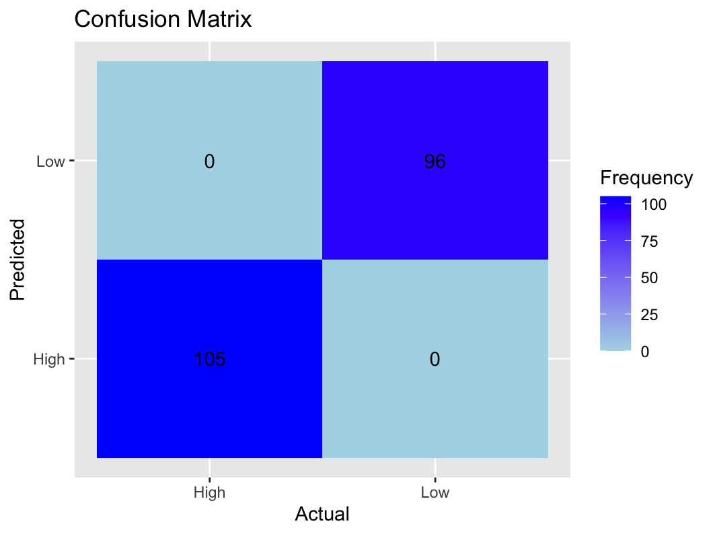
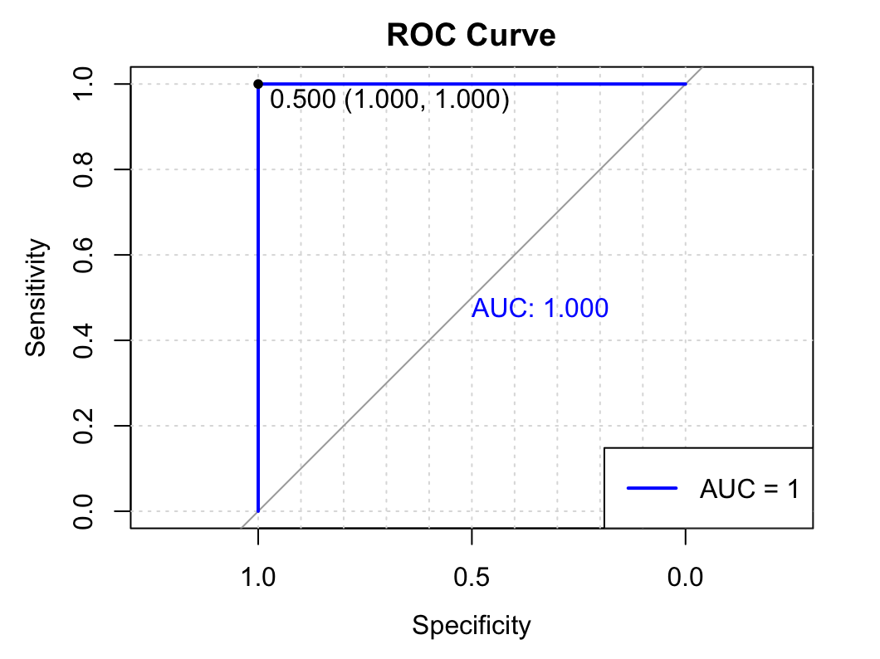
Method 3: Logistic Regression
Figure 18: Classification Results from Logistic Regression Model in a Confusion Matrix
Figure 19: ROC Curve and AUC from Logistic Regression Model

Slide 21
Method 4: Random Forest
Hypothesis:
The random forest model will effectively classify the levels of cancer by capturing complex interactions and non-linear relationships among the various predictors within the dataset.
Model Explanation:
Random forests are robust to outliers and noise, reducing the risk of overfitting, especially when the dataset has many features like our medical dataset. Random forests can also provide estimates of feature importance, allowing for the identification of the most significant predictors out of potentially many correlated variables. This can help us see which risk factors or symptoms are indicative of having lung cancer.
Preprocessing:
The data was split into training and testing sets using an 80-20 split, as this is usually an optimal split. We set a seed for the random index to ensure reproducibility.

Slide 22

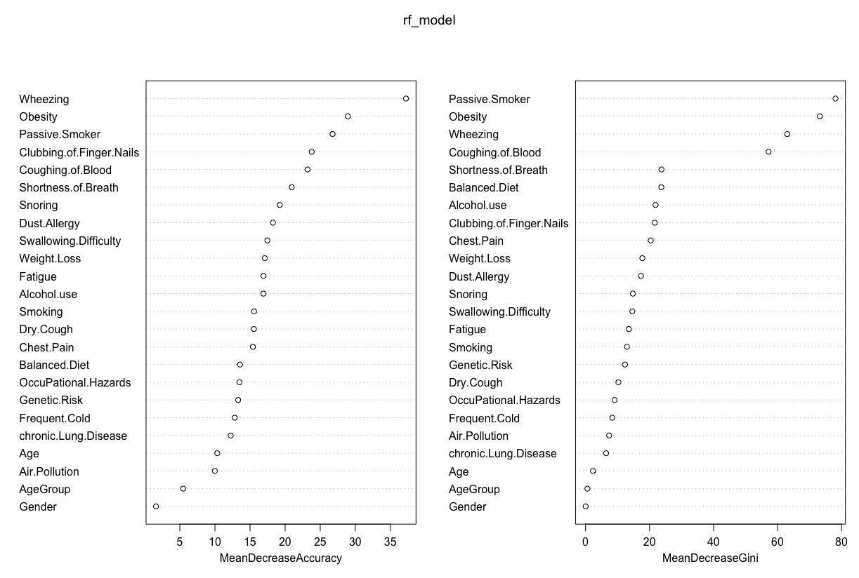
Method 4: Random Forest
Figure 20: Variable Importance Plots
Figure 21: Classification Results from Random Forest Model

Slide 23
Result Analysis:
Performance Comparison:
Model | Accuracy | Kappa
K-Nearest Neighbors (KNN) | 100% | 1.0
Decision Tree | 100% | 1.0
Logistic Regression | 100% | 1.0
Random Forest | 100% | 1.0
The analysis yielded compelling results, showcasing the effectiveness of the K-Nearest Neighbors, decision tree, logistic regression and random forest models in predicting lung cancer severity based on patient attributes.
The perfect accuracy reveals that all variables in the data set are closely linked with the progression of lung cancer

Slide 24
Conclusion & Discussion:
Despite the promising results, several limitations should be considered:
The analysis relied on a single dataset, which may limit the generalizability of the findings to other populations or settings.
The dataset's size (1000 samples) may not be representative of the entire population, potentially affecting the models' performance.
While various statistical models showed high accuracy, there is always a risk of overfitting, especially with complex datasets.
Future studies could explore the use of more advanced machine learning techniques or ensemble methods to improve predictive performance and robustness.
Despite these limitations, the study provides valuable insights into the potential use of machine learning in predicting lung cancer severity and highlights the importance of early detection and intervention in improving patient outcomes.

