Slide 1
Visualizing Regresion Discontinity
An Nguyen

Slide 2
Descriptive Statistics - Focal Community
created_date | m_toxicity | m_identity_attack | m_insult | p_toxicity | p_identity_attack | p_insult
2019-09-28 | 0.3310084 | 0.0135714 | 0.1289217 | 0.3333333 | 0.0000000 | 0.1062802
2019-09-29 | 0.2093660 | 0.0124813 | 0.0698800 | 0.1847826 | 0.0108696 | 0.0597826
2019-09-30 | 0.3365034 | 0.0146867 | 0.1527977 | 0.3386243 | 0.0052910 | 0.1402116
2019-10-01 | 0.2105917 | 0.0143560 | 0.0715028 | 0.1956522 | 0.0054348 | 0.0543478
2019-10-02 | 0.2410209 | 0.0082379 | 0.0759891 | 0.2413793 | 0.0000000 | 0.0551724
2019-10-03 | 0.2588818 | 0.0062354 | 0.1056009 | 0.2375479 | 0.0000000 | 0.0881226
2019-10-04 | 0.2556396 | 0.0135816 | 0.0889953 | 0.2387268 | 0.0026525 | 0.0742706
2019-10-05 | 0.3156507 | 0.0147776 | 0.1223549 | 0.3195266 | 0.0029586 | 0.0946746
2019-10-06 | 0.2300988 | 0.0108683 | 0.0828937 | 0.2292994 | 0.0000000 | 0.0541401
2019-10-07 | 0.2042268 | 0.0094024 | 0.0652748 | 0.2004556 | 0.0000000 | 0.0546697
2019-10-08 | 0.2152099 | 0.0098777 | 0.0733577 | 0.2136364 | 0.0022727 | 0.0477273
2019-10-09 | 0.2420333 | 0.0144941 | 0.0939349 | 0.2451193 | 0.0000000 | 0.0650759
2019-10-10 | 0.2388441 | 0.0101766 | 0.0883191 | 0.2342733 | 0.0000000 | 0.0780911
2019-10-11 | 0.2607228 | 0.0076250 | 0.0683391 | 0.2450980 | 0.0024510 | 0.0392157
2019-10-12 | 0.1887222 | 0.0053770 | 0.0564168 | 0.1671642 | 0.0029851 | 0.0388060
2019-10-13 | 0.2300381 | 0.0054839 | 0.0760668 | 0.2225352 | 0.0000000 | 0.0535211
2019-10-14 | 0.2344846 | 0.0084985 | 0.0781753 | 0.2280702 | 0.0029240 | 0.0467836
2019-10-15 | 0.2319788 | 0.0124803 | 0.0806875 | 0.2161172 | 0.0036630 | 0.0695971
2019-10-16 | 0.2510785 | 0.0104776 | 0.0778705 | 0.2375691 | 0.0000000 | 0.0552486
2019-10-17 | 0.2657187 | 0.0143361 | 0.0984404 | 0.2575758 | 0.0075758 | 0.0858586
2019-10-18 | 0.2702445 | 0.0163988 | 0.0986874 | 0.2759434 | 0.0070755 | 0.0754717
2019-10-19 | 0.3023439 | 0.0120376 | 0.1070734 | 0.3017241 | 0.0034483 | 0.0965517
2019-10-20 | 0.2557033 | 0.0192554 | 0.0767412 | 0.2323232 | 0.0101010 | 0.0555556
2019-10-21 | 0.2290665 | 0.0088837 | 0.0837843 | 0.2040816 | 0.0000000 | 0.0686456
2019-10-22 | 0.3137189 | 0.0205712 | 0.1218327 | 0.3036952 | 0.0103926 | 0.1050808
2019-10-23 | 0.3092424 | 0.0155089 | 0.1311534 | 0.2992126 | 0.0034996 | 0.1198600
2019-10-24 | 0.2597514 | 0.0161689 | 0.0977066 | 0.2486065 | 0.0055741 | 0.0802676
2019-10-25 | 0.2634797 | 0.0179468 | 0.1049565 | 0.2494357 | 0.0045147 | 0.0846501
2019-10-26 | 0.2440751 | 0.0129296 | 0.0827836 | 0.2314578 | 0.0025575 | 0.0626598
2019-10-27 | 0.3148443 | 0.0187672 | 0.1330512 | 0.3110261 | 0.0089229 | 0.1166348
2019-10-28 | 0.2072375 | 0.0080652 | 0.0710291 | 0.1848875 | 0.0000000 | 0.0546624
2019-10-29 | 0.2738117 | 0.0124250 | 0.1079941 | 0.2748948 | 0.0028050 | 0.0883590
2019-10-30 | 0.2651266 | 0.0148489 | 0.1067327 | 0.2584009 | 0.0046350 | 0.0926999
2019-10-31 | 0.2790659 | 0.0160489 | 0.1060473 | 0.2728411 | 0.0075094 | 0.0876095
2019-11-01 | 0.2277068 | 0.0126672 | 0.0800828 | 0.2051672 | 0.0045593 | 0.0623100
2019-11-02 | 0.2682568 | 0.0141924 | 0.0926645 | 0.2548263 | 0.0077220 | 0.0656371
2019-11-03 | 0.2409060 | 0.0079310 | 0.0974115 | 0.2267081 | 0.0000000 | 0.0745342
2019-11-04 | 0.2368619 | 0.0085039 | 0.0867194 | 0.2229299 | 0.0015924 | 0.0732484
2019-11-05 | 0.2602153 | 0.0124116 | 0.0919768 | 0.2583942 | 0.0029197 | 0.0744526
2019-11-06 | 0.2644238 | 0.0098400 | 0.0874672 | 0.2581369 | 0.0000000 | 0.0639731
2019-11-07 | 0.2514517 | 0.0110039 | 0.0893011 | 0.2388818 | 0.0038119 | 0.0686150
2019-11-08 | 0.2812533 | 0.0095577 | 0.0940354 | 0.2602546 | 0.0014144 | 0.0693069
2019-11-09 | 0.2858794 | 0.0090073 | 0.0951674 | 0.2753404 | 0.0000000 | 0.0786687
2019-11-10 | 0.2826792 | 0.0098004 | 0.1043721 | 0.2722343 | 0.0000000 | 0.0856833
2019-11-11 | 0.2241101 | 0.0101896 | 0.0716758 | 0.2184769 | 0.0024969 | 0.0499376
2019-11-12 | 0.2372074 | 0.0143662 | 0.0936280 | 0.2196879 | 0.0096038 | 0.0792317
2019-11-13 | 0.2428948 | 0.0095967 | 0.0845650 | 0.2411348 | 0.0014184 | 0.0638298
2019-11-14 | 0.2214021 | 0.0067528 | 0.0857822 | 0.2145546 | 0.0012547 | 0.0727729
2019-11-15 | 0.2265181 | 0.0077770 | 0.0750283 | 0.2237522 | 0.0000000 | 0.0550775
2019-11-16 | 0.2492543 | 0.0095916 | 0.0790314 | 0.2465753 | 0.0015221 | 0.0547945
2019-11-17 | 0.1949617 | 0.0085376 | 0.0591332 | 0.1736771 | 0.0013569 | 0.0393487
2019-11-18 | 0.2180223 | 0.0070505 | 0.0686553 | 0.1994342 | 0.0014144 | 0.0537482
2019-11-19 | 0.2399459 | 0.0075159 | 0.0791608 | 0.2219275 | 0.0017683 | 0.0610080
2019-11-20 | 0.2183095 | 0.0077768 | 0.0727332 | 0.2019635 | 0.0000000 | 0.0532959
2019-11-21 | 0.2370259 | 0.0105621 | 0.0715790 | 0.2223881 | 0.0044776 | 0.0492537
2019-11-22 | 0.2152000 | 0.0075903 | 0.0646458 | 0.2062193 | 0.0016367 | 0.0409165
2019-11-23 | 0.2040235 | 0.0097705 | 0.0576116 | 0.1938580 | 0.0038388 | 0.0326296
2019-11-24 | 0.2013207 | 0.0072514 | 0.0636722 | 0.1825038 | 0.0015083 | 0.0512821
2019-11-25 | 0.2333376 | 0.0079406 | 0.0811790 | 0.2230088 | 0.0035398 | 0.0566372
2019-11-26 | 0.2484966 | 0.0097672 | 0.0826150 | 0.2542153 | 0.0025940 | 0.0661479
2019-11-27 | 0.2724977 | 0.0114754 | 0.0978998 | 0.2580645 | 0.0053763 | 0.0806452

Slide 3
Empirical Evidence
H1: The harassment towards community members declines after the implementation of the moderation bot
H2: The harassment towards other outgroup members will increase in community discussion after the implementation of the bot.
H3: After the implementation of the bot, communities with similar topics and without bot moderation (human-only moderated communities) will experience an increase in harassment

Slide 4
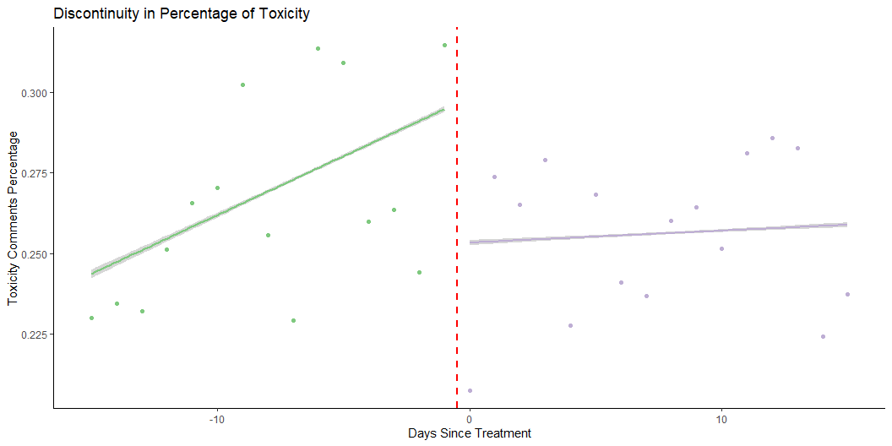
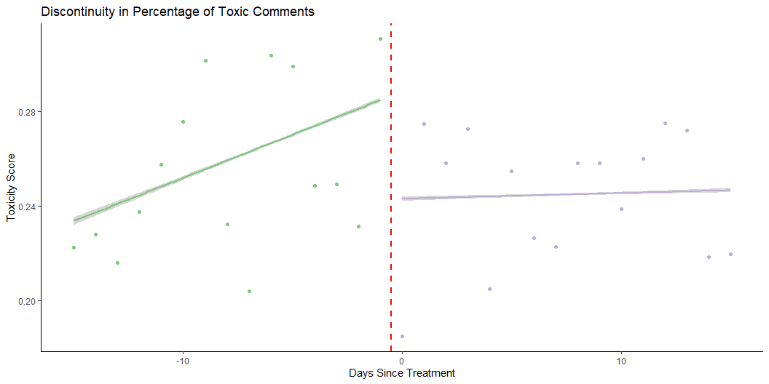
H1: Toxicity within the focal community

Slide 5
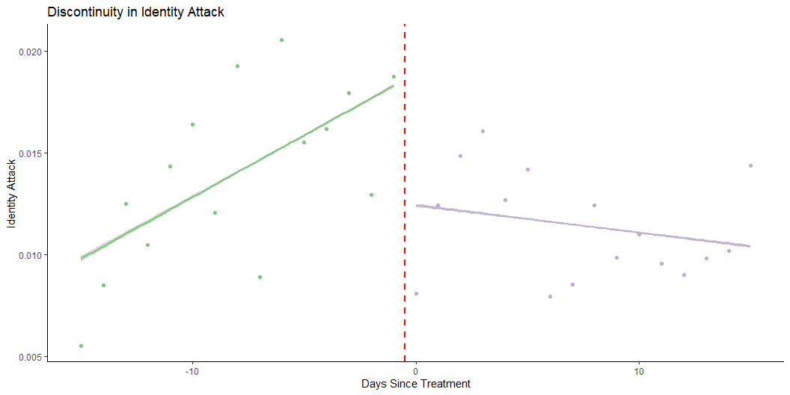
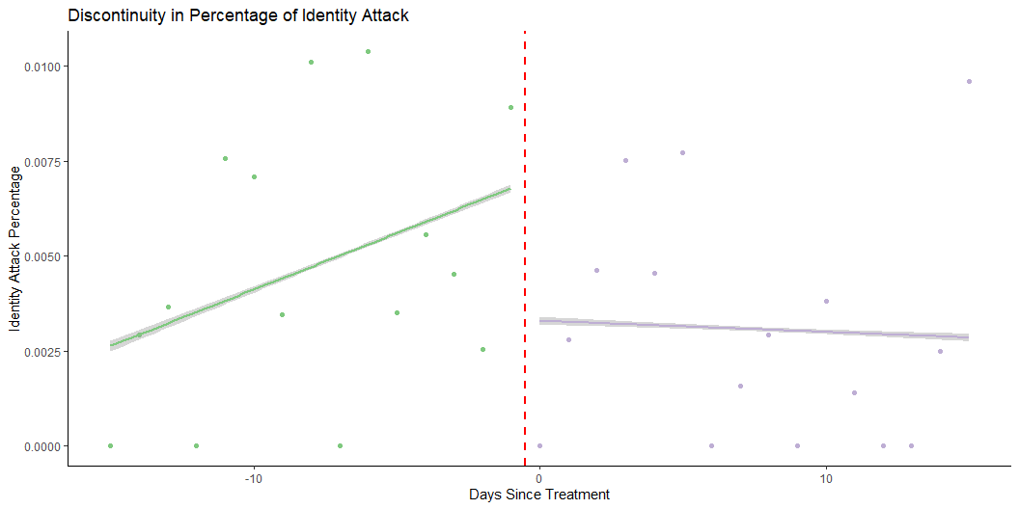
H1: Identity Attack within the focal community

Slide 6
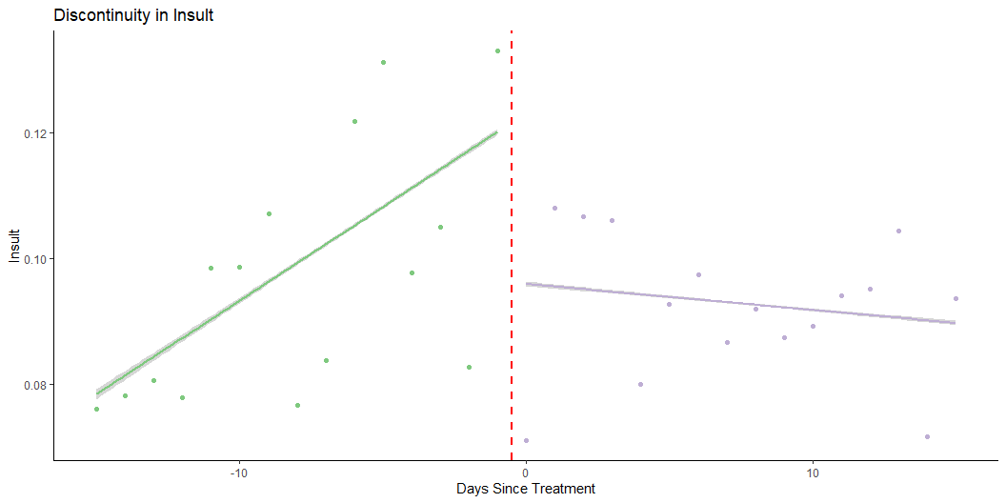
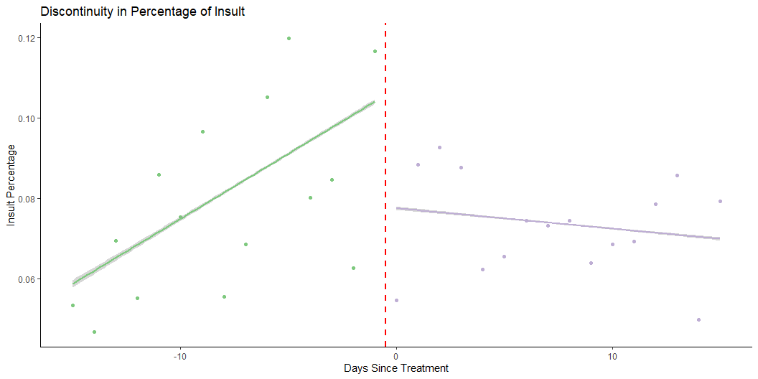
H1: Insult within the focal community

Slide 7
H1: Synthetic Control

