Slide 1
AIT-736 Applied Machine Learning
Group Presentation: Team 3 – An Huynh
Telco Customer Churn Prediction
Course: AIT736 Applied Machine Learning (Spring 2026)
Faculty Course Developer: Dr. Emanuela Marasco

Slide 2
Introduction/Motivation
Customer churn is the rate/percentage of customers who end relationship with a business.
Customer churn matters because it impacts a company’s revenue, profit, and growth.
Customer churn prediction is useful as it helps the company to save on high acquisition cost, consolidate the company’s position in the industry, and strengthen company’s lifetime value.
Notes:
This slide is a Section Header. Repeat this slide for each segment of your presentation. And remember, each group member should present at least one segment. Update the title; you are not required to do anything else on this slide. Do not change the fonts/colors in any way. The only adjustment you should need to make is the size of the text if your presentation has a long title.
Add the Title. If you copy/paste information into this slide, make sure to Clear Formatting to ensure that the formatting for accessibility remains. You can find the Clear Formatting button on the Home Tab, within the Font section. It looks like a Capital Letter A with an eraser. The text will increase or decrease as you type to ensure that the proper sizing is used.
Delete this text in the Notes section when you are finished.

Slide 3
Problem Statement/Business Goal
Problem statement: This project aims at building different machine learning models to predict customer churn at Telco company by analyzing customer related factors.
Target variable: Churn (Yes/No)
Business goal: The primary goal is to maximize churn detection (recall) while minimizing the number of missed churner, enabling the company to proactively retain customers
Challenge: class imbalance
Notes:
This is a slide that will be used often. It is set up for a title, subtitle, and text. Do not change the fonts/colors in any way. The only formatting adjustment you should need to make is the size of the text if your presentation has a long title or subtitle.
Add the Title.
Add the Subtitle – If you don’t have one, you can delete that text box or ignore it.
Add your content to the Text box. If you copy/paste information into this slide, make sure to Clear Formatting to ensure that the formatting for accessibility remains. You can find the Clear Formatting button on the Home Tab, within the Font section. It looks like a Capital Letter A with an eraser. The text will increase or decrease as you type to ensure that the proper sizing is used.
Delete this text in the Notes section when you are finished.

Slide 4
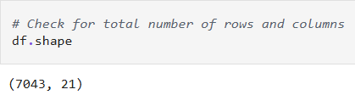
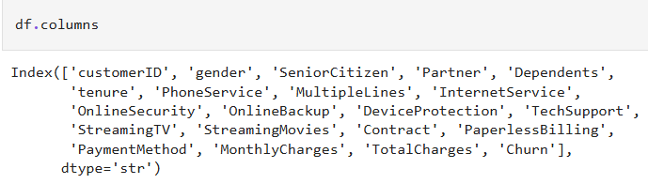
Dataset Description
Dataset name: Telco Customer Churn
Source: Kaggle
Size: 7043 rows, 21 columns
Feature types: There are 20 independent features.
Notes:
This is another slide that you may want to use frequently. This slide is set up for a title and text. Do not change the fonts/colors in any way. The only adjustment you should need to make is the size of the text if your presentation has a long title.
Add the Title.
Add your content to the Text box. If you copy/paste information into this slide, make sure to Clear Formatting to ensure that the formatting for accessibility remains. You can find the Clear Formatting button on the Home Tab, within the Font section. It looks like a Capital Letter A with an eraser. The text will increase or decrease as you type to ensure that the proper sizing is used.
Delete this text in the Notes section when you are finished.

Slide 5

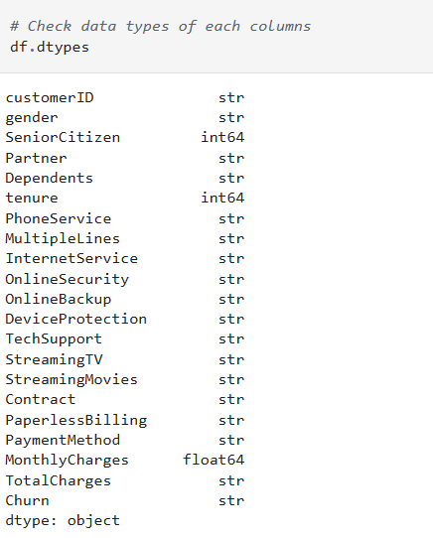
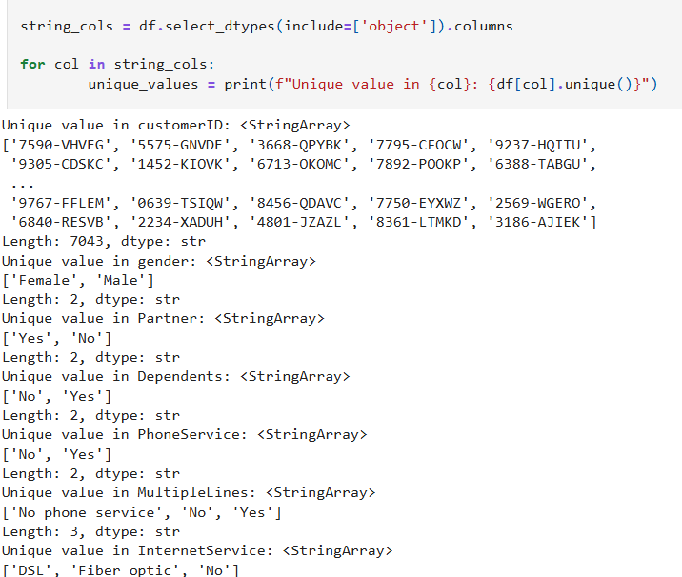


Exploratory Data Analysis
Check missing values
Check data type of each feature
Understand data distribution using descriptive statistics
Check the values in categorical features
Notes:
This is another slide that you may want to use frequently. This slide is set up for a title and text. Do not change the fonts/colors in any way. The only adjustment you should need to make is the size of the text if your presentation has a long title.
Add the Title.
Add your content to the Text box. If you copy/paste information into this slide, make sure to Clear Formatting to ensure that the formatting for accessibility remains. You can find the Clear Formatting button on the Home Tab, within the Font section. It looks like a Capital Letter A with an eraser. The text will increase or decrease as you type to ensure that the proper sizing is used.
Delete this text in the Notes section when you are finished.

Slide 6
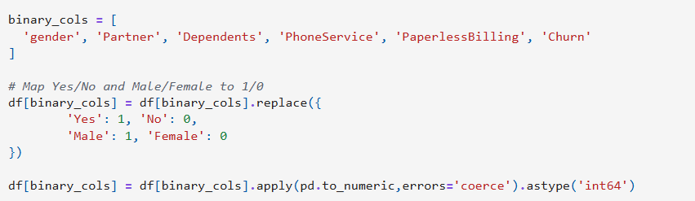
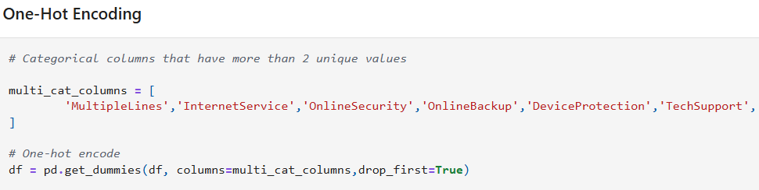
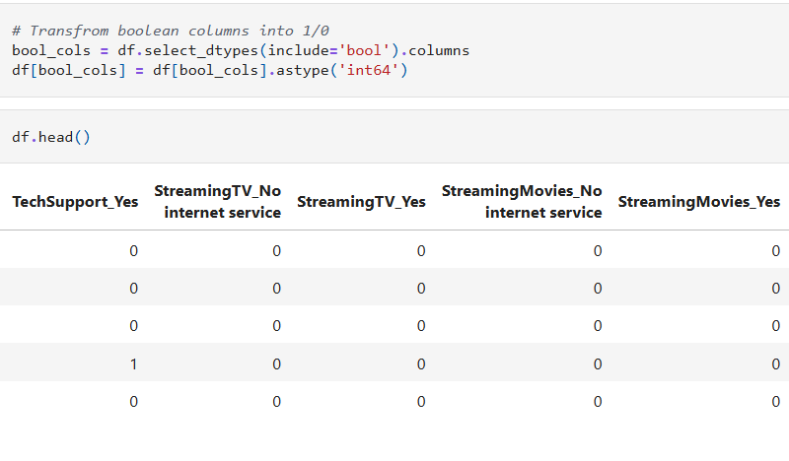
Dataset Preparation and Cleaning
Encoding categorical variables
For columns with two unique categories, map one value to 1 and the other to 0.
For columns with three unique values or more, apply one-hot encoding.
Convert ‘TotalCharges’ column to numeric type.
Handling missing values (drop 11 rows with null values)
Transform Boolean values into 1 and 0
After the transformation and cleaning, the final dataset has 31 columns with 7032 rows.
Notes:
This is another slide that you may want to use frequently. This slide is set up for a title and text. Do not change the fonts/colors in any way. The only adjustment you should need to make is the size of the text if your presentation has a long title.
Add the Title.
Add your content to the Text box. If you copy/paste information into this slide, make sure to Clear Formatting to ensure that the formatting for accessibility remains. You can find the Clear Formatting button on the Home Tab, within the Font section. It looks like a Capital Letter A with an eraser. The text will increase or decrease as you type to ensure that the proper sizing is used.
Delete this text in the Notes section when you are finished.

Slide 7
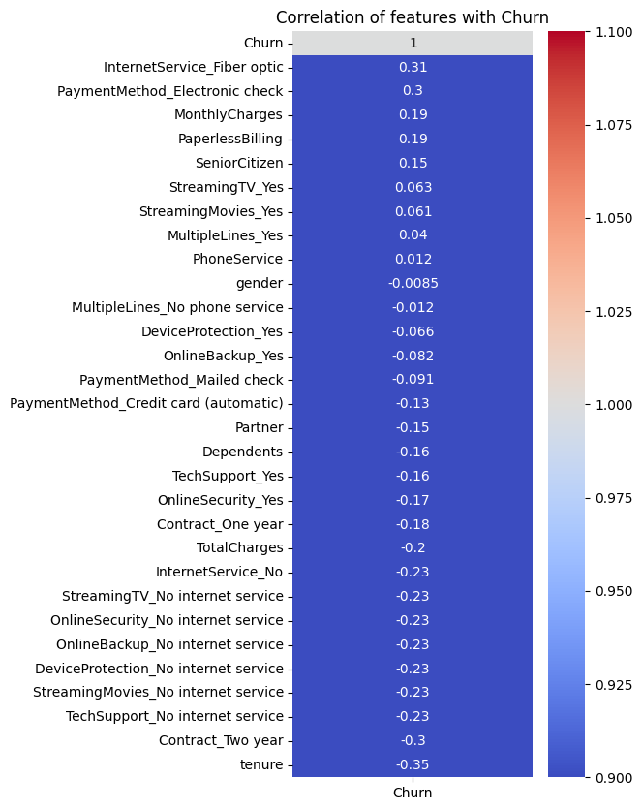
Dataset Visualization
Positive (higher the value = higher the churn likelihood)
Customer who use fiber optic internet is more likely to churn.
Customers who pay electronically also churn more compared to those who mail checks or use credit card.
Negative (higher the value = lower the churn probability)
Customers who stay longer are less likely to churn.
Customers who have 2-year contract are also less likely to churn compared to those who contracted for 1 year only.
Notes:
This is another slide that you may want to use frequently. This slide is set up for a title and text. Do not change the fonts/colors in any way. The only adjustment you should need to make is the size of the text if your presentation has a long title.
Add the Title.
Add your content to the Text box. If you copy/paste information into this slide, make sure to Clear Formatting to ensure that the formatting for accessibility remains. You can find the Clear Formatting button on the Home Tab, within the Font section. It looks like a Capital Letter A with an eraser. The text will increase or decrease as you type to ensure that the proper sizing is used.
Delete this text in the Notes section when you are finished.

Slide 8
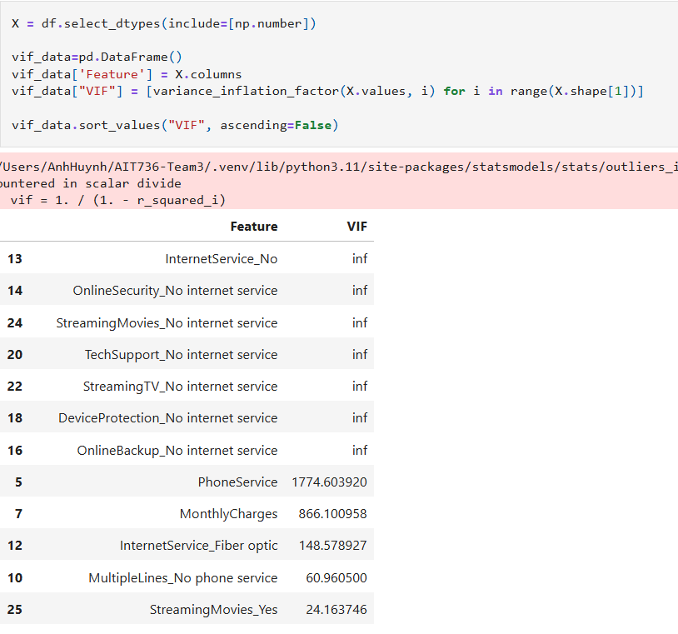
Multicollinearity Analysis (VIF)
VIF - Variance Inflation Vector quantify the extent of correlation between a predictor to other predictors in a model. In other words, it measures multicollinearity problem.
VIF ranges from 1 to infinite, which 1 indicates no collinearity, and infinitive indicates perfect collinearity. In case of VIF > 5 to inf, predictor(s) need to be removed.
Due to multicollinearity, we decided to go with tree-based models as tree-based models handle multicollinearity better than regression models.
Notes:
This is another slide that you may want to use frequently. This slide is set up for a title and text. Do not change the fonts/colors in any way. The only adjustment you should need to make is the size of the text if your presentation has a long title.
Add the Title.
Add your content to the Text box. If you copy/paste information into this slide, make sure to Clear Formatting to ensure that the formatting for accessibility remains. You can find the Clear Formatting button on the Home Tab, within the Font section. It looks like a Capital Letter A with an eraser. The text will increase or decrease as you type to ensure that the proper sizing is used.
Delete this text in the Notes section when you are finished.

Slide 9
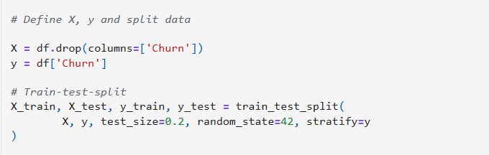
Train/Test Split
X is independent variable, including all features except for “Churn”
y is the dependent factor, or the target variable, which is “Churn”
Train – test – split with 80% reserved for training, and 20% reserved for testing
Random state ensures reproducibility.
Notes:
This is another slide that you may want to use frequently. This slide is set up for a title and text. Do not change the fonts/colors in any way. The only adjustment you should need to make is the size of the text if your presentation has a long title.
Add the Title.
Add your content to the Text box. If you copy/paste information into this slide, make sure to Clear Formatting to ensure that the formatting for accessibility remains. You can find the Clear Formatting button on the Home Tab, within the Font section. It looks like a Capital Letter A with an eraser. The text will increase or decrease as you type to ensure that the proper sizing is used.
Delete this text in the Notes section when you are finished.

Slide 10
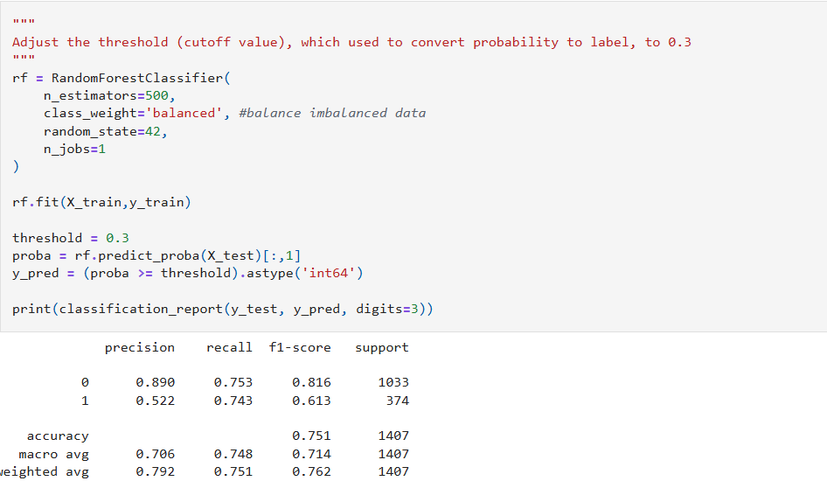
Models Development – Random Forest Classifier Baseline Tree model
The model was built using 500 decision trees to reduce variance.
Since the data is imbalanced (more non-churn than churn), we applied ‘balanced’ class weights.
The model outputs churn probabilities using predict_proba().
To better capture churners, we adjusted the decision threshold from the default 0.5 to 0.3, which increases recall by predicting churn more aggressively.
Notes:
This is another slide that you may want to use frequently. This slide is set up for a title and text. Do not change the fonts/colors in any way. The only adjustment you should need to make is the size of the text if your presentation has a long title.
Add the Title.
Add your content to the Text box. If you copy/paste information into this slide, make sure to Clear Formatting to ensure that the formatting for accessibility remains. You can find the Clear Formatting button on the Home Tab, within the Font section. It looks like a Capital Letter A with an eraser. The text will increase or decrease as you type to ensure that the proper sizing is used.
Delete this text in the Notes section when you are finished.

Slide 11
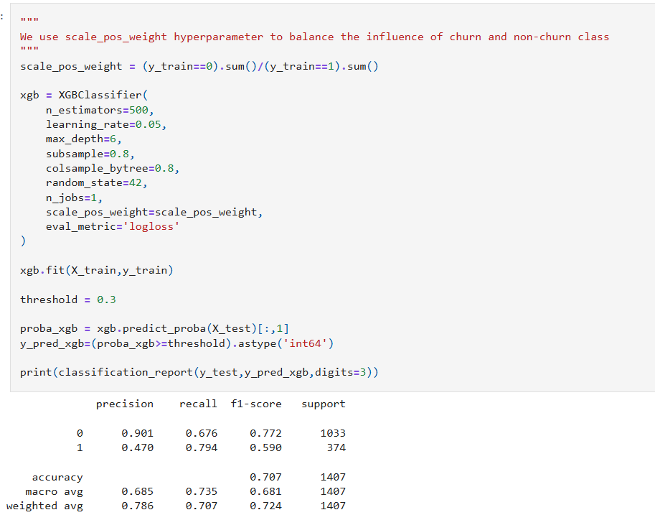
Models Development – XGBOOST Classifier
The XGBOOST model was trained on 500 decision trees to reduce prediction error.
We use scale_pos_weight to handle class imbalance.
A learning rate of 0.05 determines how each trees contribute to the final decision, which helps reduce overfitting.
The model was optimized using ‘logloss’, which evaluate probability prediction quality
Predicted probabilities were converted to churn label using threshold of 0.3 to aggressively capture churn.
Notes:
This is another slide that you may want to use frequently. This slide is set up for a title and text. Do not change the fonts/colors in any way. The only adjustment you should need to make is the size of the text if your presentation has a long title.
Add the Title.
Add your content to the Text box. If you copy/paste information into this slide, make sure to Clear Formatting to ensure that the formatting for accessibility remains. You can find the Clear Formatting button on the Home Tab, within the Font section. It looks like a Capital Letter A with an eraser. The text will increase or decrease as you type to ensure that the proper sizing is used.
Delete this text in the Notes section when you are finished.

Slide 12
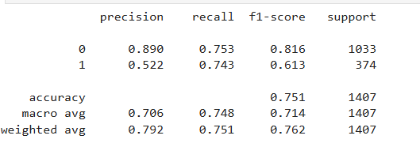
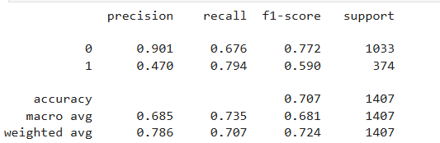
Models Comparison
Random Forest Classifier
Because hyperparameter tuning is computationally expensive, we compared the two models and selected XGBoost due to higher recall score and performed fine-tuning on the chosen model.
XGBOOST Classifier
Notes:
This is another slide that you may want to use frequently. This slide is set up for a title and text. Do not change the fonts/colors in any way. The only adjustment you should need to make is the size of the text if your presentation has a long title.
Add the Title.
Add your content to the Text box. If you copy/paste information into this slide, make sure to Clear Formatting to ensure that the formatting for accessibility remains. You can find the Clear Formatting button on the Home Tab, within the Font section. It looks like a Capital Letter A with an eraser. The text will increase or decrease as you type to ensure that the proper sizing is used.
Delete this text in the Notes section when you are finished.

Slide 13
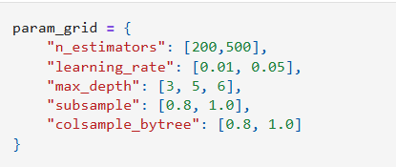

XGBOOST Model Tuning
We performed hyperparameters tuning using 5 folds stratified cross validation over key XGBoost parameters.
For each parameter combination, the model generated churn probabilities, and we tested on multiple thresholds to control recall-precision balance.
Measure performance was measured using recall (primary metric) and F1-score
Notes:
This is another slide that you may want to use frequently. This slide is set up for a title and text. Do not change the fonts/colors in any way. The only adjustment you should need to make is the size of the text if your presentation has a long title.
Add the Title.
Add your content to the Text box. If you copy/paste information into this slide, make sure to Clear Formatting to ensure that the formatting for accessibility remains. You can find the Clear Formatting button on the Home Tab, within the Font section. It looks like a Capital Letter A with an eraser. The text will increase or decrease as you type to ensure that the proper sizing is used.
Delete this text in the Notes section when you are finished.

Slide 14
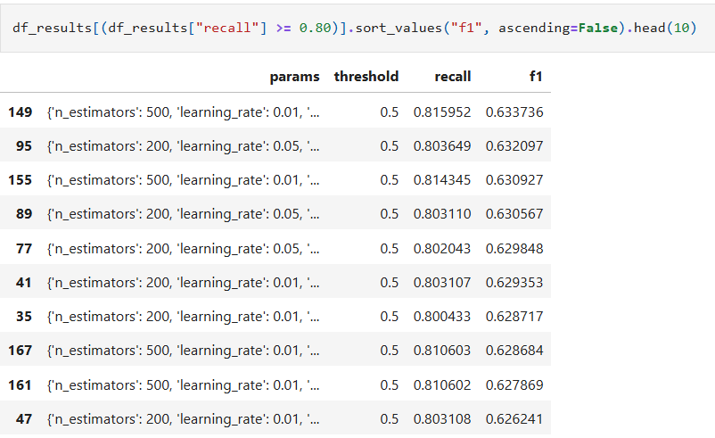
XGBOOST Parameters Exploration
After perform hyperparameter tuning, we selected the best XGBoost configuration that has high recall score and high F1-score.
The best performing model was row 149, which achieved:
Recall: 0.816
F1-score: 0.634
Threshold: 0.5
This configuration provides the best trade-off between identifying churners and reduce false classifications.
Notes:
This is another slide that you may want to use frequently. This slide is set up for a title and text. Do not change the fonts/colors in any way. The only adjustment you should need to make is the size of the text if your presentation has a long title.
Add the Title.
Add your content to the Text box. If you copy/paste information into this slide, make sure to Clear Formatting to ensure that the formatting for accessibility remains. You can find the Clear Formatting button on the Home Tab, within the Font section. It looks like a Capital Letter A with an eraser. The text will increase or decrease as you type to ensure that the proper sizing is used.
Delete this text in the Notes section when you are finished.

Slide 15
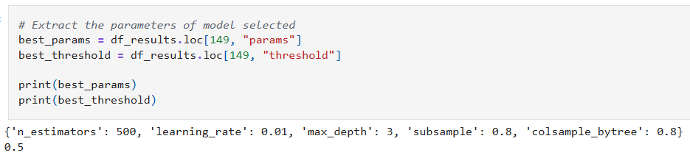
Final XGBOOST Model Selection
The final selected model has the following configurations
n_estimators: 500
learning_rate: 0.01
max_depth: 3
subsample: 0.8
colsample_bytree: 0.8
Decision threshold: 0.5
This configuration provides strong and stable performance while maintaining high churn detection capability.
Notes:
This is another slide that you may want to use frequently. This slide is set up for a title and text. Do not change the fonts/colors in any way. The only adjustment you should need to make is the size of the text if your presentation has a long title.
Add the Title.
Add your content to the Text box. If you copy/paste information into this slide, make sure to Clear Formatting to ensure that the formatting for accessibility remains. You can find the Clear Formatting button on the Home Tab, within the Font section. It looks like a Capital Letter A with an eraser. The text will increase or decrease as you type to ensure that the proper sizing is used.
Delete this text in the Notes section when you are finished.

Slide 16
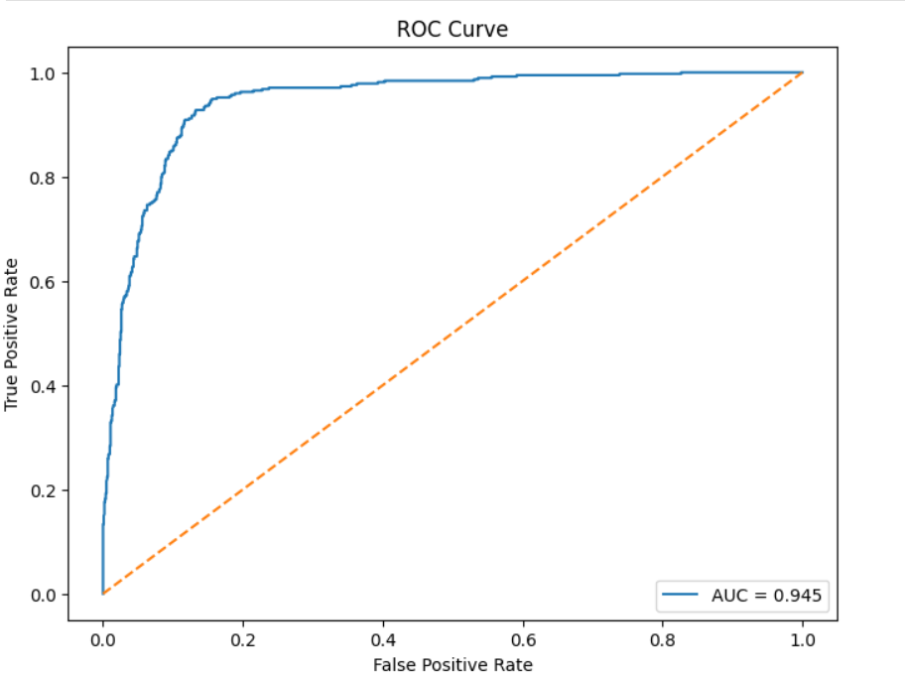
Model Evaluation
The final XGBoost model achieved ROC-AUC of 0.945, indicating strong classification capability.
An AUC closes to 1.0 suggests that the model produces reliable probability predictions and ranks churn customers higher than non-churn customers most of the time.
Overall, the high ROC-AUC score confirms the model generalizes well and is effective for churn prediction.
Notes:
This is another slide that you may want to use frequently. This slide is set up for a title and text. Do not change the fonts/colors in any way. The only adjustment you should need to make is the size of the text if your presentation has a long title.
Add the Title.
Add your content to the Text box. If you copy/paste information into this slide, make sure to Clear Formatting to ensure that the formatting for accessibility remains. You can find the Clear Formatting button on the Home Tab, within the Font section. It looks like a Capital Letter A with an eraser. The text will increase or decrease as you type to ensure that the proper sizing is used.
Delete this text in the Notes section when you are finished.

Slide 17
Conclusion
In this project, we built churn prediction models using Random Forest and XGBoost on Telco customer churn dataset.
The business goal is to maximize customers churn detection, so we emphasize on the Recall metric.
The final model was evaluated based on best overall performance – high recall score, high F1-score, and high ROC-AUC score.
The final tuned XGBoost model achieved strong results, including:
Recall ≈ 0.82
F1-score ≈ 0.63
ROC-AUC = 0.945
In conclusion, the model effectively identifies customers with high risk of churn and can support proactive customer retention.
Notes:
This is another slide that you may want to use frequently. This slide is set up for a title and text. Do not change the fonts/colors in any way. The only adjustment you should need to make is the size of the text if your presentation has a long title.
Add the Title.
Add your content to the Text box. If you copy/paste information into this slide, make sure to Clear Formatting to ensure that the formatting for accessibility remains. You can find the Clear Formatting button on the Home Tab, within the Font section. It looks like a Capital Letter A with an eraser. The text will increase or decrease as you type to ensure that the proper sizing is used.
Delete this text in the Notes section when you are finished.

Slide 18
References
Huynh, A. (2026). AIT736-Team3. Github
https://github.com/annguyenhuynh/AIT736-Team3/tree/main
Kaggle. (2017). Telco Customer Churn. Kaggle
https://www.kaggle.com/datasets/blastchar/telco-customer- churn
Lopez, M.(2025). What Is Customer Churn? A Complete Guide with Examples. Salesforce https://www.salesforce.com/sales/analytics/customer-churn/
Notes:
This is another slide that you may want to use frequently. This slide is set up for a title and text. Do not change the fonts/colors in any way. The only adjustment you should need to make is the size of the text if your presentation has a long title.
Add the Title.
Add your content to the Text box. If you copy/paste information into this slide, make sure to Clear Formatting to ensure that the formatting for accessibility remains. You can find the Clear Formatting button on the Home Tab, within the Font section. It looks like a Capital Letter A with an eraser. The text will increase or decrease as you type to ensure that the proper sizing is used.
Delete this text in the Notes section when you are finished.

Slide 19

Notes:
This is another slide that you may want to use frequently. This slide is set up for a title and text. Do not change the fonts/colors in any way. The only adjustment you should need to make is the size of the text if your presentation has a long title.
Add the Title.
Add your content to the Text box. If you copy/paste information into this slide, make sure to Clear Formatting to ensure that the formatting for accessibility remains. You can find the Clear Formatting button on the Home Tab, within the Font section. It looks like a Capital Letter A with an eraser. The text will increase or decrease as you type to ensure that the proper sizing is used.
Delete this text in the Notes section when you are finished.

