Slide 1
Motorcycle
Nguyễn Văn Chúc Ân – 11130001
Bùi Đình Nhu - 11130077

Slide 2
Contents
System Architecture
Software Architecture
Technologies
Functionalities
Template

Slide 3
System Architecture
.NET Server
Client Server
Upload Image

Slide 4
Software Architecture(1)
View
Format
Html files
Filters
Controllers
Business
Servers
Services
requests

Slide 5
Software Architecture(2)
ASP.NET Web API 2 (RESTful WS)
Internet
requests
LINQ
SQL SERVER

Slide 6
Technologies(1)
LINQ (Language-Integrated Query)
CORS (Cross Origin Resource Sharing)
SQL SERVER
ASP .NET WEB API 2

Slide 7
Technologies(2)
Angular JS
UI Router
UI Bootstrap
Bootstrap Framework
ng-file-upload

Slide 8
Technologies(3)
Express Server Framework
Node JS
Multer

Slide 9
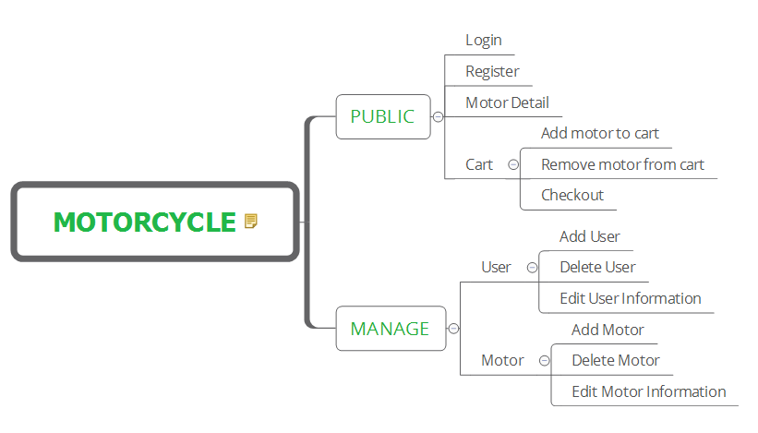
Functionalities

Slide 10
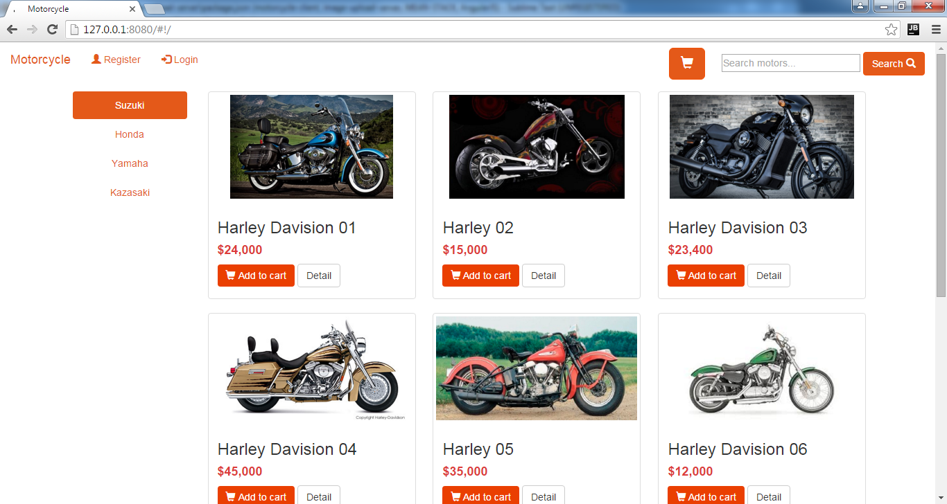
Template(1)

Slide 11
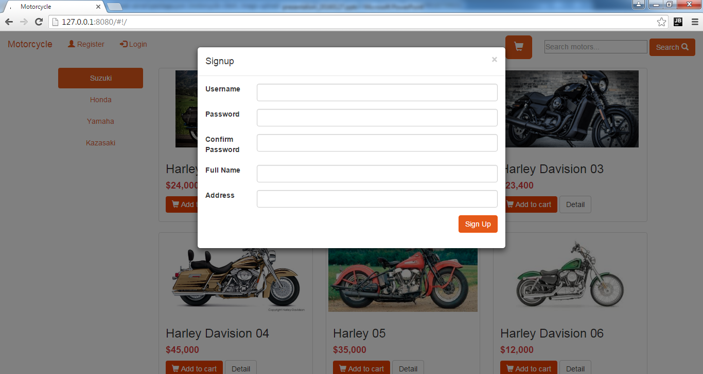
Template(2)

Slide 12
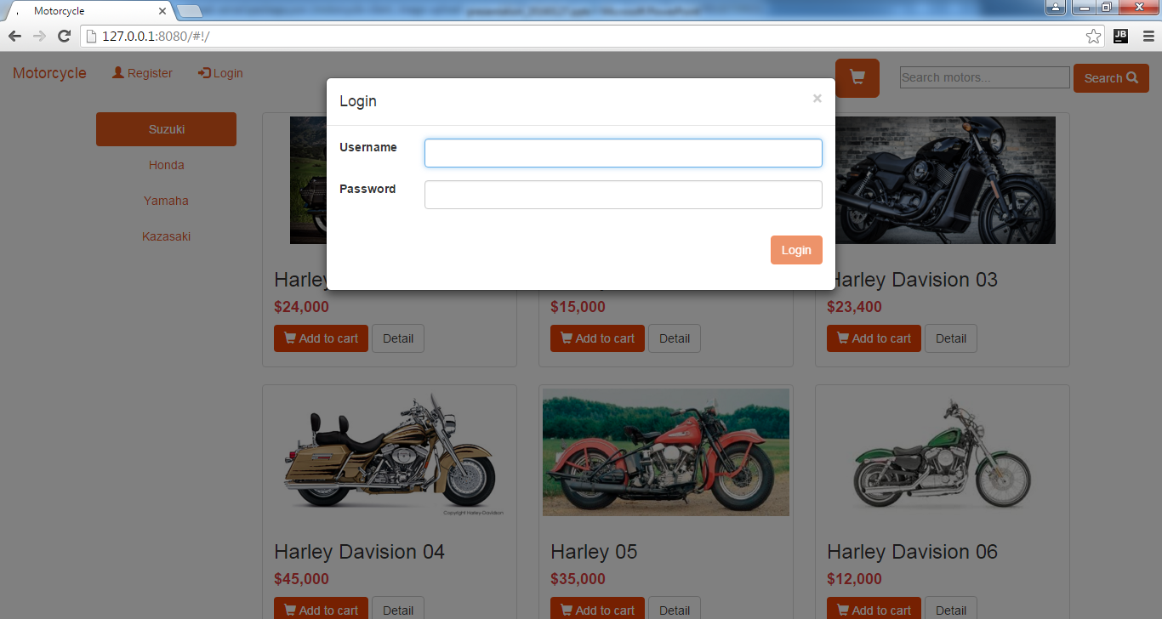
Template(3)

Slide 13
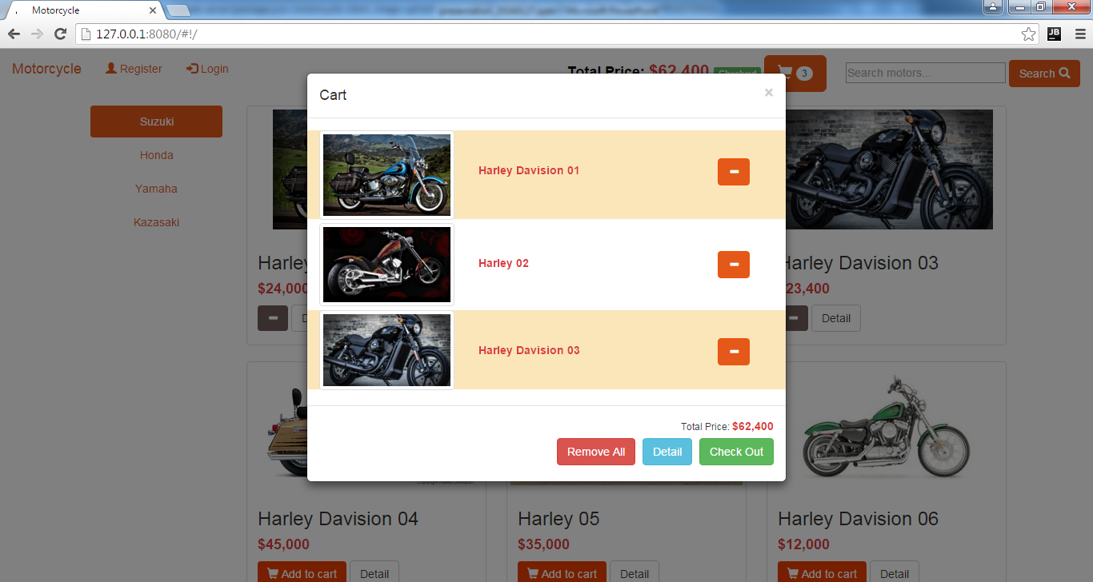
Template(4)

Slide 14
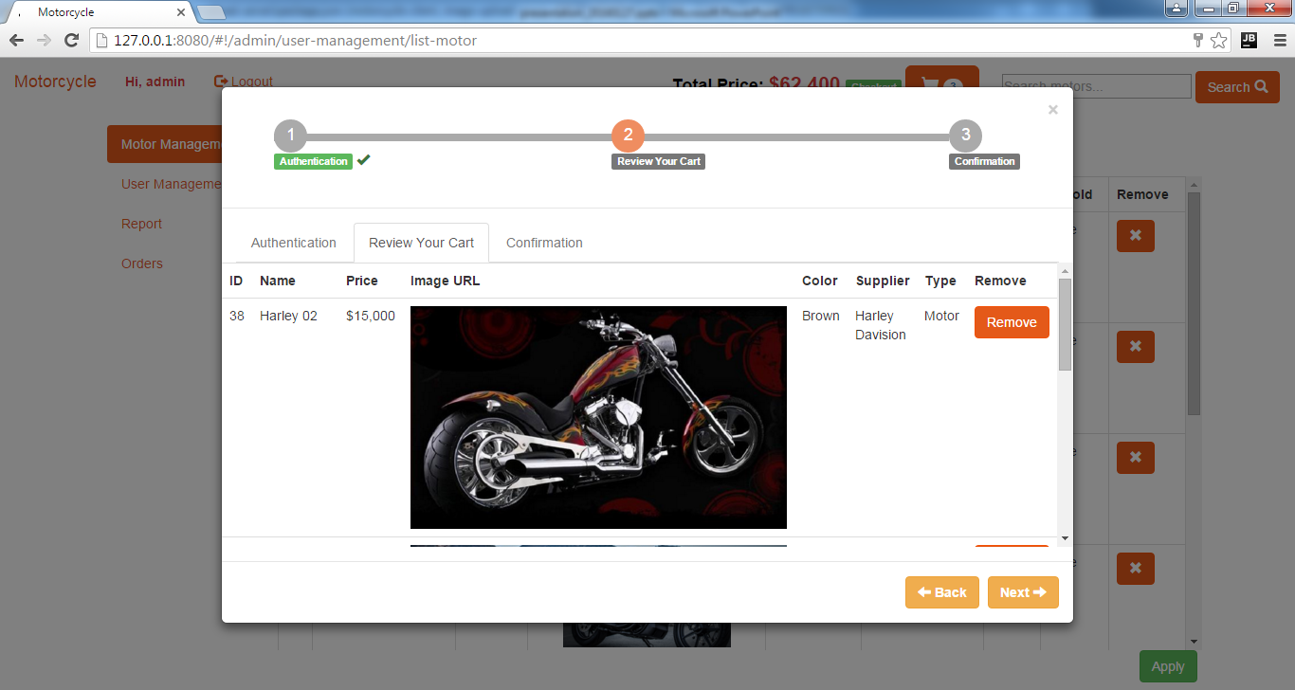
Template(5)

Slide 15
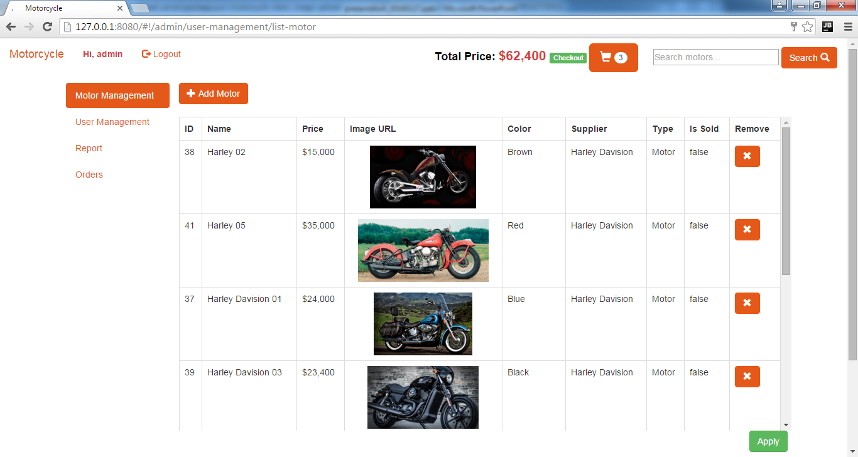
Template(6)

Slide 16
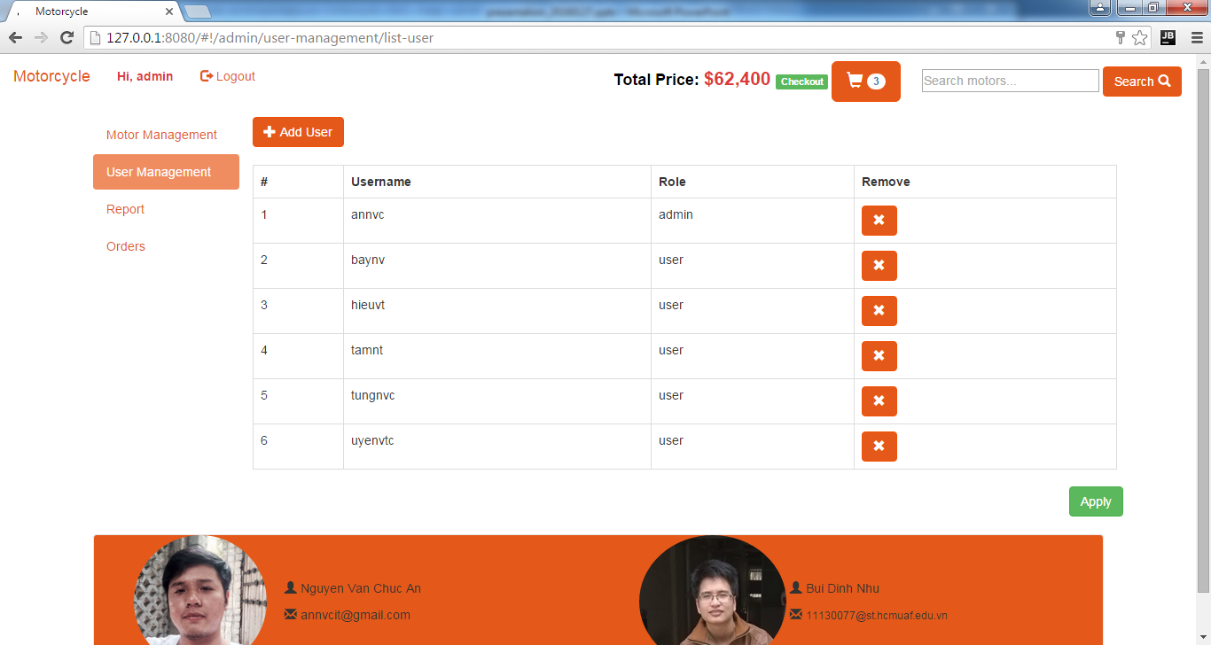
Template(7)

