Slide 1
Kafka Producer-Consumer Automation Testing
Using Java, JMeter, Docker, and ELK Stack

Slide 2
Introduction
Objective: Automate Kafka message flow and verify data integrity
Tools: Java, JMeter, Docker, Kafka, Elasticsearch, Logstash, Kibana

Slide 3
Technology Stack
Java: Kafka Client for producing/consuming messages
JMeter: Kafka Plug-in for load testing
Docker: Containerization of Kafka and ELK stack
ELK Stack: Log management and visualization

Slide 4
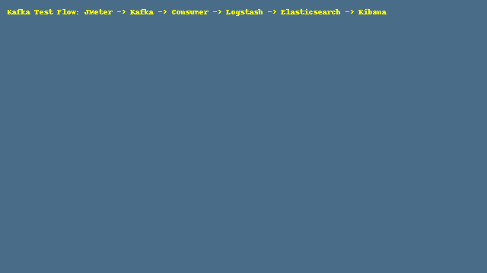
Docker Setup
Containers: Kafka, Elasticsearch, Logstash, Kibana
Locally built and run using custom Docker images
Managed with Docker Compose or individual Docker commands

Slide 5
Kafka Configuration
Created Kafka topic using CLI
Producer: Sends 100+ messages via JMeter
Consumer: Receives and logs messages

Slide 6
JMeter Integration
Kafka JMeter Plug-in used
Configured with message payload and test plan
Ran performance tests with hundreds of messages

Slide 7
ELK Stack Integration
Logstash: Parses Kafka logs
Elasticsearch: Indexes logs
Kibana: Visualizes message flow and count
Accessed via localhost:5601

Slide 8
Validation
Verified message delivery and reception
Log indexing in Elasticsearch
Visualization in Kibana
Message count validated using Kafka Java Client

Slide 9
Results & Observations
Successful message delivery
Accurate message count match
Real-time logs viewable in Kibana
Seamless setup and teardown with Docker

Slide 10
Challenges & Learnings
Docker network configurations
Kafka topic lag analysis
JMeter Kafka plug-in tuning
Logstash filter configuration

Slide 11
Conclusion
End-to-end Kafka test pipeline established
Automated validation with Java & JMeter
Real-time monitoring using ELK
Scalable and reproducible test environment

