Slide 2
C#
Programming Structure

Slide 3
About C#
Two languages that are central to .NET framework are C# and Visual Basic.
It is fundamentally a simple and object oriented language.
It was developed by Microsoft development team.
Lot of syntax for C# is obtained C language. C# also shares many similarity with popular Java language, thereby making learning of C# even more simpler.

Slide 4
C# Features
C# is a type-safe, component-based, high-performance language
it is complete object oriented programming Lang
it supports structured error handling
it supports multi threading app development
it support to develop any type of app like console,windows,web etc.
Versions:1.0,2.0,3.0,4.0,5.0 up to 8.0

Slide 5
Comments
Single line comment
//
// This is a single line comment
Multiline comments
/* */
/* This is a multi
line comment */

Slide 6
Variables
Variables are storage locations that are associated with a value.
The value that a variable stores are of certain data type.
Syntax: Datatype var_name;
There are different types of variables that can be defined in C# depending on the scope : static variables, instance variables, array elements, and local variables.
The variables created inside Main() are local. They are available only inside the method where they are declared.
The local variable must always be initialized before using.

Slide 7
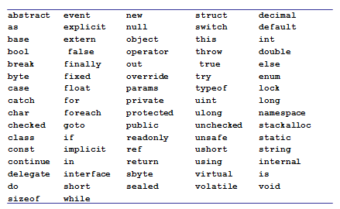
Keywords

Slide 8
C# Data types
C# like C and C++ is a strongly typed language and so every variable must have a data type.
Data types in C# are of 2 types
Value types
Reference types.

Slide 9
C# Data types
Value types
Built in Data types like int, char, float ,double and user defined types like struct or enum
For every value type there is a type(Class or Struct) in BCL
They are allocated in stack
Value types can not contain the value null.

Slide 10
C# Data types
Reference
User defined type created using class or interfaces
Reference types are allocated in heap at runtime.
Reference types can contain the value null

Slide 11
C# Value Types
Built in Types
Boolean type
bool
Integer types
byte int long sbyte short uint ulong ushort
Character type
char
Floating point types
decimal double float
User Defined Types
enum
struct

Slide 12
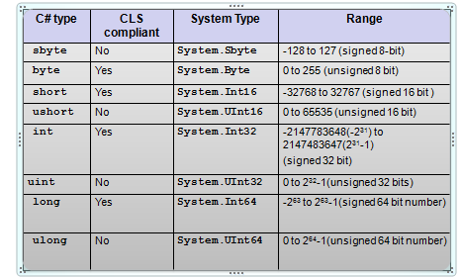
Integer types

Slide 13
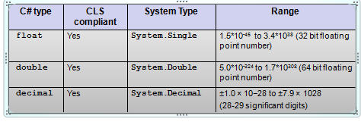
Floating point types

Slide 14
Floating-point literals
Floating-point literals can be written in two ways
Fixed notation: 3.14
Scientific notation: 0.314E1, 314e-2
Floating-point literal types
Literal with no suffix→ is double
Literal with F or f as suffix (Example 3.14f, 3.14F)→ is float
Literal with D or d as suffix (Example 3.14D, 3.14D) → is double
Literal with M or m as suffix (Example 3.14m, 3.14M) → is decimal
decimal d = 3.45; //error
decimal d = 3.45m; //ok
float f = 3.4;// error
float f = 3.4f;// ok

Slide 15
Character type and Character Literal
char keyword is alias for System.Char
It is CLS compliant.
char c=‘a’; //ok
char c=1; //error

Slide 16
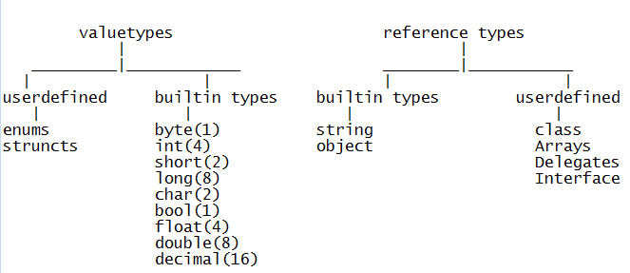

Slide 17
Reading inputs from the console
Console.ReadLine() Reads the next line of characters from the standard input stream.
Console.Read() reads a character and returns in the form of int.
using System;
class SayHello{
public static void Main(){
string s;
Console.Write("Please your name”);
s = Console.ReadLine();
Console.WriteLine(“Hello “+ s);
}}

Slide 18
Identifiers Naming Rules
Identifiers are variables, methods , class or any other named constructs in C#
Rules
Should not be a keyword
Must start with a letter or underscore or @
Subsequent characters can be a letter, number or underscore

Slide 19

Console output Formatting
Write statement can be used to print any type of variable.
Console output can be formatted using Write statement.
Example:
int intval=90;
double doubleval=9.99;
bool boolval=true;
Console.WriteLine("Double value= {1} \n
Int value= {0} \n Boolean value= {2} ",
intval, doubleval, boolval);
Specifies the argument index

Slide 20
Operators

Slide 21
Operators-Arithmetic
+ | - | / | * | ++ | -- | %
Most of the operators work the same way as it does in C.
Applicable to integer and floating point types
int i = 10;
int j = i+ 255;
byte k = i + 255; //error
const double PI = 3.14;
double f = PI + 12;
When 2 of any integral types (other than long) are involved in arithmetic operation, the result is an int.
byte i = 10;
byte j = 20;
j=j+i; //error

Slide 22
Operators-Relational
== | != | < | > | >= | <=
Relational operator return bool value – true or false.
int i=10;
int j=20;
Console.WriteLine( i>j ); // output is False
Console.WriteLine(i == 10); // output is True

Slide 23
Operators-Logical
&& | || | !
These are both boolean operators. These work only on bool values.
&& checks if the first condition is false. If it is so then it doesn't evaluate the second condition.
|| checks if the first condition is true. If it is so then it doesn't evaluate the second condition.
int i=0;
int j=2;
bool b= (i>j) && (j++>i);
Console.WriteLine(j);
What does the code print?

Slide 24
Assignment Operators
= | += | -= | *= | /= | %=
int a = 10;
int b=2;
a+=b; // 12 same as a=a+b;
Console.WriteLine(a);
double d=45.3;
d/=1.2;
Console.WriteLine(d); // 37.75 same as d=d/1.2
float d1=2.4f;
d1 %= 1.2f;
Console.WriteLine(d1); // 0

Slide 25
Other Operators
Operator | Name | Example
?: | Ternary operator | 10 % 2 > 0 ? 1 : 10
[] | Array subscript | a[1]
() | Cast
. | dot operator | n.Length
is | Type Conversion
as
typeof | In refection
new
checked
unchecked
=> | Lambda

