Slide 1
HTML5 INTRODUCTION
What IS HTML:
HTML stands for HyperText Markup Language
HTML is the main markup language for describing the structure of web pages.
Markup languages use sets of markup tags to characterize text elements within a document, which gives instructions to the web browsers on how the document should appear.
Why use HTML5 :
HTML 5 is enriched with advance features which makes it easy and interactive for designer/developer and users.

Slide 2
The WEB
The Internet is a heterogeneous worldwide network consisting of a large number of host computers and local area networks.
Internet (or The Web) is a massive distributed client/server information system
The Internet uses the TCP/IP (Transmission Control Protocol/Internet Protocol) suite of protocols.
This allows the integration of a large number of different computers into one single network with highly efficient communication between them

Slide 3
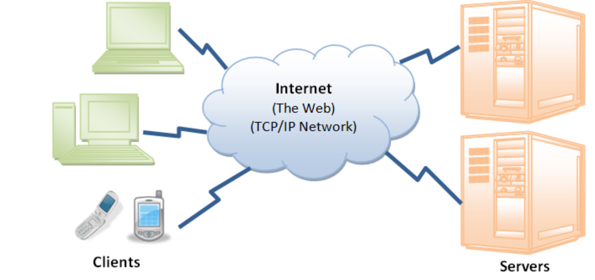
HTTP
Many applications are running concurrently over the Web, such as web browsing/surfing, e-mail, file transfer, audio & video streaming, and so on.
In order for proper communication to take place between the client and the server, these applications must agree on a specific application-level protocol such as HTTP, FTP, SMTP, POP, and etc.

Slide 4
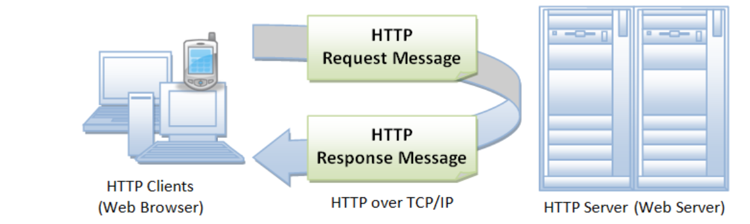
HTTP
HTTP is a client-server application-level protocol. It typically runs over a TCP/IP connection.
HTTP need not run on TCP/IP. It only presumes a reliable transport. Any transport protocols that provide such guarantees can be used.
HTTP (Hypertext Transfer Protocol) is the most popular application protocol used in the Internet

Slide 5
Browser and URL
Whenever you issue a URL from your browser to get a web resource using HTTP, e.g. http://www.nowhere123.com/index.html, the browser turns the URL into a request message and sends it to the HTTP server.
The HTTP server interprets the request message, and returns you an appropriate response message, which is either the resource you requested or an error message.
A URL (Uniform Resource Locator) is used to uniquely identify a resource over the web. URL has the following syntax:
protocol://hostname:port/path-and-file-nameThere are 4 parts in a URL:

Slide 6
Role of HTML
A website is a group of globally accessible, interlinked web pages which have a single domain name.
A web application is a software or program which is accessible using any web browser
HTML (Hypertext Markup Language) is the primary building block of creating a website
By using HTML, the basic user interface of webapplication can be made easily available on the web.
HTML - Hypertext Markup Language and CSS (Cascading Style Sheets) are two of the core technologies for building Web pages.
HTML is the language for describing the structure of Web pages designed to be displayed in a web browser
HTML elements are the building blocks of HTML pages
HTML assisted by technologies Cascading Style Sheets (CSS) and scripting languages such as JavaScript
Web browsers receive HTML documents from a web server or from local storage and render the documents into multimedia web pages

Slide 7
Overview of Cascading Style Sheet (CSS)
Cascaded style sheet language used for describing the presentation of a document written in a markup language like HTML
CSS provides visual layout of the page for a variety of devices
CSS used to define text styles, table sizes, and other aspects of Web pages .
CSS is designed to enable the separation of presentation and content,including layout, colors, and fonts

Slide 8
Understanding & using HTML
HTML contains text to be displayed and mark up which is additional text describing how the document should be displayed.
To keep the markup part separate from the actual content of the HTML file, a special HTML syntax is used. These special components are known as HTML tags.
The tags can contain name-value pairs known as attributes and a piece of content that is enclosed within a tag is referred to as an HTML element.
An HTML element always has an opening tag, content in the middle and a closing tag. Attributes can provide additional information about the element and are included in the opening tag.
Block-level elements start on a new line in the document and take up their own space. Examples of these elements include headings and paragraph tags.
Inline elements do not start on a new line in the document and only take up necessary space. These elements usually format the contents of block-level elements. Examples of inline elements include hyperlinks and text format tags.
HTML is completely text-based, Any text editor can be used to create or edit an HTML file
HTML file is created with an .html extension.Any web browser, such as Chrome or Firefox, IE will be capable of displaying the file as a webpage.

Slide 9
HTML Tags
Html mark up page has 2 main tags.The entire html document should come under these tags
<head>--which will give the details regarding the page
<body>--will contain all the display part of the page

Slide 10
DOM
DOM stands for Document Object Model.
It is a standard defined by W3C (World Wide Web Consortium).
DOM is a programming interface (API) for representing and interacting with HTML
Main DOM Api Objects
window
The window object represents an open window containing a DOM document.
document
The document object represents the HTML document in a specific window.
It organize the elements of the document in tree structure (DOM tree) and in the DOM tree, all elements of the document are defined as objects which have properties and methods.

Slide 11
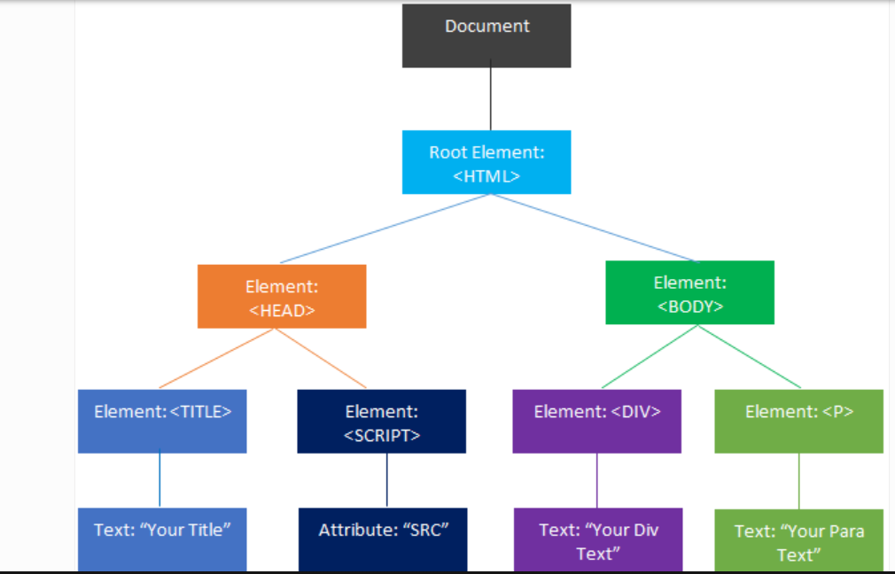
Sample DOM Tree
<HTML>
<HEAD>
<TITLE>Your Title</TITLE>
<SCRIPT src="www.cts.com/jsfile.js"></SCRIPT>
</HEAD>
<BODY>
<DIV>Your Div Text</DIV>
<P>Your Para Text</p>
</BODY>
</HTML>

Slide 12
BOM
BOM stands for Browser Object Model
No standard defined for BOM, hence different browsers implement it in different ways.
Main task of BOM is to manage browser windows and enable communication between the windows.
Each HTML page which is loaded into a browser window becomes a Document object and document object is an object in the BOM.
BOM is super set of DOM
Main BOM Objects
.window
The window object is supported by all browsers. It represents the browser's window.
Screen
object contains information about the user's screen.
The Browser Object Model (BOM) allows JavaScript to "talk to" the browser.

Slide 13
HTML5 - Getting Started
Visual Studio Code features
Visual Studio Code is one of the most popular text editors used by developers.
Free to use
Open-source, (meaning a program’s code can be viewed, modified, and shared)
IDE-like features
Supported by a large community of users and Microsoft
Google Chrome Developer tools
Is a set of web developer tools built directly into the Google Chrome browser. DevTools help to edit pages on-the-fly and diagnose problems quickly, which ultimately helps you build better websites, faster.
When you want to work with the DOM or CSS, right-click an element on the page and select Inspect to jump into the Elements panel

Slide 14
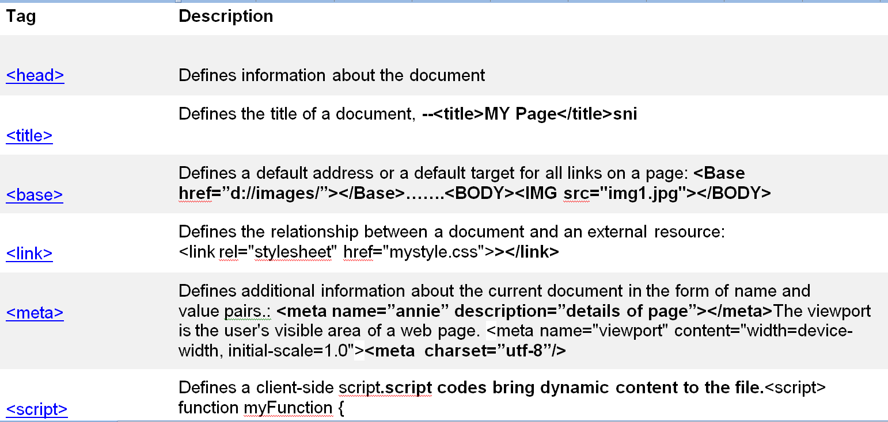
Main tags under <head> tag:

Slide 15
MainTags under BODY tag
HTML headings:HTML defines six levels of headings. header elements contain the text of the header, and do not imply any structural division of documents into sections<h1><h2><h3><h4><h5><h6>
HTML Paragraphs:The HTML <p> element represents a paragraph. Paragraphs are block-level elements,have a newline both before and after the element. Paragraphs may contain text and inline elements. but they may not contain other block elements, including other paragraphs.
HTML Line Breaks :The <br> tag inserts a line break in the HTML content, Line breaks force the beginning of a new line at a particular poinnt
HTML Horizontal Rule:The <hr> tag creates a horizontal line in an HTML page.The <hr> element can be used to divide a web page into different horizontal areas.The <hr> tag is a block level element.

Slide 16
HTML Tags
Font tags: HTML, the <font> tag is an inline element used to change certain qualities of a block of text on a web page. It is useful for changing a font's size, face, and color.
Hyperlinks :The <a> tag defines a hyperlink, which is used to link from one page to another. The most important attribute of the <a> element is the href attribute, which indicates the link's destination.
The Image Tag and the Src Attribute:images are defined with the <img> tag. The <img> tag is empty, it contains attributes only, and does not have a closing tag. The src attribute describes url of image.
<img source=“a.jpg”width=””;height=””alt = "Test Image" border = "3" />Alt:alternate text , width,height:size of image

Slide 17
LIST Tags
An unordered list starts with the <ul> tag
An ordered list starts with the <ol> tag
The type attribute of the <ol> tag, defines the type of the list item marker:
The <dl> tag defines the description list, the <dt> tag defines the term (name), and the <dd> tag describes each term:

Slide 18
HTML 5
Markup language is used to define the text document within tag which defines the structure of web pages. HTML 5 is the fifth and current version of HTML
New semantic elements like <header>, <footer>, <article>, and <section>.
New attributes of form elements like number, date, time, calendar, and range.
New graphic elements: <svg> and <canvas>.
New multimedia elements: <audio> and <video>.

Slide 19
semantic elements
HTML5 defines eight new semantic elements. All these are block-level elements. A semantic element clearly describes its meaning to both the browser and the developer.
header, section, footer, aside, nav, main, article, figure
<article>:Defines an article in a document
<aside>:Defines content aside from the page content
<details>:Defines additional details that the user can view or hide
<dialog>:Defines a dialog box or window
<figcaption>:Defines a caption for a <figure> element
<figure>:Defines self-contained content
<footer>:Defines a footer for a document or section
<header>:Defines a header for a document or section
<nav>:Defines navigation links
<section>:Defines a section in a document
<summary>:Defines a visible heading for a <details> element

Slide 20
HTML Attributes
An attribute is used to define the characteristics of an HTML element and is placed inside the element's opening tag. All attributes are made up of two parts − a name and a value
The name is the property you want to set
The value is what you want the value of the property to be set and always put within quotations

Slide 21
Attribute | Options | Function
Align | right, left, center | Horizontally aligns tags
Valign | top, middle, bottom | Vertically aligns tags within an HTML element.
Bgcolor | numeric, hexidecimal, RGB values | Places a background color behind an element
Background | URL | Places a background image behind an element
Id | User Defined | Names an element for use with Cascading Style Sheets. <p id = "html">This para explains what is HTML</p>
Class | User Defined | Classifies an element for use with Cascading Style Sheets. class = "className1 className2 className3"
Width | Numeric Value | Specifies the width of tables, images, or table cells.
Height | Numeric Value | Specifies the height of tables, images, or table cells.
Title | User Defined | "Pop-up" title of the elements. <h3 title = "Hello HTML!">Titled Heading Tag Example</h3>

Slide 22
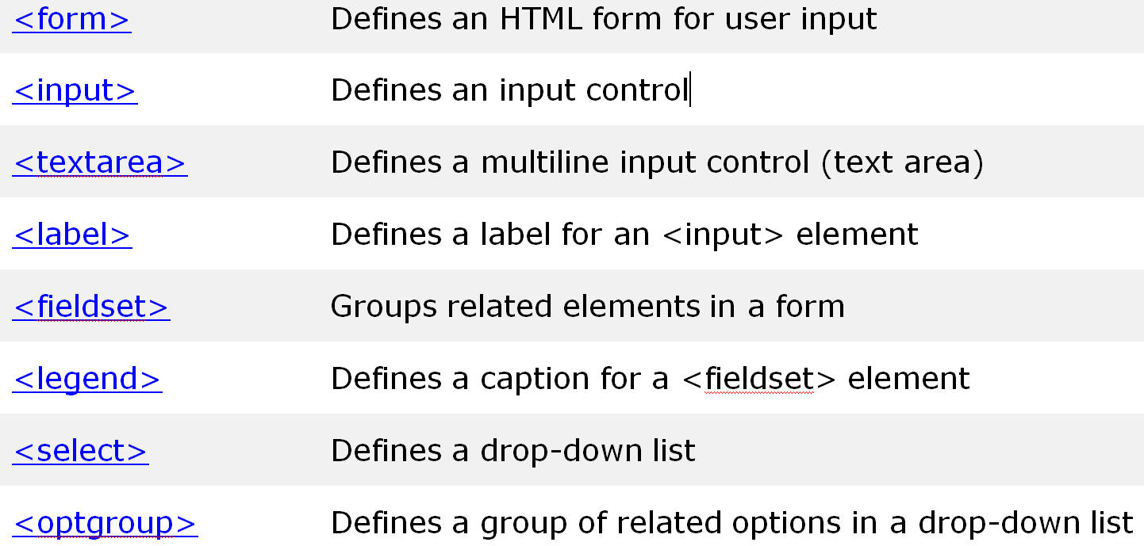
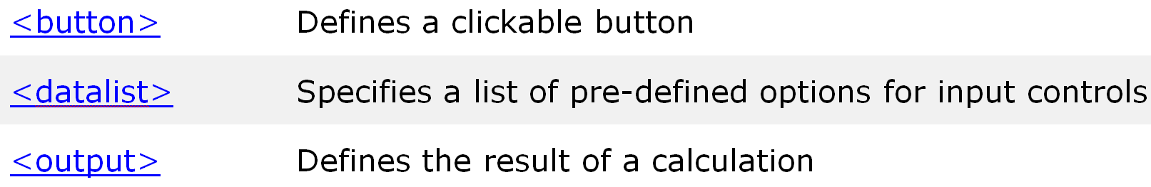
Forms

Slide 23
Form Attribute
disabled
Specifies that the input element should be disabled
max
Specifies the maximum value of an input element
min
Specifies the minimum value of an input element
pattern
Specifies the value pattern of an input element
required
Specifies that the input field requires an element
type
Specifies the type of an input element

Slide 24
HTML tables
To arrange the data that to be displayed on a page in a specific alignment we can use tables:
<Table>..To put a table,
<th>---column heading,
<tr>---row,<td>---column content
The table can be given a title using the <CAPTION> tag.
Introcuction to Div and span tags:<span> <div>
To give layout, or to group together several elements to create sections or subsections of a page. The span tag is used with inline elements whilst the div tag is used with block-level content.

Slide 25
HTML5 Style Guide
Use Lower Case Element Names
Close All HTML Elements
Close Empty HTML Elements
Use Lower Case Attribute Names
Quote Attribute Values
Image Attributes: Always add the alt attribute to images
Spaces and Equal Signs

Slide 26
Audio/Video Tag
The HTML<audio><video> used to embed audio or video in website .it will increase the visual effect of the website

Slide 27
HTML5 Web Storage
Web storage allows web applications to store data locally within the user's browser
HTML web storage provides two objects for storing data on the client:
window.localStorage - stores data with no expiration date
window.sessionStorage - stores data for one session (data is lost when the browser tab is closed)

Slide 28


HTML5 Google Maps
Geolocation-enabled website:
Can locate users’ current geographical location.
Displays points of interest around that location.
Guides the users from their current location to a target destination.
Allows a website to retrieve the current geographical location of a user.
Enables you to create applications that guide users to reach a target location
from their current location.

Slide 29
Web Technologies – Cascading Style Sheet (CSS)
CSS is a language that describes the style of an HTML documents. Defines a set of standard rules that provide better control over the page layout and appearance.
Collection of styles which is used to change the appearance of the html elements on webpage.
Using CSS, you can control the color of the text, the style of fonts, the spacing between paragraphs, how columns are sized and laid out, what background images or colors are used, layout designs,variations in display for different devices

Slide 30
CSS Class and ID
In the CSS, a class selector is a name preceded by a full stop (“.”) and an ID selector is a name preceded by a hash character (“#”).
The difference between an ID and a class is that an ID can be used to identify one element, whereas a class can be used to identify more than one

Slide 31
CSS
CSS consist of selector and declaration
A CSS comprises of style rules that are interpreted by the browser and then applied to the corresponding elements in your document.
A style rule is made of three parts −
Selector − A selector is an HTML tag at which a style will be applied. This could be any tag like <h1> or <table> etc.
Property − A property is a type of attribute of HTML tag. Put simply, all the HTML attributes are converted into CSS properties. They could be color, border etc.
Value − Values are assigned to properties. For example, color property can have value either red or #F1F1F1 etc.

Slide 32
CSS3 Selectors
CSS Element Selector
CSS Id Selector
CSS Class Selector
CSS Universal Selector
CSS Group Selector
Css attribute Selector

Slide 33
Selector
Selector{Declaration block Property:value} | table{ border :1px solid #C00; }
The universal selector : | * { color: #000000; }
To apply a style rule to a particular element only when it lies inside a particular element: | ul em { color: #000000; }
The Class Selectors: | .black { color: #000000; }
The ID Selectors: | #black { color: #000000; }
The Attribute Selectors | input[type = "text"]{ color: 000000;}
The Child Selectors | body > p { color: #000000; }
Grouping Selectors | h1, h2, h3 { color: #36C;}#content, #footer, #supplement{ position: absolute;}

Slide 34
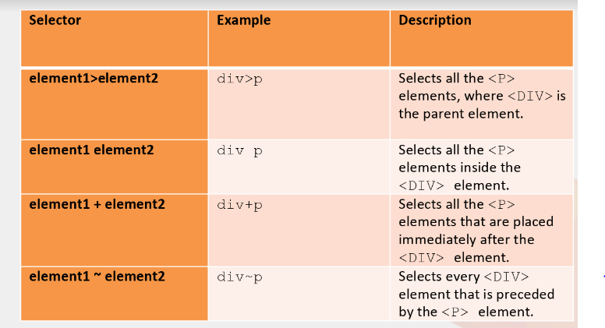
Selector

Slide 35
Inline,internal,external CSS
Inline CSS - The style Attribute
Use style attribute of any HTML element/tag to define style rules. : <element style = "...style rules...."> <body> <h1 style = "color:#36C;"> This is inline CSS </h1><P style="font-size: 24pt; color: red">Hotel booking fromthe comfort of your room.</P><P>Compare and book from more than 5000 hotels. </P> </body>
Embedded /Internal CSS - The <style> Element
CSS rules into an HTML document using the <style> element. This tag is placed inside the <head>...</head> tags.
<head> <style type = "text/css" media = "all“> body { background-color: linen; } h1 { color: maroon; margin-left: 40px; }
p{color:red;font-size:20pt;font-style:italic;} </style> </head>
External CSS
The <link> element can be used to include an external stylesheet file in your HTML document.An external style sheet is a separate text file with .css extension. You define all the Style rules within this text file and then you can include this file in any HTML document using <link> element.Is used when multiple webpages to be styled in the same manner.
<head> <link type = "text/css" href = "mystyle.css" media = " all" /> </head>

Slide 36
CSS Margins
The CSS margin properties are used to create space around elements, outside of any defined borders.
CSS has properties for specifying the margin for each side of an element:
margin-top,margin-right,margin-bottom,margin-left
All the margin properties can have the following values:
auto - the browser calculates the margin
length - specifies a margin in px, pt, cm, etc.
% - specifies a margin in % of the width of the containing element
inherit - specifies that the margin should be inherited from the parent element

Slide 37
CSS Properties
CSS – Backgrounds: used to specify the background color,image and position of the html element | <head><style>body { backgroundimage:url("/css/images/css.jpg"); background-color: #cccccc; background-repeat: repeat; background-position:100px; } </style></head>
CSS – Text: Used to change color,indentation,and alignment of text elements in webpage | <body> <p style = "color:red; direction:rtl; letter-spacing:5px; text-align:right; text-decoration:underline; text-transform:capitalize;"> This text </p> </body>
CSS – Fonts: Used to customize the manner in which some text is displayed on the page | <body> <p style = "font-family:georgia,garamond,serif; font-style:italic; font-variant:small-caps; font-weight:bold; font-size:large;"> This text </p> </body>

Slide 38
CSS Other Ptoperties
CSS-List: Used to customize the look of the ordered and unordered html lists | ul {list-style: square inside url("sqpurple.gif");list-style-type: square;}
CSS Links can be styled with any CSS property.((e.g. color, font-family, background, etc.). links can be styled differently depending on what state they are in. | a:link - a normal, unvisited link a:visited - a link the user has visited a:hover - a link when the user mouses over it a:active - a link the moment it is clicked
The CSS border properties allow you to specify the style, width, and color of an element's border. | dotted - Defines a dotted border dashed - Defines a dashed border solid - Defines a solid border double - Defines a double border none - Defines no border hidden - Defines a hidden border

Slide 39
Box Model
The CSS box model is a box that wraps around every HTML element.
CSS box model is a container which contains multiple properties .
Box-Model has multiple properties in CSS.
Borders: A border that goes around the padding and content
Margins: Clears an area outside the border and transparent
Padding: Clears an area around the content and transparent
Content: The content of the box, where text and images appear
div { width: 300px; border: 15px solid green; padding: 50px; margin: 20px; }

Slide 40
CSS Backgrounds and Borders
Allows to style elements' backgrounds and borders. Backgrounds can be filled with a color or image, clipped or resized, and otherwise modified.
Borders can be decorated with lines or images, and made square or rounded.
Element boxes can be decorated with a shadow.

Slide 41
NewProperties in CSS3
border-radius, which is used to give “rounded corners” to square boxes.With the rounded corners you can create boxes with the background color or background-image.
CSS3 Border image: can add image border to some elements.It allows to specify an image to be used instead of the normal border around an element.
CSS Multi background property is used to add one or more images at a time without HTML code. We can add images as per our requirement

Slide 42
CSS 3 User Interface
Resize: The resize property specifies how an element should be resizable by the user
outline-offset: The outline-offset property adds space between an outline and the edge or border of an element

