Slide 1
C#
Introduction History

Slide 2
.NET
An “Application Development Platform”.
It is developed by Microsoft Corporation in the year 2000.
.NET Stands for Network Enabled Technology.
.NET is a Package or SDK or Framework also called as ".NET Framework".
Used for powerful software application development.
It provides necessary environment (IDEs, compilers, run time engines, libraries) for developing efficient and powerful applications for the end-users.
.NET provides a distributed object oriented platform for building
Stand-alone Applications(Console & Winforms)
Web-based Applications
Service Applications
Mobile Applications

Slide 3
.NET FRAMEWORK
.NET Framework requires to run and develop any .NET Application
.NET Framework is a set of components, which are essential for develop and run any application in .NET Environment.
.NET Framework is a common Architecture for all .NET Applications.
.NET Framework Consist of following Components.
Languages
Technologies
Base Class Libraries
CLR[Common Language Runtime]

Slide 4
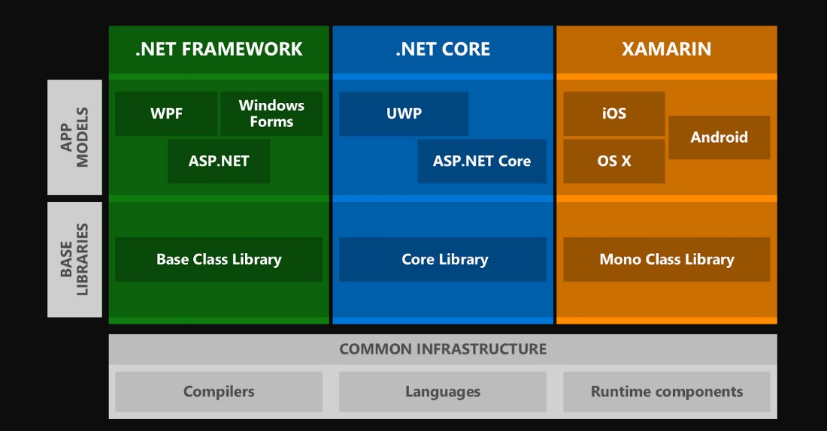
.NET Framework Architecture

Slide 5
.NET Framework Architecture
C#.NET
VB.NET
VC++
F#.Net
Win Forms,WPF
Web Forms(Asp.Net ,Asp.net MVC
Services(WCF,WEB API)
…..
ADO.NET,EntityFramework
.NET Framework
Base Class Library
Common Language Runtime
Operating System

Slide 6
Languages
.NET gives choice of languages includes VB.NET, C#, F#, VC++ for developing diff kind on Applications. All of these compile to a Common Intermediate language.
On compiling any .NET language, you will get MSIL.
MSIL stands for Microsoft Intermediate Language.
Ex: C#.NET MSIL
Ex: VB.NET MSIL
Ex: VC++.NET MSIL
MSIL is a compile code of any .NET Language.
Microsoft Intermediate Language (MSIL) is a CPU-independent set of instructions that can be efficiently converted to the native code.
Also Called as Common Intermediate Language or Managed Code.
MSIL code will be saved in a file called "Assembly".
Its file extension can be either ".exe" or ".dll".
EXE file are directly executable files.
A DLL file shares the common code among many projects..
CSC
VBC

Slide 7
Managed Code Vs UnManaged Code
Managed code is a code whose execution is managed by Common Language Runtime.
It gets the managed code and compiles it into machine code.
After that, the code is executed. The runtime here i.e. CLR provides automatic memory management, type safety,
Managed code is written in high-level languages run on top of .NET. This can be C#, F#, etc.
A code compiled in any of this language with their compilers, a machine code is not generated. However, you will get the Intermediate Language code, compiled and executed by runtime".
The code, which is developed outside . NET, Framework is known as unmanaged code.
The "unmanaged code” is the program in binary that is loaded by the operating system into the memory.
The programmer has to take care of.all memory management and type safety

Slide 8
CLR
Common Language Runtime is the core component for .NET framework
CLR is Common Runtime Engine for all .NET Applications
All the .NET program execution is managed by CLR.
CLR uses Just-In-Time (JIT) compiler to compile CIL code into the machine understandable code(Native code).
.cs/.vb
CSC/VBC
MSIL
CLR
Native Code
Base
Class
Library

Slide 9
Components of CLR and Roles
The main function of Common Language Runtime (CLR) is to convert the Managed Code into native code and then execute the Program.
It acts as a layer between Operating Systems and the applications written in .
Components of CLR
Common Language Specification (CLS):It is responsible for converting the different .NET programming language syntactical rules and regulations into CLR understandable format.
Common Type System (CTS):CTS is responsible for understanding all the data type systems of .NET programming languages and converting them into CLR understandable format
Garbage Collection (GC):It is used to provide the Automatic Memory Management feature.
Just In – Time Compiler (JIT):It is responsible for converting the CIL(Common Intermediate Language) into machine code or native code using the Common Language Runtime environment.

Slide 10
Base Class Libraries
.NET Base Class Library is the sub part of the Framework that provides library support to Common Language Runtime to work properly.
Base Class Libraries are Standard Libraries common to all .NET languages comes with .NET framework
Base Class Libraries provides some set of Common classes , which are useful for development of .NET applications.
All Base class Libraries are in the form of .dll(dynamic link libraries)
The Base class Libraries also called Assemblies or Namespaces.

Slide 11
Base Class Libraries
Important DLL files of BCL
System.IO
System.Threading
System.Data
System. Web
System.Web.MVC
Microsoft.AspNetCore
System is the Base Library in .Net Framework.
Adding a Library to the Application
using System. Web----------C#
Imports System.Web----------VB.net

Slide 12
Just In Time Compiler
Just-In-Time compiler(JIT) is a part of Common Language Runtime (CLR) in .NET which is responsible for managing the execution of .NET programs regardless of any .NET programming language
This intermediate language is then converted into the machine code by the Just-In-Time (JIT) compiler.
This machine code is specific to the computer environment that the JIT compiler runs on.

Slide 13
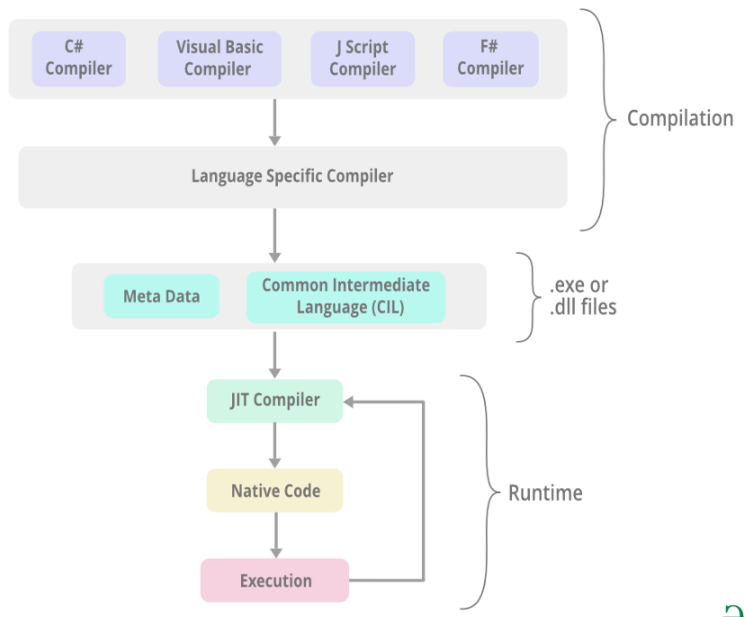
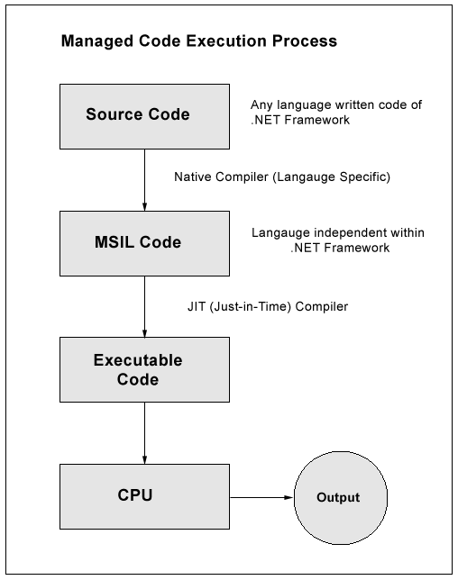
Execution Process

Slide 14
Common Runtime Engine and CIL(Compilation Model)
.NET compilation model
VB.NET.C#/J#/C++ Code
.NET compatible languages compile to a platform-neutral language called Common Intermediate Language(CIL)
Compiler
Common Intermediate Language
The platform-specific CLR compiles CIL to machine-readable code that can be executed on the current platform
Common Language Runtime
01101100101011
10010101100110

Slide 15
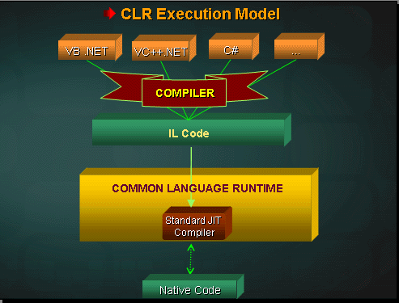

Slide 16
Understanding MSIL Code
When a compiler produces Microsoft Intermediate Language (MSIL), it also produces Metadata.
The Microsoft Intermediate Language (MSIL) and Metadata are contained in a portable executable file .
Microsoft Intermediate Language (MSIL) includes instructions for loading, storing, initializing, and calling methods on objects, as well as instructions for arithmetic and logical operations, control flow, direct memory access, exception handling, and other operations
MSIL contains assembly manifest and type metadata
The ILDASM (IL Disassembler ) is a great tool used to view the assembly content of all the code components

Slide 17
Metadata- The Self Explanatory Files
Metadata is binary information describing the program
Metadata stores the following information:
Description of the assembly.
Identity (name, version, culture, public key).
The types that are exported.
Other assemblies that this assembly depends on.
Security permissions needed to run.
Description of types.
Name, visibility, base class, and interfaces implemented.
Members (methods, fields, properties, events, nested types).
Attributes.
Additional descriptive elements that modify types and members.

Slide 18
NET Assemblies Explanation
Microsoft .Net Assembly is a logical unit of code, that contains code which the Common Language Runtime (CLR) executes..
It include both executable application files that you can run directly from Windows without the need for any other programs (.exe files), and libraries (.dll files) for use by other applications.
During the compile time Metadata is created with Microsoft Intermediate Language (MSIL) and stored in a file called Assembly Manifest .
An EXE file can be run independently while a DLL is used by other applications
A DLL file can be reused by other applications while an EXE cannot.
A DLL would share the same process and memory space of the calling application while an EXE creates its separate process and memory space.

Slide 19
Visual Studio
IDE for creating .NET applications which are
Console based
Web based
Windows form based
Web services
Features
Page design
Automatic error detection
Debugging tools
IntelliSense (IntelliSense helps in auto completion by providing functions/methods names parameters etc.)
.

Slide 20
Visual Studio
Visual Studio 6.0
Visual Studio .NET (2002)
Visual Studio .NET 2003
Visual Studio 2005
Visual Studio 2008
Visual Studio 2010
Visual Studio 2012
Visual Studio 2013
Visual Studio 2015
Visual Studio 2017
Visual Studio 2019

Slide 21
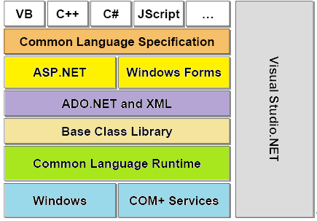

Slide 22
.NET framework versions
.NET 1.0
Visual Studio .NET 2003
Windows Server 2003
.NET 2.0
Visual Studio .NET 2005
Windows Server 2003 R
.NET 3.0
Visual Studio .NET 2005
Windows Vista, Windows Server 2008
.NET 3.5
Visual Studio 2008
Windows 7, Windows Server 2008 R2
.NET 4.0
Visual Studio 2010
Windows 7(Recommended)
.NET 4.5
Visual Studio 2012
Windows 7,8, Windows Server 8
.NET 1.1
Visual Studio .NET
Windows XP tablet and Media center

Slide 23
.NET Framework (4.0)
MVC
TPL
Parallel LINQ
AJAX-enabled Web sites
LINQ
EF
WCF
WPF
WF
4.0
ADO.NET
ASP.NET
WinForm
3.5
3.0
Base Class Libraries
2.0
Common Language Runtime

Slide 24
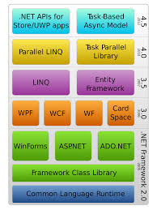
Notes:
Universal Windows Platform (UWP) apps - MSDN - Microsoft

Slide 25
Environment Setup
Windows Platform(Windows 10)
Visual Studio.NET(2019)

