Slide 1
JavaScript

Slide 2
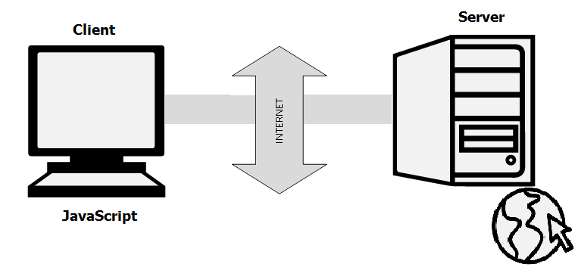
Introduction
JavaScript is a very powerful client-side scripting language.
JavaScript is used mainly for enhancing the interaction of a user with the webpage
JavaScript is Object Based

Slide 3
What is DOM
JavaScript is accessing the HTML document through DOM
Document Object Model (DOM) is a platform and language-neutral interface that allows programs and scripts to dynamically access and update the content, structure, and style of a document.
JavaScript gets the power to create dynamic HTML With the object model,
JavaScript can change the following html components through DOM
HTML elements in the page
HTML attributes in the page
CSS styles in the page
Remove existing HTML elements and attributes
Add new HTML elements and attributes
React to all existing HTML events in the page
Create new HTML events in the page
The DOM Programming Interface is the properties and methods of each object.
A property is a value that you can get or set (like changing the content of an HTML element).
A method is an action you can do (like add or deleting an HTML element).

Slide 4
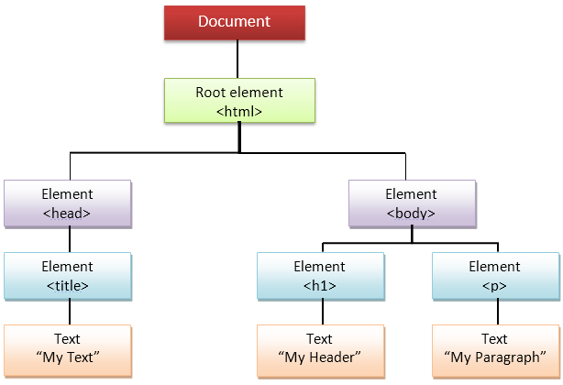
HTML DOM
Where to insert JavaScript Code
JavaScript code must be inserted between <script> and </script> tags.
Scripts can be placed in the <body>, or in the <head> section of an HTML page, or in both.
Snippet:
<script>
alert("Hello world");
</script>

Slide 5
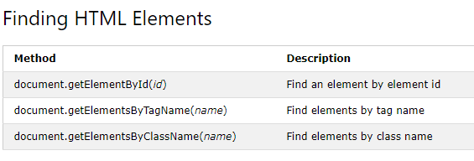
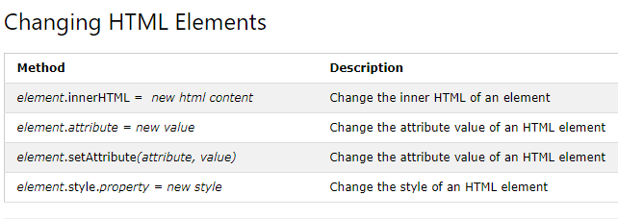
How JavaScript Access HTML Using DOM

Slide 6
Data Types
Primitive datatype
Number,string,Boolean,undefined
Complex datatype
Objects,function
Snippet
<script>
var length = 16; //number
var lastName = "Johnson"; //string
var x = { firstName: "John", lastName: "Doe" }; //object
document.getElementById(“num").innerHTML = length;
document.getElementById("str").innerHTML = lastName;
document.getElementById("obj").innerHTML = x.firstName + "" + x.lastName;
</script>

Slide 7
Function
A JavaScript function is a block of code designed to perform a particular task.
Syntax:
function name(parameter1, parameter2, parameter3)
{ code to be executed }
Snippet
function Addition(a, b) {
return a + b;
}

Slide 8
Function Invocation
Function Invocation takes place in one of the following way
The code inside the function will execute when "something" invokes (calls) the function:
When an event occurs (when a user clicks a button)
When it is invoked (called) from JavaScript code
Automatically (self invoked)
Snippet
document.getElementById("demo").innerHTML = Addition(4, 5);

Slide 9
Array
An array is a special variable, which can hold more than one value at a time.
Syntax:
var array_name = [item1, item2, ...];
var array_name = new Array [item1, item2, ...];
Eg:
var color=[“red”,”blue”,”green”];
var color=new color[“red”,”blue”,”green”];

Slide 10
Array Properties and Methods
length property --> If you want to know the number of elements in an array, you can use the length property.
reverse method --> You can reverse the order of items in an array using a reverse method.
Method
sort method --> You can sort the items in an array using sort method.
pop method --> You can remove the last item of an array using a pop method.
shift method --> You can remove the first item of an array using shift method.
push method --> You can add a value as the last item of the array.

Slide 11
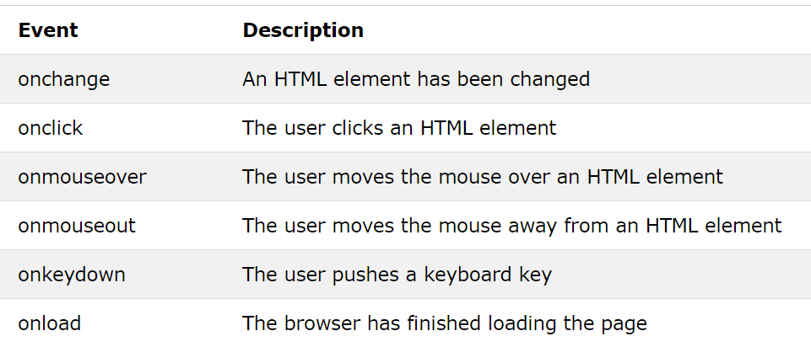
JavaScript Events
HTML allows event handler attributes, with JavaScript code, to be added to HTML elements.
Syntax:
<element event="some JavaScript">
Eg:
<button onclick="document.getElementById('demo').innerHTML = Date()">The time is?</button>
Below are the HTML Events

Slide 12
Snippet:
<script type="text/javascript">
function change(){
var paragraphs = document.getElementsByTagName("p");
document.getElementById("second").innerHTML = "The orginal message is changed.";
}
</script>
Html Code:
<p id="second">This is the technology section.</p>
<button onclick=" change()">Click to change value</button>

Slide 13
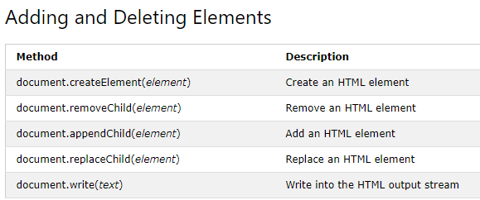
Creating HTML Elements Using DOM

Slide 14
Exceptions Handling
JavaScript implements the try,catch,finally and throw operator to handle exceptions.
script type="text/javascript">
<!--
try {
// Code to run
[break;]
}
catch ( e ) {
// Code to run if an exception occurs
[break;]
}
[ finally {
// Code that is always executed regardless of
// an exception occurring
}]
//-->
</script>

Slide 15
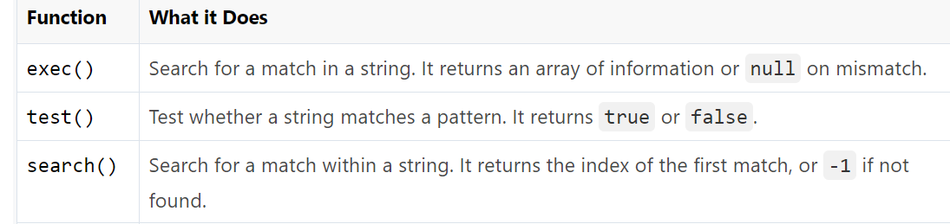
Regular Expressions
A regular expression is a sequence of characters that forms a search pattern.
Regular expressions can be used to perform all types of text search and text replace operations
The literal syntax uses forward slashes (/pattern/) to wrap the regular expression pattern.
Syntax
/pattern/modifiers;
Eg:
var patt = /Google/i; //Note:i is a modifier (modifies the search to be case-insensitive).

Slide 16
Regular Expressions
Modifiers
Modifier | Description
i | Perform case-insensitive matching
g | Perform a global match (find all matches rather than stopping after the first match)
m | Perform multiline matching

Slide 17
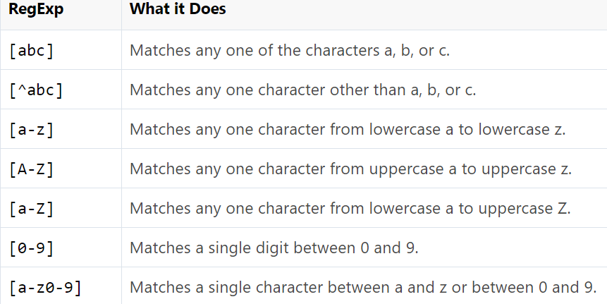
Regular Expressions
Patterns

Slide 18
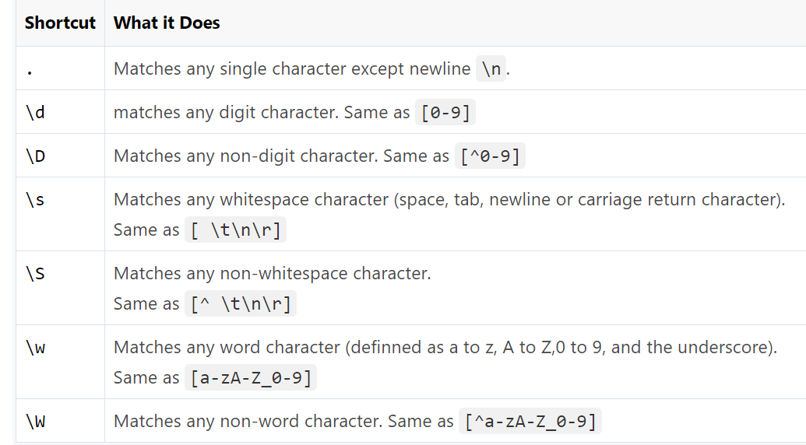
Regular Expressions
Some character classes such as digits, letters, and whitespaces are used so frequently that there are shortcut names for them.

Slide 19
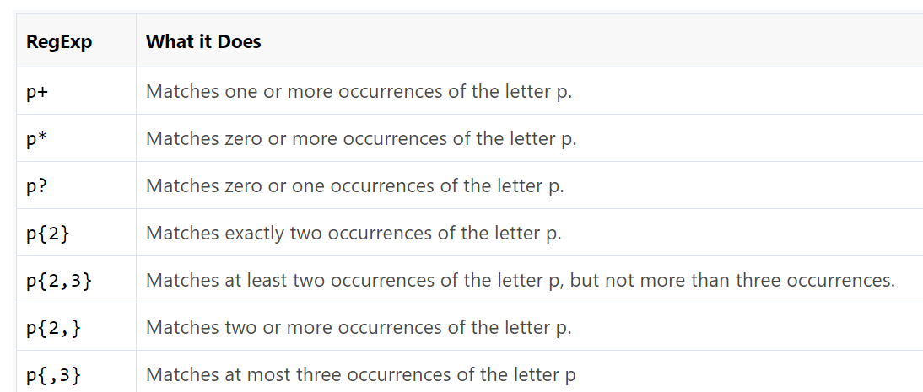
Regular Expressions cont
Quantifier
Quantifiers
Quantifier | Description
n+ | Matches any string that contains at least one n
n* | Matches any string that contains zero or more occurrences of n
n? | Matches any string that contains zero or one occurrences of n

Slide 20
Eg:
var patt = /e/; patt.test("The best things in life are free!"); //true

