Slide 1
Object Oriented Programming
OOP
software development methodology or paradigm
split a program in building blocks called objects
What Is An Object ?
Object
State
Nouns
Behavior
Verbs
Marker
length, width color
Variables
to Write()
Methods

Slide 2


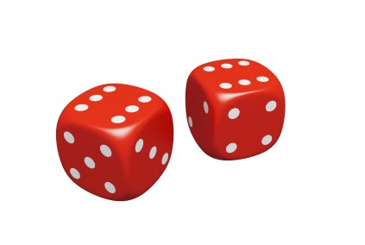
Identify Objects in a Dice Game
Player 1
Player 2

Slide 3
What is a class?
A class describes an object
Class is a blueprint of an object
Properties & Behaviors of Classes in Dice Game
Dice
P Player
Properties
faceValue
Properties
name
value
Behaviors
roll
Behaviors
throw

Slide 4
Classes and Objects
Classes and Objects
class Player{
String name;
int value;
void throwDice(){
//some logic
}
}// end of class
Player
Properties
name
value
Behaviors
throwDice

Slide 5
Classes and Objects
Objects are communicating each other through objects
All messages have three parts
1. Message Receiver
playerOne.throwDice(diceOne,diceTwo)
2. Message
3. List of arguments
Define Classes
Steps in Object Communication
Step 1
Create Objects
Step 2
Pass Messages
Step 3

Slide 6
Example of Product Class
class Product
{
public string Name {get; set;}
public int ProductId {get;set;}
public double Price{get;set;}
public void Display()
{
System.Console.WriteLine(“Name:”+Name); System.Console.WriteLine(“ID:”+ProductId); System.Console.WriteLine(“Price:”+Price);
}
}
Responsibility of this class is the integrity of details of product
Data Members(Property)
Method or Member Function
Accessing Members
with in the method of the same class

Slide 7
Creating Objects
ClassName refVariable;
refVariable= new Classname();
or
ClassName refVariable = new Classname();
Example :
Dice diceOne ;
diceOne = new Dice();
or
Dice diceTwo = new Dice();

Slide 8
Creating Object
Creating Objects
To create a object new keyword is used
Members of a class are accessed using . Operator
class Test
{
static void Main()
{
Product p1=new Product()
}
}
p1.ProductId=10
p1.Name=“Keyboard”
p1.price=300
p1.Display()

Slide 9
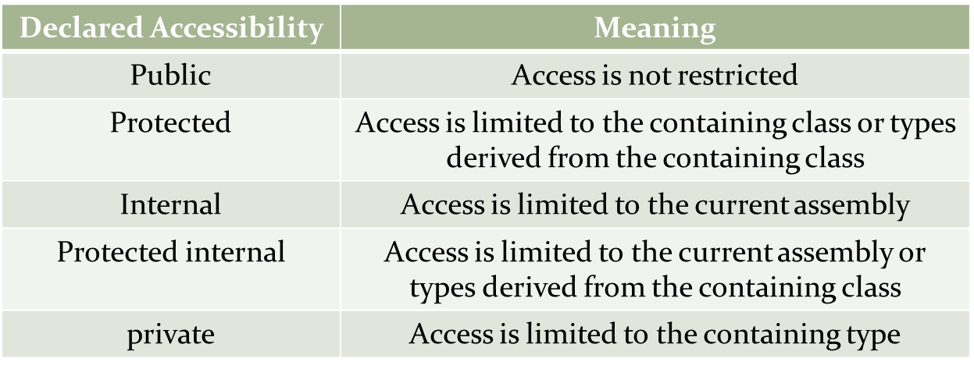
C# Access Modifiers
All types and type members have an accessibility level
Controls whether they can be used from other code in your assembly or other assemblies

Slide 10
Creating Object
Class Members
Variables , Methods and Constructors defined inside a class are called members of the class
Types of Members
Data members/Fields
Member Functions
Methods
Constructors
Destructors
Properties

Slide 11
Creating Object
Data Member Declaration
A Data member is a variable declared inside a class
Data members are also called as class variables
<modifier> <data type> <name>
Modifiers
Data Type
Name
private
String
Variable Name
Ex:
private int Product_Id ;
public string Product_Nam; public double salary ;

Slide 12
C# Methods
A Method is a sub-program consist of one or more executable statements
Methods divide an application into logical units
To use Method, you required:
Define Methods
Call Methods
The following syntax can be used to define a method
<Access Specifier> <Return Type> <Method Name>(Parameter List)
{
Method body
}

Slide 13
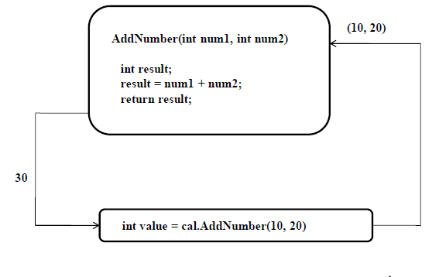
C# Methods….(Contid)
The building blocks of a method are
Access Specifier
Return Type
Method Name
Parameter List
Method body
Method can be called by using the name of the method
The method name is followed by parentheses
MethodName();
MethodName(value1,value2);
Dice diceOne = new Dice();
diceOne.roll();
int value = diceOne.faceValue();

Slide 14
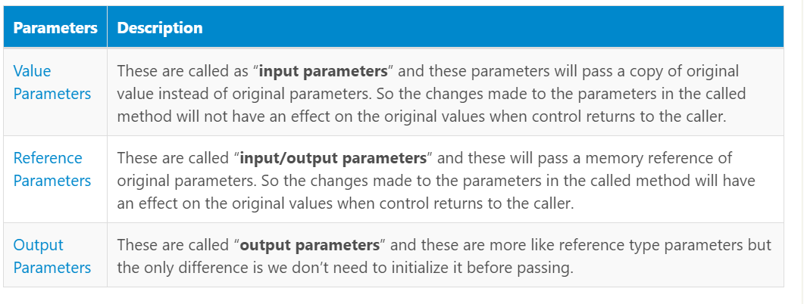
C# Passing Parameters to Methods
In
c#, params keyword is useful to specify a method parameter that takes a variable number of arguments. The params keyword is useful when we are not sure about the number of arguments to send as a parameter.
In c#, params keyword is used to specify a method parameter that takes a variable number of arguments.
The params keyword is useful when we are not sure about the number of arguments to send as a parameter.

Slide 15
Types of Variables and Methods
Methods are of 3 types:
Static method
Instance method
The member variables of a class is known as instance variables
Instance variables define object properties
These instance methods act upon the instance variables of a class
Instance methods are invoked with an object <<object reference>>.<<method-name>>;

Slide 16
Static Variables and Methods
Variable which belongs to the class and not to object(instance)
Also called as class variables
Static variables are initialized only once , at the start of the execution
A single copy shared by all instances of the class
A static variable can be accessed directly by the class name and doesn’t need any object
Syntax : <class-name>.<variable-name>
A static method can be called and executed without creating an object
Static method can be invoked directly using class name
All C# program needs a Main method which is static
Syntax:
<access-modifiers> static <return type> <method name>(<parameters>); Eg: public static void main()

Slide 17
Constructors
Constructors are similar to functions
Have same name as class name
Automatically called when ever an object of the class
is created
Constructors initialize the object
Example :
class Car{
public Car() { // this is constructor
. . .
}
}

Slide 18
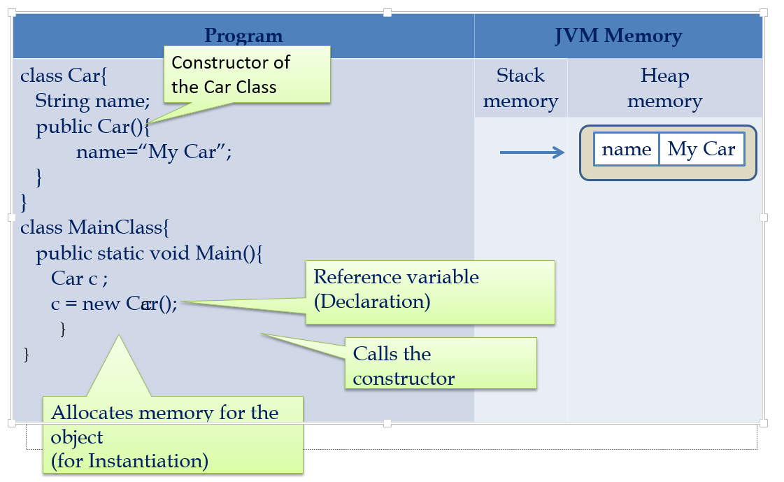
Constructors

Slide 19
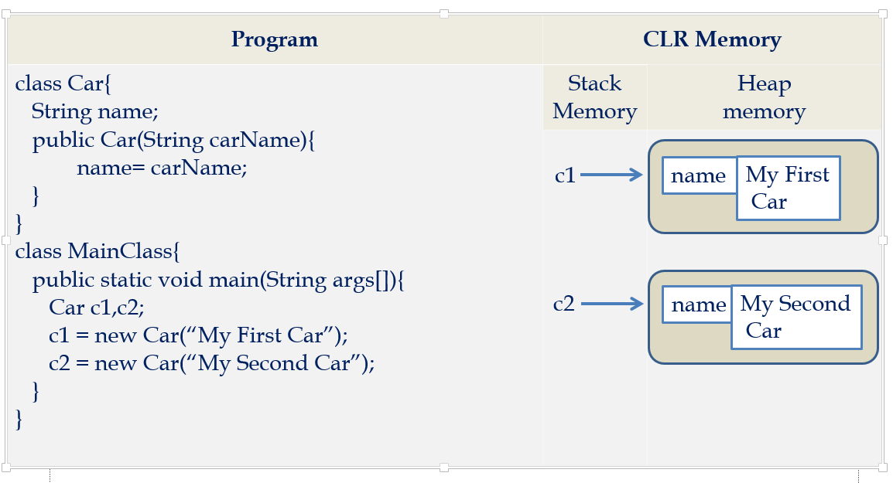
Constructors

Slide 20
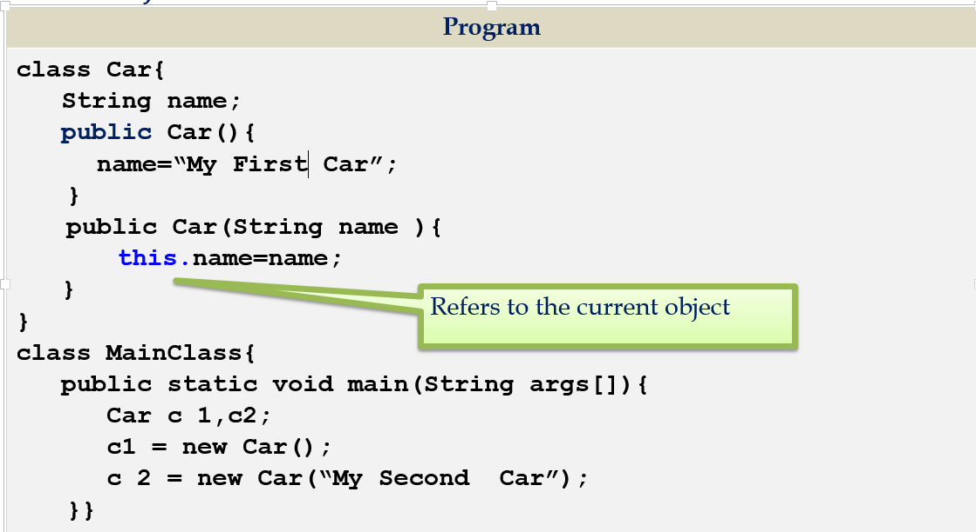
This Keyword
This is a keyword which contains the current object reference

Slide 21
This Keyword….(Contid)
Explicit constructor invocation
public class MyClass {
private int x, y, a, b;
public MyClass() : this(0, 0, 0, 0)
{
}
public MyClass(int a, int b) {
this(0, 0, a, b);
}
public MyClass(int x, int y, int a, int b) {
this.x = x;
this.y = y;
this.a = a;
this.b = b;
}
...
}

Slide 22
Properties
Property is an extension of the class variable and it provides a mechanism to read, write or change the value of the class variable without affecting the external way of accessing it in our applications.
properties contain one or two code blocks called accessors and those are called a get accessor and set accessor.
By using get and set accessors, we can change the internal implementation of class variables and expose it without effecting the external way of accessing it based on our requirements.
In object-oriented programming languages define fields as private, and then use properties to access their values in a public way with get and set accessors.
<access_modifier> <return_type> <property_name>
{
get
{
// return property value
}
set
{
// set a new value
}
}
The get accessor code block will be executed whenever the property is read and the code block of set accessor will be executed whenever the property is assigned to a new value.

Slide 23
Constructor OverLoading
Having multiple constructors with different parameters in a class
Example:
class Loan{
String loanType;
public loan(){
}
public loan(String type){
this.loanType= type;
}
}

Slide 24
Method OverLoading
Methods with same name but with different parameters present in a class are called method overloading
Different :
Data types
number of parameters
Sequence of Parameters
Example:
public class ArithmeticOperation
{
public void add( int a,int b){//}
public void add(float a,float b){//}
public void add( int a,float b){//}
public void add(float a,int b){//}
public void add( int a,int b,int c){//}
}

Slide 25
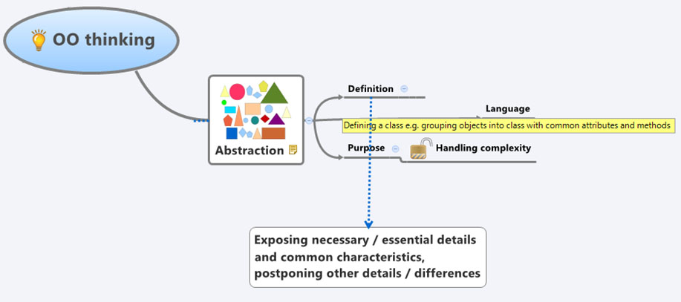
Abstraction
Notes:
Abstraction allows relevant information visible and encapsulation enables a programmer to implement the desired level of abstraction.

Slide 26
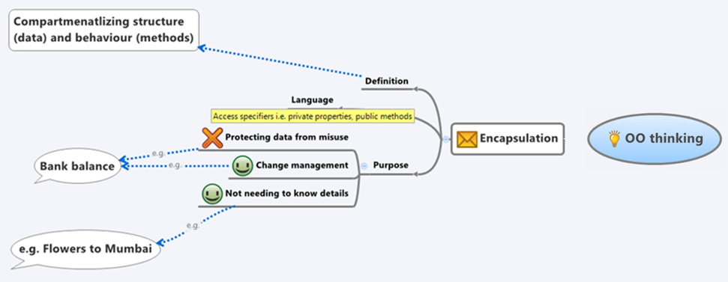
Encapsulation

Slide 27
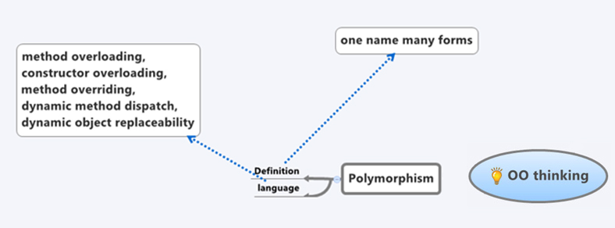
Polymorphism
Notes:
The word polymorphism means having many forms. In object oriented programming paradigm, polymorphism is often expressed as 'one interface, multiple functions'.
Polymorphism can be static or dynamic. In static polymorphism the response to a function is determined at the compile time. In dynamic polymorphism it is decided at run time.
Static Polymorphism
The mechanism of linking a function with an object during compile time is called early binding. It is also called static binding. C# provides two techniques to implement static polymorphism.
They are:
Function overloading
Operator overloading

Slide 28
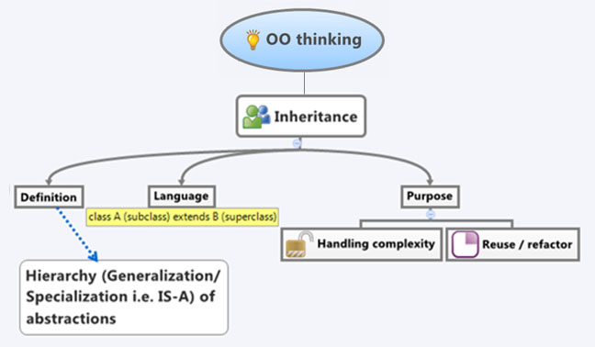
Inheritance
Notes:
One of the most important concepts in object-oriented programming is inheritance.
Inheritance allows to define a class in terms of another class, which makes it easier to create and maintain an application.
This also provides an opportunity to reuse the code functionality and fast implementation
When creating a class, instead of writing new data members and member functions, the programmer can designate that the new class should inherit the members of an existing class.
This existing class is called the base class, and the new class is referred to as the derived class.
The idea of inheritance implements the IS-A relationship. For example, mammal IS A animal, dog IS-A mammal hence dog IS-A animal as well.

Slide 29
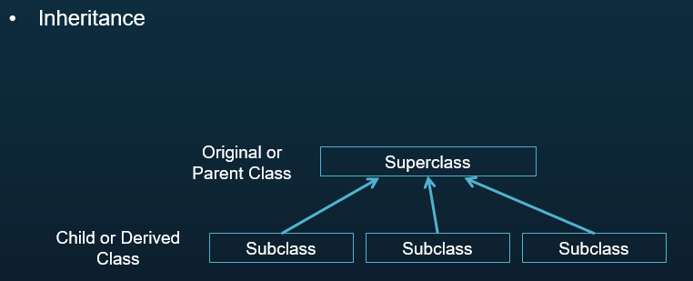
Inheritance
Can inherit the features of another class
- One class is the parent class of another
Inheritance

Slide 30
Method Overriding
Feature in Polymorphism where child class provides a different implementation for the method defined in the parent class
Parent class has to define a method to be overridable using the keyword ‘override’ for it to be overriden
Inheritance

Slide 31
Interfaces
An interface in C# is a pure abstract class
Interfaces looks like a class, but has no implementation.
It contain only definition of events, indexers, methods and/or properties.
Interfaces inherited by classes and structs, which must provide an implementation for each interface member defined.
All interfaces should be declared with the keyword interface.
It is possible to implement any number of interfaces in a single derived class, but you should provide signatures to all methods.
C# does not support multiple inheritance, but using interfaces it can do that.
In interface all the methods are abstract.
Inheritance

Slide 32
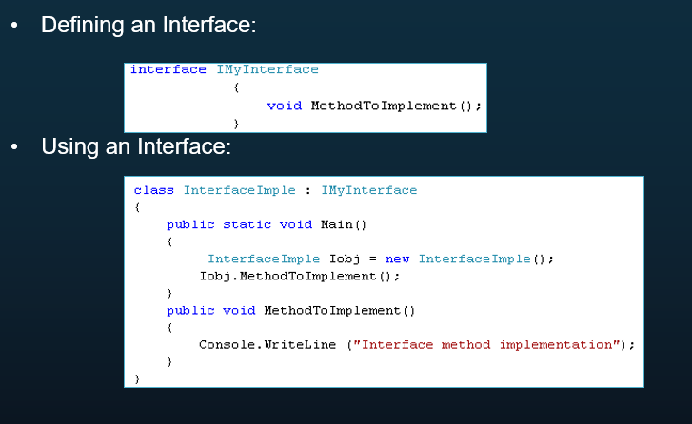
Interfaces…(Contid)
Inheritance

Slide 33
Collections
C# includes specialized classes that store series of values or objects are called collections.
Collections are non generic and generic
The System.Collections namespace contains the non-generic collection types
System.Collections.Generic namespace includes generic collection types.

Slide 34
Non Generic Collections
ArrayList- it will grow dynamically and also shrink . Allows duplicate items
HashTable- Represents a collection of key/value pairs . Any non-null object can be used as a key but a value can be null. Cannot have duplicate keys
SortedList- It uses a key as well as an index to access the items in a list.
Stack- Stack stores the values in LIFO style (Last In First Out). It provides a Push() method to add a value and Pop() & Peek() methods to retrieve values.
Queue- Queue stores the values in FIFO style (First In First Out). It provides an Enqueue() method to add values and a Dequeue() method to retrieve values from the collection

Slide 35
Generic Collections
List | It is useful to represent a list of objects that can be accessed by index.
Queue | It is useful to represent a FIFO (First In, First Out) collection of objects.
Stack | It is useful to represent a LIFO (Last In, First Out) collection of objects.
SortedList<K,V> | It is useful to represent a collection of key/value pairs that are sorted by a key.
Dictionary<K,V> | It is useful to represent a collection of key/value pairs that are organized based on the key.
HashSet | It is useful to store non-duplicate elements.

Slide 36
Exception
try:
A Identifies a block of code for which particular exceptions is activated
catch:
A program catches an exception with an exception handler at the place in a program where you want to handle the problem
finally
The finally block is used to execute a given set of statements, whether an exception is thrown or not thrown.
throw
Throws the exception to the calling method
A Identifies a block of code for which particular exceptions is activated
catch:
A program catches an exception with an exception handler at the place in a program where you want to handle the problem
finally
The finally block is used to execute a given set of statements, whether an exception is thrown or not thrown.
throw

Slide 37
Thank You

