Slide 1
ANSI SQL
DDL_DML_DQL

Slide 2

Session Objectives
At the end of the session you will be able to
Identify the various SQL operations that a developer or tester needs to know to work with DBMS.
Define DQL - Select Statements.
Describe DML - Insert Statement, Update, and Delete Statement.
Recognize DDL - Create Table, Alter Table, Rename, Truncate, and Drop table.

Slide 3
Data Definition language
Creating database is a core task as it must signify the meaning of its existence.

Slide 4
Create Database
Create is used to create objects like database, tables , views
Query
Create database TrainingDB;
Syntax
Create database db_name;

Slide 5
Create Table
Syntax
Query
CREATE TABLE table_name(
column1 datatype,
.....
columnN datatype,
PRIMARY KEY( one or more columns )
);
Create table Employee
(Employee_id int primary key,
Firstname varchar(100),
LastName varchar(100),
Email varchar(200),
DOB date
);

Slide 6
Alter Table
Syntax
ALTER TABLE table_name ADD column_name datatype;
ALTER TABLE table_name DROP COLUMN column_name;
ALTER TABLE table_name MODIFY COLUMN column_name datatype;
ALTER TABLE table_name
ADD CONSTRAINT MyUniqueConstraint UNIQUE(column1, column2...);
ALTER TABLE table_name
ADD CONSTRAINT MyPrimaryKey PRIMARY KEY (column1, column2...);

Slide 7
Drop Table
Syntax
Query
DROP TABLE table_name;
Drop table customers;

Slide 8
Truncate Table
Syntax
Query
Truncate TABLE table_name;
Truncate table customers;

Slide 9
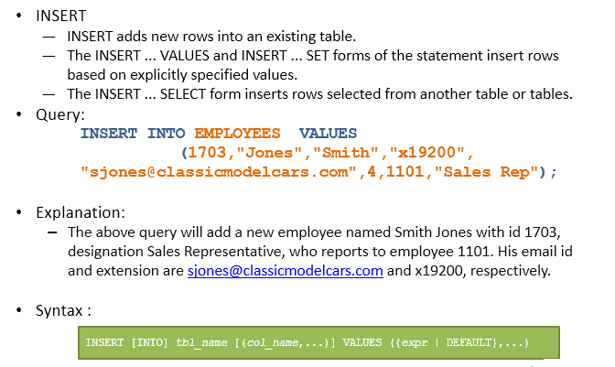
Data manipulation Language

Slide 10
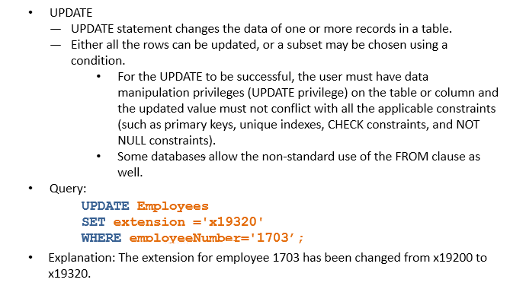
Data manipulation Language

Slide 11
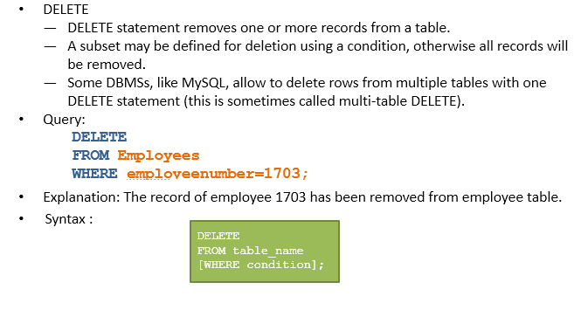
Data manipulation Language

Slide 12


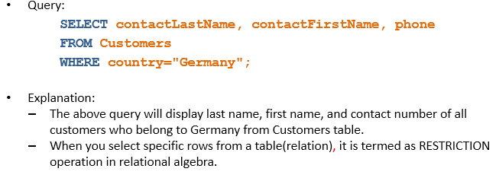
Data Query language

Slide 13
111
You have completed DML_DDL_DQL

