Slide 1
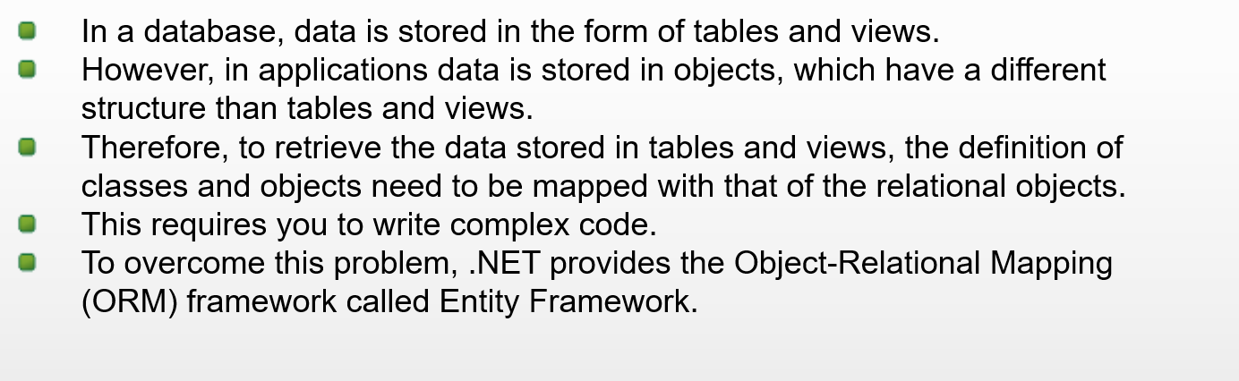
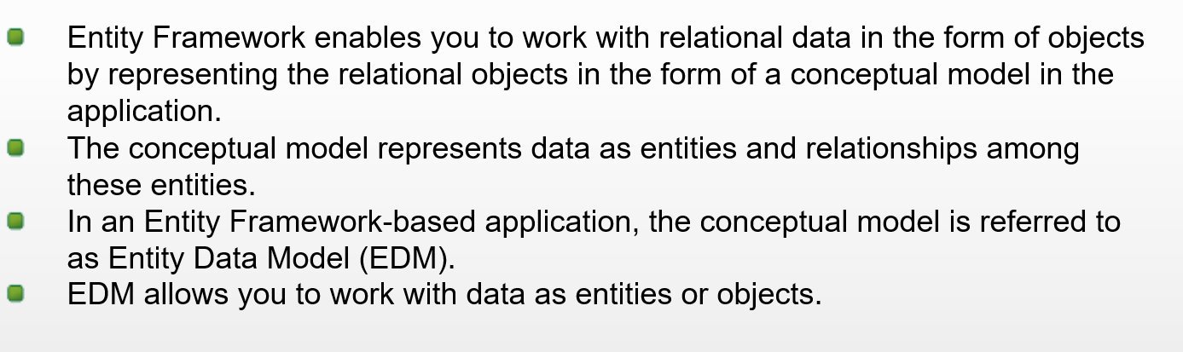
Introduction to Entity Framework

Slide 2
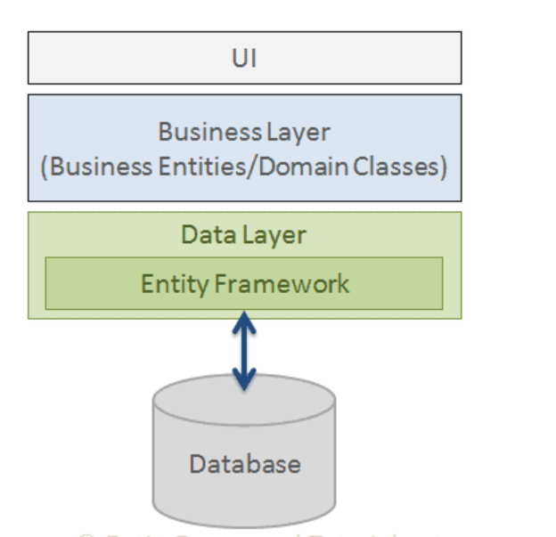
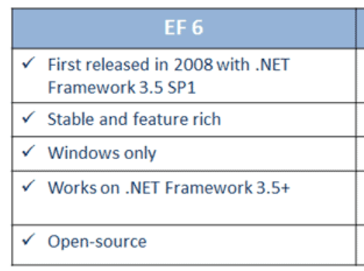
Entity FrameWork Design & Version

Slide 3
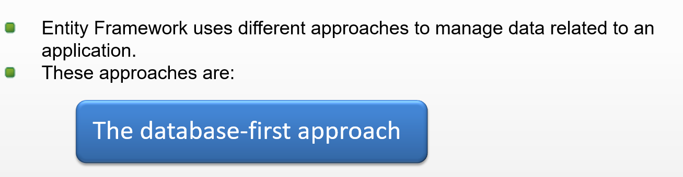

Entity Framework
Entity Framework is a data access technology.
Entity Framework latest version is EF 6.x.
It is open-source, lightweight, extensible and a cross-platform version.
It is an enhancement to ADO.NET
Entity Framework gives developers an automated mechanism for accessing & storing the data in the database.

Slide 4
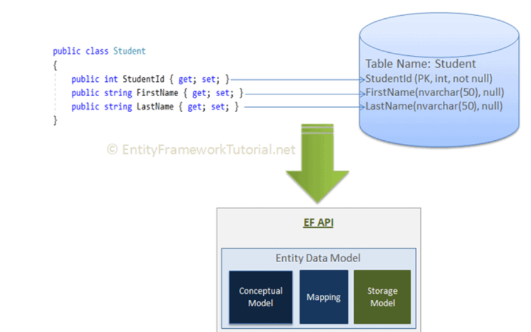
Entity Framework
EF API builds an Entity Data Model (EDM). EDM is an in-memory representation of the entire metadata: conceptual model, storage model, and mapping between them.

Slide 5
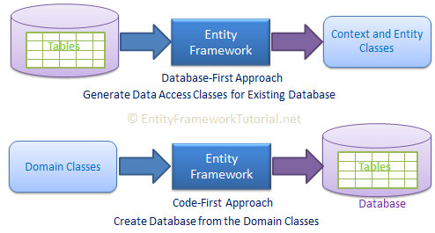
EF Development Approaches
1) Code-First
2) Database-First.
EF mainly targets the code-first approach and provides little support for the database-first approach.
In the code-first approach, EF creates the database and tables using migration based on the conventions and configuration provided in your domain classes. This approach is useful in Domain Driven Design (DDD).
In the database-first approach, EF Core API creates the domain and context classes based on your existing database using EF commands.

Slide 6
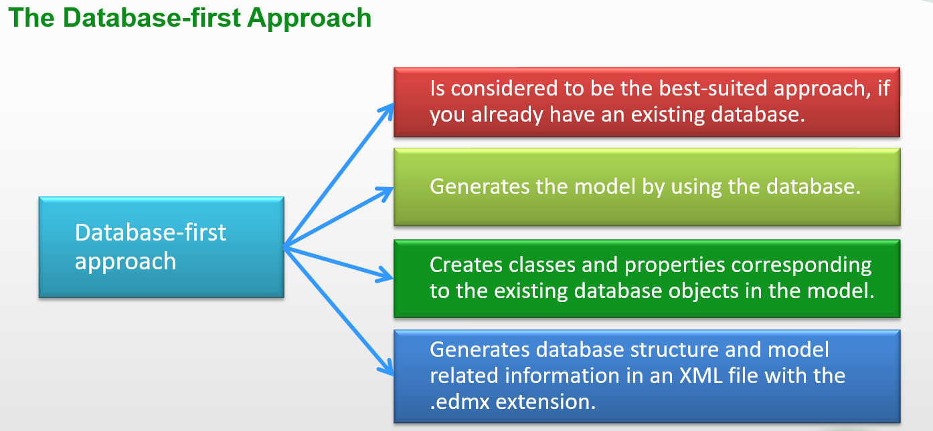
Entity Framework

Slide 7
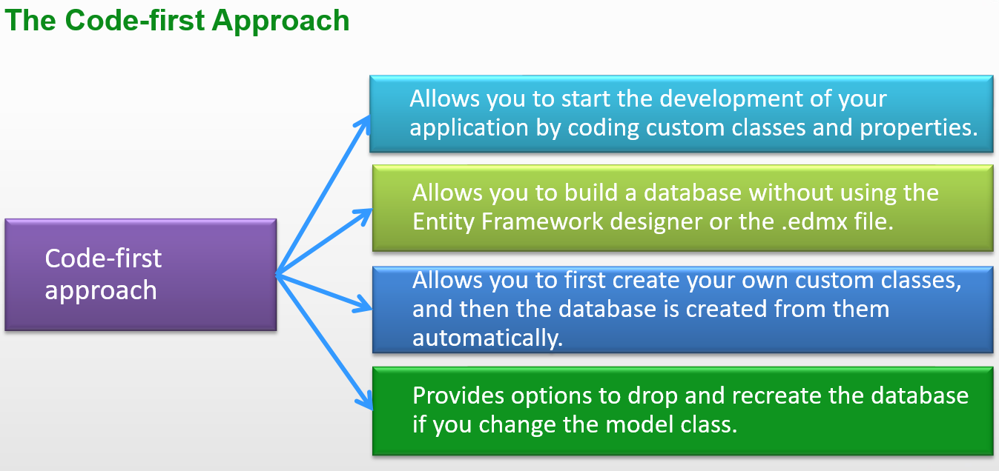
Entity Framework
Entity Framework Core is the new and improved version of Entity Framework for .NET Core applications. EF Core is new, so still not as mature as EF 6.
EF Core continues to support the following features and concepts, same as EF 6.
DbContext & DbSet
Data Model
Querying using Linq-to-Entities
Change Tracking
SaveChanges
Migrations

Slide 8
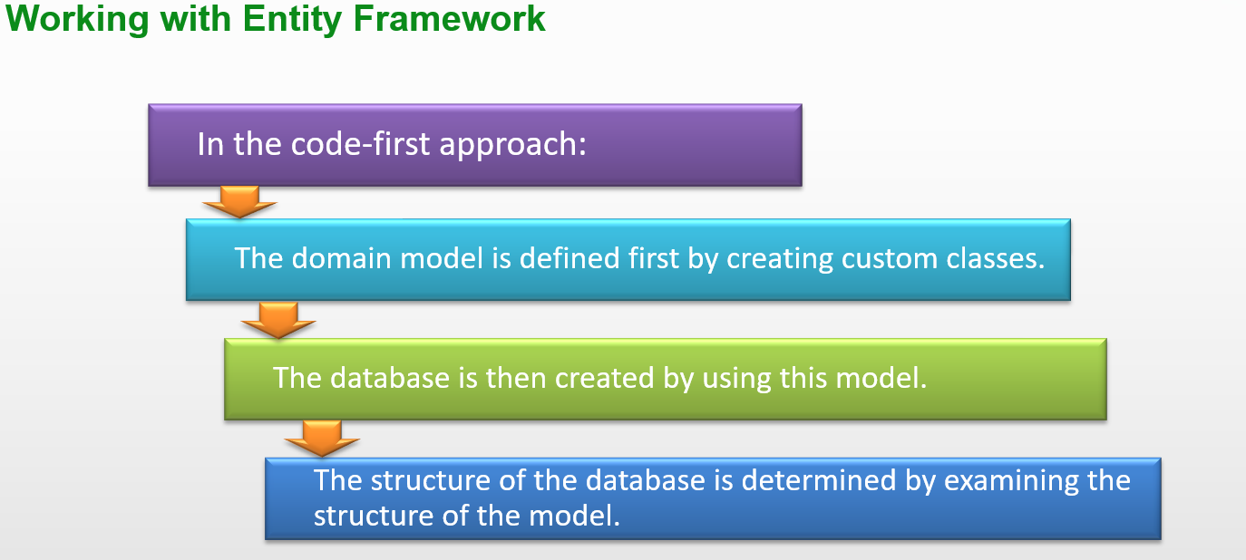
CodeFirst Approach

Slide 9
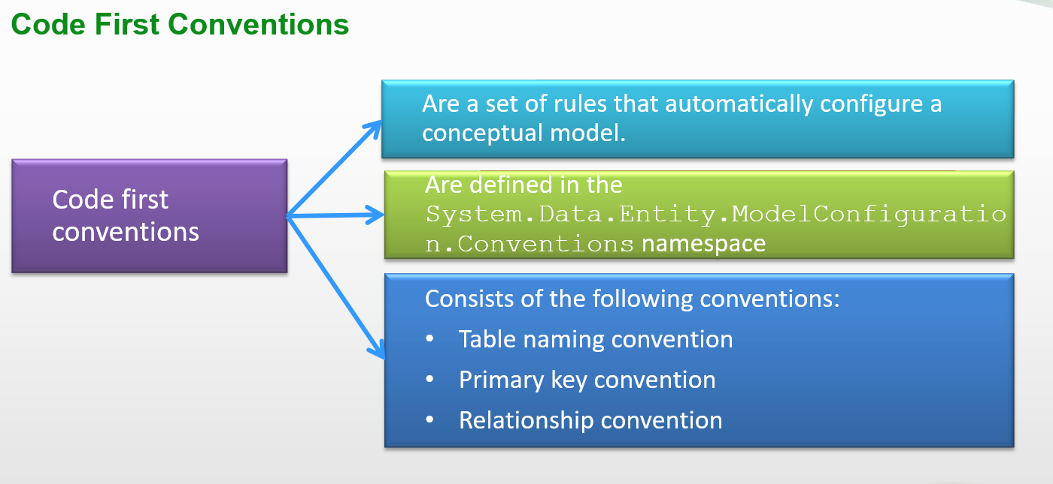
Code First Approach

Slide 10
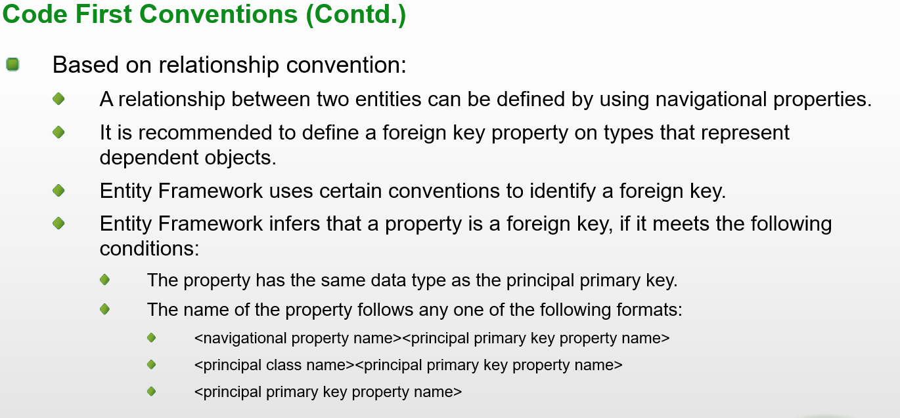
Code First Approach

Slide 11
Entity Framework : DbContext
The DbContext class is an integral part of Entity Framework.
An instance of DbContext represents a session with the database which can be used to query and save instances of your entities to a database.
The context class in Entity Framework is a class which derives from System.Data.Entity.DbContextDbContext
An entity in Entity Framework is a class that maps to a database table.
This class must be included as a DbSet<TEntity> type property in the DbContext class.
EF API maps each entity to a table and each property of an entity to a column in the database.
DbContext is a combination of the Unit Of Work and Repository patterns.

Slide 12
Entity Framework : DbContext
DbContext in EF Core allows us to perform following tasks:
  Manage database connection
  Configure model & relationship
  Querying database
  Saving data to the database
  Configure change tracking
  Caching
  Transaction management
To use DbContext in our application, we need to create the class that derives from DbContext, also known as context class. This context class typically includes DbSet<TEntity> properties for each entity in the model.
entities
public DbSet<Student> Students { get; set; }
public DbSet<Course> Courses { get; set; } }

Slide 13
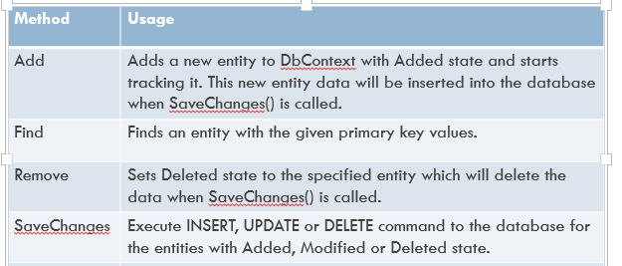
Entity Framework : DbContext
DbContext Methods

Slide 14
DbContext: Database initialization
There are four different database initialization strategies:
CreateDatabaseIfNotExists: This is the default initializer. it will create the database if none exists as per the configuration. However, if you change the model class and then run the application with this initializer, then it will throw an exception.
DropCreateDatabaseIfModelChanges: This initializer drops an existing database and creates a new database, if your model classes (entity classes) have been changed.
DropCreateDatabaseAlways: This initializer drops an existing database every time you run the application, irrespective of whether your model classes have changed or not. This will be useful when you want a fresh database every time you run the application, for example when you are developing the application.
Custom DB Initializer: You can also create your own custom initializer, if the above do not satisfy your requirements or you want to do some other process that initializes the database using the above initializer.

Slide 15
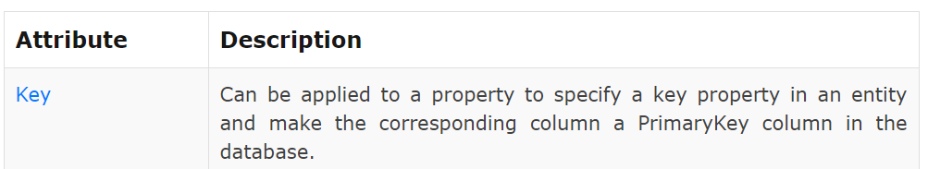
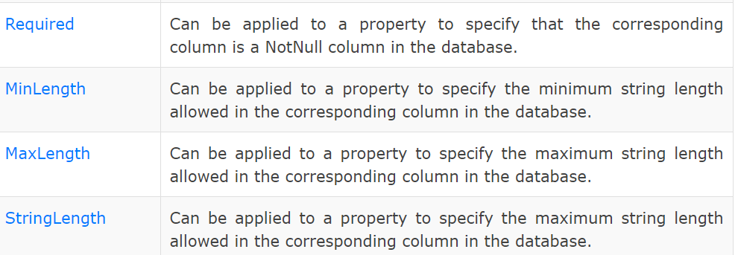
Entity Framework : Data Annotations
DbContext Methods

Slide 16
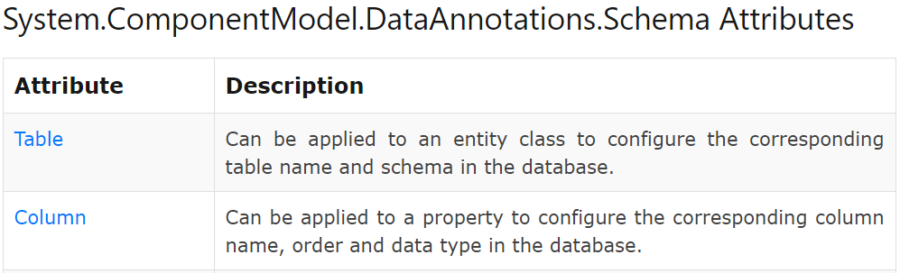
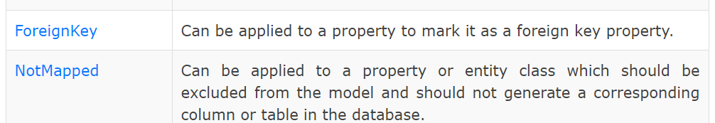
Entity Framework : Data Annotations
DbContext Methods

Slide 17
Adding a Migration
With migration, it will automatically update the database schema, when your model changes without losing any existing data or other database objects.
EF includes different migration commands to create or update the database based on the model.
It uses a new database initializer called MigrateDatabaseToLatestVersion.
There are two kinds of Migration −
  Automated Migration
  Code based Migration
Execute the migration command using NuGet Package Manger Console as well as dotnet CLI (command line interface).
In Visual Studio, open NuGet Package Manager Console from Tools -> NuGet Package Manager -> Package Manager Console and enter the following command:
  Enable-Migrations: Enables the migration in your project by creating a Configuration class.
  Add-Migration: Creates a new migration class as per specified name with the Up() and Down() methods.
  Update-Database: Executes the last migration file created by the Add-Migration command and applies changes to the database schema.
  To add or update domain classes or configurations, we need to sync the database with the model using add-migration and update-database commands.

Slide 18
EF Fluent API
Entity Framework Fluent API is used to configure domain classes to override conventions.
provides more options of configurations than Data Annotation attributes.
To write Fluent API configurations, override the OnModelCreating() method of DbContext in a context class
Can use Data Annotation attributes and Fluent API at the same time. Entity Framework gives precedence to Fluent API over Data Annotations attributes.
the DbModelBuilder class acts as a Fluent API using which we can configure many different things

Slide 19
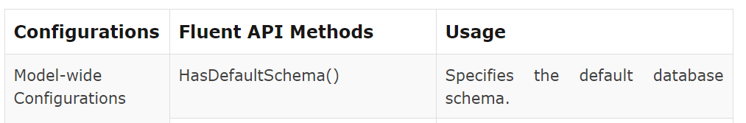

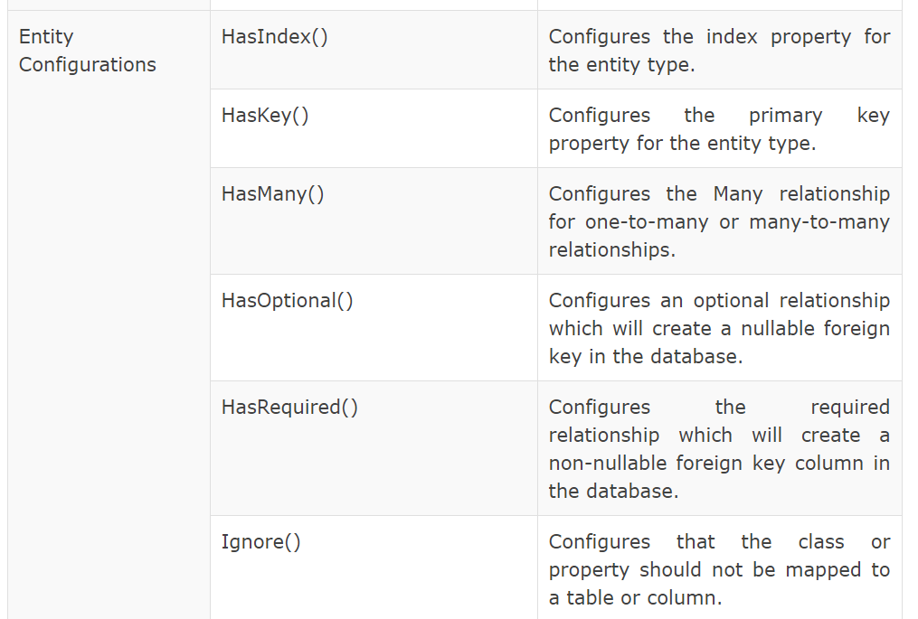
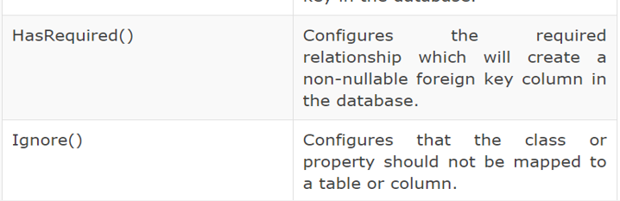

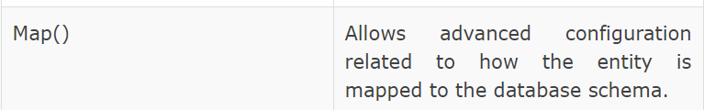

Entity Mappings using Fluent API in EF 6

Slide 20
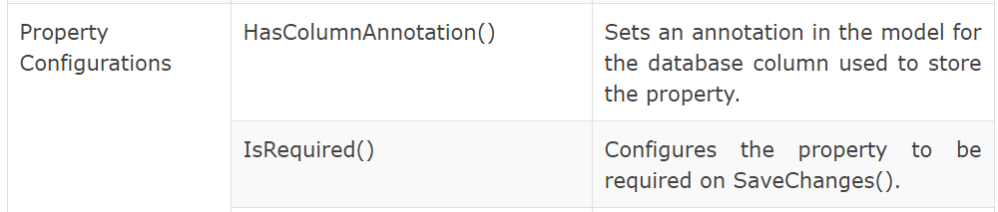
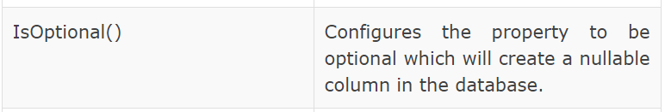
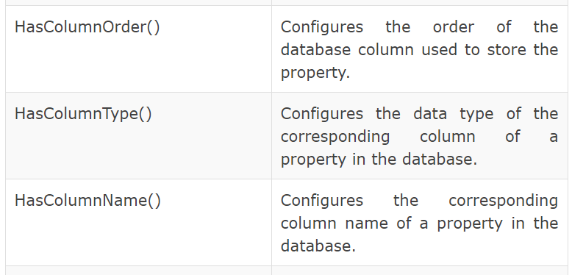
Entity Mappings using Fluent API in EF 6
DbContext Methods

Slide 21
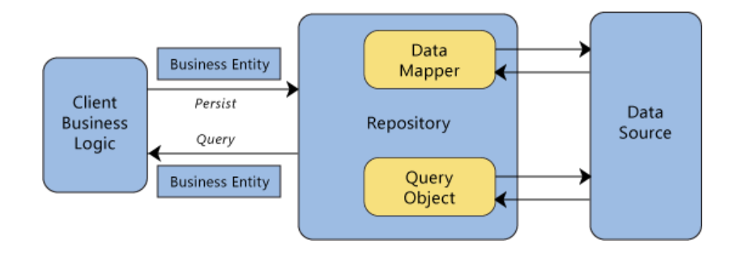
Reposiory Pattern in EF
A Repository pattern mediates between the domain and Entity Framework data mapping layer
It allows to pull a record or number of records out of data sources, and these records acting like an in-memory domain object collection
update or delete records within those object collection, and the mapping code encapsulated by the Repository will carry out the appropriate operations behind the scenes

Slide 22
Unit Of Work Pattern
Use of separate repository for a single transaction could result in partial updates.
For example, If update two different entity types as part of the same transaction. If each uses a separate database context instance, one might succeed and the other might fail
To ensure that all repositories use the same database context (and thus coordinate all updates) is to use a unit of work class.

