Slide 1
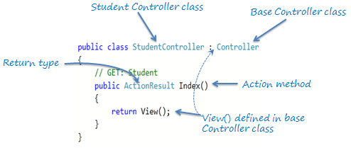
Action method
All the public methods of a Controller class are called Action methods. They are like any other normal methods with the following restrictions:
Action method must be public. It cannot be private or protected
Action method cannot be a static method.

Slide 2
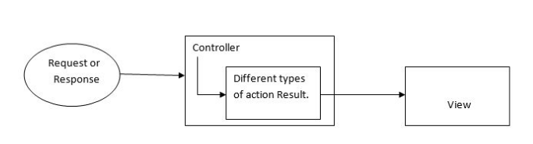
ActionResult
In ASP.NET, MVC has different types of Action Results.
Each action result returns a different format of output.
A programmer uses different action results to get expected output. Action Results return the result to view the page for the given request.
Action Result is a result of action methods or return types of action methods. ActionResult is an abstract class. It is a base class for all type of action results.

Slide 3
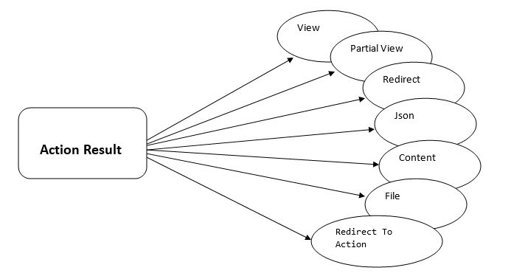
ActionResult

Slide 4
ActionResult
Types of Action Results There are different Types of action results in ASP.NET MVC. Each result has a different type of result format to view page. ActionResult is a base class of all the result type which returns from Action method.
View Result
Partial View Result
Redirect Result
Redirect To Action Result
Redirect To Route Result
Json Result
File Result
Content Result

Slide 5
ActionResult
View Result
View result is a basic view result. It returns basic results to view page. View result can return data to view page through which class is defined in the model. View page is a simple HTML page. Here view page has “.cshtm” extension.
public ViewResult About()
{
ViewBag.Message = "Your application description page.";
return View();
}
Partial View Result
Partial View Result is returning the result to Partial view page. Partial view is one of the views that we can call inside Normal view page.
public PartialViewResult Index()
{
return PartialView("_PartialView");
}

Slide 6
ActionResult
Redirect Result
Redirect result is returning the result to specific URL. It is rendered to the page by URL. If it gives wrong URL, it will show 404 page errors.
public RedirectResult Index()
{
return Redirect("Home/Contact");
}
Redirect to Action Result
Redirect to Action result is returning the result to a specified controller and action method. Controller name is optional in Redirect to Action method.
If not mentioned, Controller name redirects to a mentioned action method in current Controller.
Suppose action name is not available but mentioned in the current controller, then it will show 404 page error.
public ActionResult Index()
{
return RedirectToAction("Login", "Account");
}

Slide 7

ActionResult
Json Result Json result is a significant Action Result in MVC. It will return simple text file format and key value pairs. If we call action method, using Ajax, it should return Json result.
public ActionResult Index()
{
var persons = new List<Person1>
{
new Person1{Id=1, FirstName="Harry", LastName="Potter"},
new Person1{Id=2, FirstName="James", LastName="Raj"}
};
return Json(persons, JsonRequestBehavior.AllowGet);
}
Output

Slide 8
ActionResult
While returning more data in Json format, there is a need to mention maximum length. Assign maximum length of data Using “MaxJsonLength” property.
public ActionResult Index()
{
var persons = new List<Person1>
{
new Person1{Id=1, FirstName="Harry", LastName="Potter"},
new Person1{Id=2, FirstName="James", LastName="Raj"}
};
var jsonResult = Json(persons, JsonRequestBehavior.AllowGet);
jsonResult.MaxJsonLength = int.MaxValue;
return jsonResult;
}

Slide 9
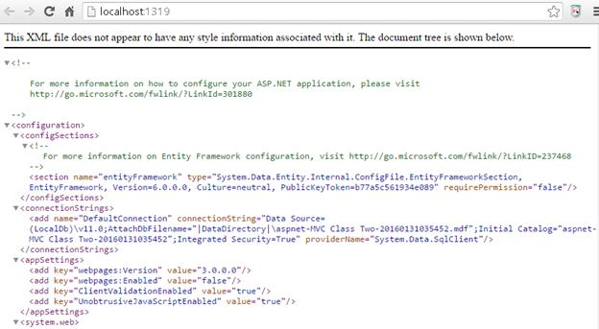
ActionResult
File Result
File Result returns different file format view page when we implement file download concept in MVC using file result. Simple examples for file result are shown below:
public ActionResult Index()
{
return File("Web.Config", "text");
}

Slide 10
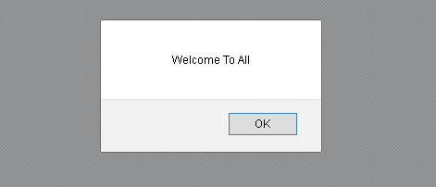
ActionResult
Content Result
Content result returns different content's format to view. MVC returns different format using content return like HTML format, Java Script format and any other format.
public ActionResult Index()
{
return Content("<script>alert('Welcome To All');</script>");
}

Slide 11
Types of action results
ActionResult | Helper Method | Description
ViewResult | View | ViewResult Renders a view as a web page.
PartialViewResult | PartialView | As the name describe PartialViewResult renders the partial view.
RedirectResult | Redirect | redirect to another action method. It takes the URL path to be redirect.
RedirectToRouteResult | RedirectToRoute | Redirects another action of same or other controller
ContentResult | Content | Returns a user-defined content type
JsonResult | Json | When you want to return a serialized JSON object
JavaScriptResult | JavaScript | Returns a script that can be executed on the client
FileResult | File | Returns a binary output to write to the response
EmptyResult | (None) | returns a null result

