Slide 1
+First[2] :int +Second[2] :int +Count:int -Score :int -Cont :int -destroy :*Destroy -Objectarray[][] :basic* -Ui: ui::candycrush - o over
+explicit candycrush(); +~candycrush(); +checkall(int,int): bool +check4h(int[]):bool +check4v(int[]):bool +check5(int[]):bool +checkL(int[]): bool +check3(int[]):bool +putzero(): void +canmove() bool +reset() :void +setclickpicture():void +remove():void
Over.h
+Game :int +Score:int Ui :ui::over
+Explicit over() +~over + gameover():void
Candys.h
+candys();
Basic.h
+ row :const int + col :col + color :int + button :QPushButton*
+explicit basic(QWidget *parent ,int i,int j) + ~basic() +setrandcolor() :void + setpicture(): void + Click():void +click: void +operator –(basic) +operator (basic
start.h
+start :int - Ui :ui::over
+Explicit start() +~start -on_pushButton_clicked():void

Slide 2
fourv.h
+ fourv (): + ~fourv ():virtual + condiction(asic*[][],basic): virtual int + make(asic*[][],basic,int):virtual void + boom(asic*[][],basic):virtual void
three.h
+ three (): + ~three ():virtual + condiction(asic*[][],basic): virtual int + make(asic*[][],basic,int):virtual void + boom(asic*[][],basic):virtual void
Destroy.h
+ Destroy(): + ~Destroy():virtual + condiction(basic*[][],basic): virtual int + make(asic*[][],basic,int):virtual void + boom(asic*[][],basic):virtual void
nine.h
+ nine (): + ~nine ():virtual + condiction(asic*[][],basic): virtual int + make(asic*[][],basic,int):virtual void + boom(asic*[][],basic):virtual void
Chocolatwh
+ chocolate(): + ~chocolate():virtual + condiction(asic*[][],basic): virtual int + make(asic*[][],basic,int):virtual void + boom(asic*[][],basic):virtual void
fourH.h
+ fourH (): + ~fourH ():virtual + condiction(asic*[][],basic): virtual int + make(asic*[][],basic,int):virtual void + boom(asic*[][],basic):virtual void

Slide 3
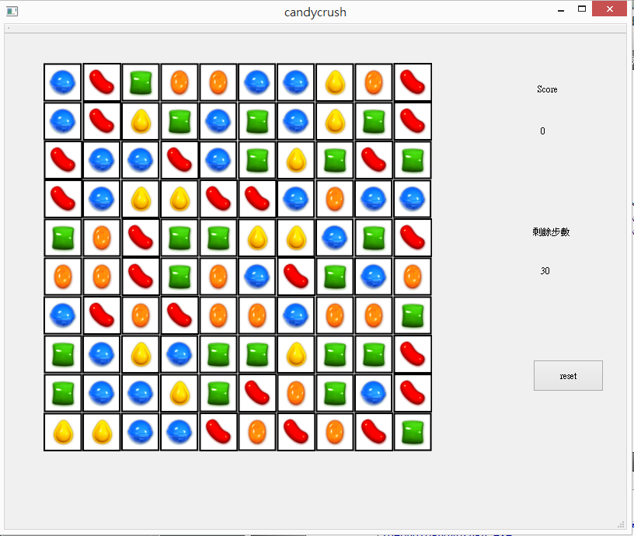

Slide 4
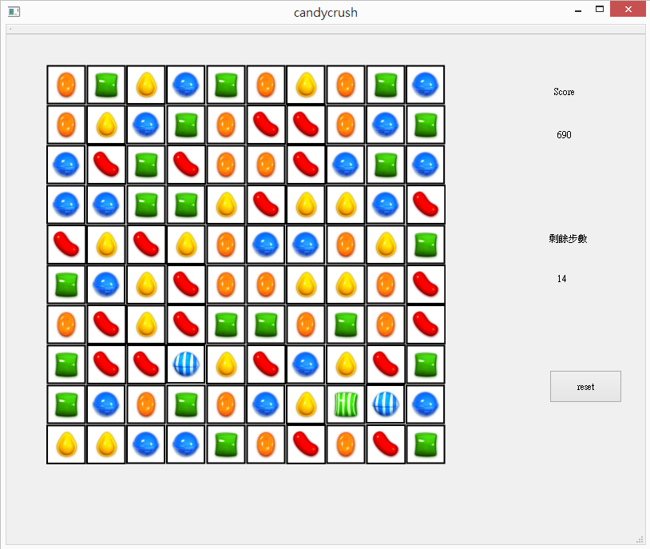

Slide 5
