Slide 1
Simple designs to save a life
工科系112 張娟鳴

Slide 2
Outline
Speaker
Fuel
Water testing system
Conclusion

Slide 3
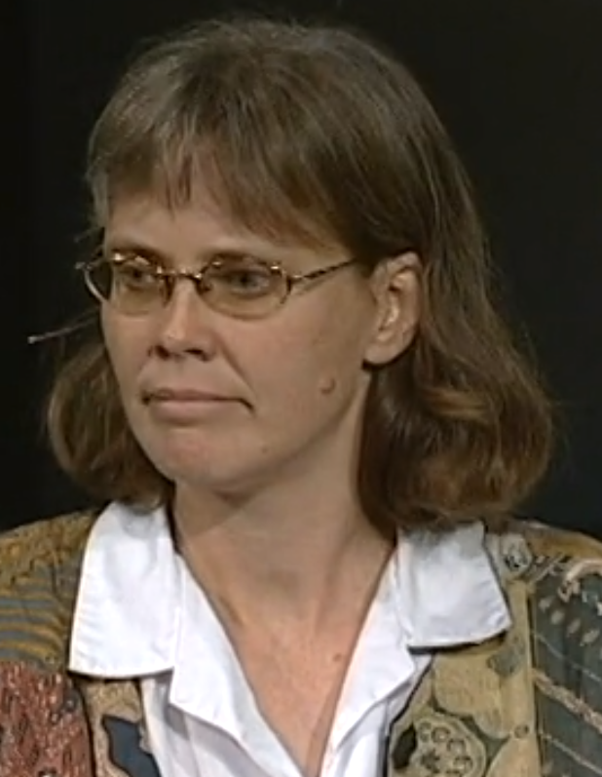
Speaker
Amy Smith
Inventor and mechanical engineer
cheap, low-tech devices
Make future better

Slide 4
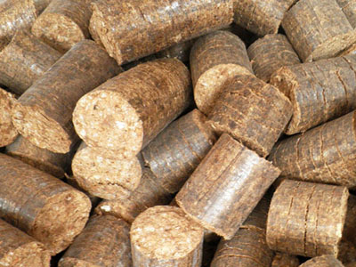
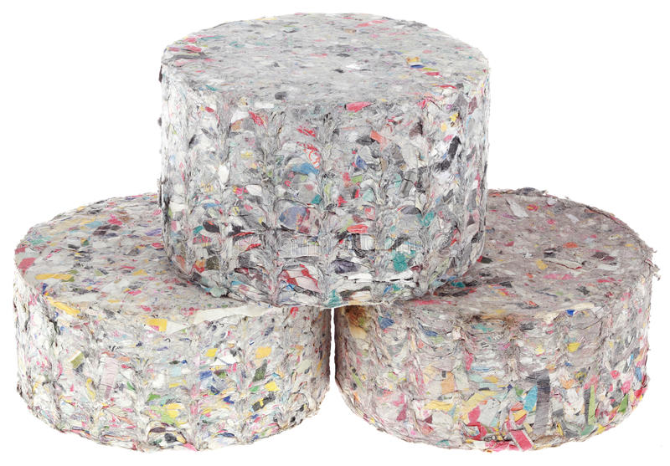
Cleaner fuels
Briquettes made by paper
easy, can’t burned
Sugarcane bagasse briquettes
huge revenue, difficult

Slide 5
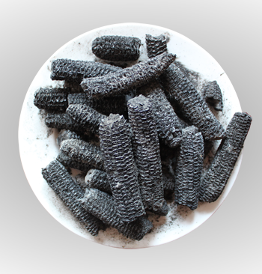
Cleaner fuels
corncobs charcoal
easy , spread more quickly

Slide 6
Water quality testing
Help people maintain water systems
solar water disinfection
need lot of people
marketplace is fragmented
consumer no income

Slide 7
Conclusion-reflection
Clear vision of the world
See people in property
Find a way to solve problem
Stop be poor

Slide 8
Reference
Video
Paper Briquettes
Sugarcane bagasse briquettes
corncobs charcoal

Slide 9
Q&A

