Slide 1
Music Genre Identifier App
Annie Liu
Daniel Mata
Madeline Ben
Jerin Joseph
Notes:
We took some of the old project and went in a different direction. Swapped web for app, instead of taking song name, we record the audio and predict the genre.

Slide 2
Abstract
With an increase in the quantity of music via platforms like Spotify, Apple Music, and Pandora, grouping together different types of music in order to better handle data is a task that has become increasingly daunting. Whether it’s database management, searching for a song, or even just storing a song, being able to classify music into different genres can help ease the process of working with such large amounts of data. This inspired us to create a better user experience for both clientele and developers.
Fortunately, we have material from a previous group project to build off of. We intend to use it as both a resource and to further extend what has been accomplished. One of the key features we would like to implement is the ability of a user to record a song through their phone, which can then be classified based on their genre.

Slide 3
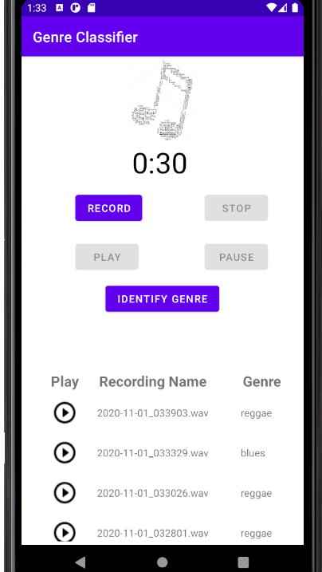
Outline
1. Pick up from where the previous group left off
2. Keep the same dataset from Kaggle (GTZAN)
3. Refine the CNN model accuracy
4. Use Google Cloud to host audio and extract MFCC
5. Implement an Android app for users to record and identify music audio

Slide 4
Tools and Frameworks Used
Android Studio
Developer software for Android OS apps
Json
Data format used to call the cloud function and the model in ML Engine.
Python
Main language for programming in Google Colab
Librosa
Library used for extracting MFCCs and loading in audio files
Numpy
Library used for storing audio features in nd-arrays
Sklearn
Library used for confusion matrix
Tensorflow-Keras
Library used for training the CNN model
Others: Google Cloud, Matplotlib, Statistics

Slide 5
Data Specifications
GTZAN dataset
The most-used public dataset for evaluation in machine listening research for music genre recognition (MGR).
Files were collected in 2000-2001 from a variety of sources including personal CDs, radio, microphone recordings, in order to represent a variety of recording conditions.
Includes 1000 audio files and 2 CSV files containing their features, such as mean and variance.
Audio file lengths - 30 seconds per file, divided into 5 second samples.
This helped us increase the size of the dataset and eventually helped us in improving the accuracy.

Slide 6
Model
Our project continued to use and modify the original CNN model. It makes use of the MFCCs (Mel-frequency cepstral coefficients) of .wav audio files in order to determine the genre of music.
KNN vs CNN
Tried changing the layers
Trained on 30 epochs of 32 batch sizes
Accuracy improved by segmenting the audio files into 5-second clips
Original accuracy: 50-56%
Improved accuracy: 70-72%

Slide 7

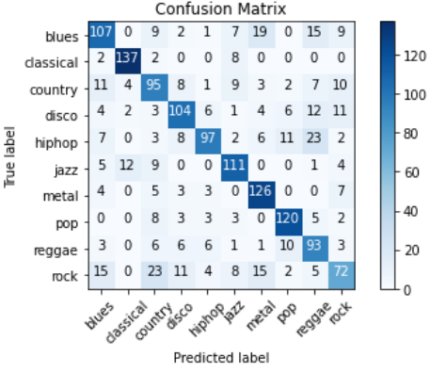
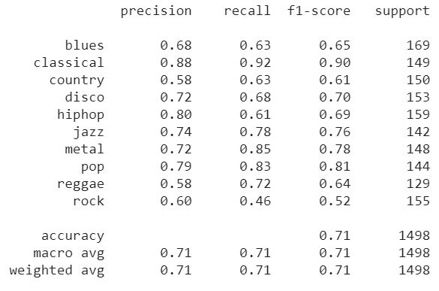
Confusion Matrix
Really successful at predicting classical
Rock was confused with several other labels (blues, country, metal)
Some hip hop was confused with reggae

Slide 8
Design Decisions
Deciding whether to use KNN vs CNN model
We were originally planning to use a KNN model per our original tutorial suggestion, however Dr. Albert recommended we continue using the CNN model for ease. Fortunately, the CNN model’s performance is not far behind what a KNN model could accomplish.
Android Studio vs Flutter software development kit
Android Studio was chosen over Flutter Studio Development Kit because Android Studio was specifically designed for Android development and it seems easier to learn and use as opposed to the Flutter Studio Development Kit.
Android had better support for recording the audio and also in storing and playing back the audio.

Slide 9
Android App Details
Android Studio is the development environment for Google’s Android operating system. It has tools that builds apps on every type of Android device. In order to create an app, you need to have an xml file, which controls the design. You are able to create text views, image views and buttons. There is also a javascript or kotlin file, which consists of functions that the app runs. So the things that the app is created to do is in this file.
A button was added from the palette column and was named ‘RECORD’. Once this button is clicked, it calls the function in the JavaScript allocated to recording audio and starts recording what the user says. This is the same for the other buttons on the app: ‘STOP’, ‘PLAY’, ‘PAUSE’ and ‘IDENTIFY GENRE’. The only difference is the function that would be called when each button is clicked. For the ‘STOP’ button, it calls the function created to stop the recording. For the ‘PLAY’ button, it calls the function created to playback the recording made. For the ‘PAUSE’ button, it calls the function allocated to stopping the playing of the recoding. Lastly, for the ‘IDENTIFY GENRE’, it calls the genre classification model and that prints out what the genre is.

Slide 10
Android App Details
The functions that control what the buttons do have to be written and when it comes to the recording, stoping, playing and pausing the recording, there are libraries that help with making it easier to define these functions. The libraries are: android.media.MediaPlayer and android.media.MediaRecorder.
The functions to be created are:
A function to record the audio
A function to stop the recording
A function to playback the recording
A function to pause the recording

Slide 11

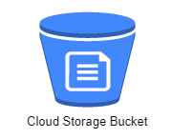
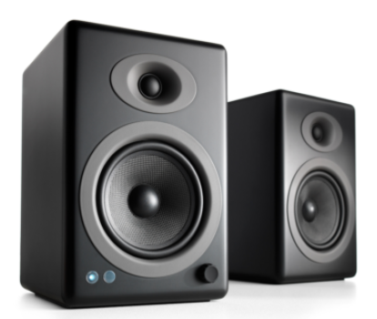

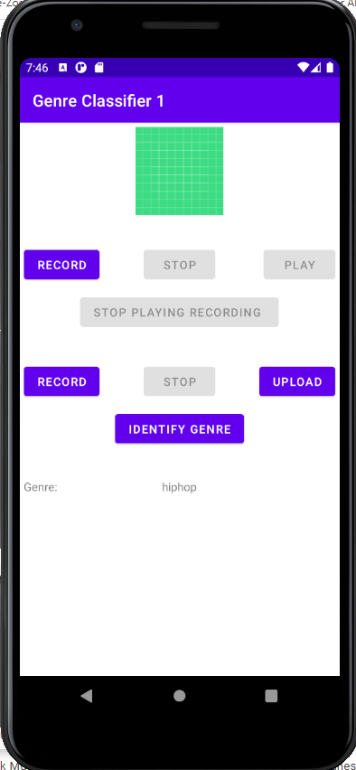



Genre Identifier Process Flow
2
1
Load Audio to Cloud Storage
Record Audio
3
4
Trigger Cloud Function (Pass Filename)
Read audio file
Return Predicted Genre
8
6
Call Model
Extract MFCC using librosa
Return Predicted Genre
7
5

Slide 12


Slide 13
How To Improve/Next Steps
Some way to detect the song within first 5 seconds
Ensemble learning to improve the model
Improve the user interface
Improve the model accuracy

Slide 14
Milestones
We meet every Sunday, within the duration of this project.
10/21/20 - Submit Proposal Slides
10/22/20 to 11/01/20 - Progress meeting on Discord. Sharing updates:
KNN Model
Android App front-end (Android Studio & conversion of input file to .wav)
Android App back-end (Google Colab)
11/03/2020 - Final meeting on Discord:
Round up the project, work on the report / presentation slides
11/04/20 - Submit Report/Presentation Slides

Slide 15
Workflow
Model will be created on Google Colab:
https://colab.research.google.com/drive/1bHPOeVWPfa3EPEDDGRtako8X1-0z3le5?usp=sharing#scrollTo=aI8hmH9M7bXV
The model is hosted on Google Cloud ML Engine
Audio preprocessing is deployed as a Google Cloud Function.
Develop an Android app with Android Studio tools
Android app will record audio, then call both the Cloud function and the Cloud ML Engine
Version Control - Github
https://github.com/anniecliu/Music-Genre-Project
Discord - Sundays 12PM weekly meetings
Notes:
Cnn model - remove layers, change activation layer parameters, michael suggested including more features for accuracy, may try 5 sec clips

Slide 16
Roles
Daniel
CNN model
Jerin
Android App backend, Google Cloud
Madeline
Android App frontend
Annie
CNN model, slides

Slide 17
Acknowledgements
Michael Moore
Assisted with suggestions on how to improve CNN model accuracy, such as cutting sound bites into 5 seconds chunks, trying ensemble learning, and using Libroso to extract extra features like average frequency, RMS, zero-crossing rate, etc.
Naga Sumanth
Suggested that workflow could be changed to where Google Cloud Storage could trigger the cloud function when file upload completes. This way, the final result can be polled from or posted to the client rather than the client invoking the cloud function.

Slide 18
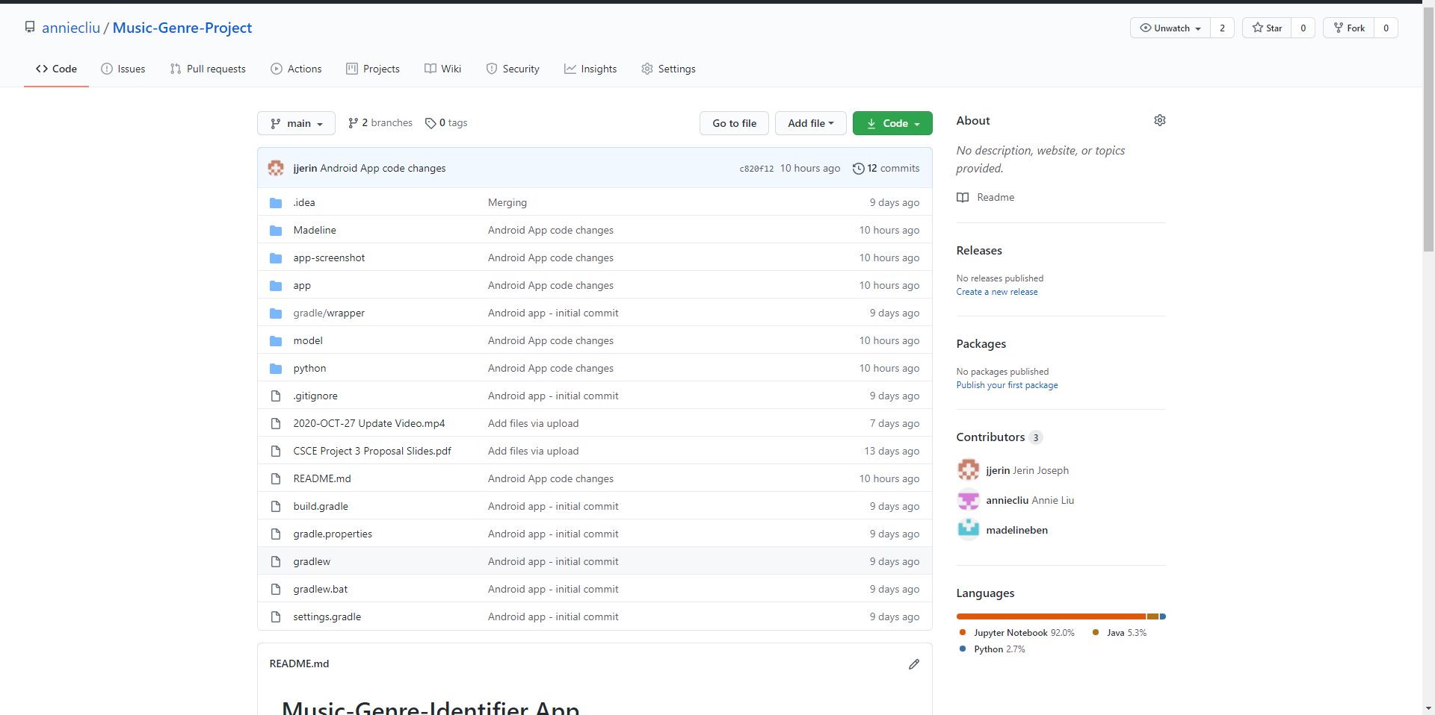
Repository Archive
https://github.com/anniecliu/Music-Genre-Project

Slide 19
Resources & Tutorials
KNN Model Tutorial: https://data-flair.training/blogs/python-project-music-genre-classification/
This tutorial makes use of the dataset below in order to train a KNN model using the mfcc feature.
Dataset: https://www.kaggle.com/andradaolteanu/gtzan-dataset-music-genre-classification
This dataset contains wav. Files, image representation of each wav. File, and two CSVs containing several features such as the length, the root mean squared mean, and other spectral features
Android Studio: https://developer.android.com/training/basics/firstapp/building-ui
This tutorial guides you through how to build a simple Android app using Android Studio.
Recorder.js: https://blog.addpipe.com/using-recorder-js-to-capture-wav-audio-in-your-html5-web-site/
Reference tutorial for how to use Recorder.js.

