Slide 1
Identifying Toxicity In Gaming
Jacqueline Hong, Eric Wang, Annie Dang, Sophia Shaw, Chris Ding
Notes:
4:15 - 4:35pm

Slide 2
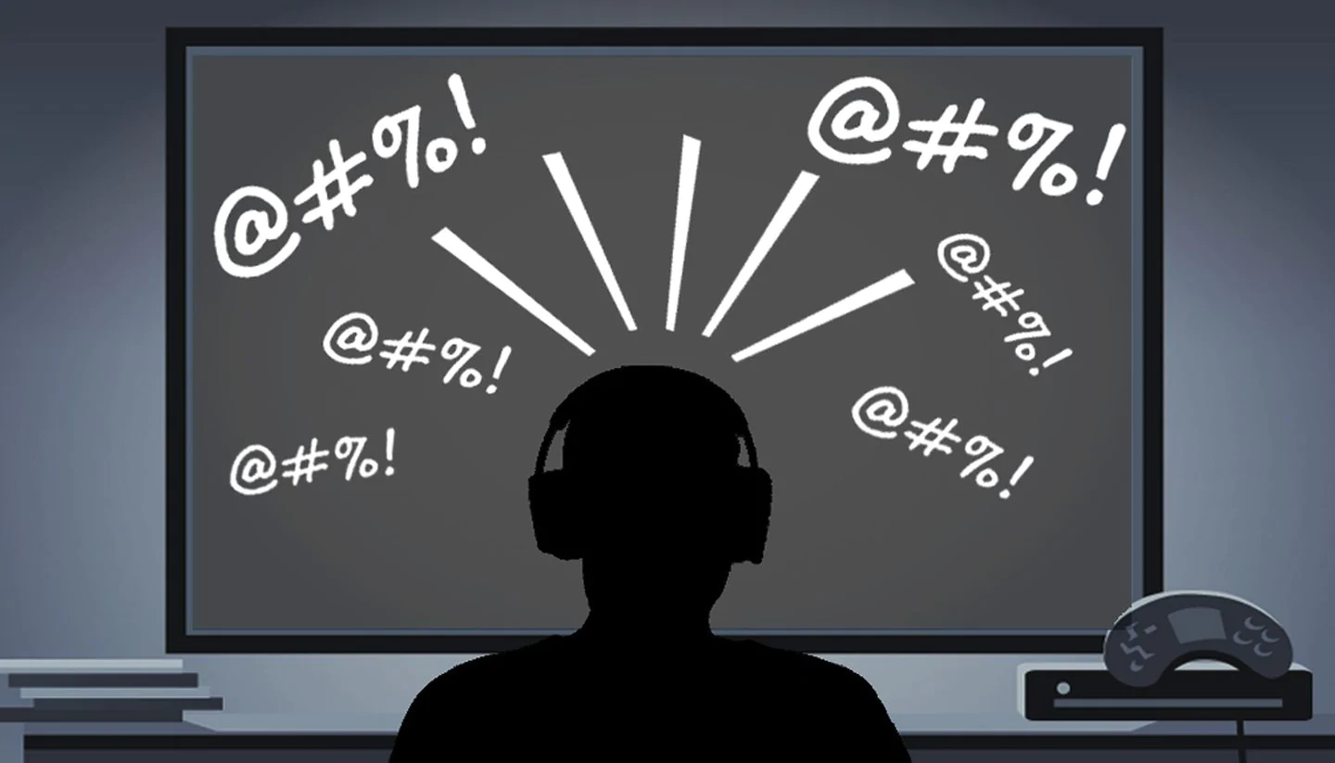
Introduction
Source: Here
What is toxicity in video games?
Can we detect it? How?
Why does it matter?
Notes:
Toxic - In short, toxicity is having a bad attitude or behavior and aggressively blaming teammates or throwing insults/using offensive language. Due to the nature of video games, toxicity is extremely common because people can threaten and insult others under somewhat anonymous identities.
The main point of our project is the exploration of toxicity in video games and our ability to detect it accurately. Throughout our presentation, we’ll be going into detail about the models and methodologies that we used as well as insights and solutions.
Why does the exploration of this topic matter? From a business perspective, there are tons of investment opportunities in this market due to its growth in recent years. From an everyday perspective, if you’ve played video games before, you have likely witnessed toxic behavior that has negatively impacted your experience.

Slide 3
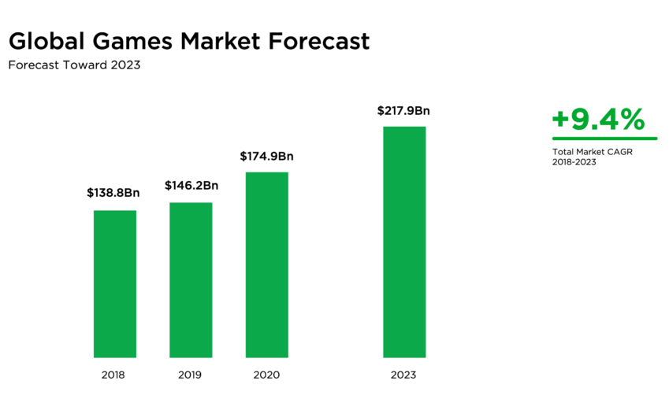
The Gaming Industry
Data Source: Click Here
Notes:
you can see just how much the gaming industry has grown recently, as well as its expected growth in the future.
there are an increasing number of college teams, sponsorships, and professional salaries are becoming available for gamers globally.
any investor would be happy to see a near 10% compound annual growth rate, which essentially measures the return on investment over a specified period.

Slide 4
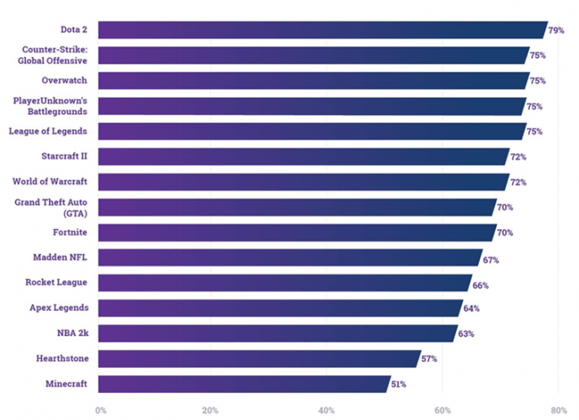
The Problem
Prevalence of toxicity/harassment (i.e. threats of violence, grooming) across many communities
Large game developers employ sophisticated toxicity combatting tools
Smaller developers lack the funding, manpower, and resources to create effective algorithms to punish toxicity
Data Source: Here
Notes:
Games are meant to be fun.
This shows the percentage of players from each of these gaming communities have experienced toxicity in their games.
While large developers may have some more sophisticated tools to combat toxicity, smaller developers lack the funding and resources to create effective algorithms to punish toxicity.
Problem that you are solving with your code/project
Answer to the above prompt: Online games are meant to be a fun.
With this element, games lose multiple players, especially after repeated harassment.
Larger corporations may already have a system in place, but smaller game developers have less funding and resources.

Slide 5
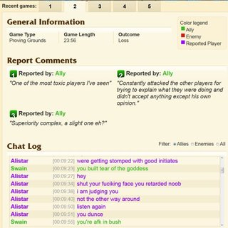
The Problem
Developers have previously used player-based tribunal systems to catch toxicity flagged by fellow players
Many game communities have grown so large that this system can no longer handle the volume of toxicity present
Source: Here
Notes:
Player-based tribunal systems were once common to help developers flag toxic behavior.
With how big many games have become, this method can no longer handle the volume of reports coming in.

Slide 6
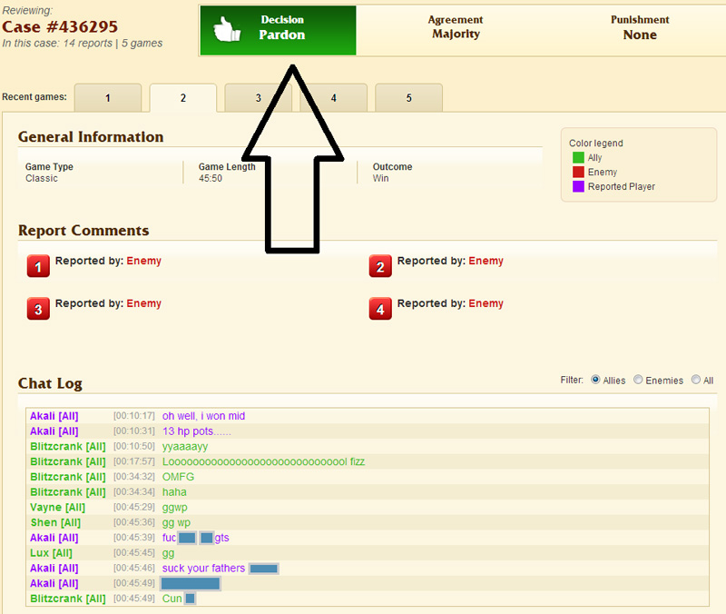
The Problem
Player-based justice systems are often ineffective for catching and punishing toxic players in the community
An effective system and algorithm for catching toxic players is needed to maintain the “fun” environment video games are meant to provide
Source: Here
Notes:
The only thing these player-based systems proved is that they were relatively ineffective for punishing toxic behavior.
Going forward, game developers need more effective algorithms for catching toxic behavior so that the fun environment of video games can be preserved.

Slide 7
Can we detect toxicity?
Enable enjoyable in-game conversations
Inform subsequent decision-making for game moderators
Implications
Retain and increase consumers
Prevents lawsuits
Safer environment and encourages
positive behavior

Slide 8
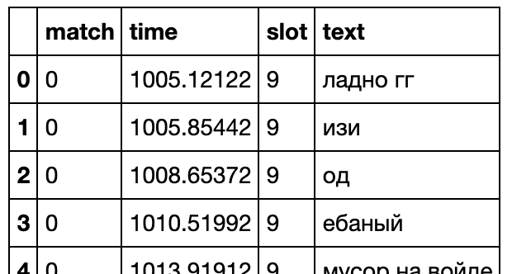
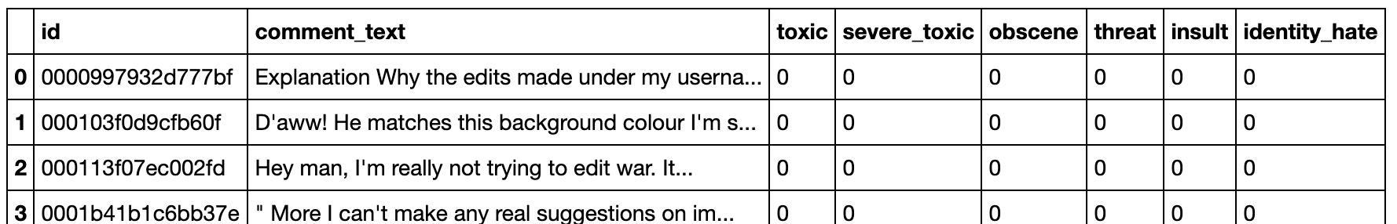
Data
Dota 2 Chat: Kaggle
Features:
Match Index, Time of Message Sent (in-game), Player Slot, Text (multiple languages)
21 million rows
Match index + player slot combination for unique identifiers
Downside: Cannot analyze players across multiple games
Wikipedia Comments: Kaggle
Features:
Unique ID, Text (English), Toxicity Labels (Toxic, Severe Toxic, Obscene, Threat, Insult,
Identity Hate)

Slide 9
Path of Approach: Initial Exploration
Starting point:
Dota Dataset
Challenges: Space, runtime, language interpretation
Workflow:
Preprocessing
Random sampling, removing stop words
Language Detection via LangDetect, FastText (batch processes)
Labeling “gaming terms” as English (i.e. gg, xD) → 21 mil to 7 mil
Exploratory Data Analysis
No relationship between time, player slot, and freq.
No relationship between types of offensive lang.

Slide 10
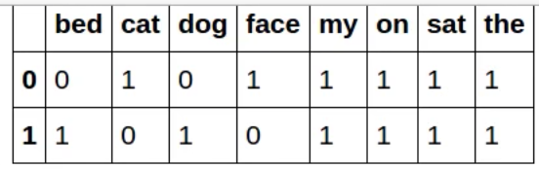
Path of Approach: Initial Exploration (cont)
Feature Engineering:
Sentiment/Polarity Scores via TextBlob
Text Length, Num Messages, Num Caps
TF-IDF Vectorizer Text Representation
tf(w) * idf(w) where tf(w) is the (number of times the word appears in a document) / (total number of words in the document) and idf(w) is the log(number of documents / number of documents containing word w)
Unsupervised K-Means Clustering
Choosing K: Elbow Method (K = 4)
No distinguishable clusters
Reframe our approach to a classification task!
Notes:
Expand on TF-IDF, what it is/does

Slide 11
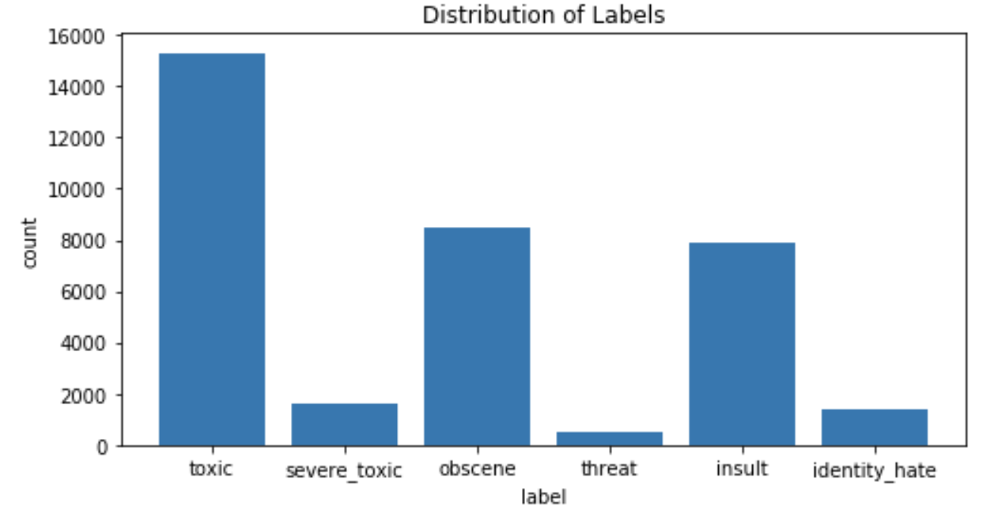
Path of Approach: Classifier
New Dataset: Wikipedia Comments
Workflow:
Similar EDA and Preprocessing
Exploratory Data Analysis
Unbalanced Data: Large variation in count per toxicity label
Impacts on error metrics (i.e. F1-Score vs. Accuracy)

Slide 12
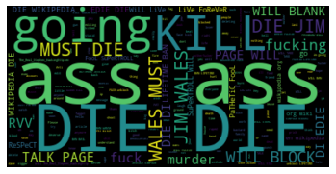
Path of Approach: Classifier
Workflow:
Exploratory Data Analysis
WordCloud: Exploring word frequency per toxicity label
With the exception of “threat”, most frequent
words were the same across other categories

Slide 13
Path of Approach: Classifier
Workflow:
Feature Engineering
If a text contained specific offensive words (overfitting)
Number of offensive words
Lowered overall area under ROC curve
Model Selection: Multi-Class Logistic Regression
Easy to implement and interpret
Makes no assumptions about class distributions in feature space,
appropriate given our minimal background in NLP and domain
knowledge in gaming

Slide 14
Path of Approach: Classifier
Workflow:
Model: Multi-Class Logistic Regression
Features: TF-IDF, Text Length, Proportion of Capital Letters
Performance: High area under ROC curve across train/test data
Score of 0.97681
Does this generalize to the gaming context?

Slide 15
Path of Approach: Classifier
Workflow: Applying Classifier to Dota Data
Initial Observations / Changes:
Toxic messages are likely to be toxic in many different ways
Ex: Toxic and obscene
Emphasis on high false positive frequency
Avoid punishing messages falsely labeled as toxic
Messages containing “kill” labeled as threatening in many
situations
“kill them”
“he’s dead”
Notes:
15-19
Once applying that model onto the Dota dataset, we saw that:
toxic messages are likely to be classified as other labels too
especially toxic with obscene (swearing)
high FP rate due to context differences, and we strongly want to avoid FPs due to possible punishments given from being flagged for toxicity
Some of the larger examples of FPs are messages that contain “kill” or “dead” in it, which was labeled as threatening

Slide 16
Path of Approach: Classifier
Workflow: Applying Classifier to Dota Data
Word Embeddings: Improve Robustness and Generalizability
Address counter evasion attempts
i.e. “n00b” mapped to “noob”
ie. “noob” mapped to “nobo”
Expand known vocabulary (4x)
i.e. Asian racial slurs not present in dataset can now be
mapped near African American racial slurs
Notes:
A potential issue we considered were possible evasion attempts against our model. To improve robustness and generalizability, we added word embeddings.
To counter evasion attempts, word embeddings can map typos of words (examples)
“noob” can be typed with 0’s and be read the same way by the model
and so can “noob” being typed with rearranged letters
Word embeddings also add generalizability bc now the model knows of 4x more words than before

Slide 17
Path of Approach: Classifier
Workflow: Applying Classifier to Dota Data
Word Embeddings Process:
Trying the Google News Corpus
Very common identity hate word not included
Very low similarity (.04) between two racial slurs
Trying the Dota Dataset for comparison of similarities
Very high similarity (.94) between two racial slurs
Very high similarity between typos (ie. noob and nobo)
~500,000 vocab words
Trying the GloVe Common Crawl Word Vectors
High similarity (.51) between two racial slurs
Very high similarity between typos (ie. noob and n00b)
Notes:
Regarding our word embedding selection process:
1st tried Google News Corpus: bc most popular and used in this class
Didn’t use bc:
Missing key sexuality slurs
Low similarity between racial slurs
Then observed the embeddings of our own Dota dataset to compare the abilities of more generalizable datasets
to have similarity values to compare to
Lastly, we found that the GloVe Common Crawl corpus was very suitable for our dataset
As there was: High similarity (.51) between two racial slurs
And: Very high similarity between typos (ie. noob and n00b)

Slide 18
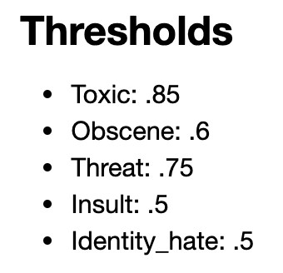
Path of Approach: Classifier
Workflow:
Model Tuning and Evaluation
High False Positive Frequency
Adjustment of log. reg. probability thresholds per category
Subjective: manually fixed commonly wrong labels (i.e. “wtf” from
toxic to non-toxic)
Error Metric (unbalanced data):
F1-Score for classification per category
How does our final model perform?
Notes:
After applying the Wikipedia comments model to the Dota dataset,
we resulted in a high rate of false positives as mentioned earlier, fixed by:
changing thresholds and manually changing labels to commonly misclassified phrases
the error metric used: f1-score per category
bc many more non-toxic comments than any label
So after our FP corrections, how does our final model perform?

Slide 19

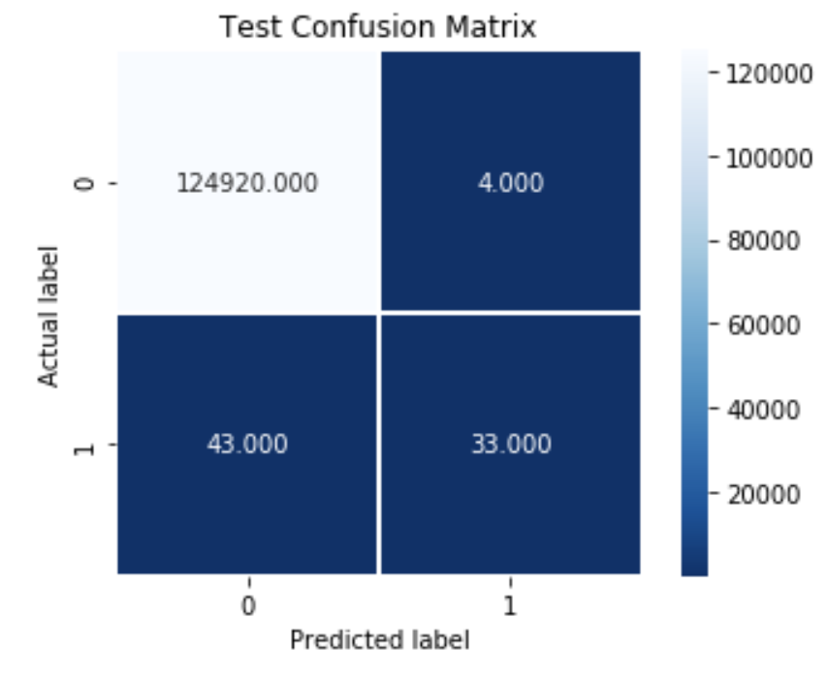
Path of Approach: Final Model
Multi-Class Logistic Regression Classifier
Features
TF-IDF, Text Length, Proportion of Caps, Word Embeddings
Performance
High F1-Scores (both classes)
Suggests good precision
and recall for both
Threat score is lower
Low False Positives
“Threat” Confusion Matrix
False negatives are less
significant relative to false
positives in our context
Notes:
For our final model: we made a lr classifier applied to the cleaned dota dataset, features, all have high F1 scores, but the threat label is faulty due to terms mentioned earlier.
The Confusion matrix shows that they’re FNs, which would not be as detrimental as FPs, since there will be more occasions to catch these players, and we wouldn’t want to falsely ban a player

Slide 20
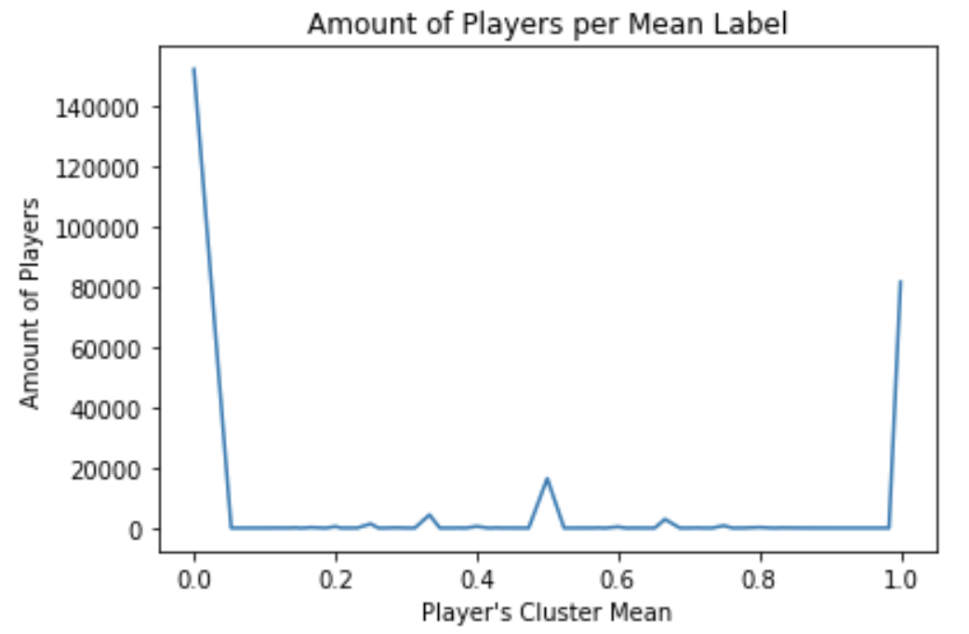
Insights
Two natural, distinct clusters for toxic text:
Name-calling (i.e. idiot, stupid, moron)
Teammate-targeted offensive interactions (i.e. you suck)
No distinct clusters for non-toxic messages
Most players remain within one cluster, never sending both types of toxic messages.

Slide 21
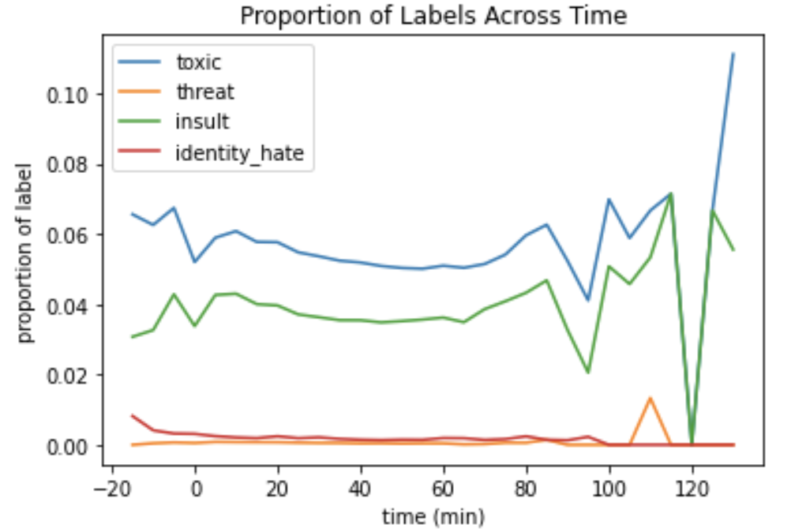
Insights (cont.)
Time Segmentation
The proportions of different toxicity labels have minimal variation over time
Notes:
Zigzags at the end might be bc there’s less data points at that area since many games would have ended by then
Looks like people aren’t more toxic at a certain time in the game
But we cannot completely know this because all games end at different times
ie. ending at 30 mins vs ending at 60 mins would result in “gg” and “push mid” type of messages at the 30 min mark

Slide 22
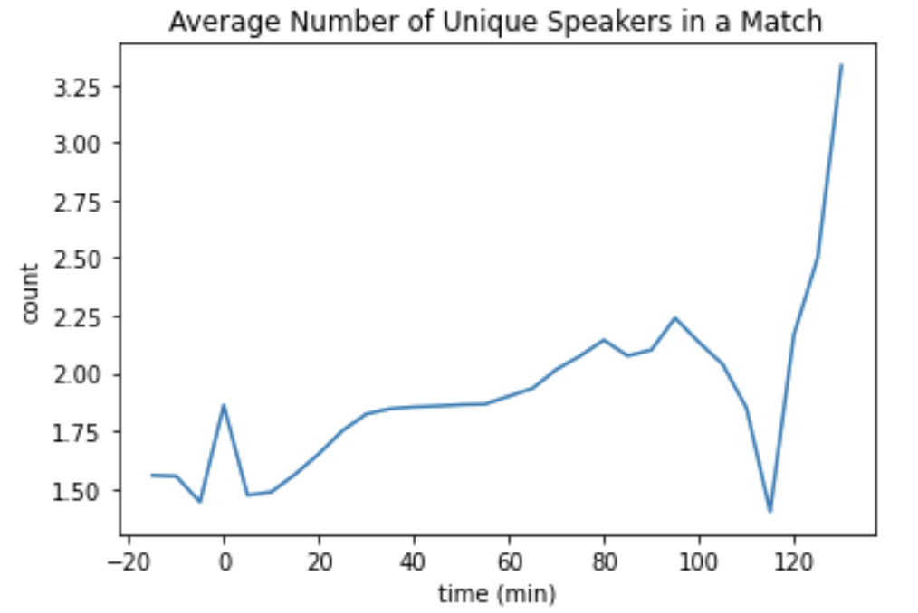
Insights (cont.)
Excessively long matches tend to trigger a sharp increase of speakers and toxic messages
Game duration
Causal inference exploration
Notes:
Zigzags at the end might be bc there’s less data points at that area since many games would have ended by then
From slide 21:
Looks like people aren’t more toxic at a certain time in the game
But we cannot completely know this because all games end at different times
ie. ending at 30 mins vs ending at 60 mins would result in “gg” and “push mid” type of messages at the 30 min mark

Slide 23
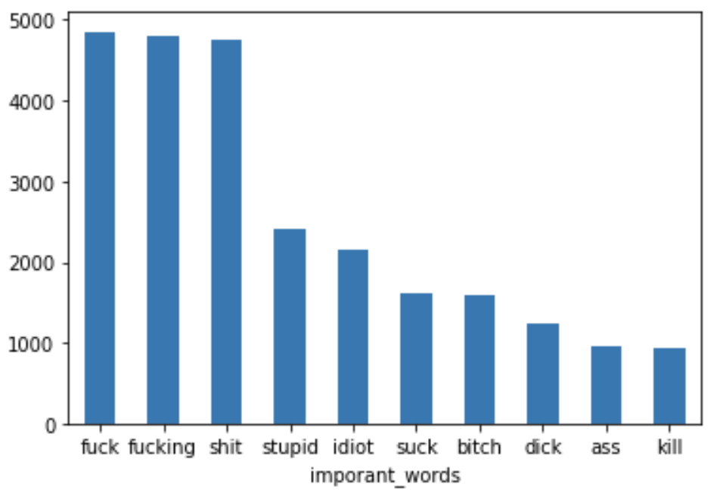
Insights (cont.)
Many of the most common words per toxicity label were
the same (i.e. fuck, bitch)
Ex: Most prominent words of toxic messages (late-game)
Suggests need for more context-based model
Notes:
* Pre-game: negative minutes
* Early game: 0-15 minutes
* Mid game: 16-35 minutes
* Late game: 36+ minutes

Slide 24
Results
A classifier for real-time identification of toxicity, obscenity,
threats, insults, and identity hate.
Robust (Word embeddings and similarity scores)
High Performance (False Positives, F1-Scores)
Various deployment options (i.e. Toxicity Detection-aaS,
model bundle) enable game moderators to make informed
decisions in a flexible manner.

Slide 25
Results (cont)
Areas for Improvement and Future Exploration
Improve speed and scalability
Explore more contextually aware models (i.e. BERT)
Time series relations (i.e. Recurrent Neural Networks)
Voice Detection Models with Audio Data
Computationally expensive, data storage
Domain specific speech to text detection algorithms

Slide 26


Thank You!
Q&A and Discussion

