Slide 1

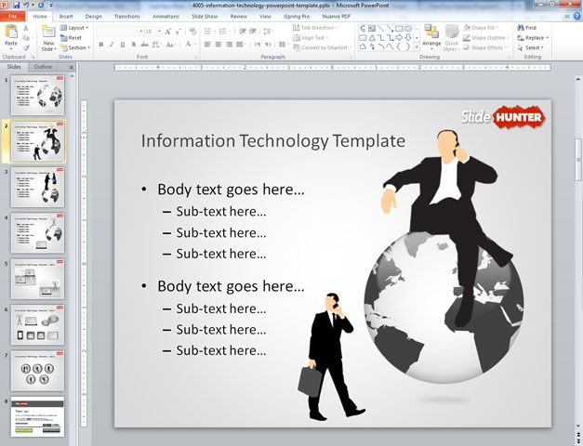


(CIT) ABOUT SOME INFORMATION
Basics Information about
Ms word
Excel sheet

Slide 2
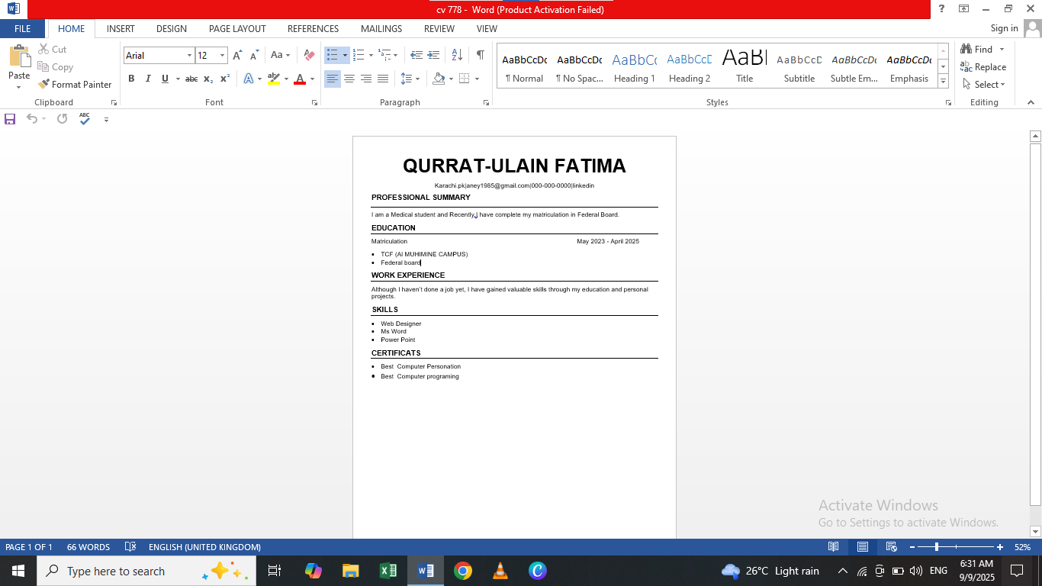
Easy to make a cv on word
Some Important point to make a cv :
Firstly you have to make a cv we should select the margins.
Then in a page centre right your name and right your professional summary.
You should definitely right some basic information about your self gut like that your education skills and about your work experience.
And cv is so important for you applying for the job online and official work.
In a work you can easily make cv in your computer.

Slide 3
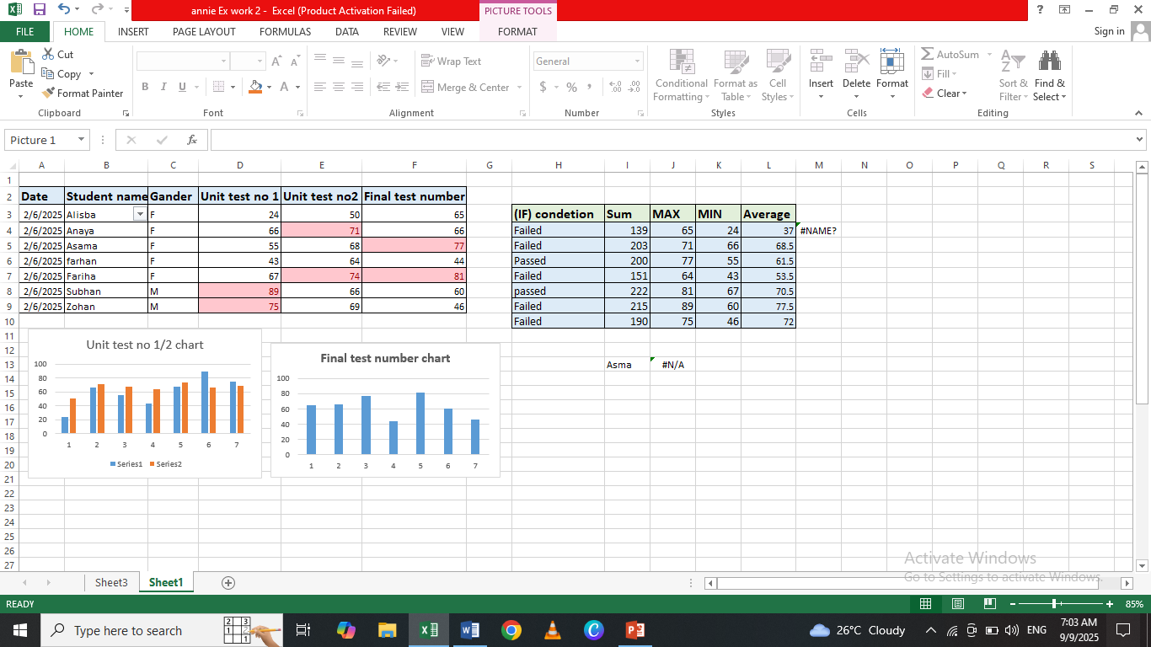
Excel Sheet work with formulas
(Excel work)
Firstly in a sheet we make a data.
Secondly select the values and applying formulas according your choice.
Basic formulas is (Sum , Max , Min ,Average).
We applying( sum) formula like this =sum(A4,A6).
Apply Max and Min formula firstly like this =MAX ( ) or =MIN( ) and select the bearcat 1and2 with coma.
We apply if conditions to like this =IF(F5<70,”Passed”,”Failed,) and select the conditions true or false.
We using if condition out come student result pass or fail and result is based on student test number.
Make a graph select the over value go to the insert and select the custom charts.

Slide 4
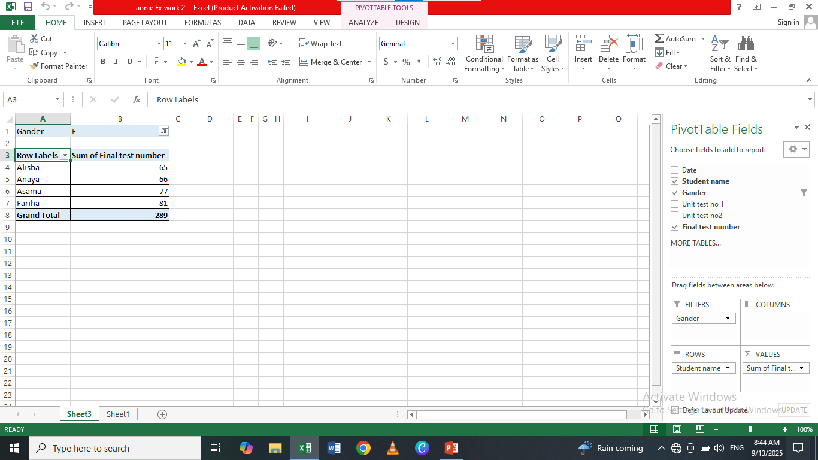
(Excel Sheet work)
Pivot Table Importance:
Firstly we apply pivot table open new sheet then select the your all over table data and click on insert then press the pivot table icon.
Secondly dividing all over data according your choice.
With the help of pivot table you can easily applying sorting and filtrate method.

Slide 5



