Slide 1
Integrating local and pairwise neural activity dynamics to study schizophrenia
Annie Bryant
Graphics to be made cooler

Slide 2
Quick background on schizophrenia BOLD fMRI

Slide 3
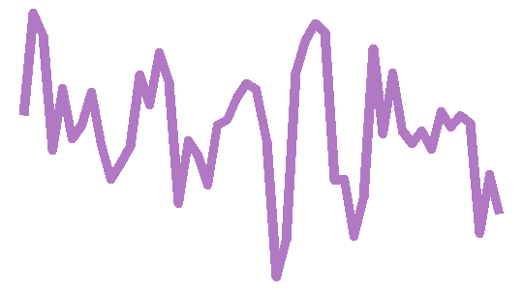
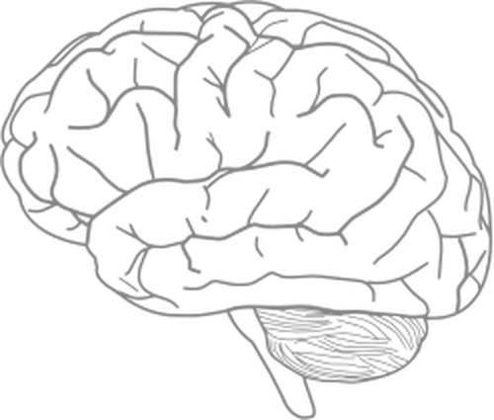
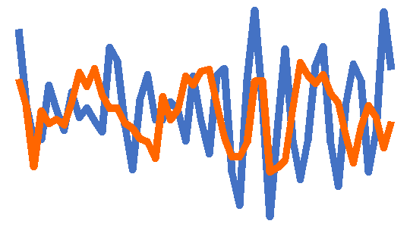
BOLD-measured neural activity represents an interacting system with individual components
Pairwise functional connectivity dynamics
Higher-order interaction networks
Local regional dynamics
Example: fALFF
Example: Pearson correlation coefficient
Example: Node degree within graph network

Slide 4
Current State of the Neuroimaging Subject Classification Union
Pairwise functional connectivity dynamics
Local regional dynamics
OR
Only 1-2 features are selected a priori based on literature standards
Complex classification models may obscure the actual brain region and time-series feature contributions to classification
Example: fALFF
Example: Pearson correlation coefficient

Slide 5
Introducing an integrated approach for the comprehensive evaluation of local and pairwise neural dynamics
Pairwise functional connectivity dynamics
Local regional dynamics
AND
Dozens to hundreds of features derived from interdisciplinary research are evaluated
Goal: combine univariate and multivariate time-series features in a biologically interpretable classification model
Example: fALFF
Example: Pearson correlation coefficient

Slide 6

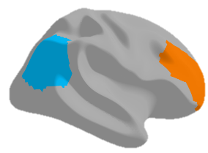
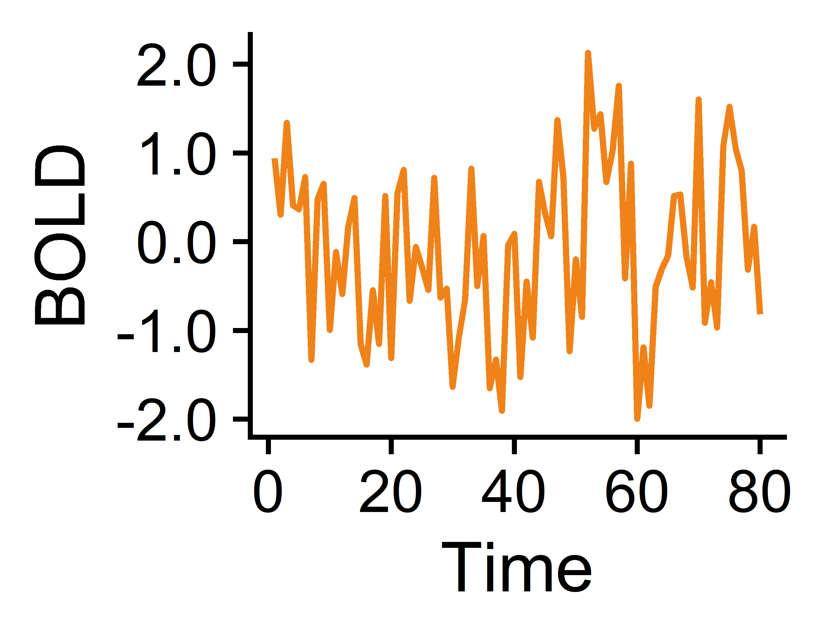
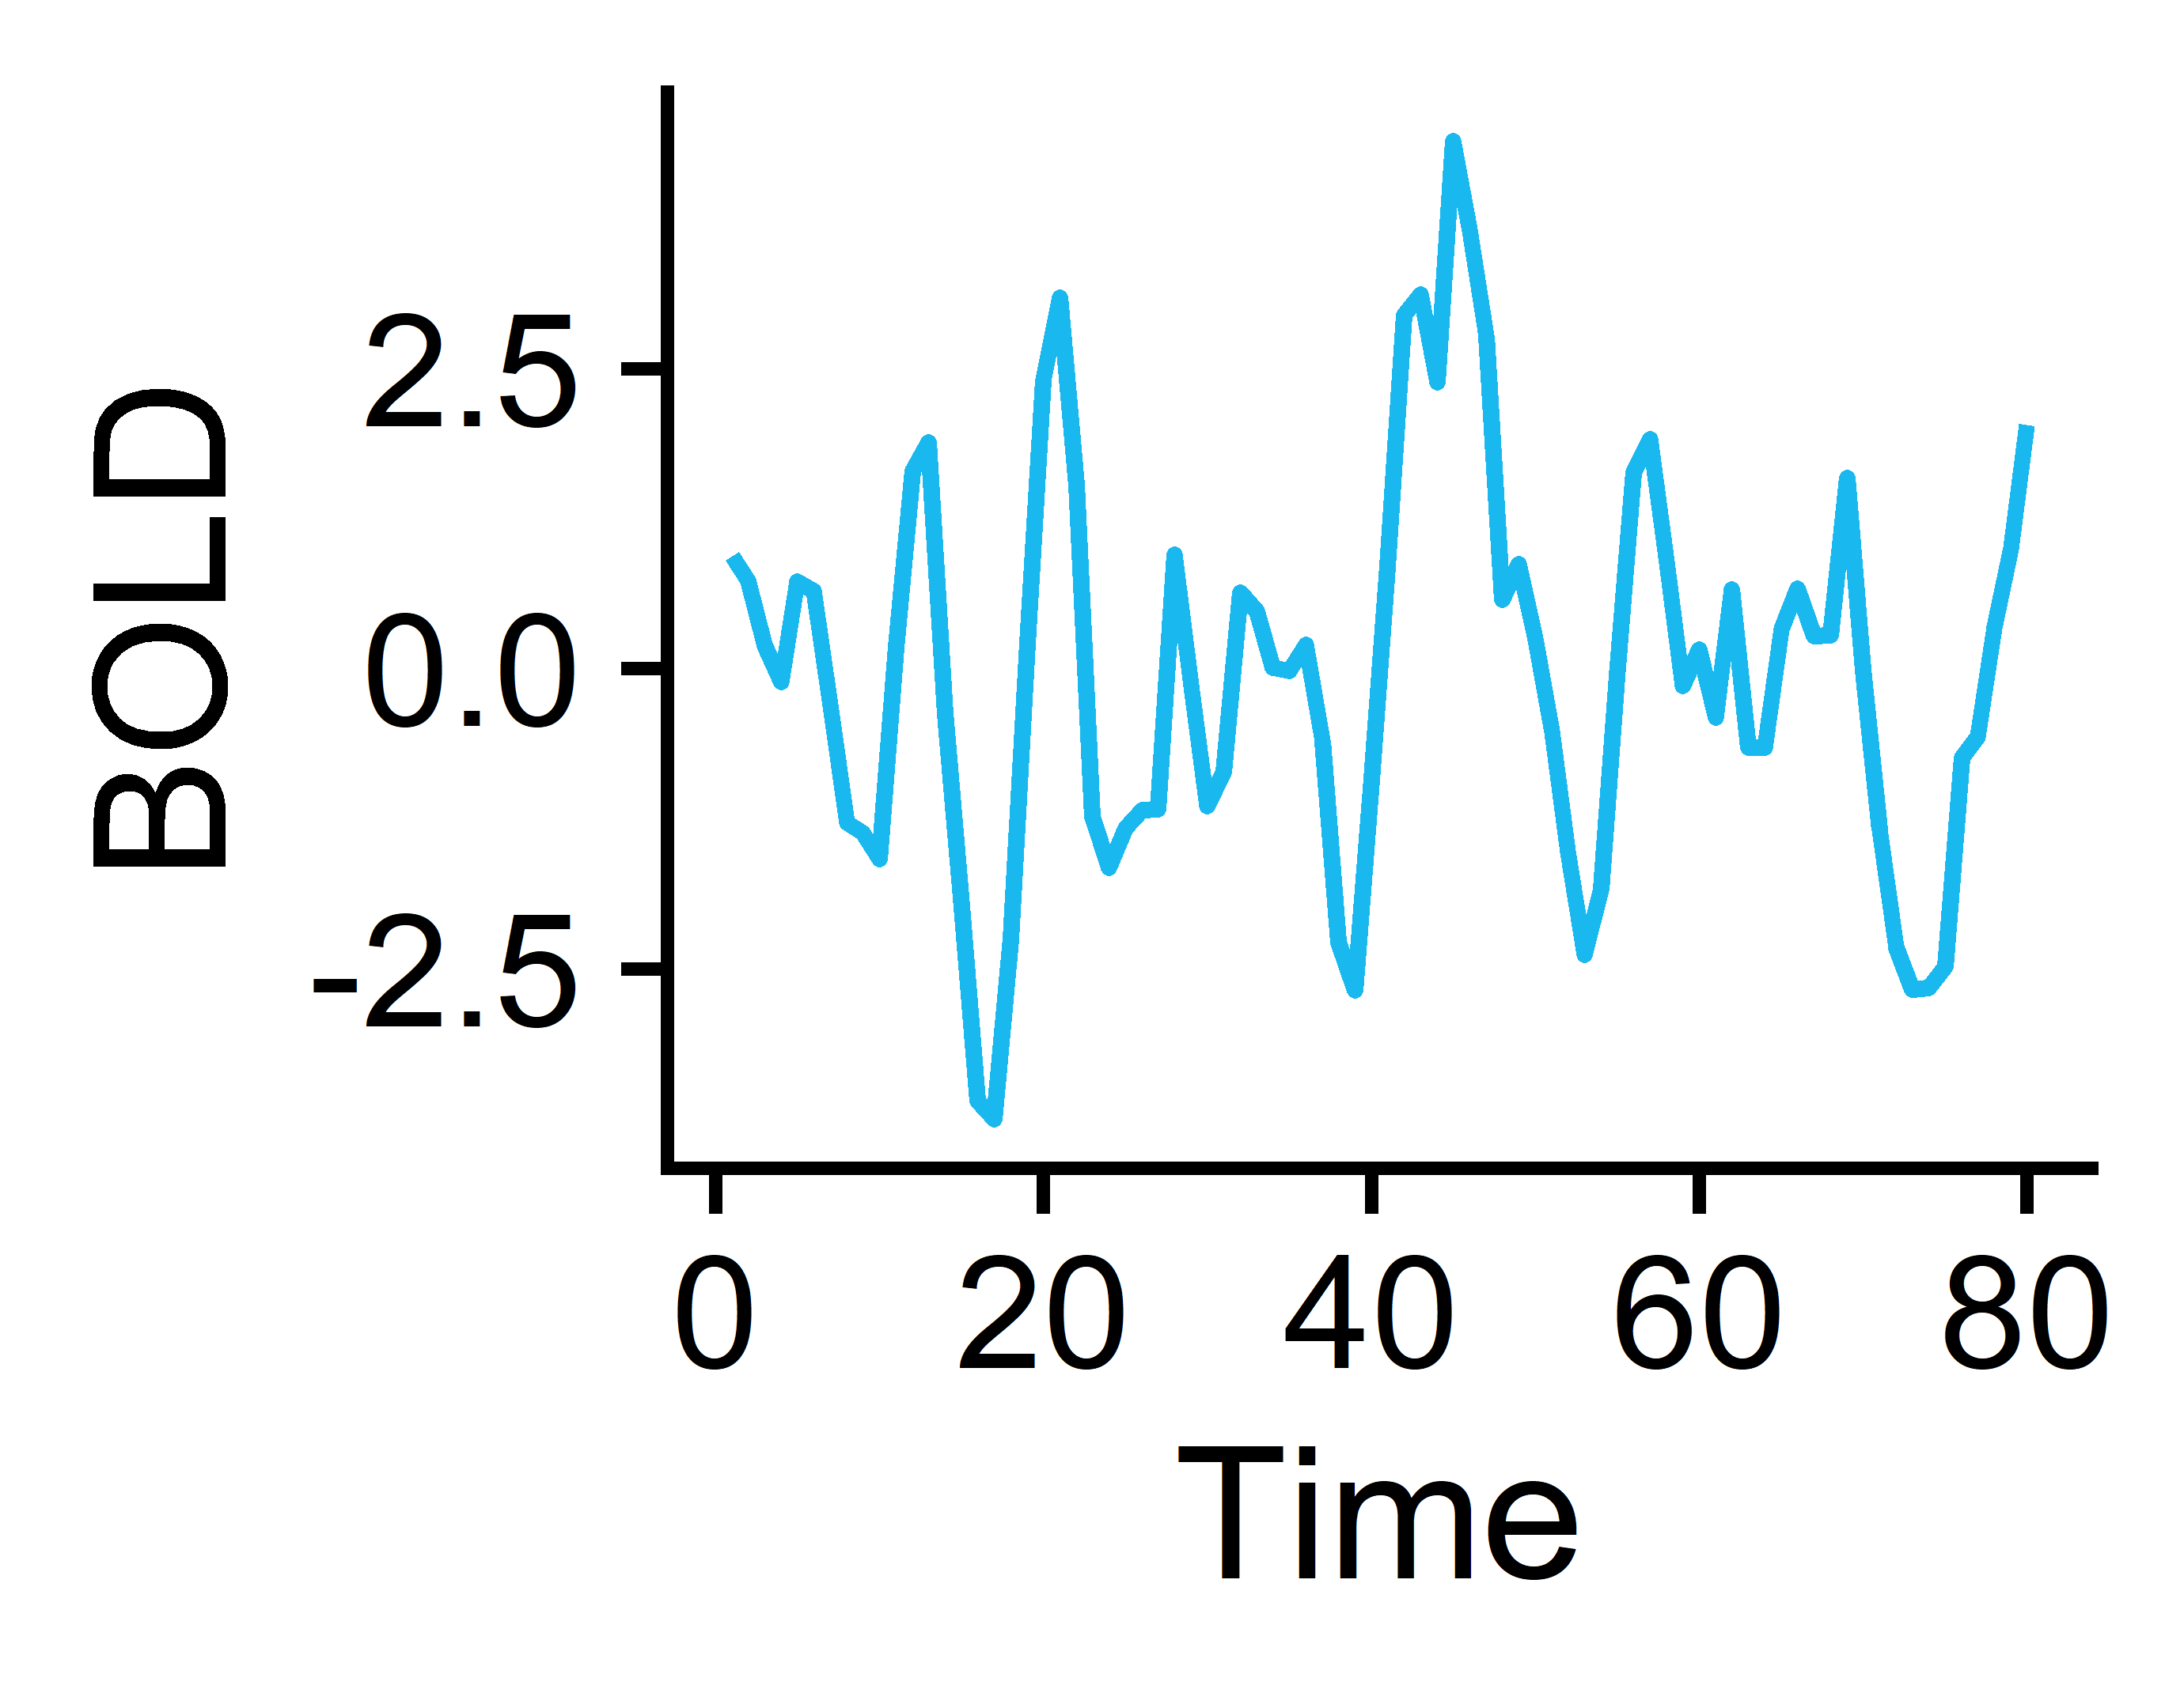
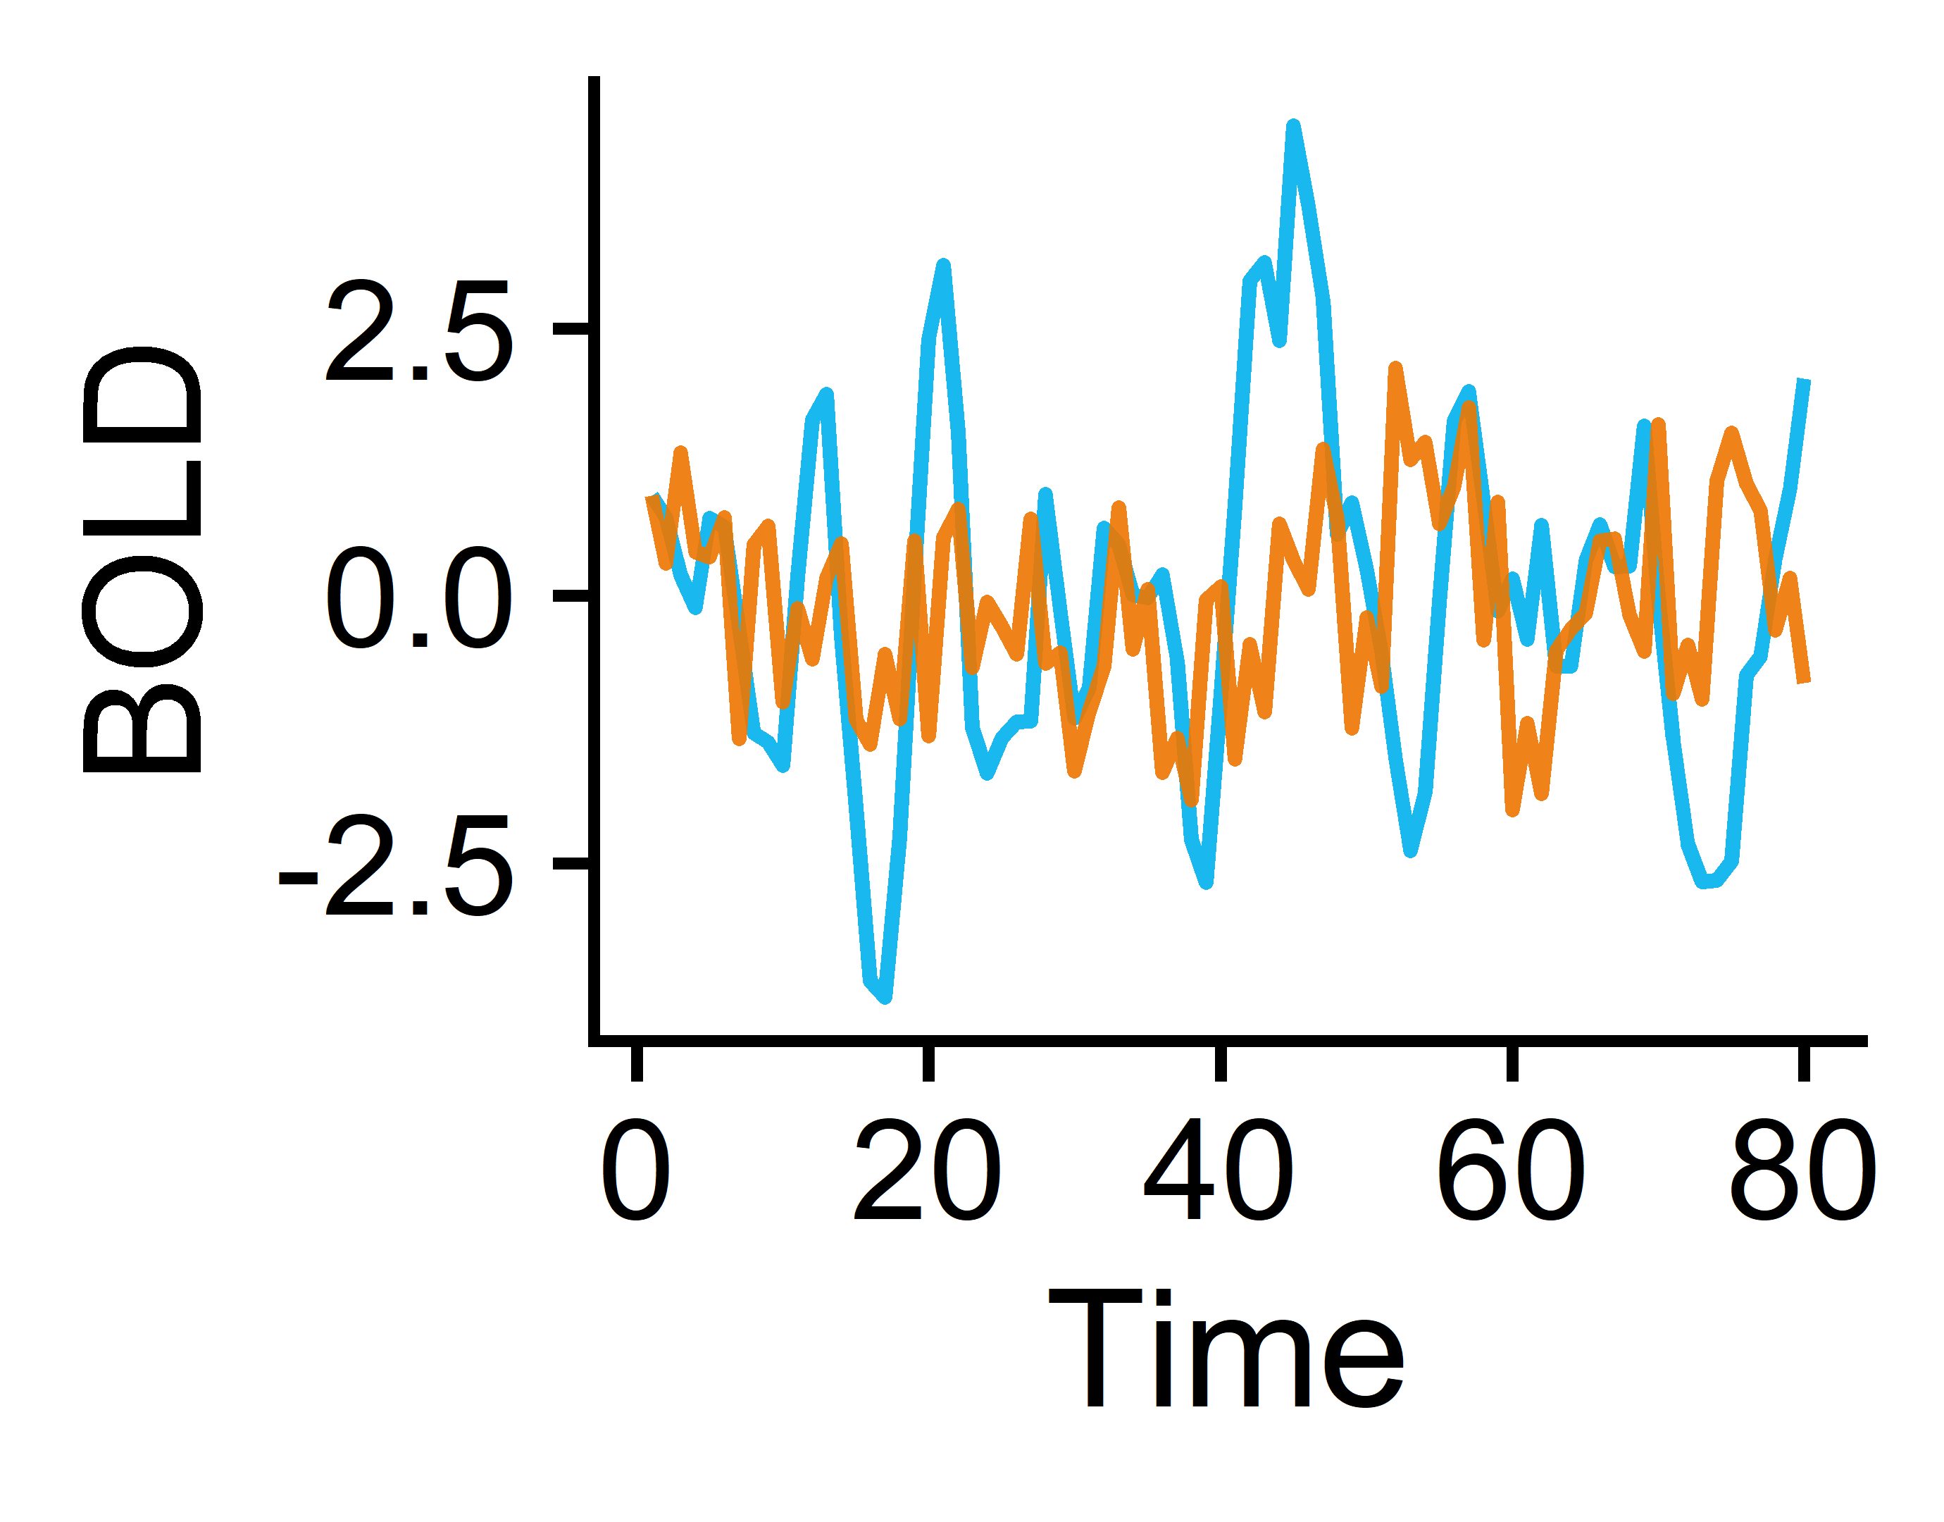
From BOLD fMRI to time-series (TS) feature matrices: a 🐤’s 👁 view
Brain
Regions 1-82
Measure BOLD temporal signals in 41 cortical + subcortical regions per hemisphere
Extract univariate TS features from each brain region
Subjects¹
Univariate features (22)
N=118 Controls
Subjects (165)
fMRI processing:
Freesurfer (structural MRI)
fmriPrep
ICA-based Automatic Removal of Motion Artifacts (AROMA)
Regress out artifacts from AROMA, signal from white matter + CSF, and signal from global gray matter (AROMA+2P+GMR)
Region pairs 1-6,632
Pairwise features (18)
N=47 with Schizophrenia
Extract pairwise TS features from each brain region pair
Subjects (165)
¹Gorgolewski KJ et al. A Preprocessed consortium for Neuropsychiatric Phenomics dataset. (2017).

Slide 7
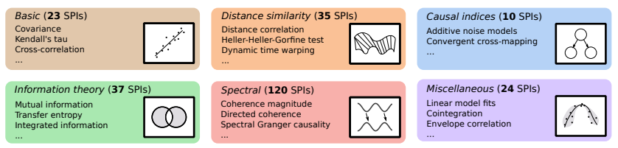




Curating time-series feature sets
Pairwise features (statistical pairwise interactions; SPIs)
Univariate features
theft
catch22
tsfel
feasts
pyspi
>1,300 features
249 SPIs
tsfresh
tsfeatures
kats
22 features spanning time-series properties including linear and nonlinear autocorrelation, periodicities, consecutive stretches, and simple forecasting
Manually curated subset of 18 SPIs that include dynamic time warping, spectral Granger causality, transfer entropy, and additive noise modeling
Trent Henderson
Henderson T and Fulcher BD. ICDMW (2021).
Oliver Cliff
Cliff OM et al. arXiv (2022).

Slide 8
Classification method overview
Region-wise classification
Feature-wise classification
Combo-wise classification
Brain
Regions 1-82
Univariate TS features 1-22
…
TS Feature 1
TS Feature 22
Region 1
Region 82
Region 1
Region 82
Subjects (165)
Subjects (165)
…
…
Subjects (165)
Univariate features (22)
Brain regions (82)
Linear SVM by Brain Region
Linear SVM by Univariate TS feature
Linear SVM with all Region-by-Feature combinations (n=1,804)
Region 1
Region 2
Region 82
Feature 1
Feature 2
Feature 22
…
…
Goal: Identify which region(s) exhibit significantly different overall neural activity in participants with vs. without schizophrenia
Goal: Identify which univariate TS feature(s) exhibit globally altered properties in participants with vs. without schizophrenia
Goal: Identify which region(s) exhibit specifically altered individual activity dynamics in participants with vs. without schizophrenia
Note: to account for class imbalances, samples were weighted according to the inverse proportion of their class membership (Schizophrenia vs. Control) and balanced accuracy was used as the performance metric.
Add citation for what balanced accuracy is

Slide 9

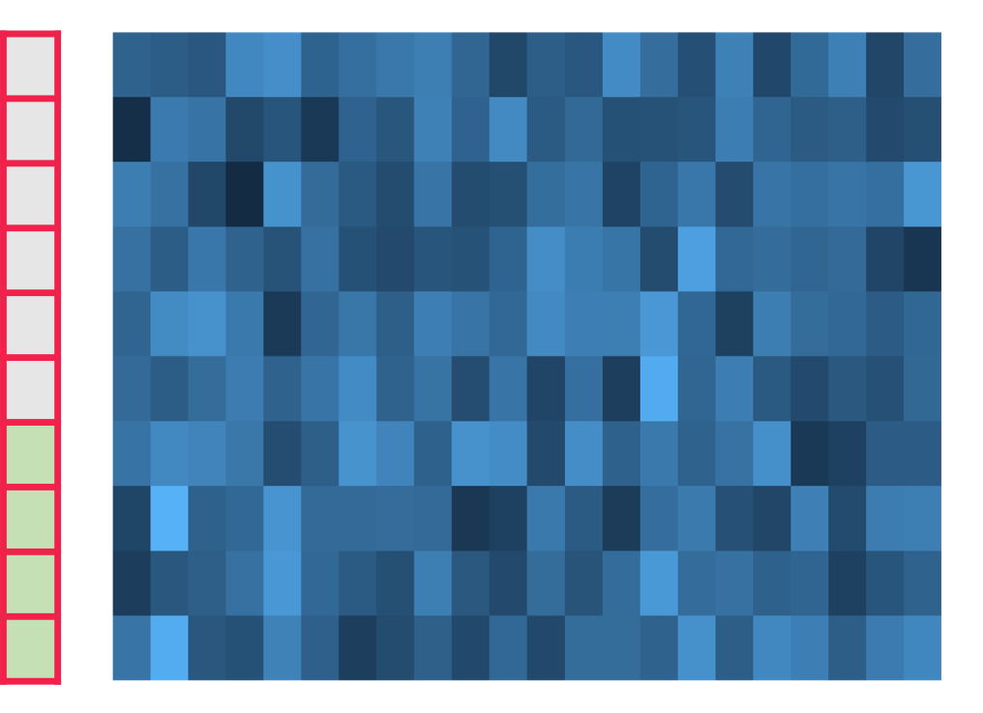
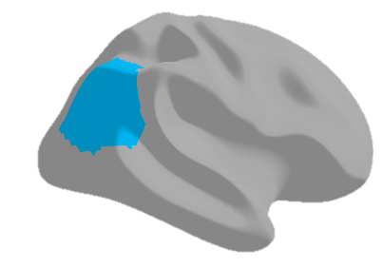
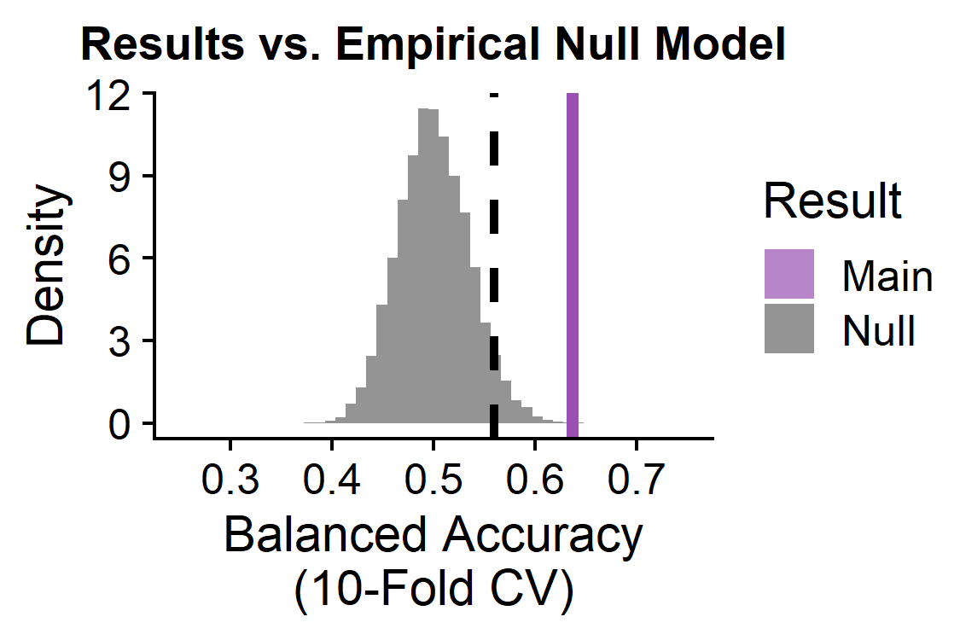
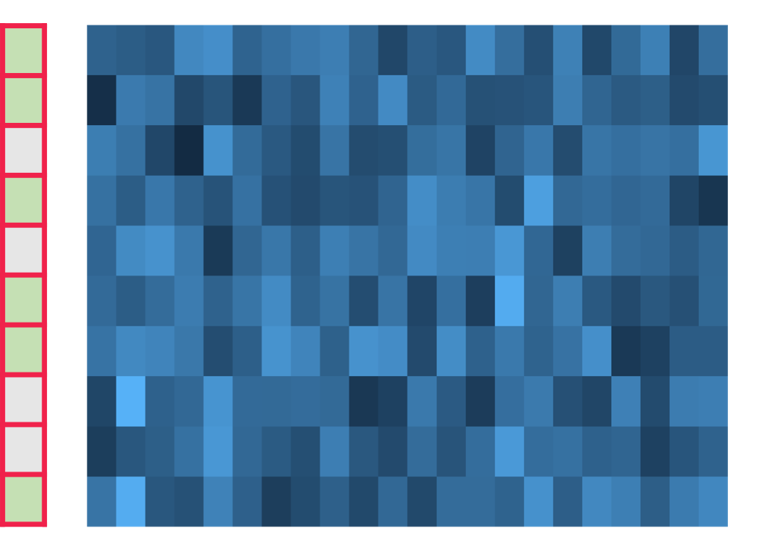
Evaluating statistical significance : pooled empirical null modeling
Linear SVM
Observed classification balanced accuracy
Group labels
Subjects (165)
Extract TS features
10-fold CV
Example region: right inferior parietal cortex
catch22 features
Shuffle group labels
Null permutation classification balanced accuracy
Group labels
Subjects (165)
Linear SVM
Repeat 1,000X per brain region
10-fold CV
catch22 features

Slide 10
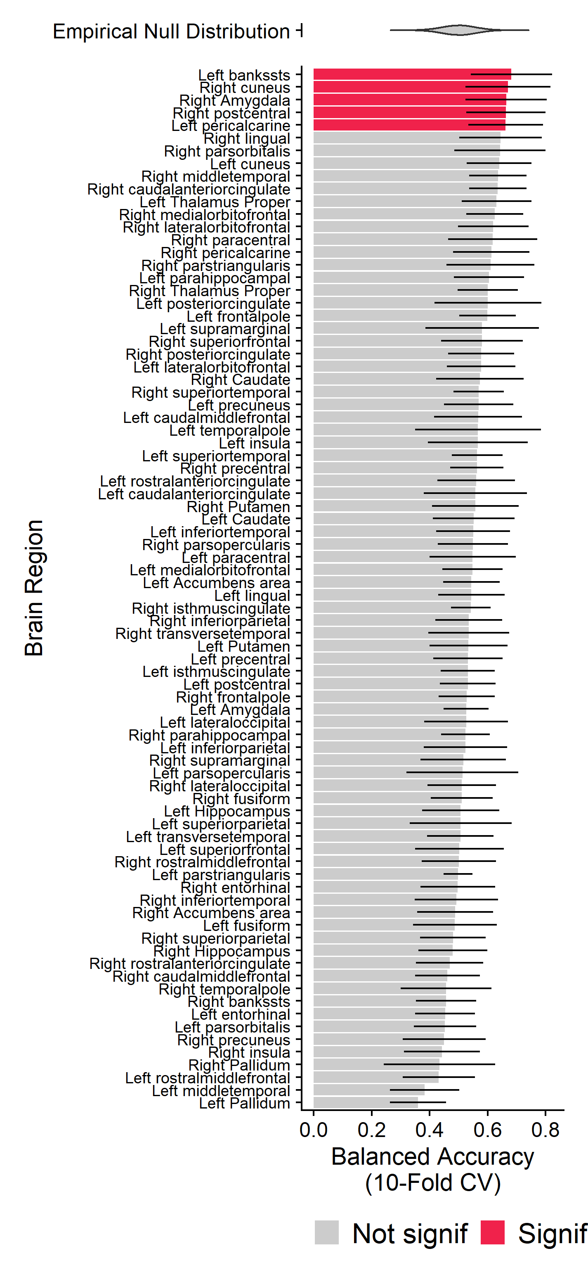
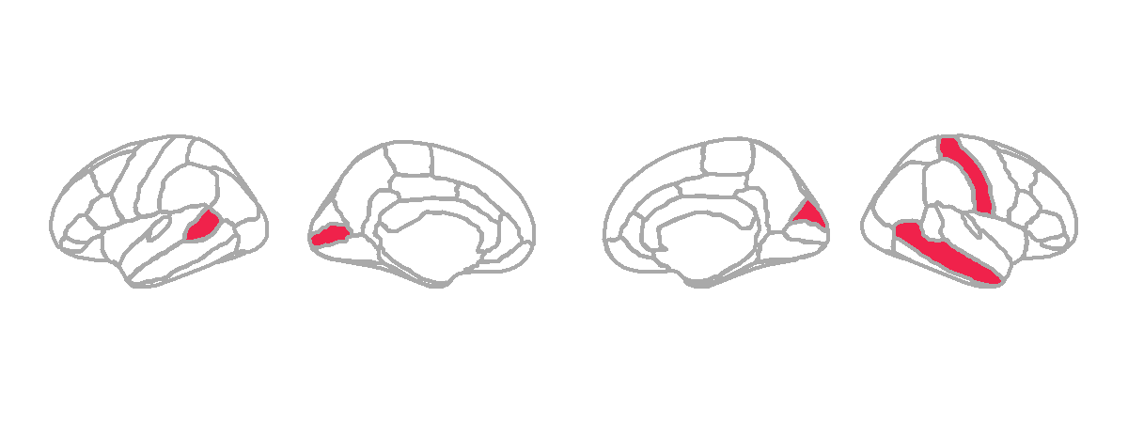
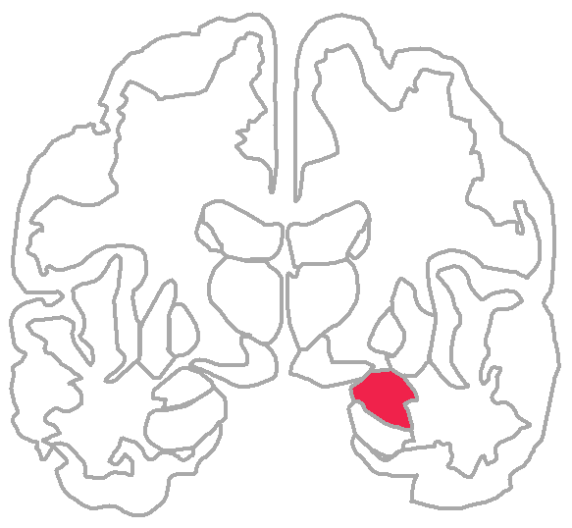
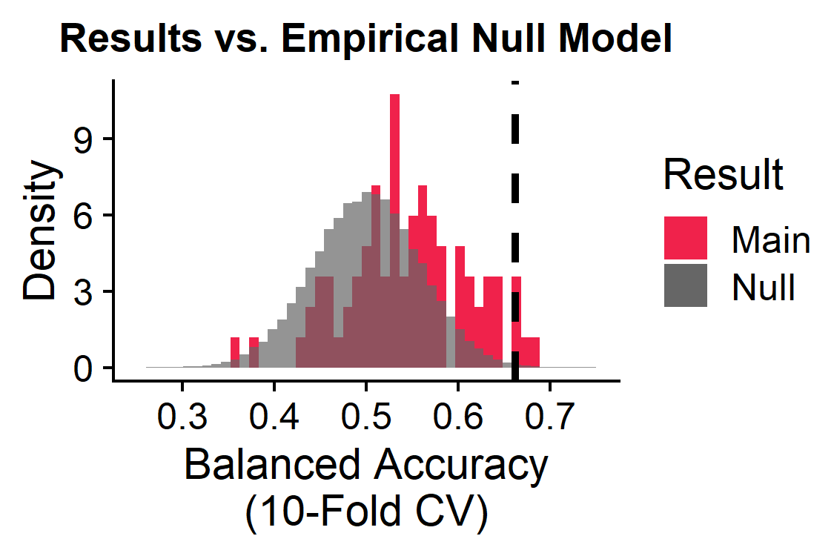
Five brain regions show altered temporal dynamics in schizophrenia
Left
Brain
Regions 1-82
L
R
L
2
1
4
Univariate TS features (22)
3
5
Subjects (165)
Right
5/82 brain regions significant:
L banks of the superior temporal sulcus
L pericalcarine
R cuneus
R postcentral
R amygdala
BH-adjusted p<0.05
Notes:
Banks STS in schizophrenia: https://www.frontiersin.org/articles/10.3389/fpsyg.2018.00578/full, https://pubmed.ncbi.nlm.nih.gov/23956120/

Slide 11
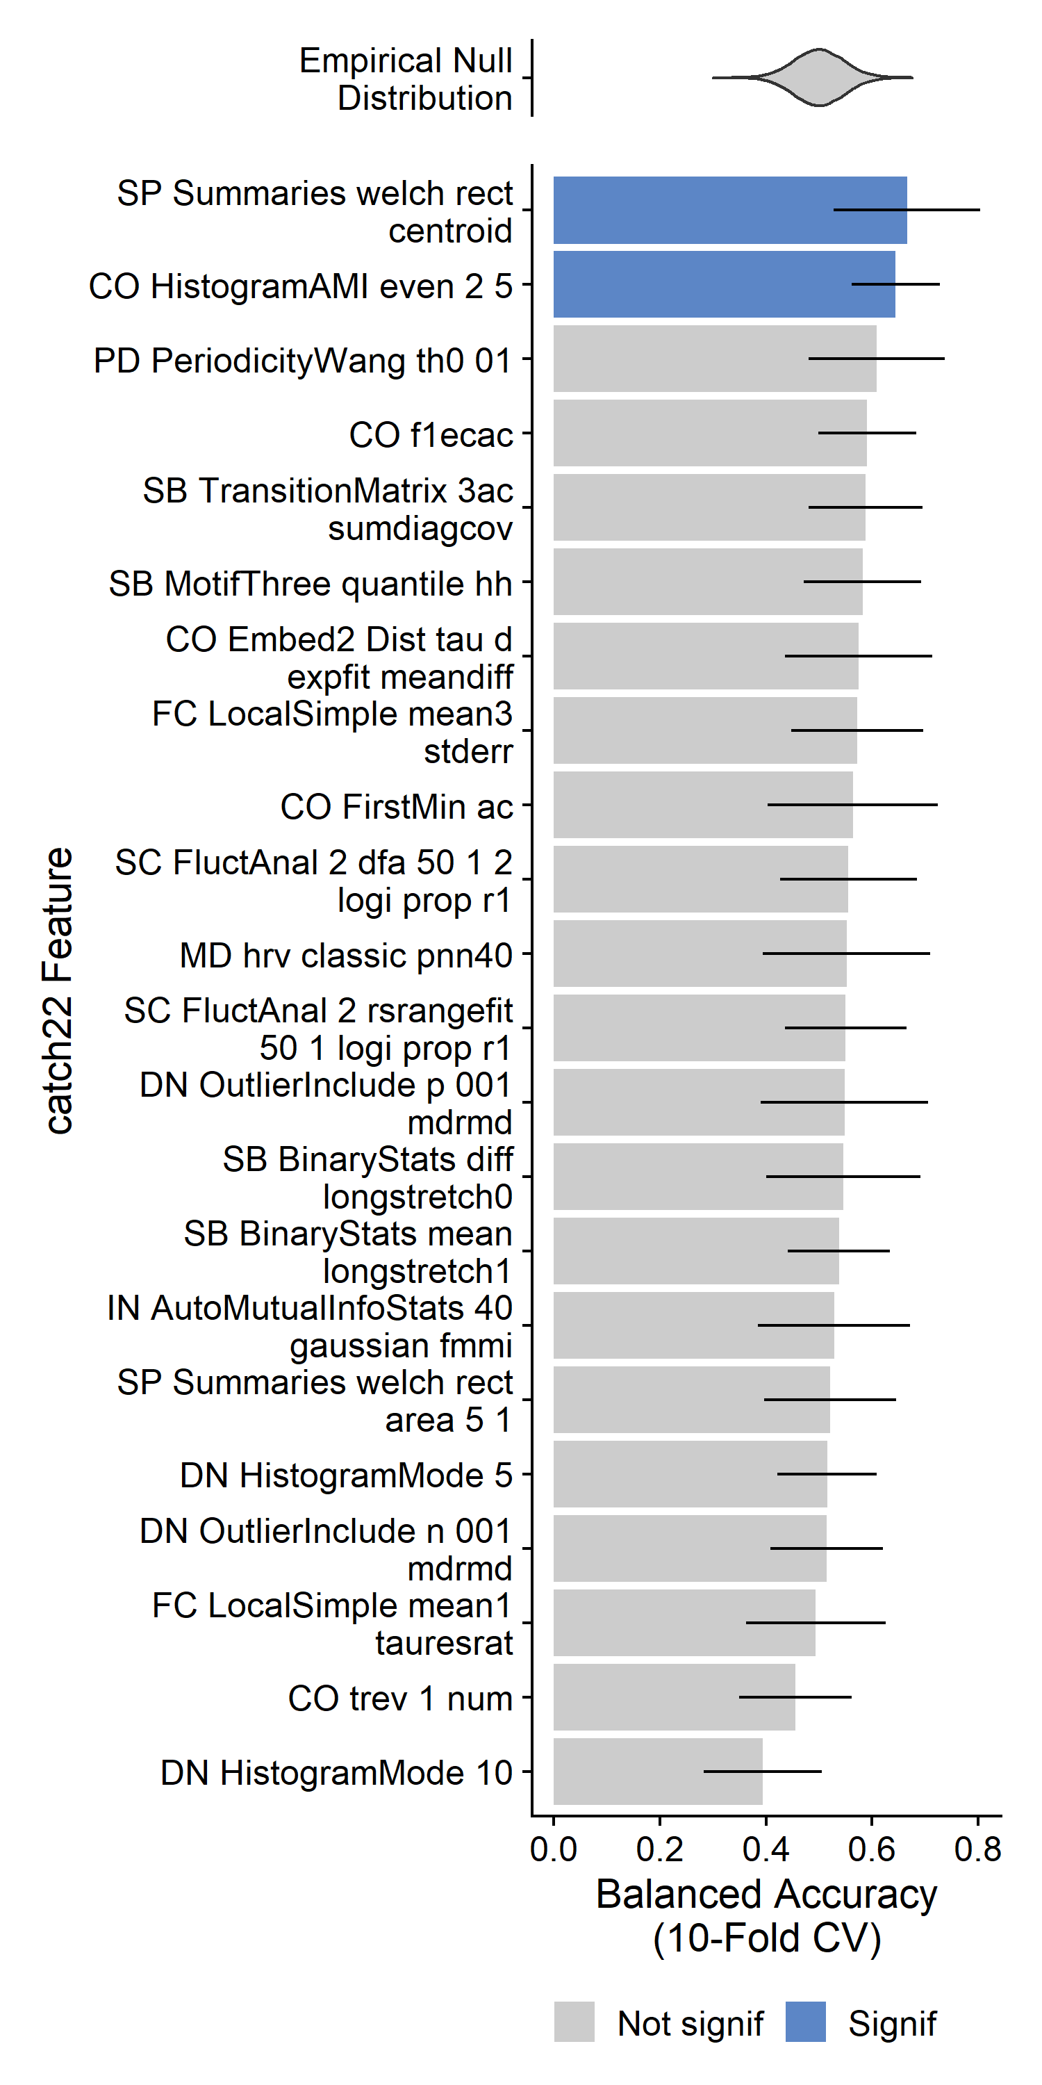
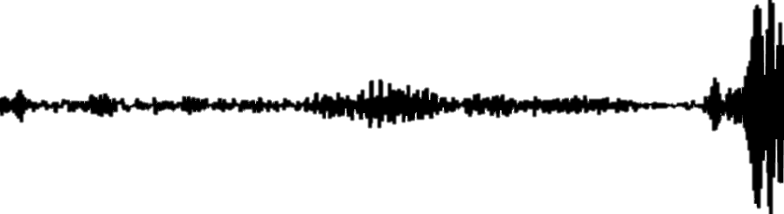
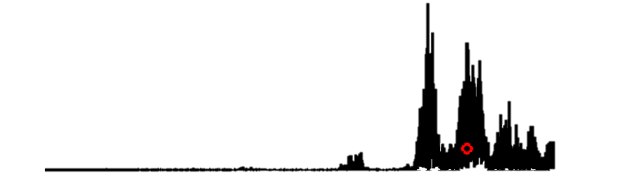
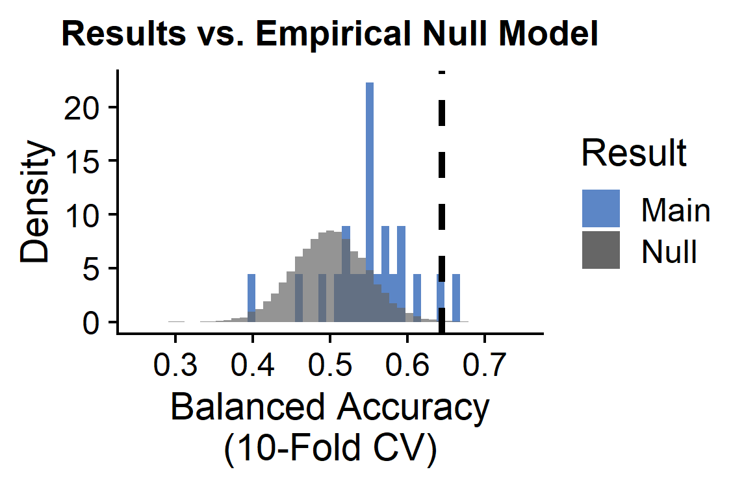
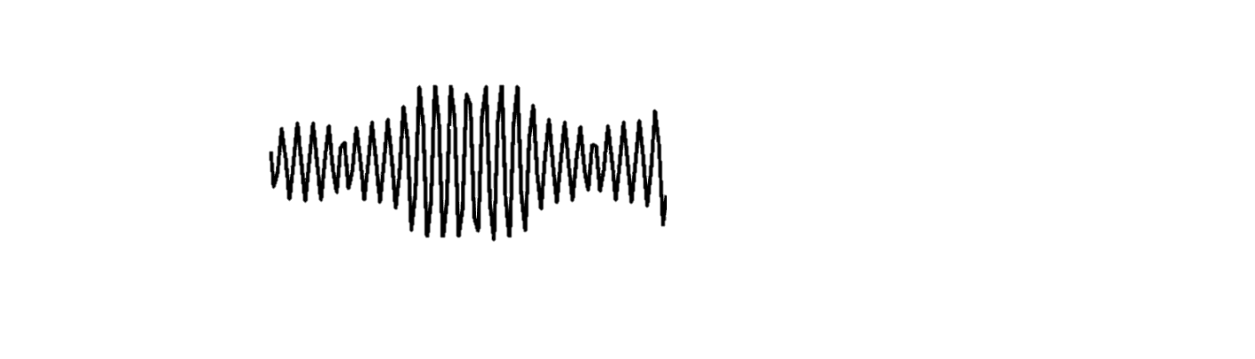
Two TS features show globally altered properties in schizophrenia
Univariate TS features 1-22
2/22 univariate TS features significant:
Brain regions (82)
TS
PSD
Subjects (165)
SP_Summaries_welch_rect_centroid: Centroid of the Welch-estimated power spectral density (PSD)
BH-adjusted p<0.05
CO_HistogramAMI_even_2_5: Nonlinear autocorrelation function with bins of 5 at lag τ = 2
Notes:
Banks STS in schizophrenia: https://www.frontiersin.org/articles/10.3389/fpsyg.2018.00578/full, https://pubmed.ncbi.nlm.nih.gov/23956120/

Slide 12
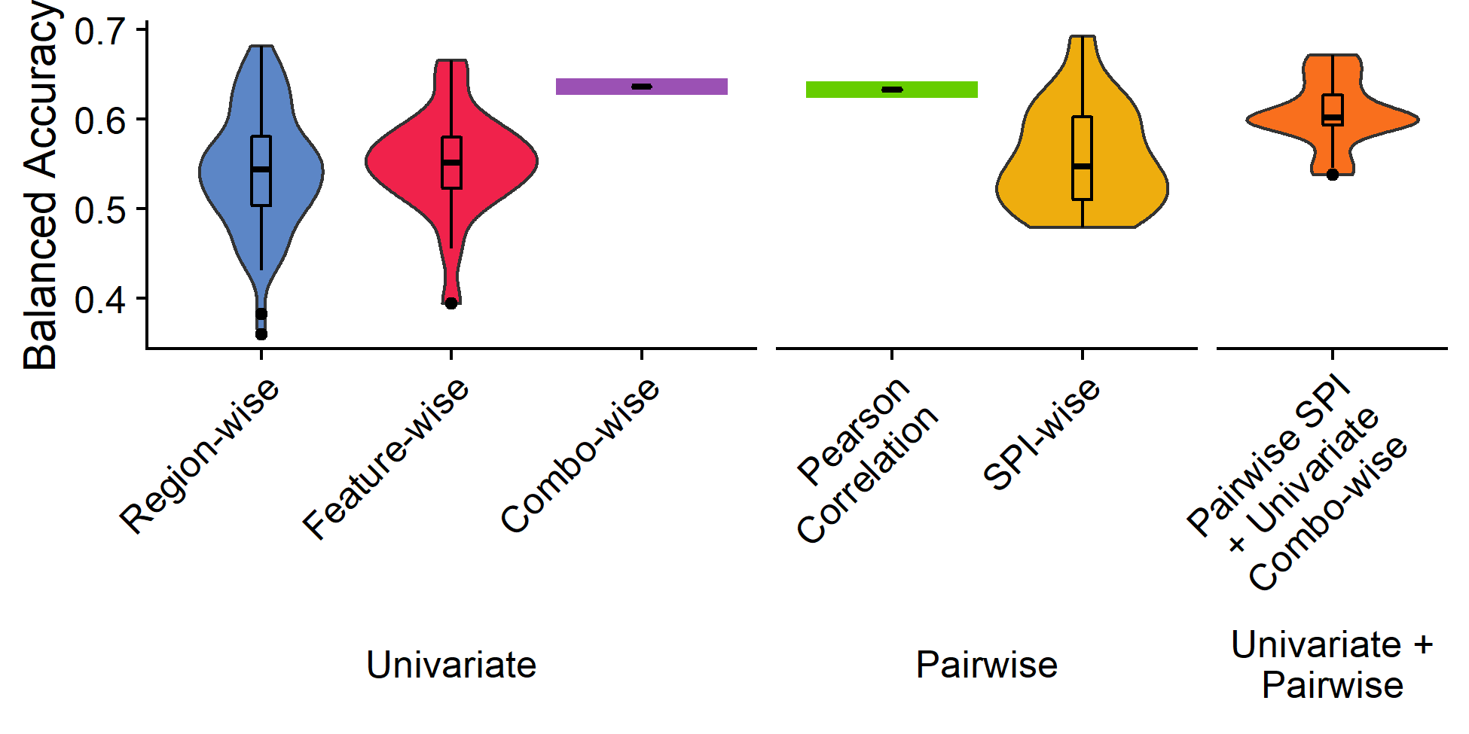
The combination of brain region X time-series dynamics
The combination of all univariate TS features X brain regions as inputs to linear SVM classifier yields a balanced accuracy of 63.67% (p<0.0001)
R superior parietal
In-sample regularized SVM: 93.5% Bacc
Out-of-sample regularized SVM: 54.6%

Slide 13
Sensitivity analysis: pairwise + univariate features
SPI-wise classification
Pairwise features + univariate features classification
SPIs 1-18
SPIs 1-18
Region 1
Region 2
Region 82
+
…
Univariate features (22)
Brain region pairs (6,632)
Brain region pairs (6,632)
Subjects (165)
Subjects (165)
Subjects (165)
Linear SVM by SPI
Linear SVM with all Region-by-Feature combinations (1,804)
Region 1
Region 2
Region 82
…
Goal: Identify which set(s) of pairwise dynamics exhibit significantly different overall neural activity in participants with vs. without schizophrenia
Goal: Identify which region(s) exhibit specifically altered individual activity dynamics in participants with vs. without schizophrenia
Note: to account for class imbalances, samples were weighted according to the inverse proportion of their class membership (Schizophrenia vs. Control) and balanced accuracy was used as the performance metric.

Slide 14
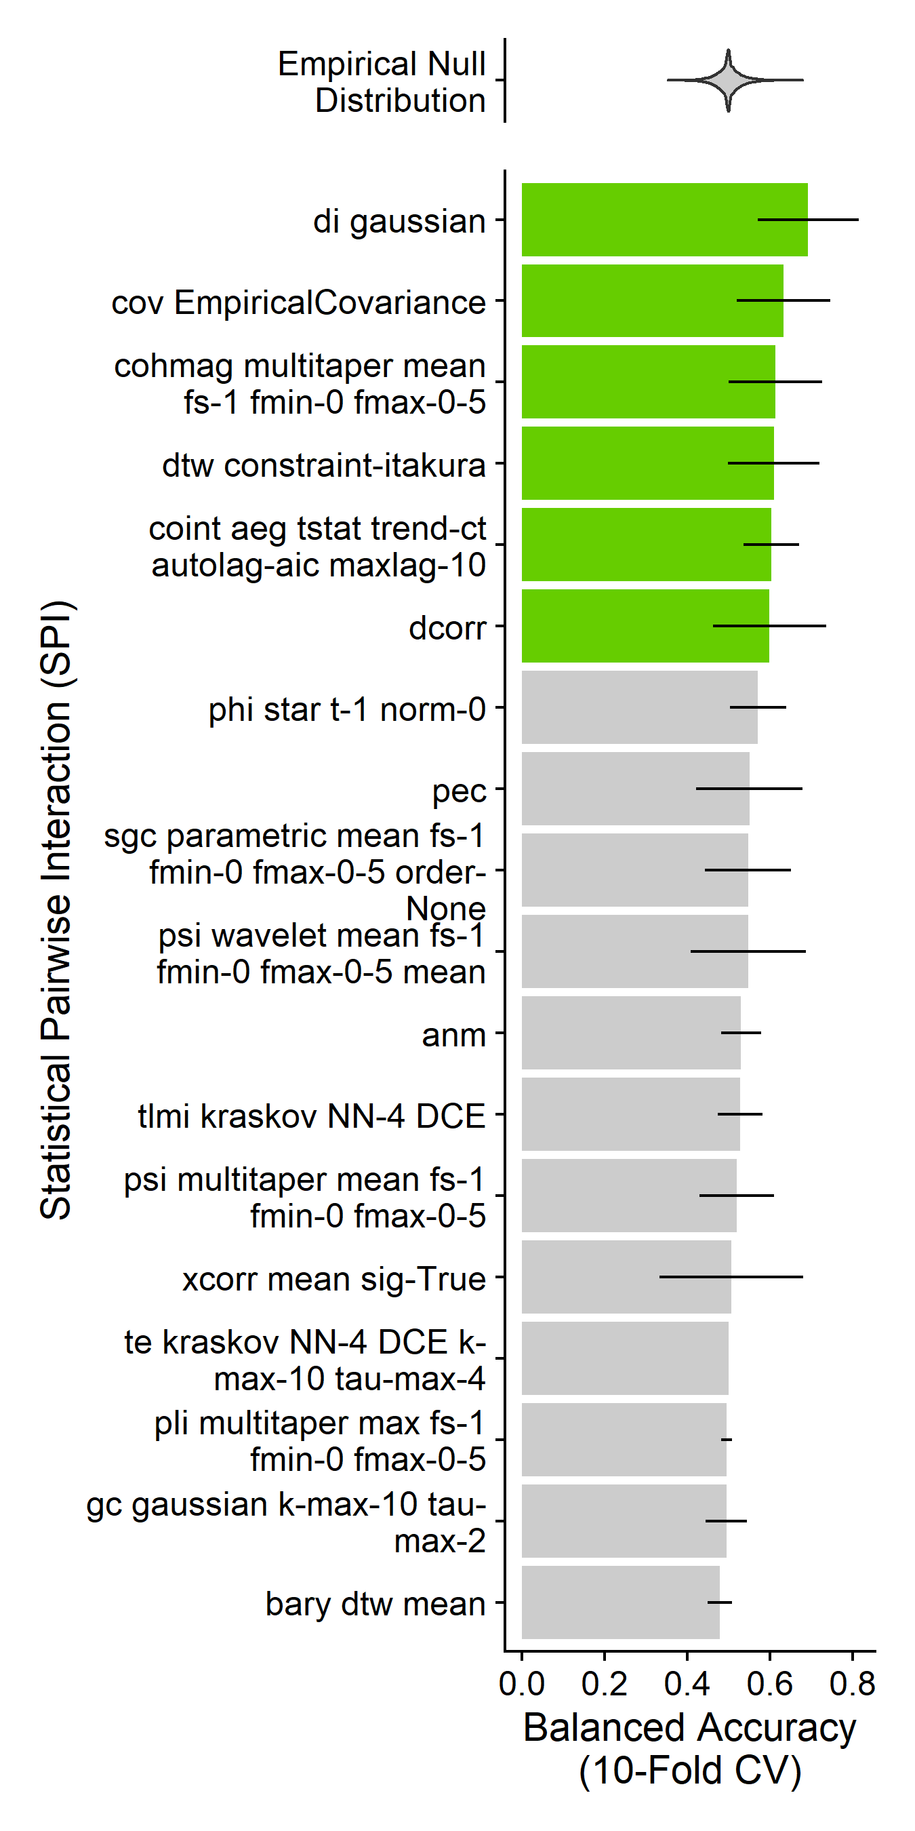
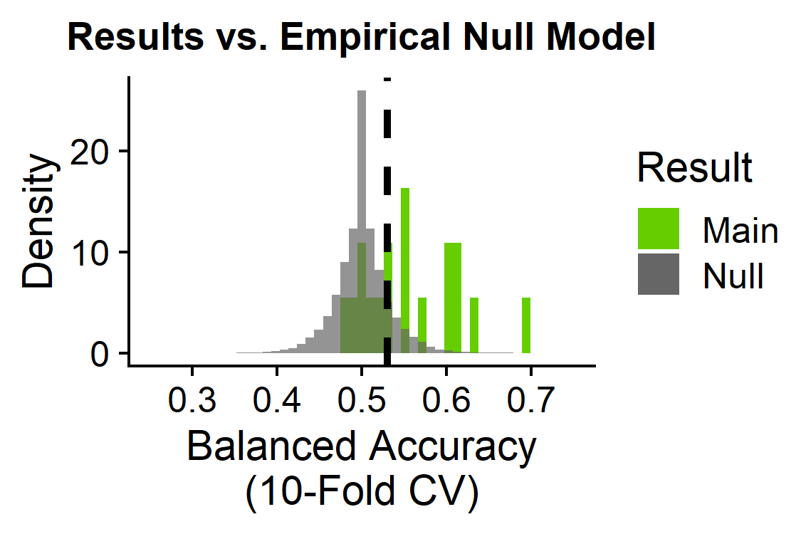
Six pairwise temporal dynamics are globally altered in schizophrenia
6/18 statistical pairwise interactions significant:
SPIs 1-18
Basic statistics
cov_EmpiricalCovariance: Pearson correlation
Information theory
di_gaussian: Directed information with a Gaussian-distribution model
Spectral
cohmag_multitaper_mean_fs-1_fmin-0_fmax-0-5: Coherence magnitude for full frequency range
Distance similarity
dtw_constraint-itakura: Dynamic time warping with Itakura parallelogram constraints
dcorr: Euclidean distance correlation
Miscellaneous features
coint_aeg_tstat_trend-ct_autolag-aic_maxlag-10: cointegration with Augmented Engle-Granger two-step test with a constant and linear trend
Brain region pairs (6,632)
Subjects (165)
BH-adjusted p<0.05

Slide 15
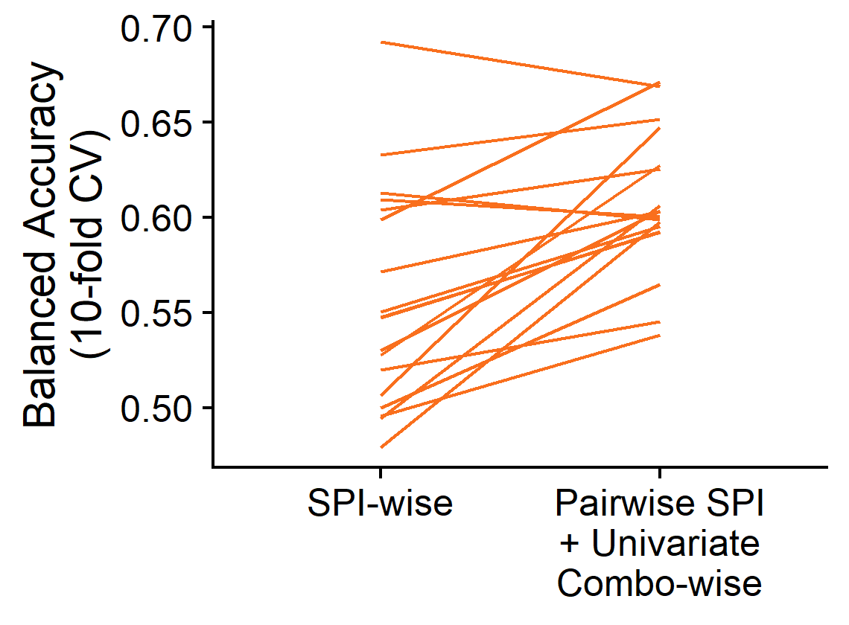
Pairwise features perform better with addition of region-specific univariate TS feature info
SPIs 1-18
Region 1
Region 2
Region 82
+
Univariate features (22)
Brain region pairs (6,632)
…
Subjects (165)
Subjects (165)

Slide 16
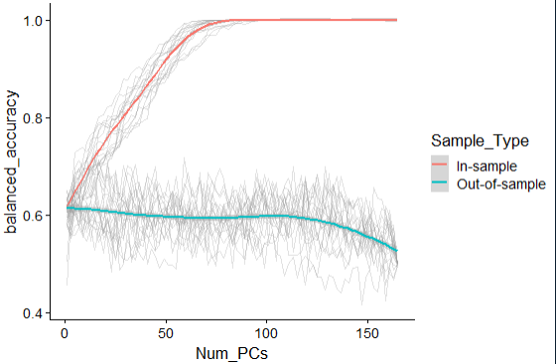
Addressing overfitting in high-dimensional space
~85 PCs sufficient to hit 100% in-sample balanced accuracy
Important question: these balanced accuracy values are still all lower than the final balanced accuracy values from the full results?
When the full set of PCs is used, there is a dropoff in out-of-sample balanced accuracy

Slide 17
Take home messages

Slide 18
Limitations + next steps
Limitations =
Next steps = dimensionality reduction to mitigate potential overfitting, feature selection to evaluate relative contribution of different regions x features, quality control, evaluate different feature subsets, apply classification model to a separate validation dataset

Slide 19
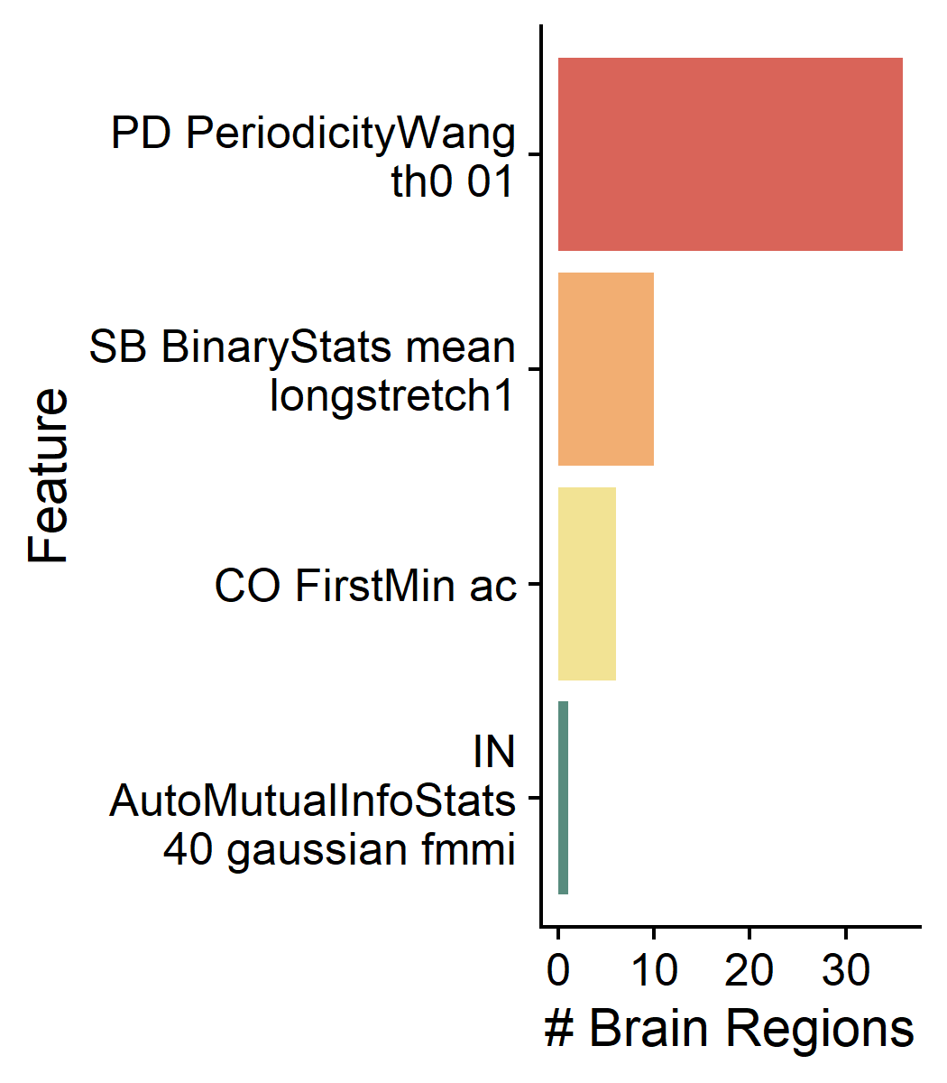
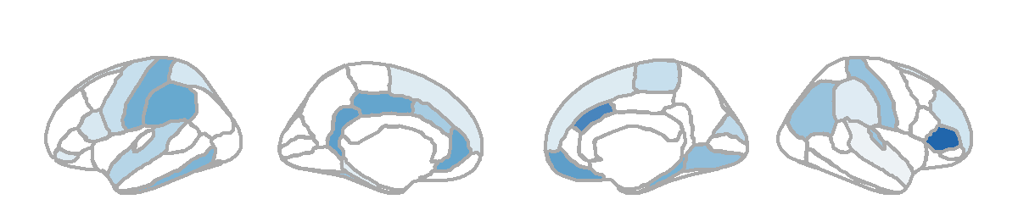
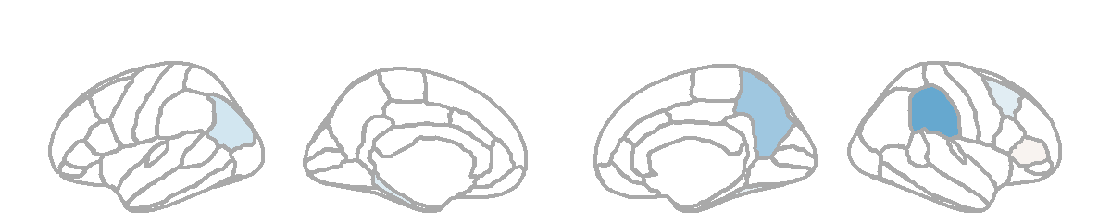
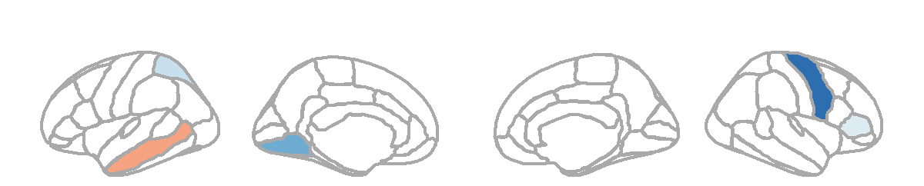
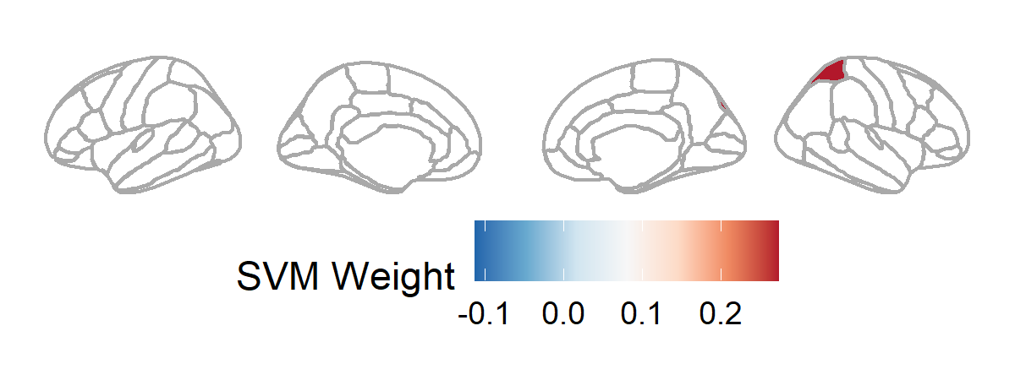
The combination of brain region X time-series dynamics
L1-regularized SVM for feature selection
Periodicity measure that is higher in slower-varying time-series
Longest sequence of consecutive time-points where value > the mean
First local minimum of the linear autocorrelation function
First local minimum of the nonlinear automutual information function
R superior temporal, R accumbens, L parahippocampal, R supramarginal, L pars orbitalis, L superior frontal, R superior frontal, L pars opercularis, L superior parietal, R rostral middle frontal, R pallidum, R temporal pole, R frontal pole, L precentral, R paracentral, R putamen, R cuneus
R pars triangularis, R fusiform, R caudal middle frontal, L parahippocampal, L temporal pole, L inferior parietal
L middle temporal, R pars triangularis, L superior parietal
R superior parietal
In-sample regularized SVM: 93.5% Bacc
Out-of-sample regularized SVM: 54.6%
R pars triangularis, R caudal anterior cingulate, R medial orbitofrontal, L isthmus cingulate, L rostral anterior cingulate, L posterior cingulate, L supramarginal, L postcentral, R parahippocampal, L inferior temporal, L frontal pole, L putamen, R lingual, R postcentral, R inferior parietal, L fusiform, R transverse temporal, L caudal anterior cingulate, L superior temporal
L frontal pole, R supramarginal, L hippocampus, R precuneus
R precentral, R pallidum, L lingual

Slide 20
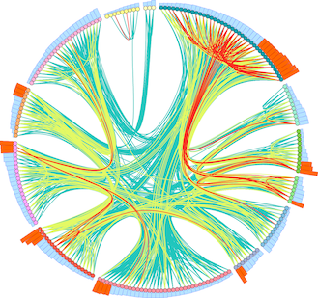


Thank you!
Dynamics and Neural Systems Lab
School of Physics
The University of Sydney
With support from:
Supervisor
Ben D. Fulcher
Collaborators
Trent Henderson
Oliver M. Cliff
The University of Sydney Physics Foundation
The American Australian Association Graduate Education Fund

