Slide 1
Integrating local and pairwise neural activity dynamics to study schizophrenia
Annie Bryant
Graphics to be made cooler

Slide 2
Quick background on schizophrenia BOLD fMRI

Slide 3
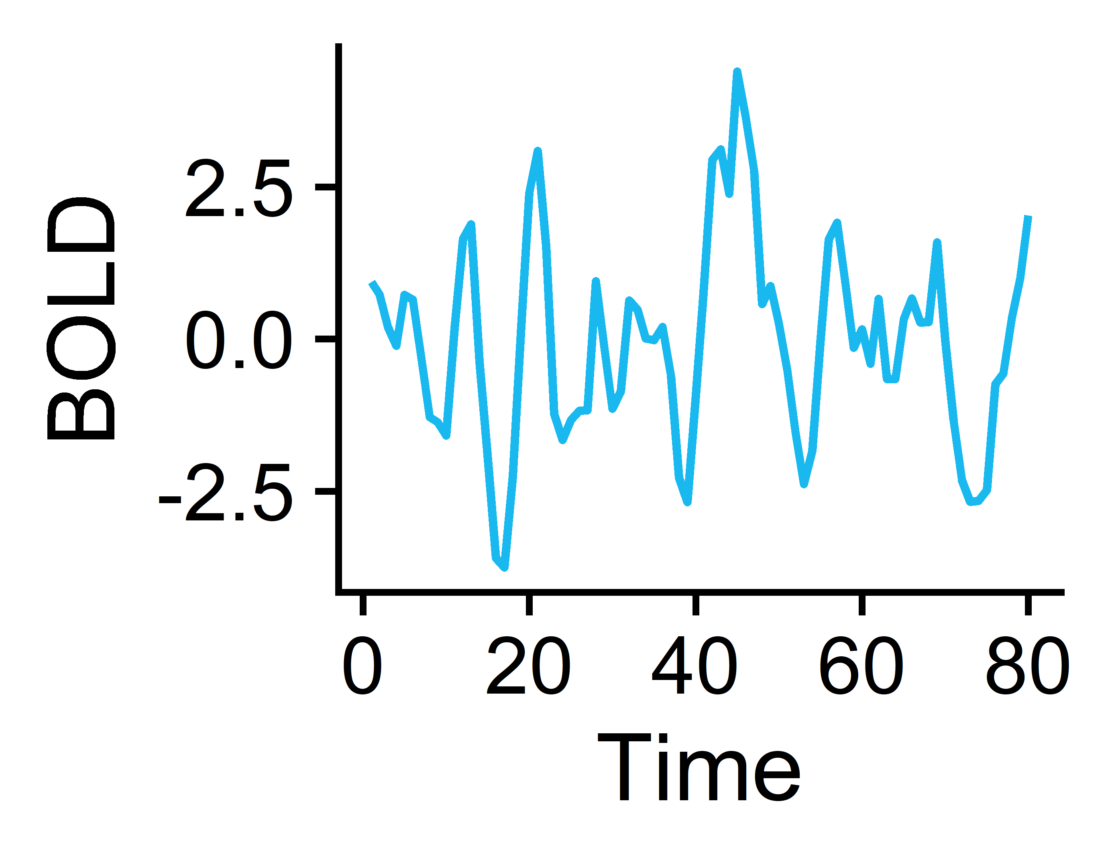

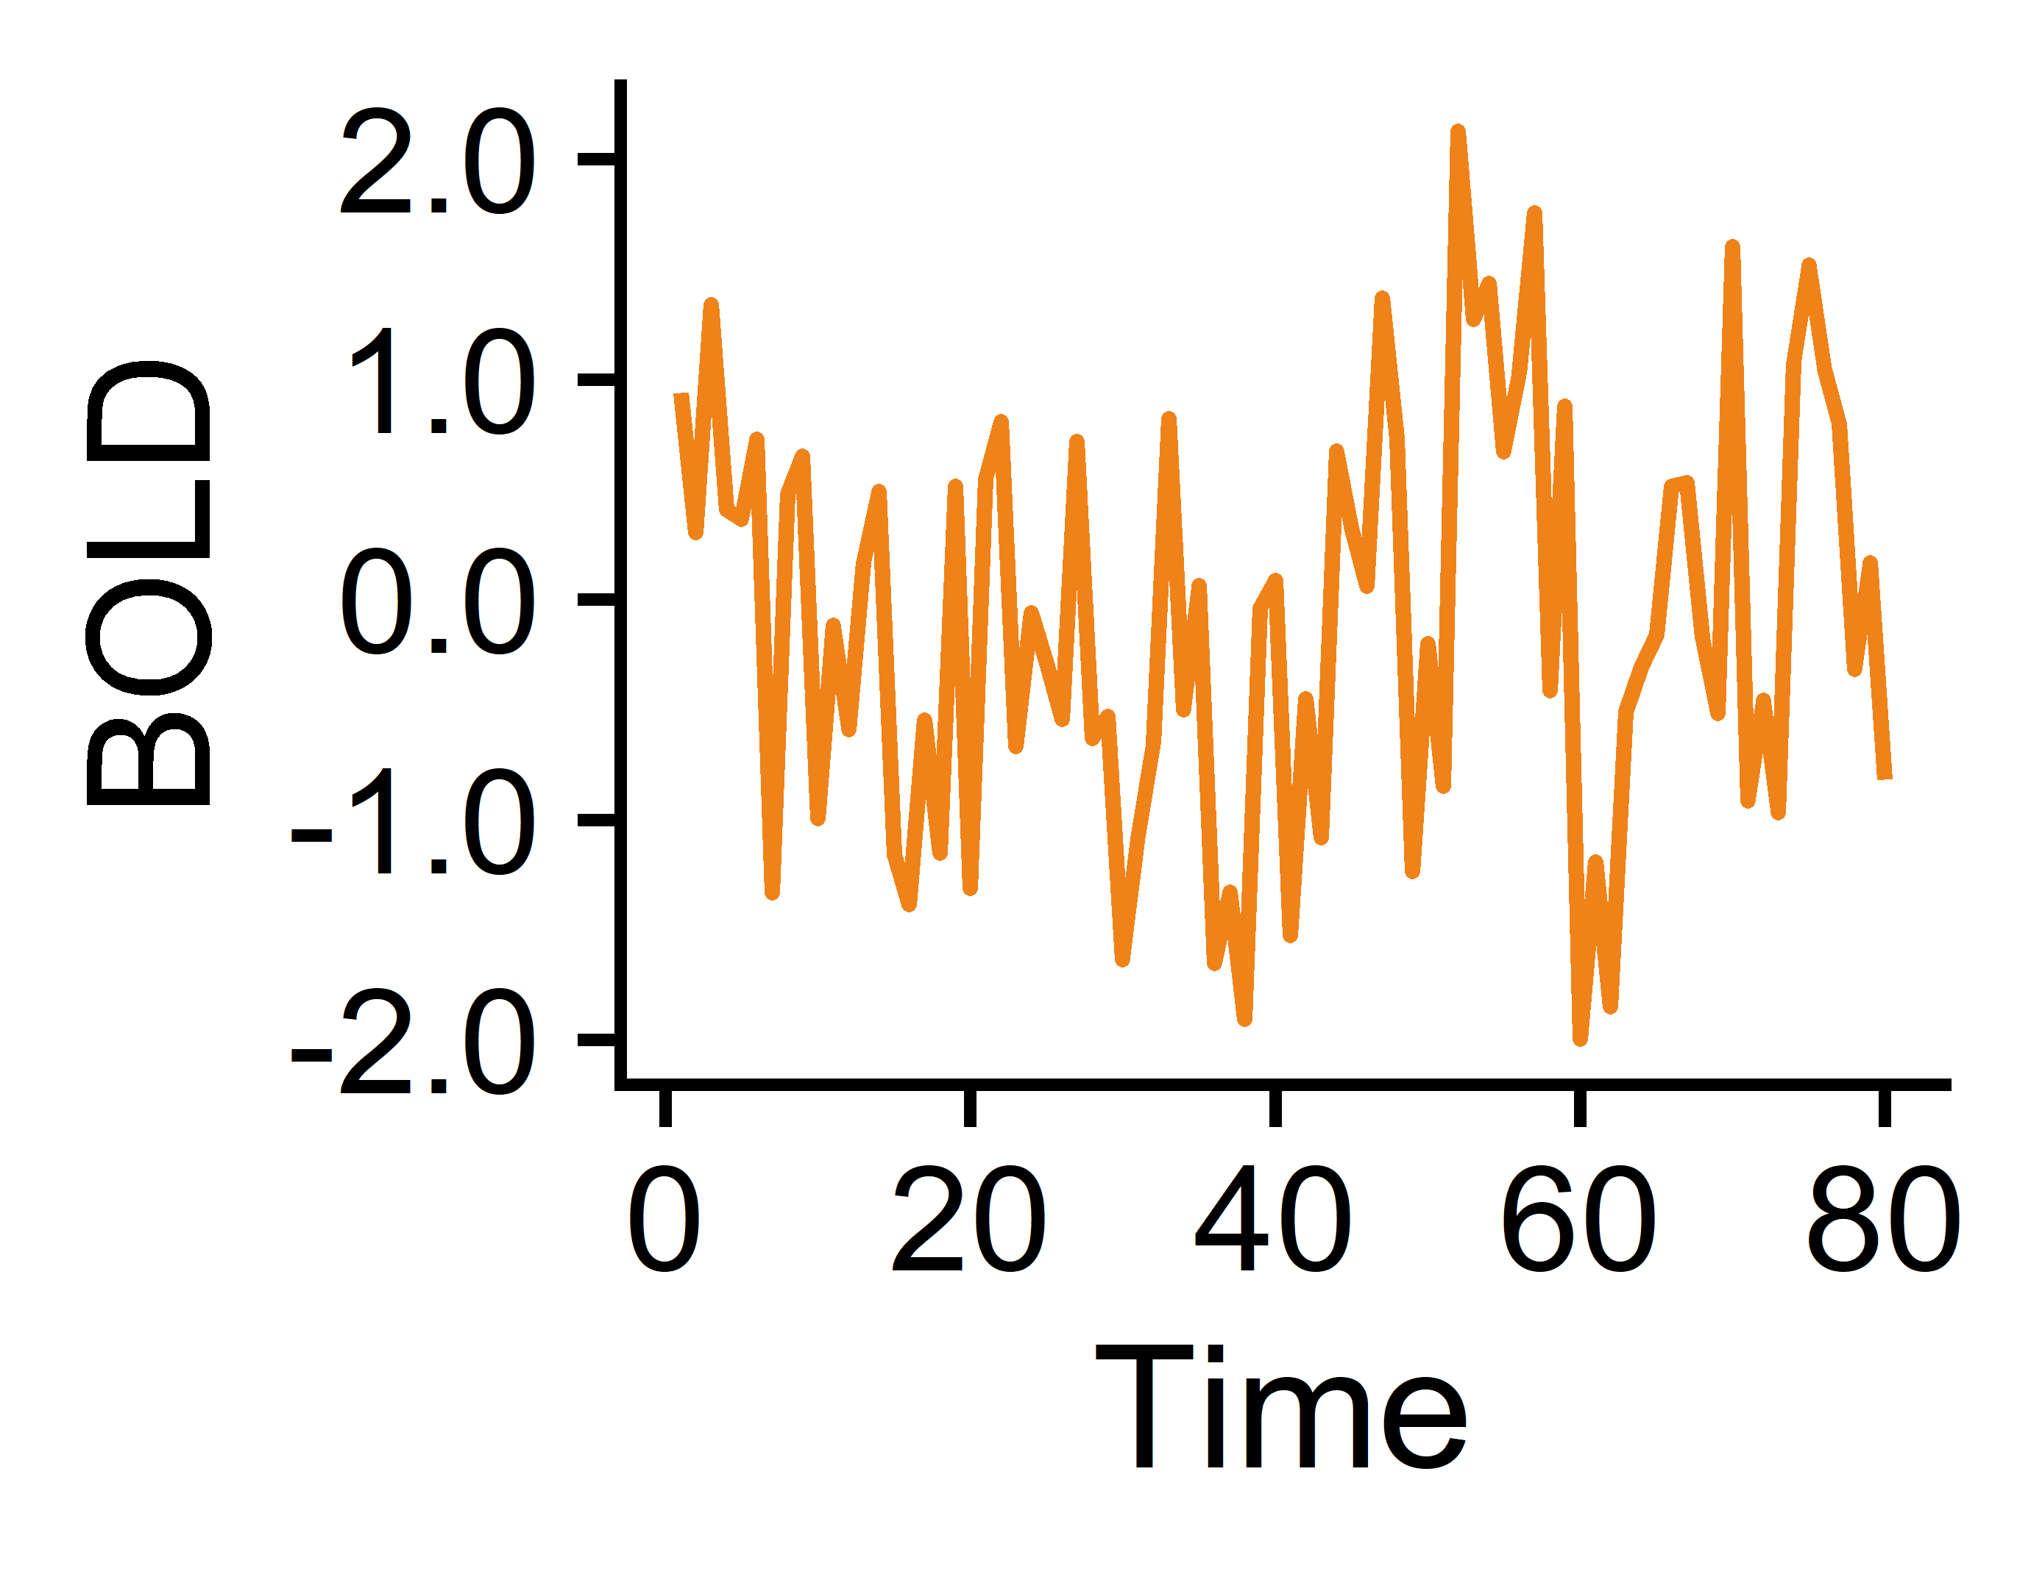
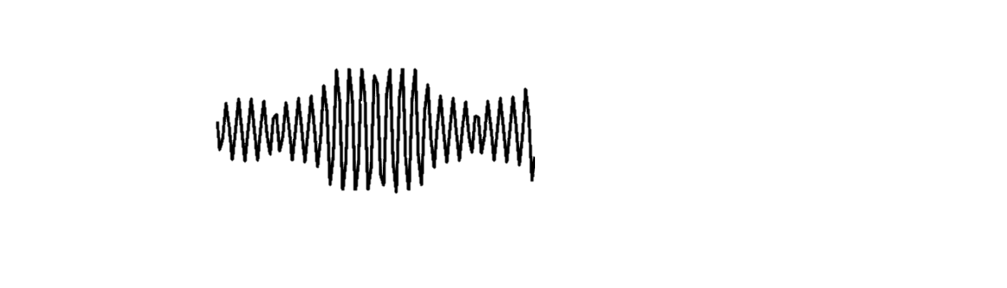
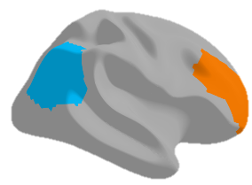
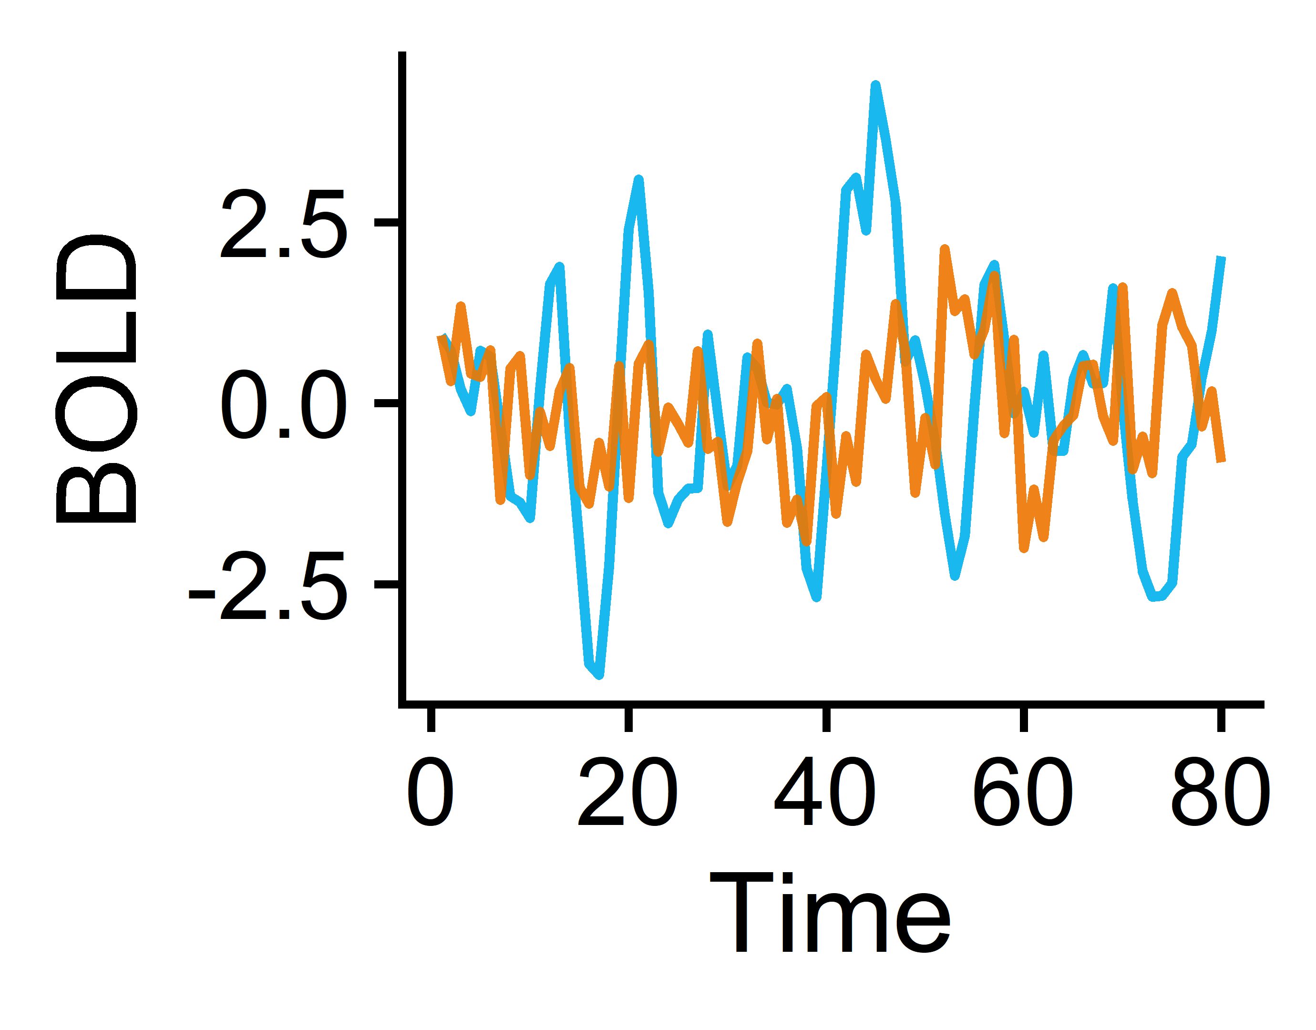
Extracting time-series features from BOLD fMRI
Brain
Regions 1-82
Extract univariate TS features from each region with theft² (R)
Subjects¹
Univariate features (22)
e.g. CO_HistogramAMI_even_2_5:
Nonlinear autocorrelation function with bins of 5 at lag τ = 2
N=118 Controls
Subjects (165)
Region pairs 1-6,632
e.g. cov_EmpiricalCovariance:
Pearson correlation coefficient between two regions across measured time points
Pairwise features (18)
N=47 with Schizophrenia
Extract pairwise TS features from each region pair with pyspi³ (python)
Measure BOLD temporal signals in 41 cortical + subcortical regions per hemisphere
Subjects (165)
¹Gorgolewski KJ et al. A Preprocessed consortium for Neuropsychiatric Phenomics dataset. (2017). ²Henderson T and Fulcher BD. ICDMW (2021). ³Cliff OM et al. arXiv (2022)

Slide 4
TS Features overview
Overview of catch22 – what do the features capture? List the ~6 groups of features
Overview of pySPI SPIs – what are the 19 that Oliver selected? What family of SPIs do they represent?

Slide 5
Classification method overview
Region-wise classification
Feature-wise classification
Combo-wise classification
Brain
Regions 1-82
Univariate TS features 1-22
Region 1
Region 2
Region 82
…
Univariate features (22)
Univariate features (22)
Brain regions (82)
Subjects (165)
Subjects (165)
Subjects (165)
Linear SVM by Brain Region
Linear SVM by Univariate TS feature
Linear SVM with all Region-by-Feature combinations (1,804)
Region 1
Region 2
Region 82
Feature 1
Feature 2
Feature 22
…
…
Goal: Identify which region(s) exhibit significantly different overall neural activity in participants with vs. without schizophrenia
Goal: Identify which univariate TS feature(s) exhibit globally altered properties in participants with vs. without schizophrenia
Goal: Identify which region(s) exhibit specifically altered individual activity dynamics in participants with vs. without schizophrenia
Note: to account for class imbalances, samples were weighted according to the inverse proportion of their class membership (Schizophrenia vs. Control) and balanced accuracy was used as the performance metric.

Slide 6
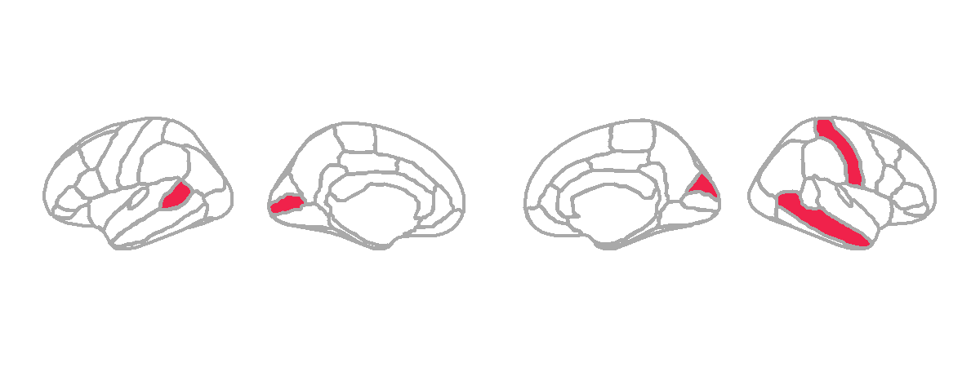
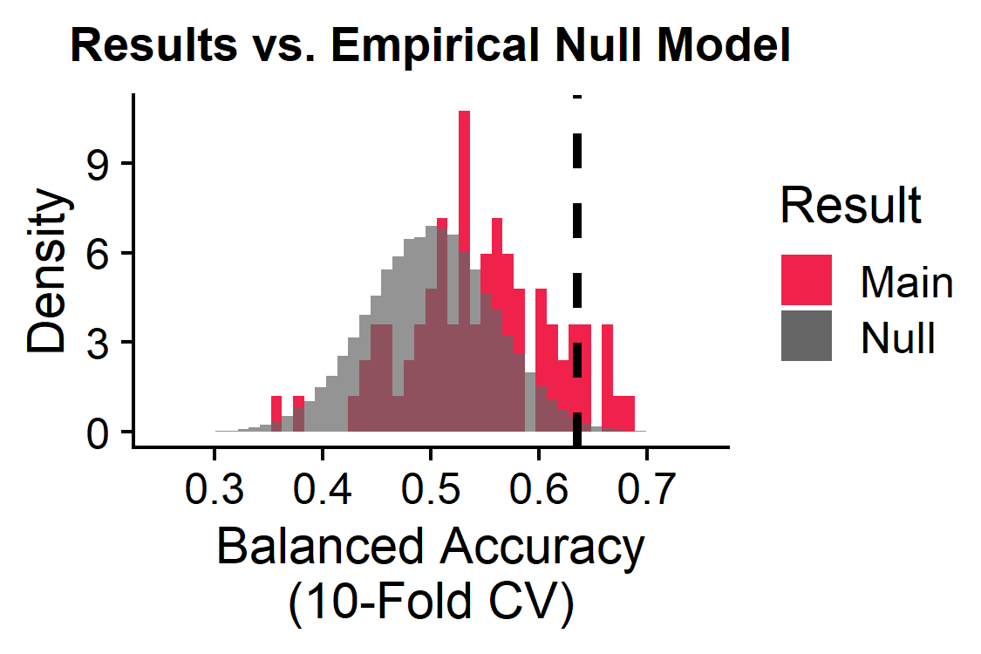
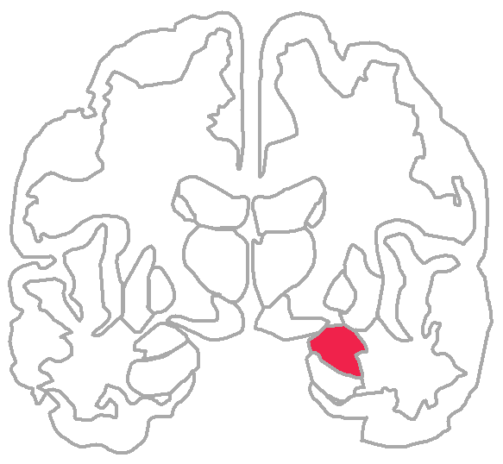
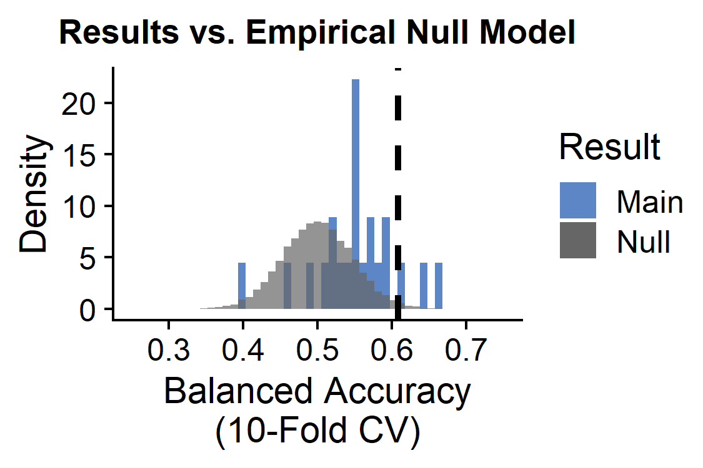
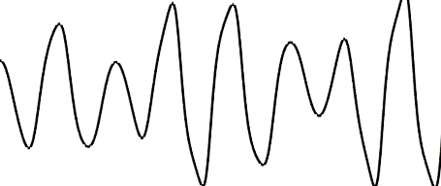
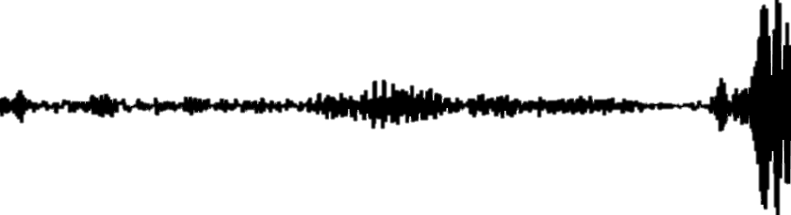
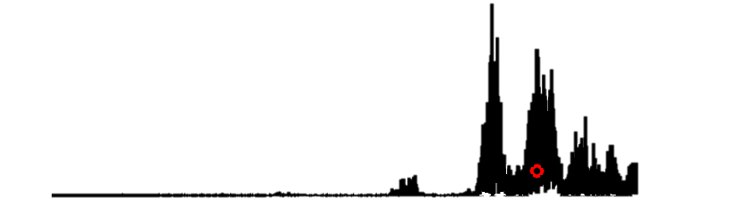
Classification performance using univariate TS features
Region-wise classification
Left
6/82 brain regions significant:
L banks of the superior temporal sulcus
L pericalcarine
R cuneus
R postcentral
R middle temporal
R amygdala
L
R
L
2
1
4
BH-adjusted p<0.05
3
6
Right
5
Feature-wise classification
3/22 univariate TS features significant:
CO_HistogramAMI_even_2_5
PD_PeriodicityWang_th0_01
SP_Summaries_welch_rect_centroid
TS
PSD
BH-adjusted p<0.05
Nonlinear autocorrelation function with bins of 5 at lag τ = 2
Periodicity measure that is higher with slow-varying time series
Centroid of the Welch-estimated power spectral density (PSD)
Notes:
Banks STS in schizophrenia: https://www.frontiersin.org/articles/10.3389/fpsyg.2018.00578/full, https://pubmed.ncbi.nlm.nih.gov/23956120/

Slide 7
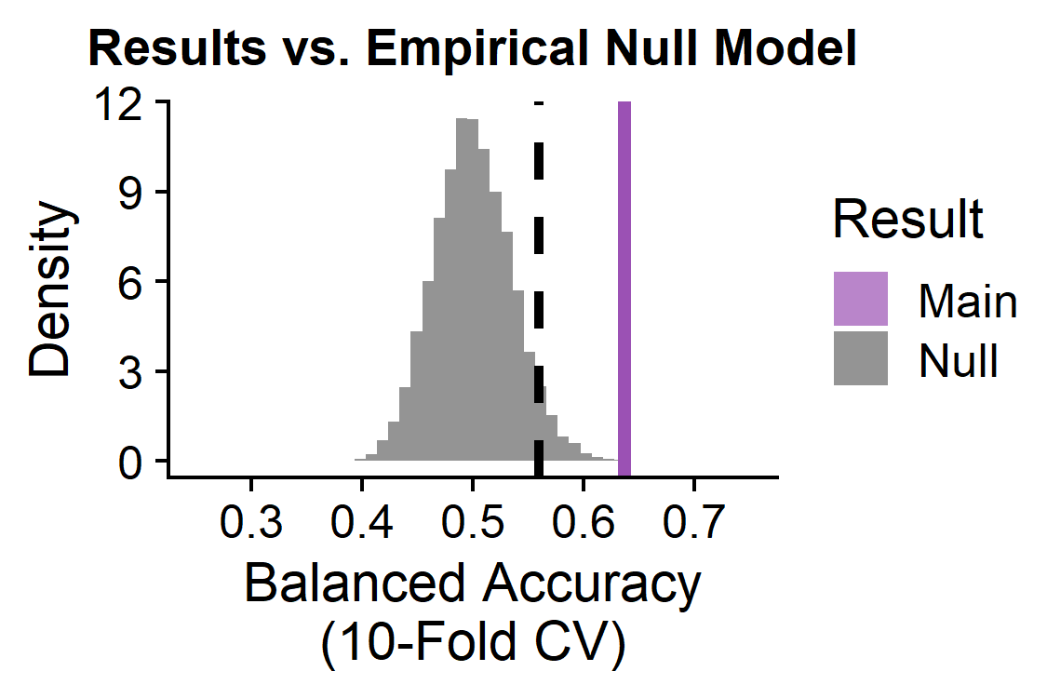
Combo-wise linear SVM results
Sparse SVM
The combination of all univariate TS features X brain regions as inputs to linear SVM classifier yields a balanced accuracy of 63.67% (p<0.0001)
Random forest

Slide 8
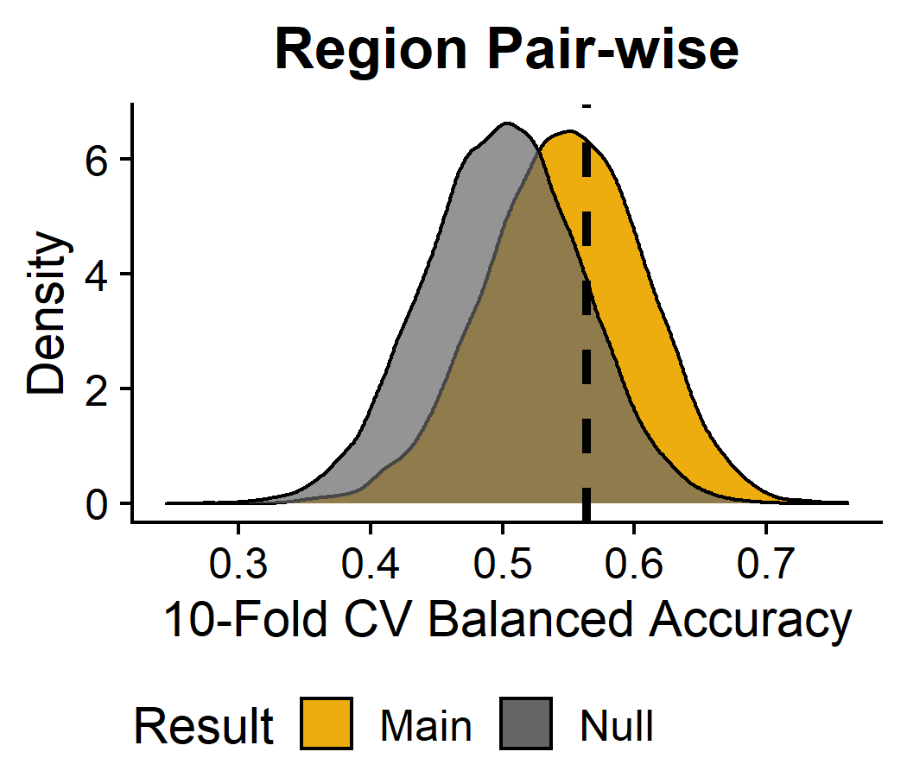
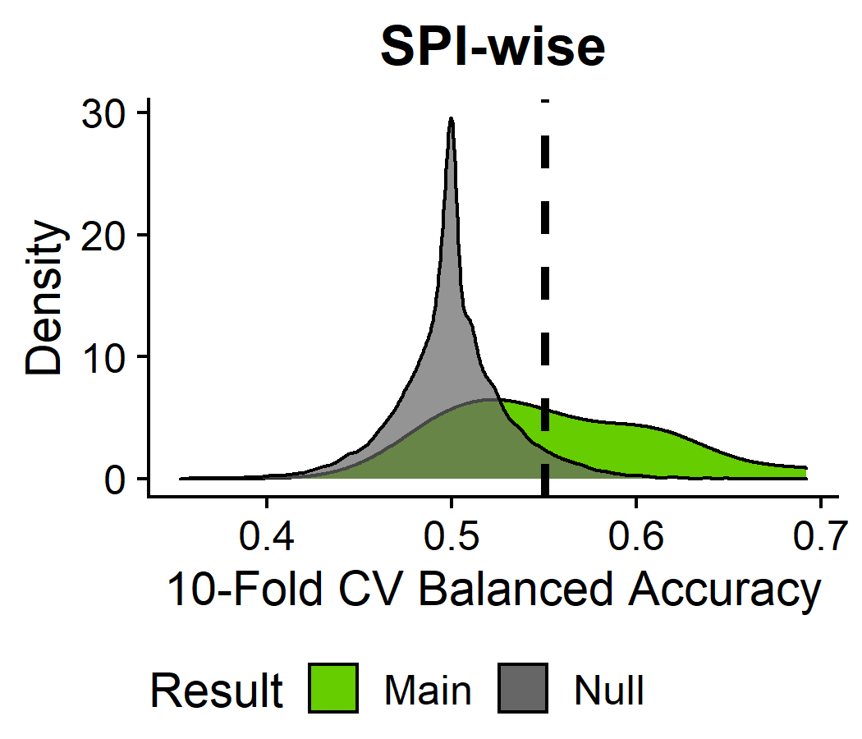
Pairwise performance
Insert graphic on the significant ROI pairs maybe?
Insert graphic on the significant SPIs here – what properties of time-series do they capture? Is there a natural clustering of the significant SPIs? Compare standard benchmark of Pearson correlation coefficients

Slide 9
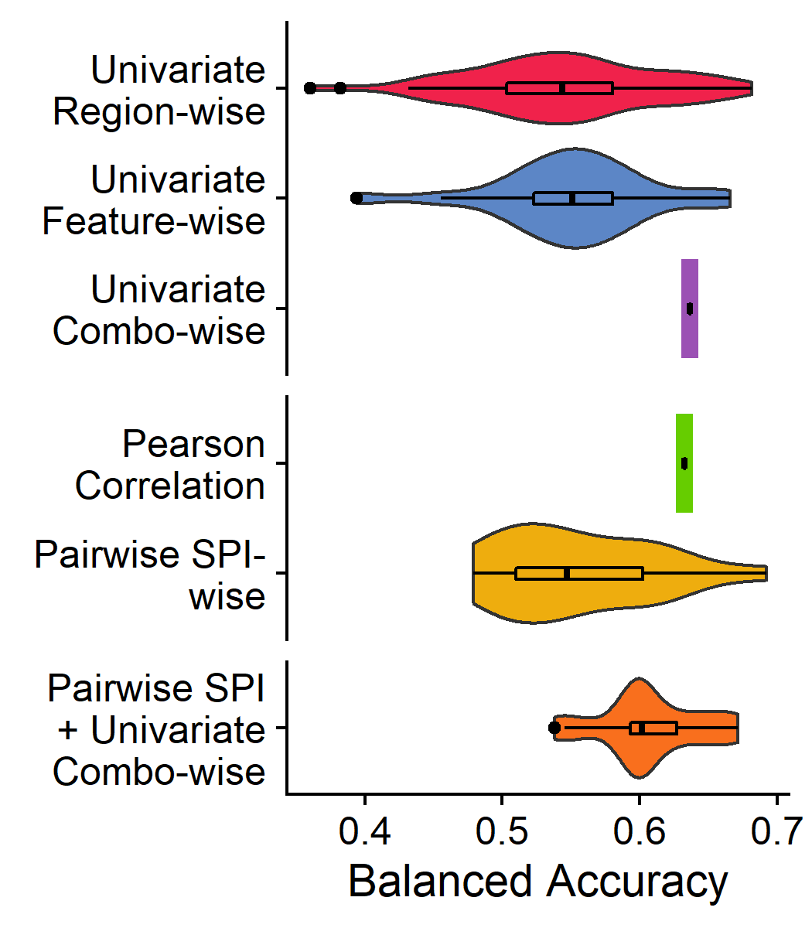
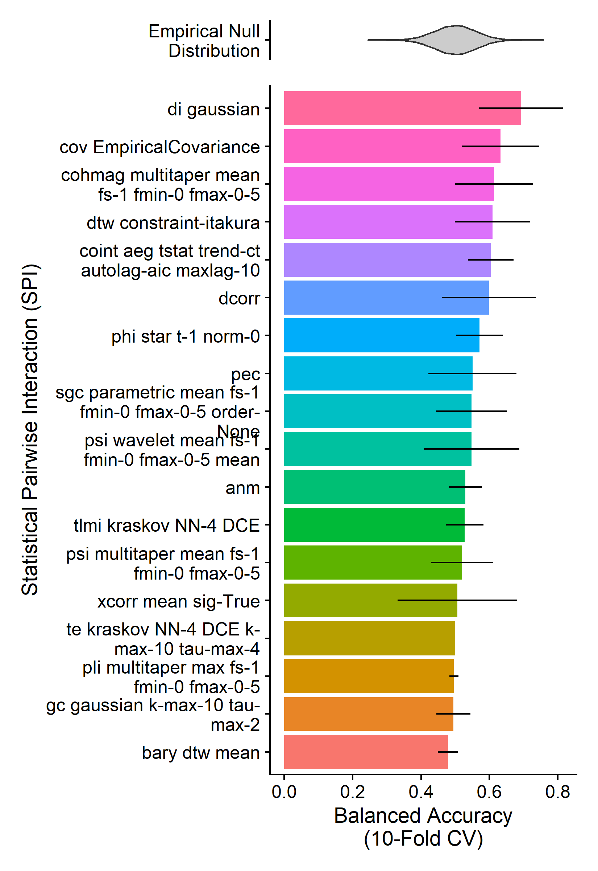
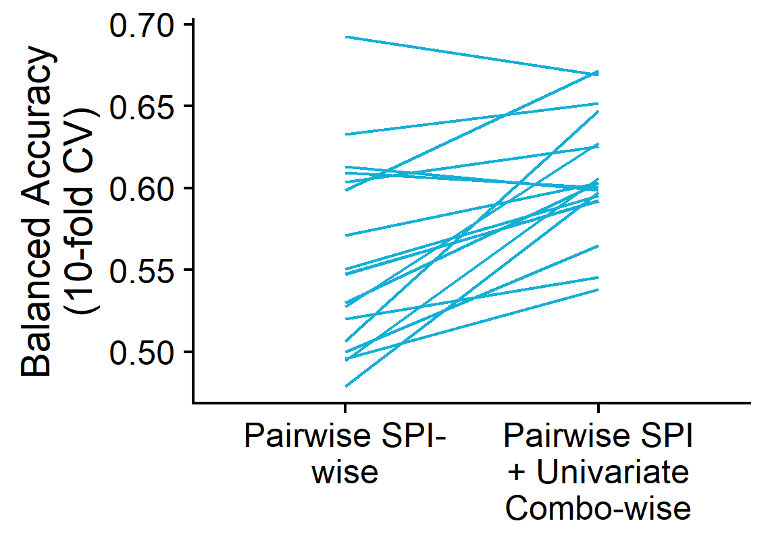
Pairwise performance
Poss add dotted vertical line indicating threshold for BH-adjusted significance?

Slide 10
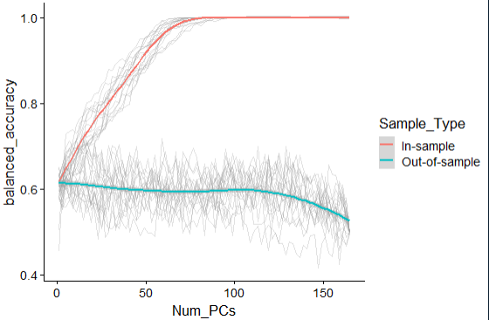
Addressing overfitting in high-dimensional space
~85 PCs sufficient to hit 100% in-sample balanced accuracy
Important question: these balanced accuracy values are still all lower than the final balanced accuracy values from the full results?
When the full set of PCs is used, there is a dropoff in out-of-sample balanced accuracy

Slide 11


Thank you! + Selected References

