Slide 1


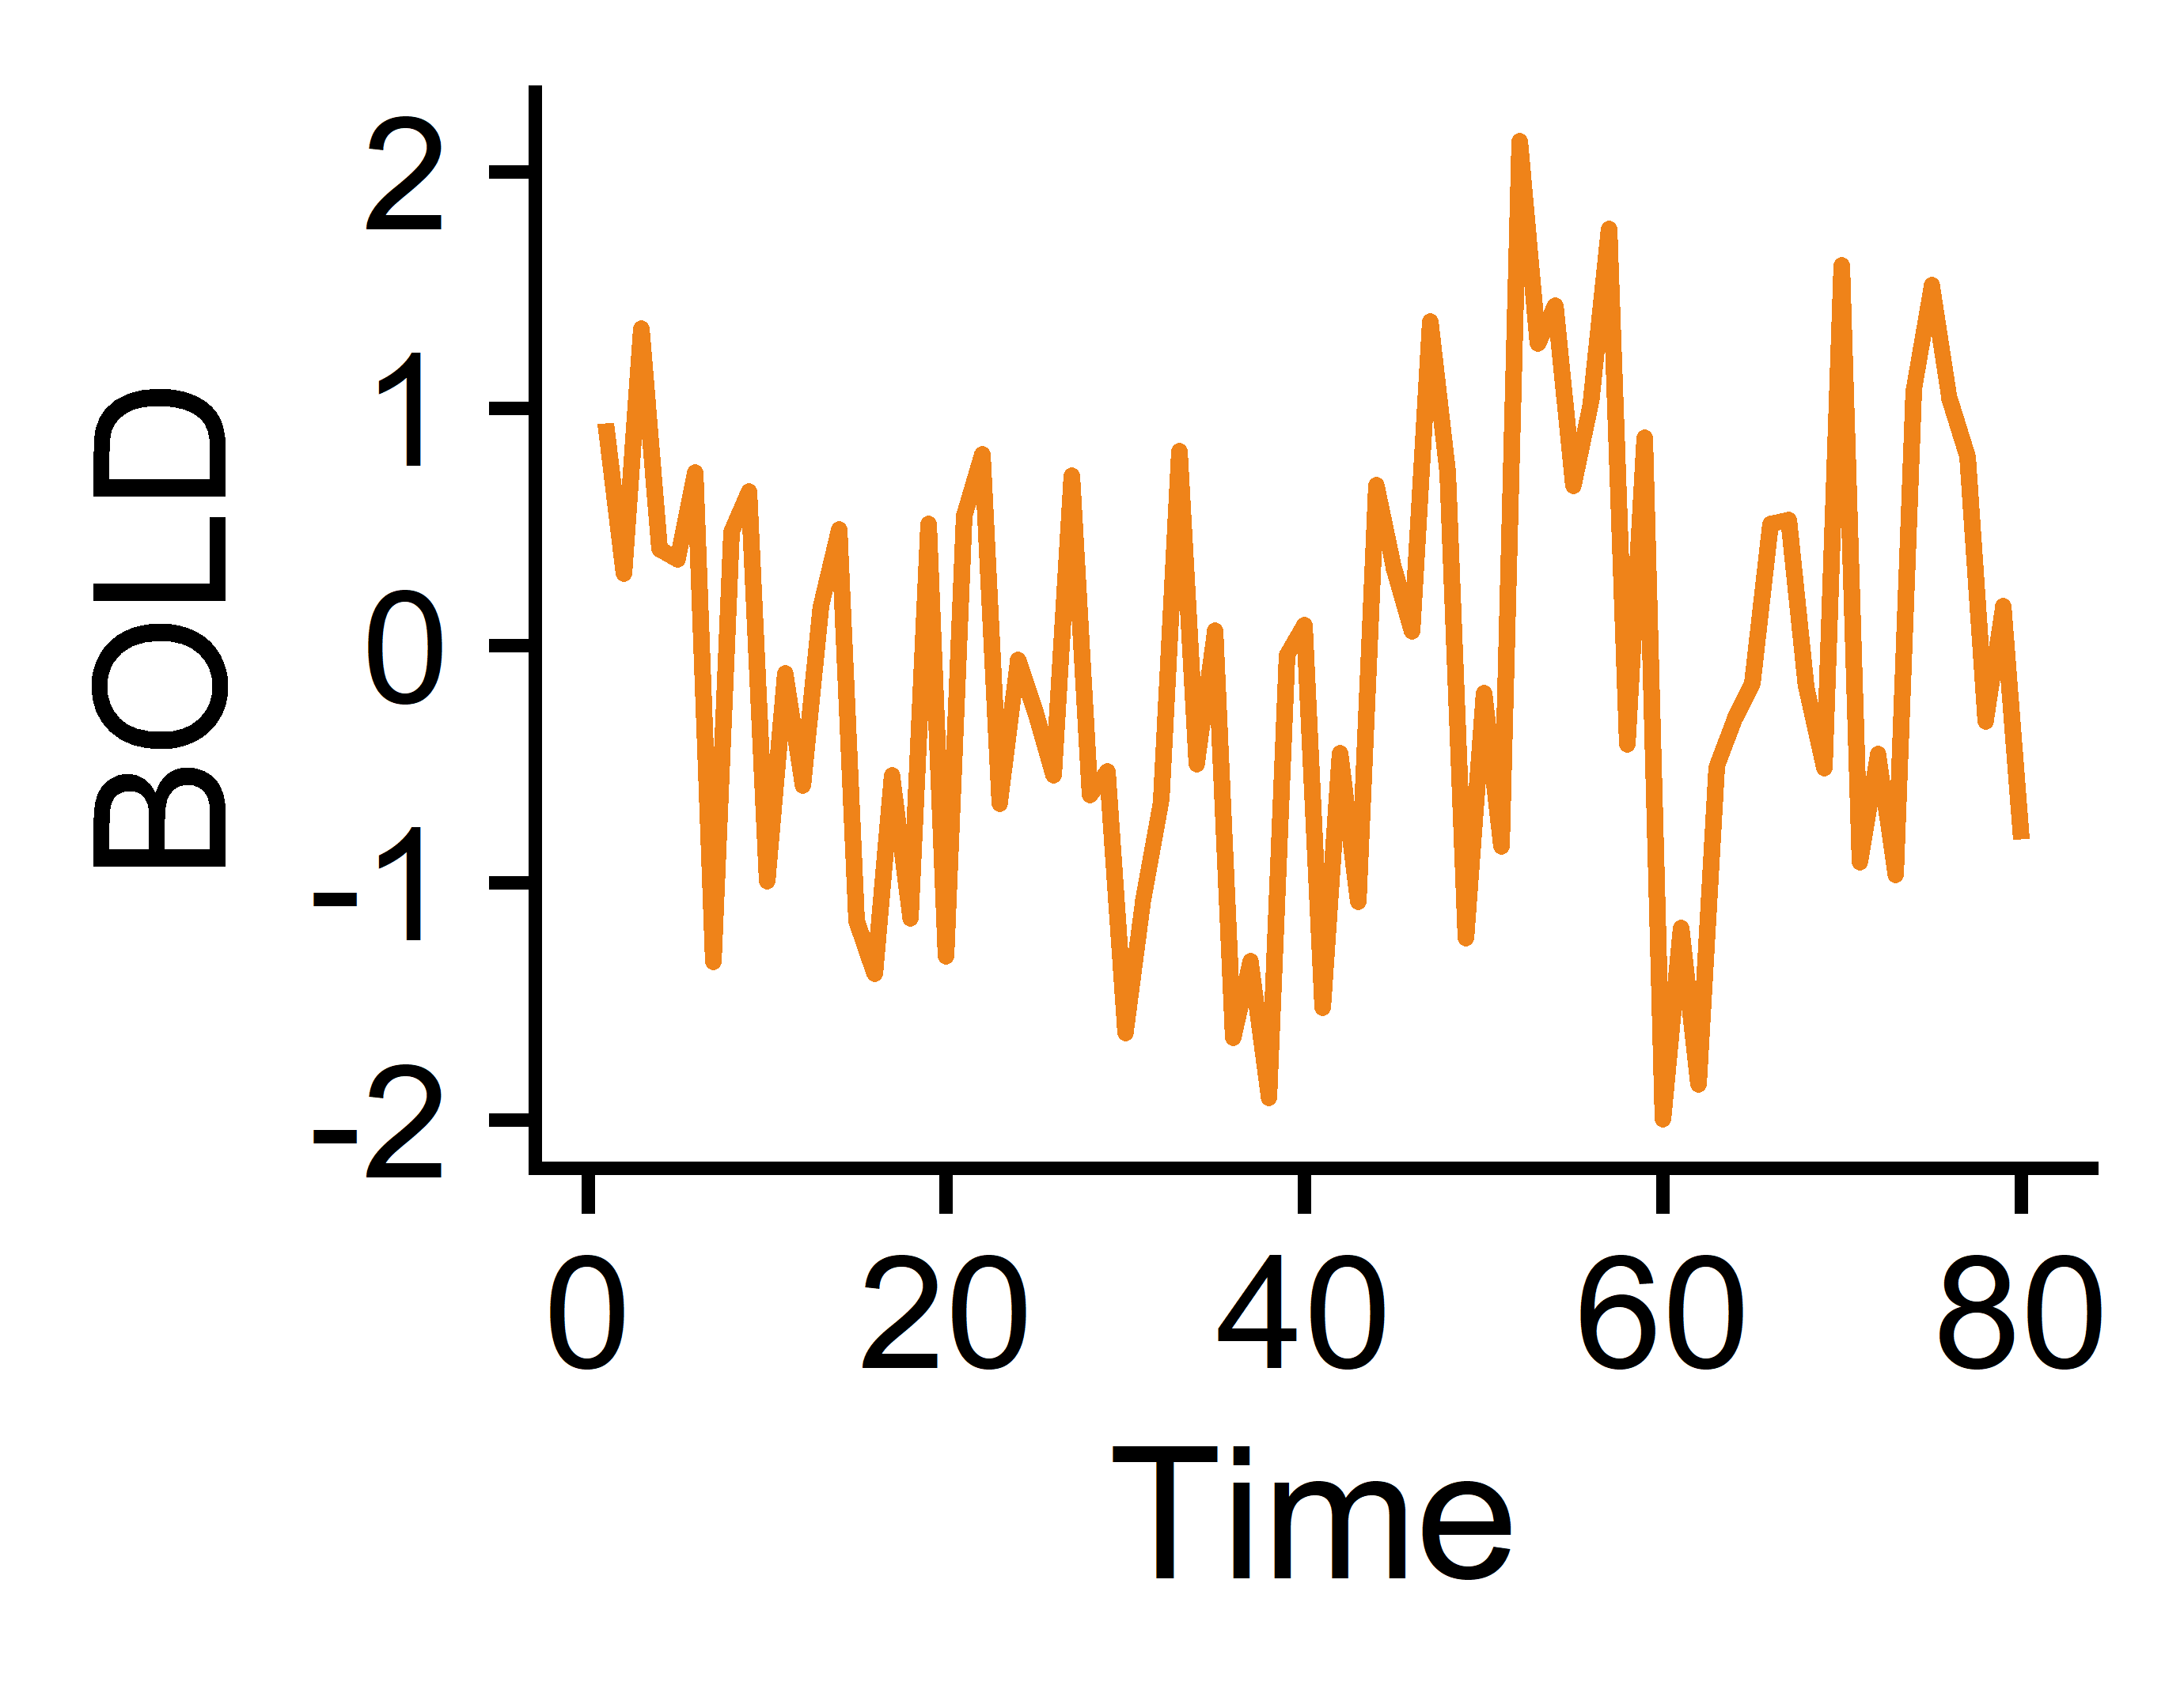


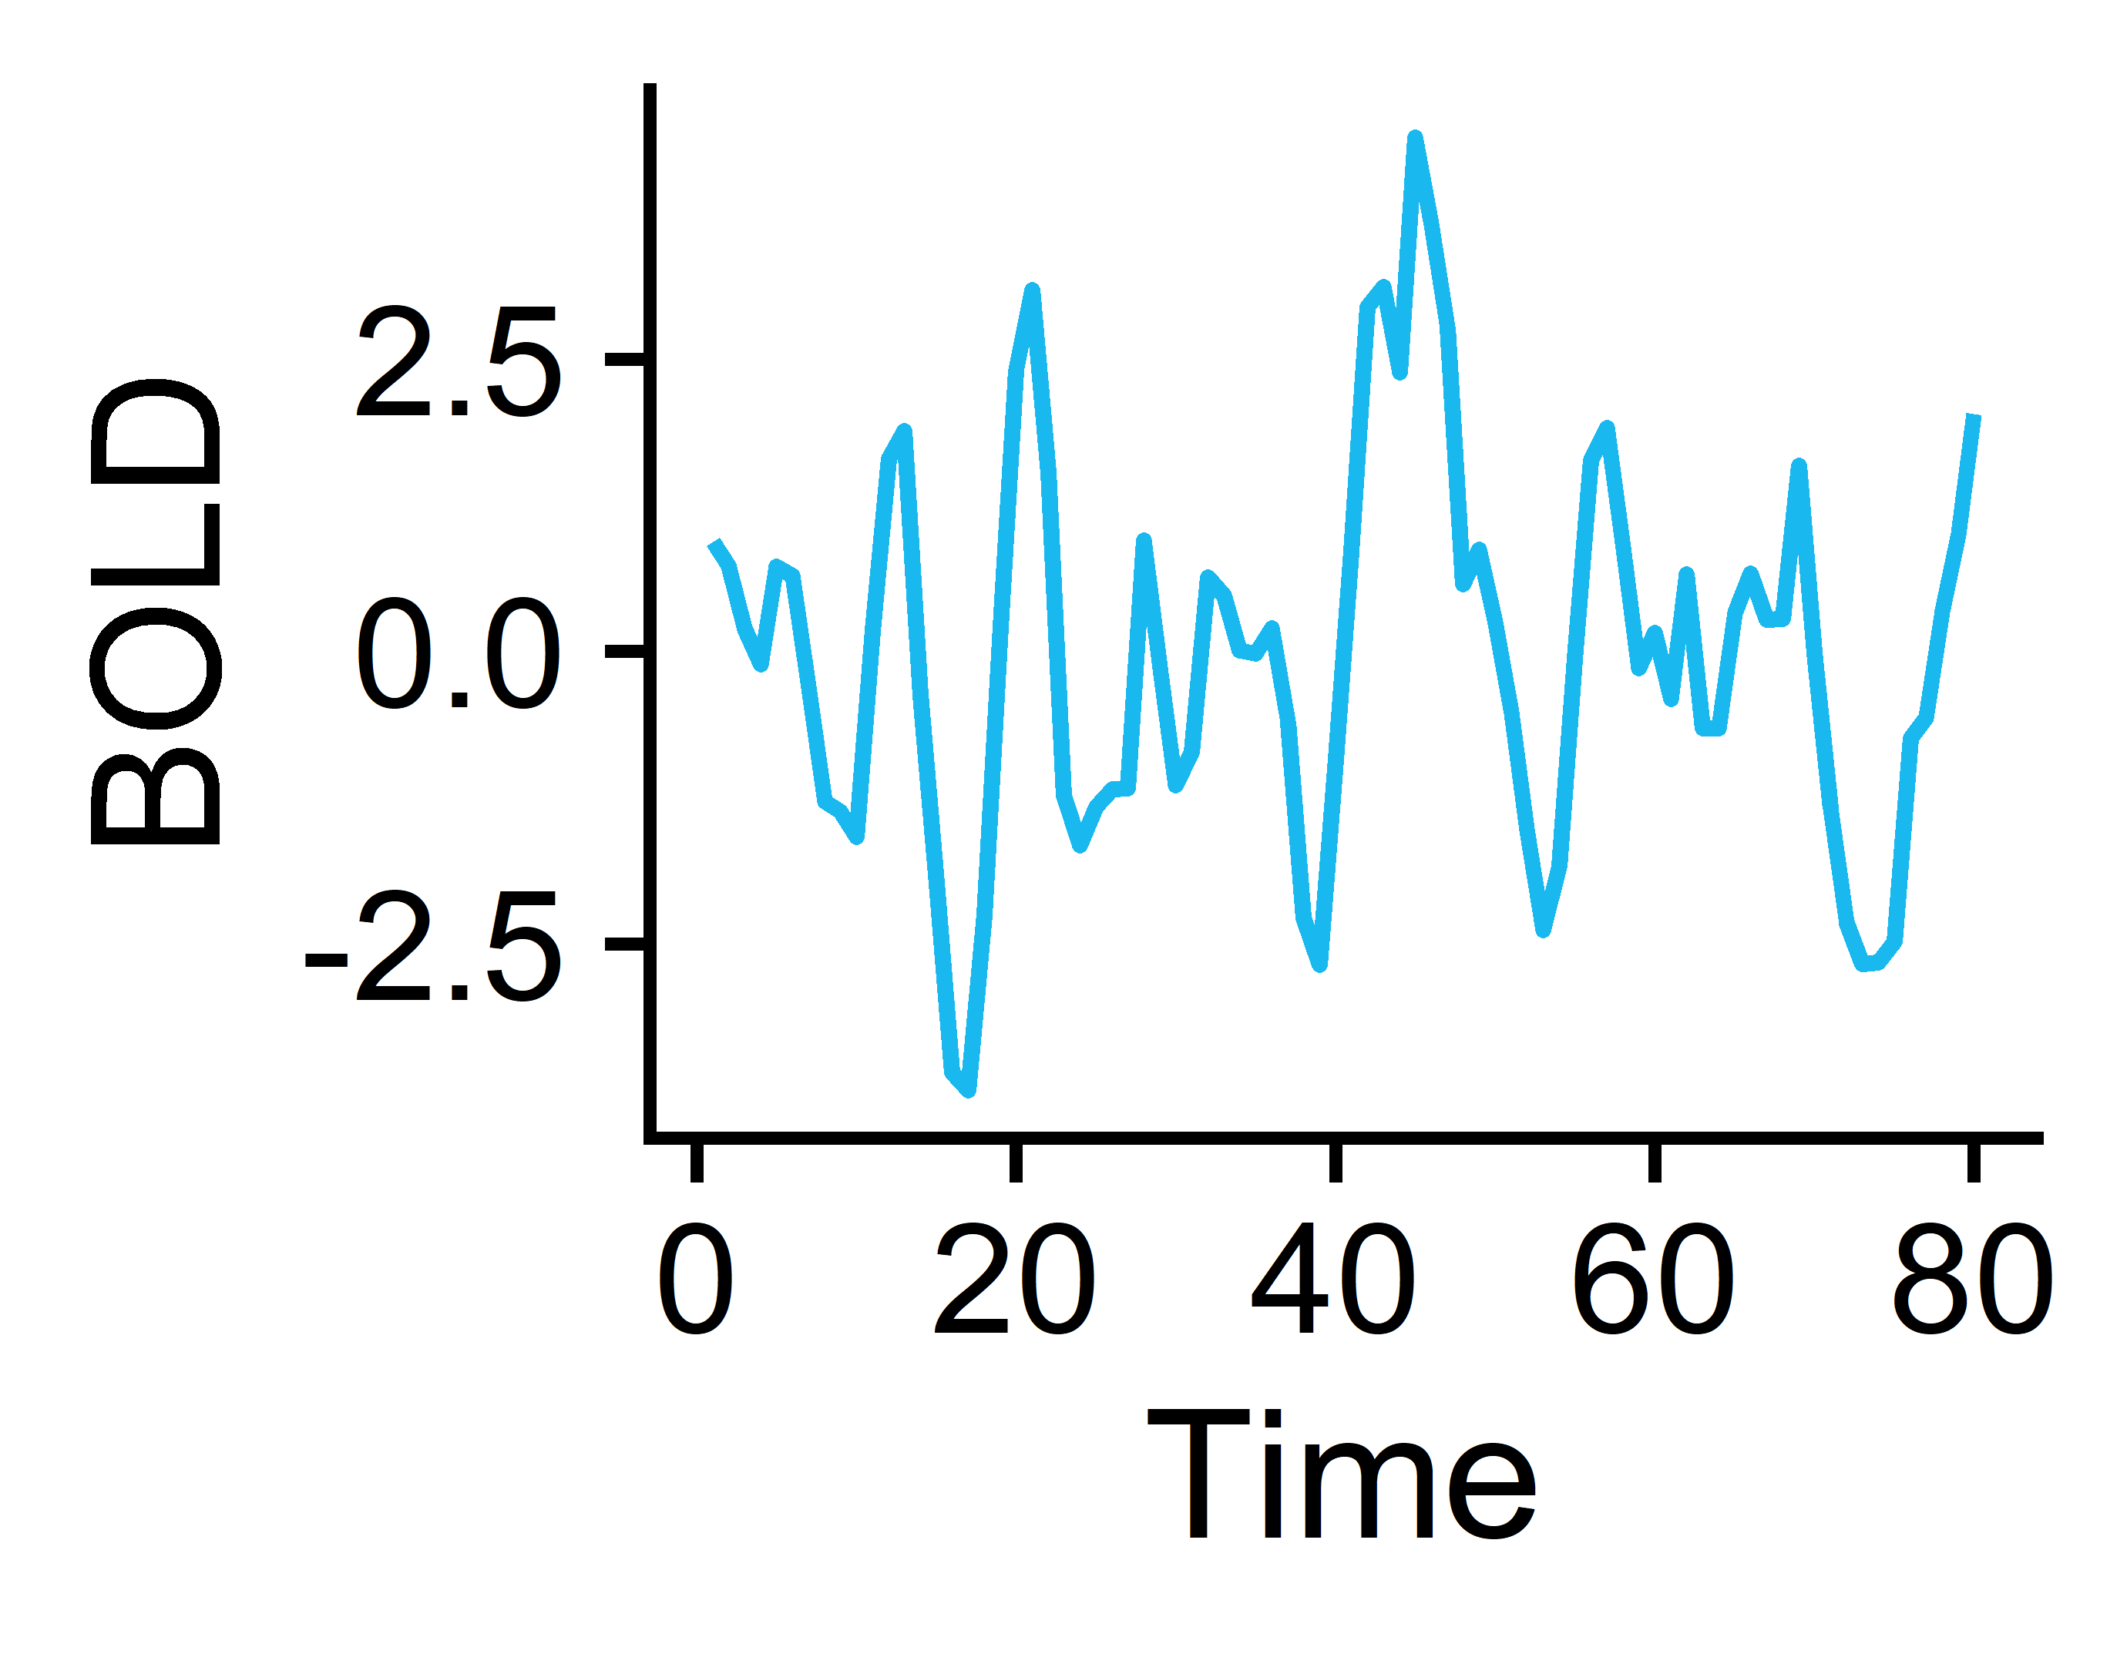

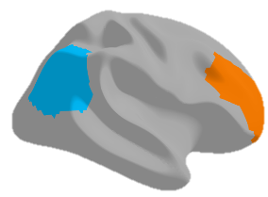
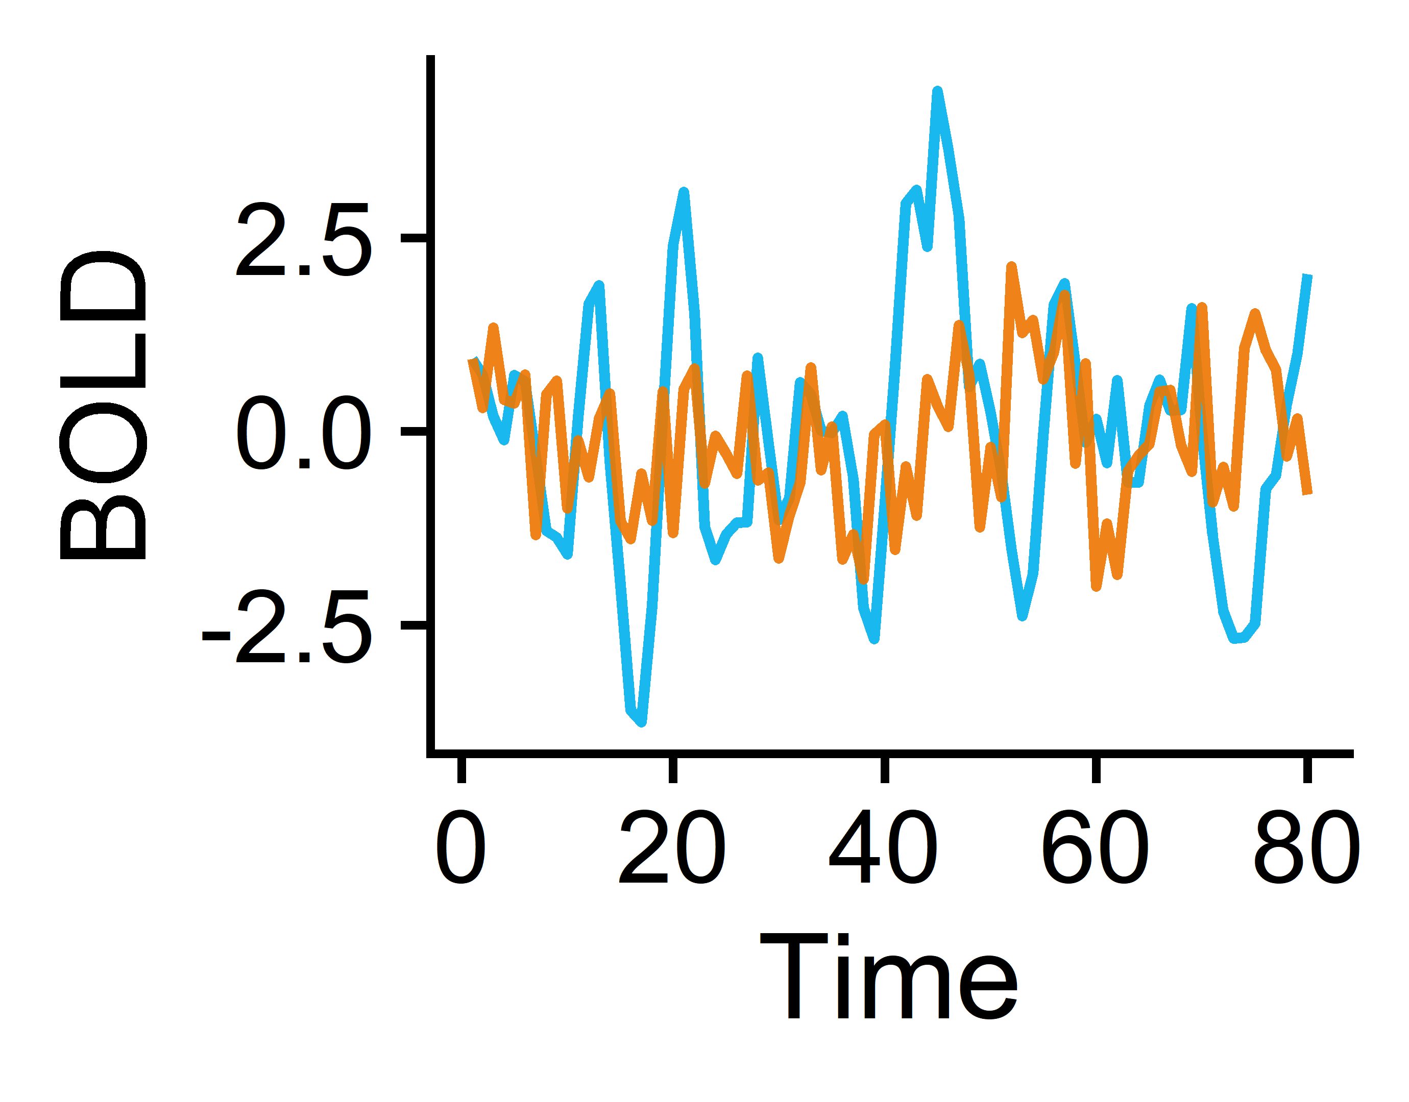
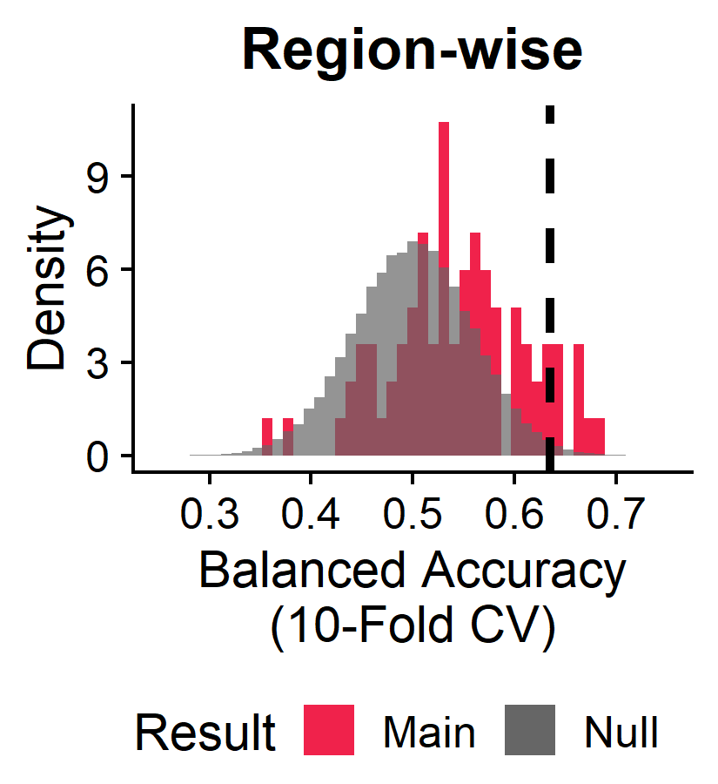
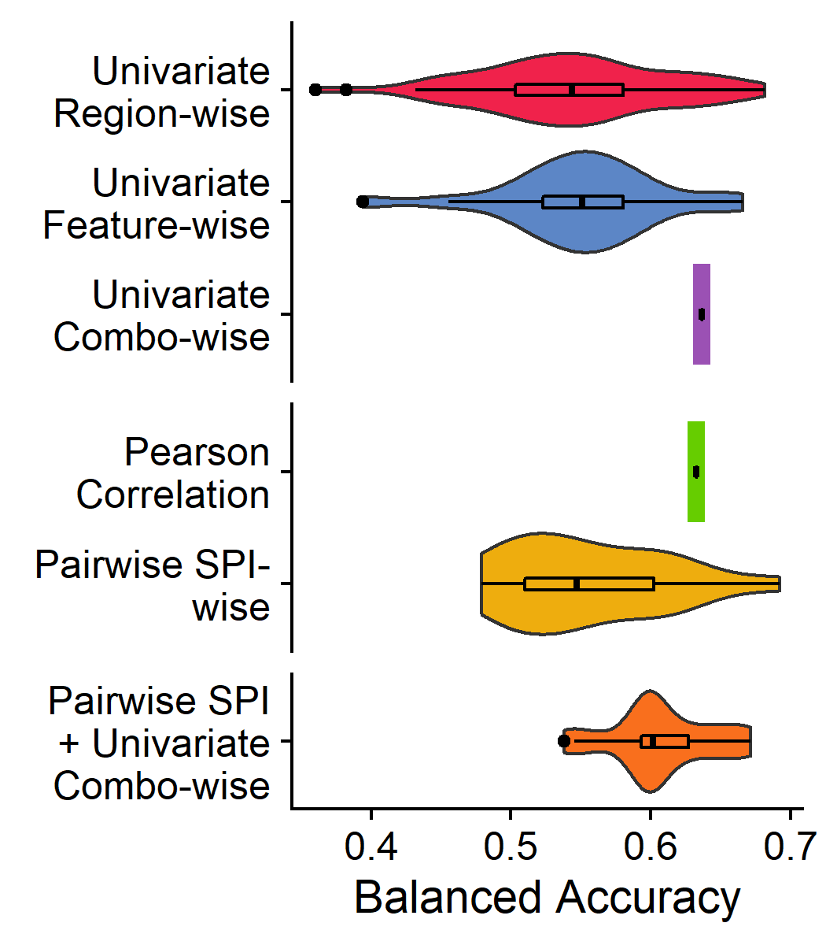
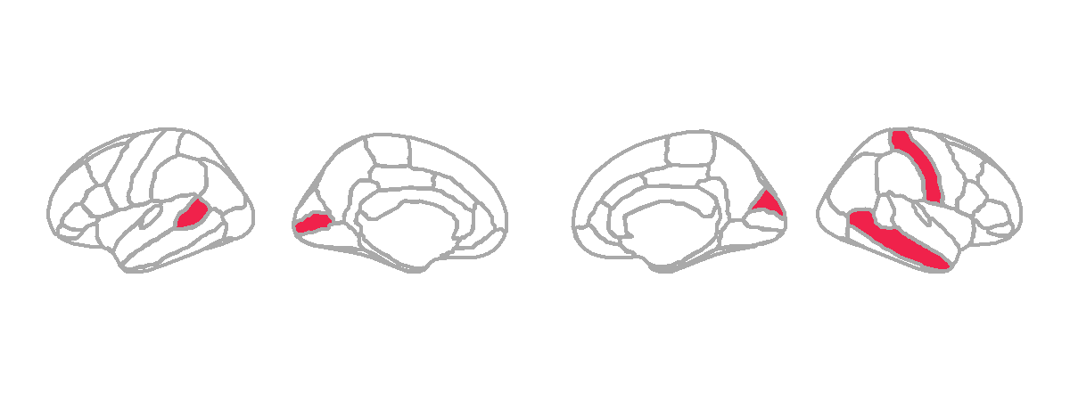
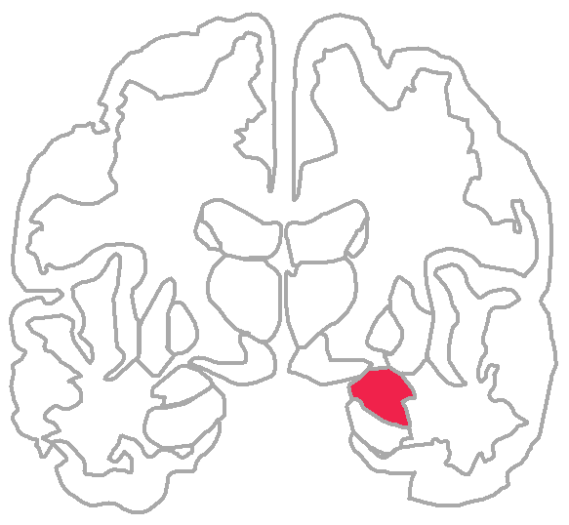
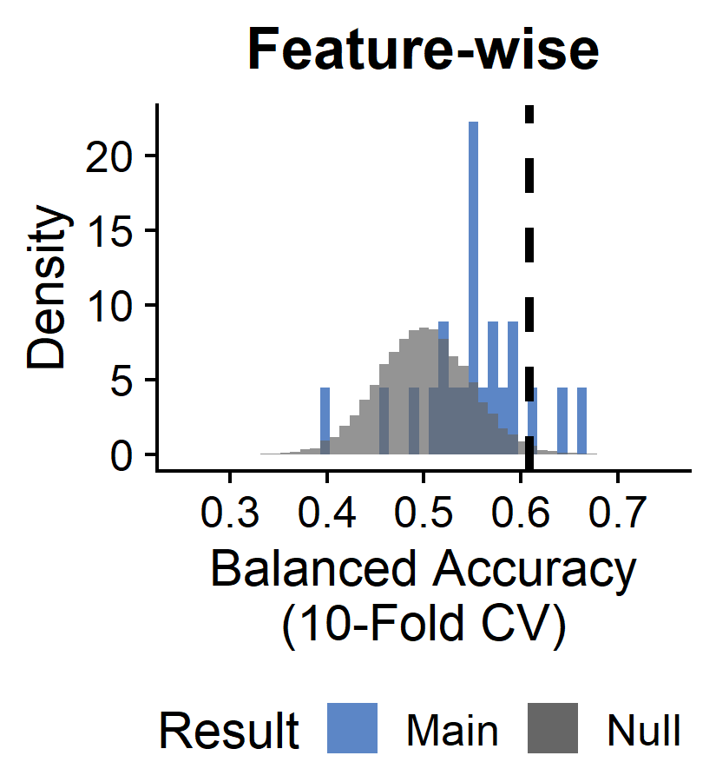
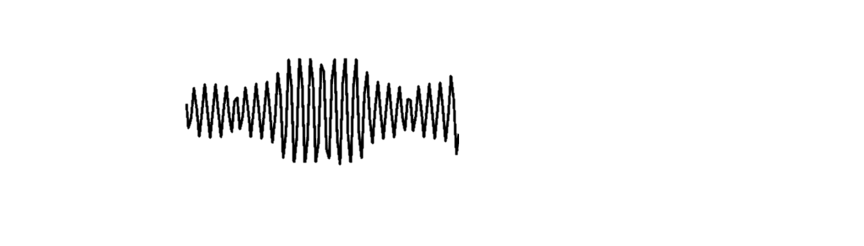
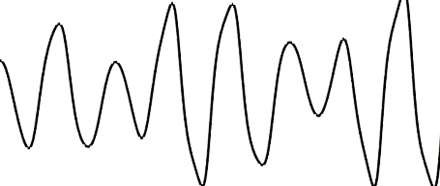
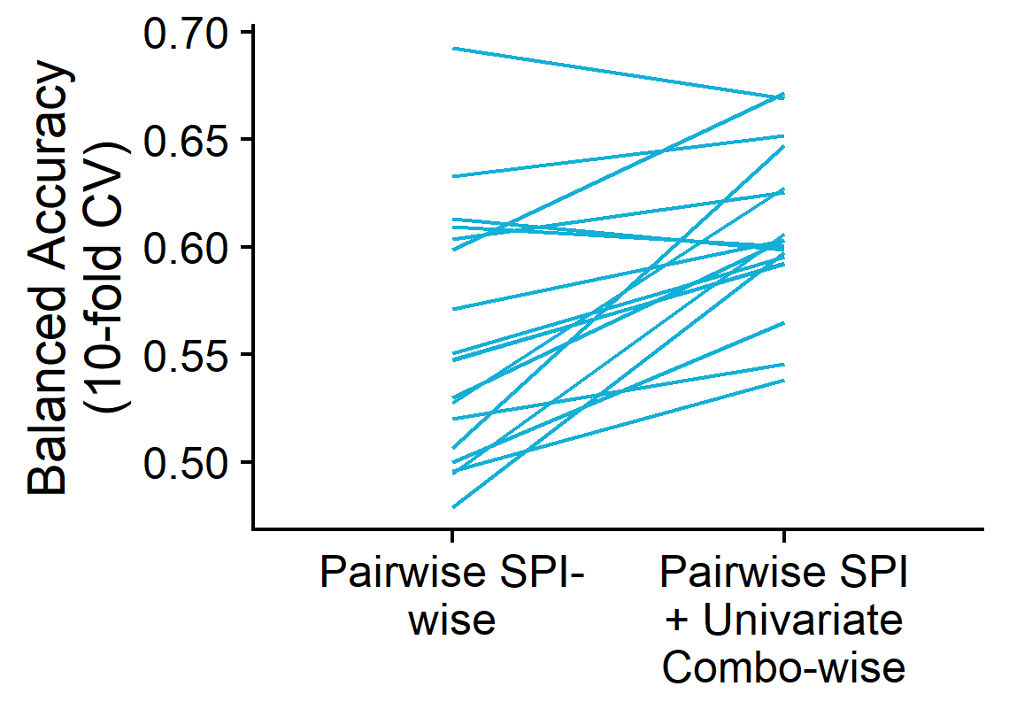
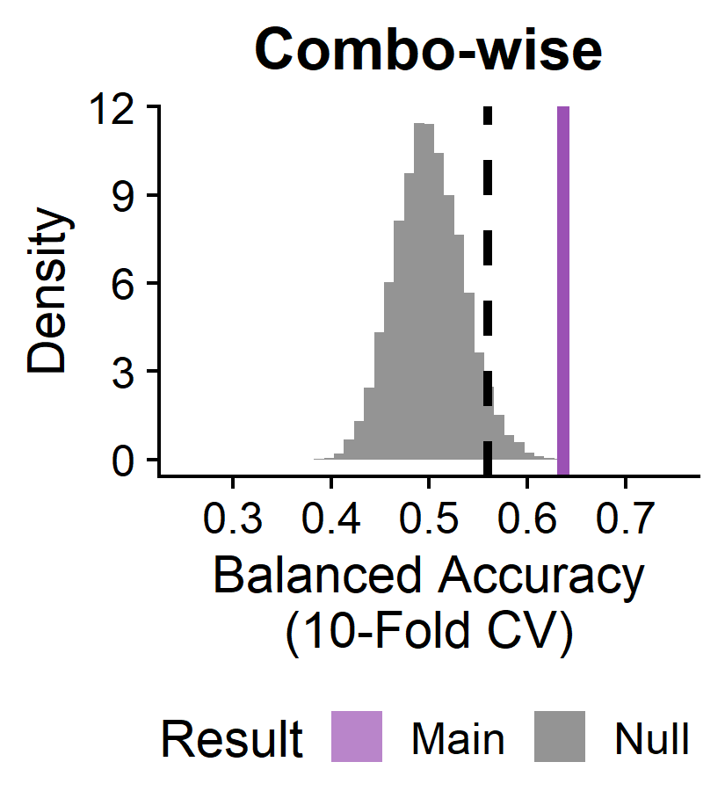
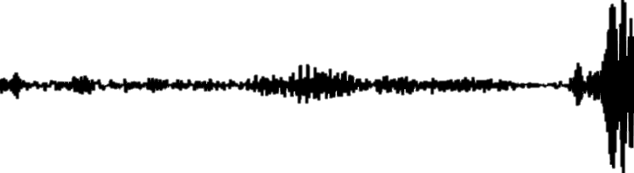
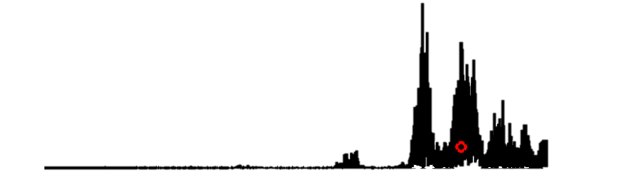


Characterizing schizophrenia neural dynamics using univariate time-series feature analysis
Annie Bryant¹, Kevin Aquino¹, Linden Parkes², Trent Henderson¹, Preethom Pal¹, Adithya Vignaraja¹, Alex Fornito², Ben Fulcher¹
¹School of Physics, The University of Sydney, Camperdown, NSW 2006; ²The Turner Institute for Brain and Mental Health, School of Psychological Sciences, Monash University, Clayton, VIC 3800
Background
Methods: Extracting TS Features from BOLD fMRI
Functional magnetic resonance imaging (fMRI) is often used to interrogate differential neural activity in diverse neurological diseases like schizophrenia. Blood oxygen level dependent (BOLD) fMRI time-series data can be combined with graph-based functional connectivity metrics and/or machine learning methods to classify patients from controls with high accuracy¹. However, such approaches generally miss region-specific local dynamics and lack biologically interpretable insights due to their black-box nature.
Here, we present the first comprehensive analysis of univariate and pairwise time-series (TS) features derived from fMRI signals in the brains of participants with and without schizophrenia. Using a simple linear support vector machine classifier, we demonstrate the benefit of integrating local and pairwise temporal properties to elucidate underlying differences in regional neural activity in schizophrenia.
Subjects²
Extract 22 univariate TS features^{3,4}
Feature vectors
N=118 Controls
Use TS features as inputs to linear SVM classifier
Extract 19 pairwise TS features⁵
Feature vector
N=47 with Schizophrenia
Measure BOLD temporal signal in each region
Results
Data partitioned for linear support vector machine (SVM)
Balanced accuracies compared against null model distributions
Evaluate statistically significant results
Compare classification performance in univariate vs. pairwise TS features
Brain Regions (82)
6/82 brain regions: (1) L banks of the superior temporal sulcus, (2) L pericalcarine, (3) R cuneus, (4) R postcentral, (5) R middle temporal, (6) R amygdala
Left
L
R
Subjects (165)
1
2
L
Right
3
4
6
TS features (22)
BH-adjusted p<0.05
5
Univariate TS features (22)
3/22 univariate time-series features:
CO_HistogramAMI_even_2_5
Nonlinear autocorrelation function with bins of 5 at lag τ = 2
Subjects (165)
Pairwise features benefit from regional univariate data
PD_PeriodicityWang_th0_01
Periodicity measure that is higher with slow-varying time series
Brain regions (82)
BH-adjusted p<0.05
SP_Summaries_welch_rect_centroid
Subjects (165)
TS
Centroid of the Welch-estimated power spectral density (PSD)
PSD
Linear SVM with each statistical pairwise interaction (SPI) with or without the addition of univariate combo-wise data, shows that adding the univariate regional data almost always improves balanced accuracy (mean +5.06%).
All TS features X Brain Regions (1,804)
Combination of all time-series features X brain regions as inputs to linear SVM classifier yields a statistically significant balanced accuracy of 63.67% (p<0.0001)
p<0.05
Conclusions
Key Takeaways
This analysis highlighted both individual brain regions and univariate TS features derived from BOLD fMRI that distinguish participants with versus without schizophrenia. Pairwise TS features, such as the commonly-used Pearson correlation coefficient, showed improved linear SVM classification performance with the inclusion of univariate TS feature information.
Systematically quantifying univariate TS features presents a promising method for understanding how the dynamics of individual brain regions contribute to disrupted network activity in neurological disease.
Selected References
Acknowledgements
1. Quaak M et al. NeuroImage Clin (2021)
2. Gorgolewski KJ et al. A Preprocessed consortium for Neuropsychiatric Phenomics dataset. (2017)
3. Henderson T and Fulcher BD. ICDMW (2021)
4. Lubba CH et al. Data Min Knowl Discov (2019)
5. Cliff OM et al. arXiv (2022)
This work was funded by the University of Sydney Physics Foundation and the American Australian Association Graduate Education Fund.

