Slide 1
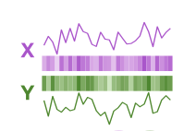
Conditional entropy

Slide 2
Mutual information

Slide 3
Joint entropy of X and Y conditioned on their past

Slide 4
Directed information

Slide 5
Causally conditioned entropy

Slide 6
Mutual

