Slide 1
A visual guide to information theory-based coupling measures

Slide 3
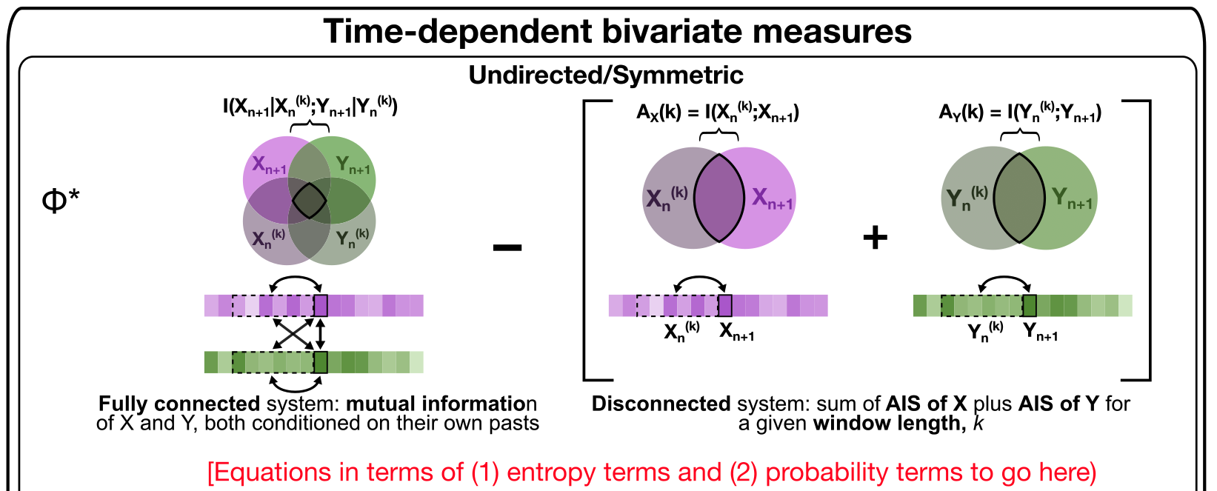
Removed phi-star schematic

Slide 4
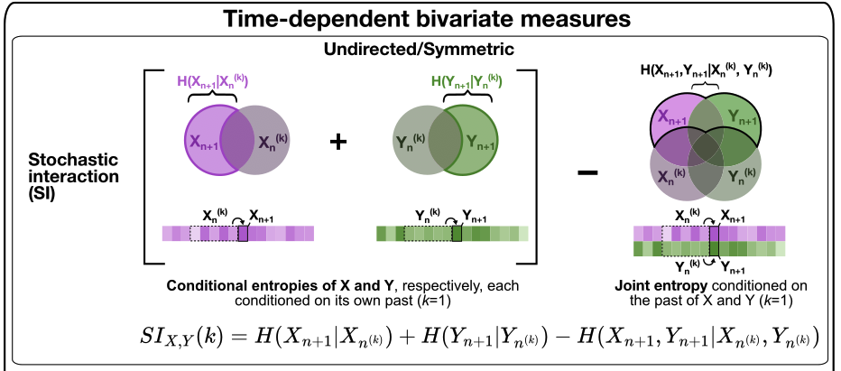
Updated: stochastic interaction
Equation 26 in Ay 2015 for this metric

Slide 5
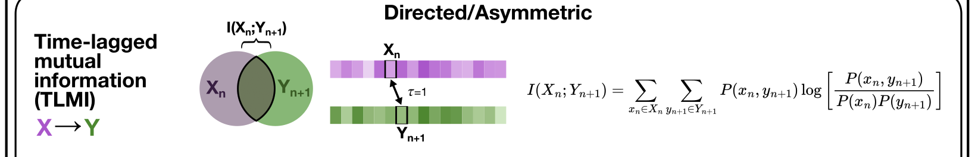
Updated: time-lagged mutual information
Is this formula correct for TLMI now?

Slide 6
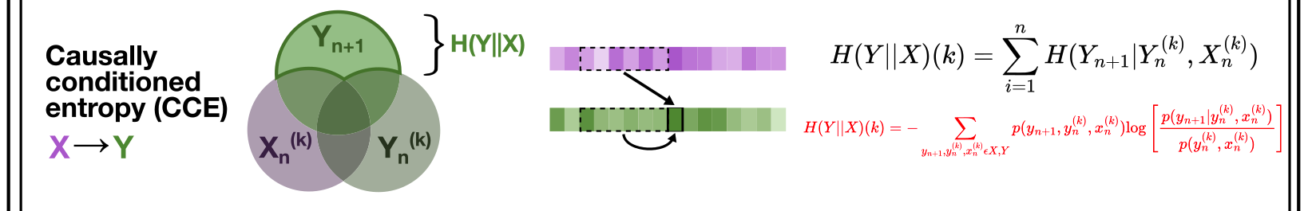
Updated: causally-conditioned entropy
For causally conditioned entropy, I filled in the equation in terms of the log probabilities for X and Y in red. Could you please check that these are right, Joe?

Slide 7
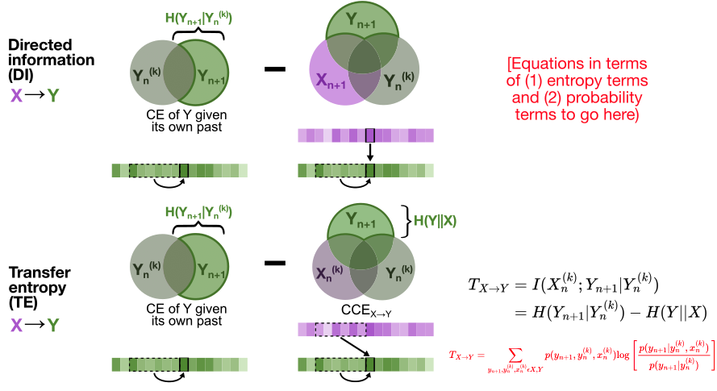
Updated: DI/TE
I split up directed information and transfer entropy, to reflect that the second term in the difference equation includes a contemporaneous measure of X for direction information (X-->Y) versus a lagged measure of X for transfer entropy (X-->Y). Based on our discussion yesterday, it seems like transfer entropy is equivalent to the conditional entropy of Y given its own past minus the causally conditioned entropy from X-->Y. However, the pyspi text + documentation states “The directed information can be computed as a difference between the conditional entropy of y given its own past, and causally conditioned entropy”, which seems to match the definition of transfer entropy rather than directed information. The three-circle Venn Diagram for directed information seems to capture a variation on CCE that includes contemporaneous signal for both source (X) and target (Y) as well as the past of the target (Y); does this map to any defined type of entropy that you know of, Joe?

Slide 8
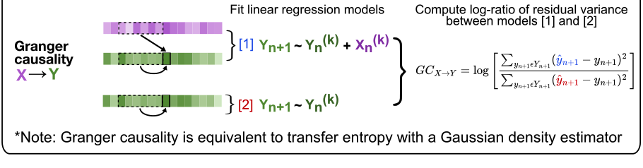
Updated: Granger causality

